Slide 1
Chapter 1: A Modern View of the Universe

Slide 2
1.1 The Scale of the Universe
Our goals for learning:
What is our place in the universe?
How big is our universe?

Slide 3
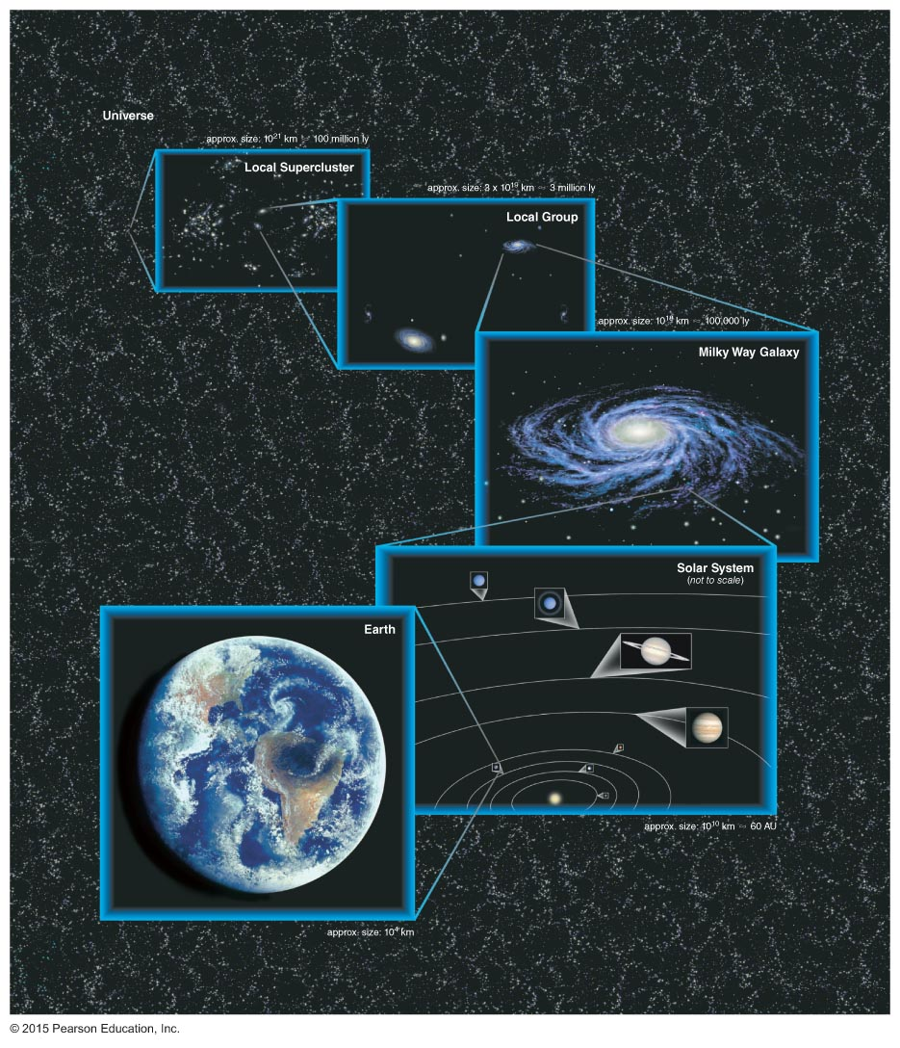
What is our place in the universe?
Our "cosmic address"
Notes:
Here at the beginning of the semester, our main goal is simply to make sure that students understand the basic hierarchy of structure from planet to solar system to galaxy to universe (clustering is less important at this stage). You might also wish to note that this slide shows a lot about human history. E.g., we first learned that Earth is a sphere some 2500 years ago; we learned that Earth is a planet going around the Sun only about 400 years ago; and we learned that the Milky Way is only one of many galaxies with the work of Hubble some 80 years ago…

Slide 4
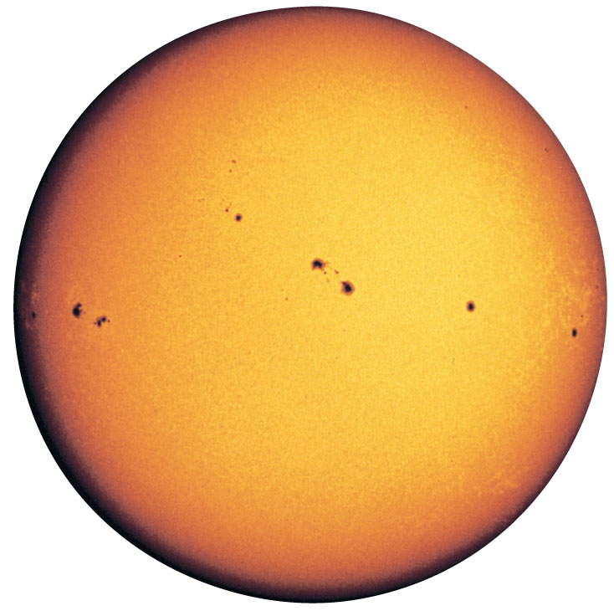
Star
A large, glowing ball of gas that generates heat and light through nuclear fusion
Notes:
This and the next several slides review some basic astronomical definitions found in the box on p. 5.

Slide 5
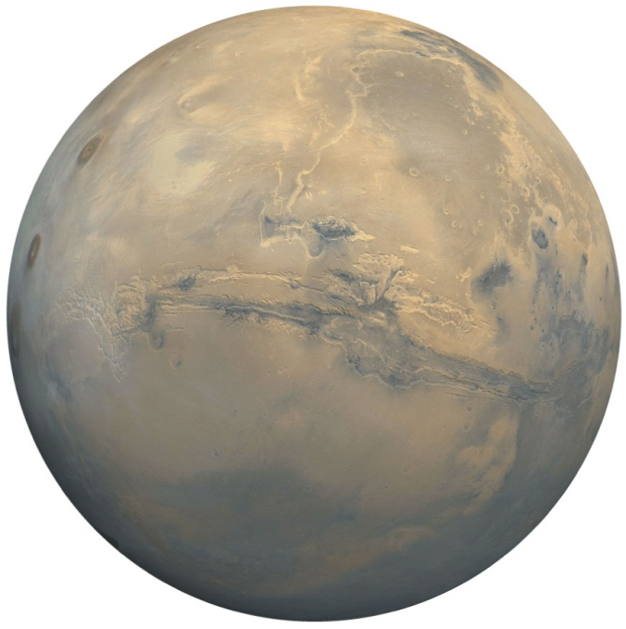
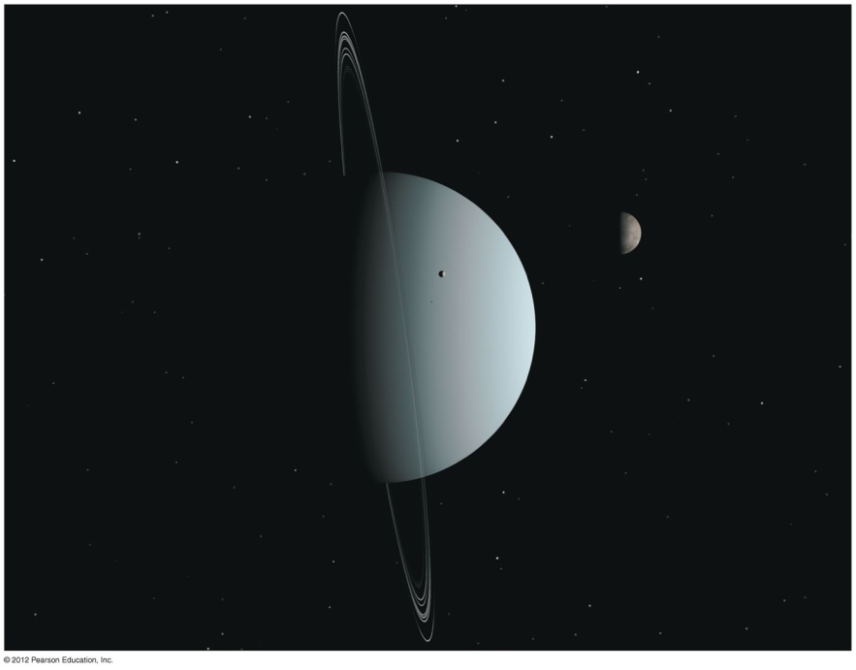
Planet
Mars
Uranus
A moderately large object that orbits a star; it shines by reflected light. Planets may be rocky, icy, or gaseous in composition.
Notes:
Also worth pointing out: (1) planets shine primarily by reflecting light from their star rather than by generating their own light like a star. (2) Astronomers sometimes disagree about what counts as a planet, because there are no official minimum or maximum sizes. E.g., later in the term we'll discuss the current controversy over Pluto's demotion to a dwarf planet.

Slide 6
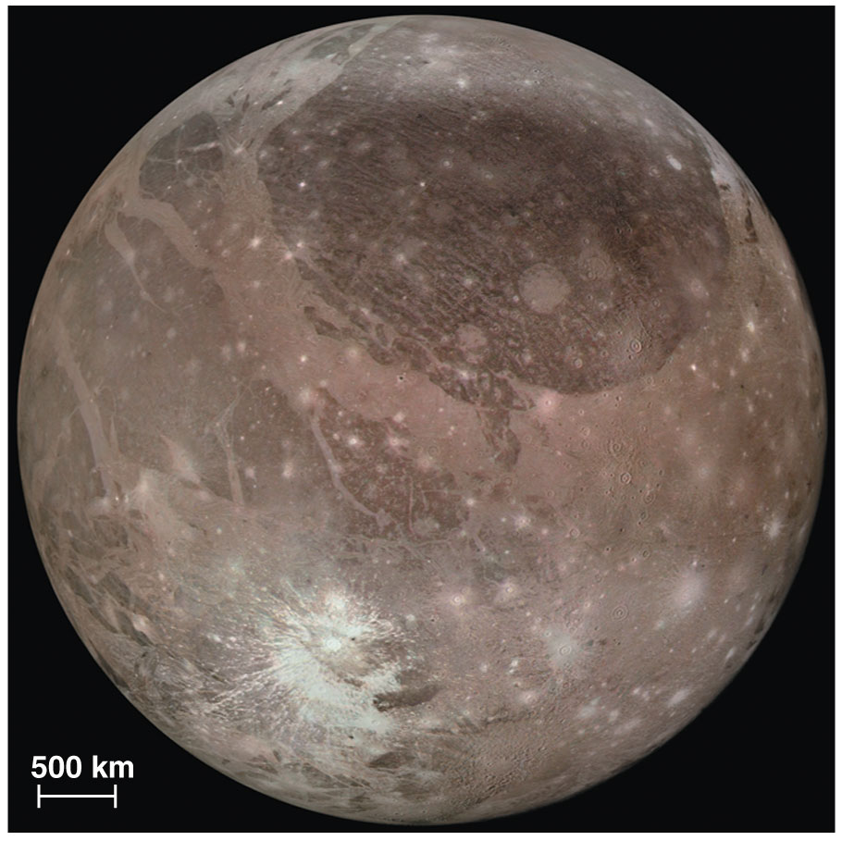
Moon (or satellite)
An object that orbits a planet
Ganymede (orbits Jupiter)
Notes:
The terms moon and satellite are often used interchangeably, but artificial objects (spacecraft) are usually called satellites and not moons…

Slide 7
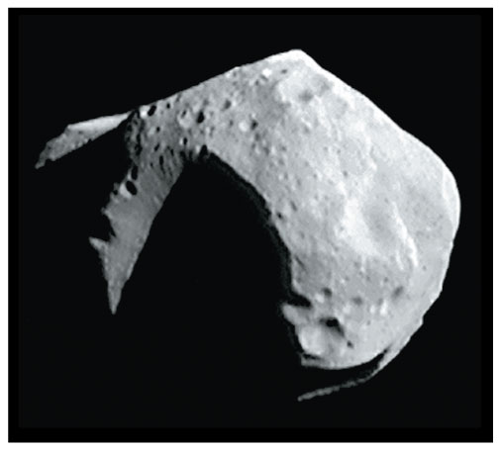
Asteroid
A relatively small and rocky object that orbits a star
Mathilde
Notes:
Also worth pointing out:
(1) Note the non-spherical shape; small objects are often non-spherical because their gravity is not strong enough to compress the material into a sphere.
(2) Asteroids are sometimes called minor planets because they orbit much like planets but are smaller than anything we consider to be a true planet.

Slide 8
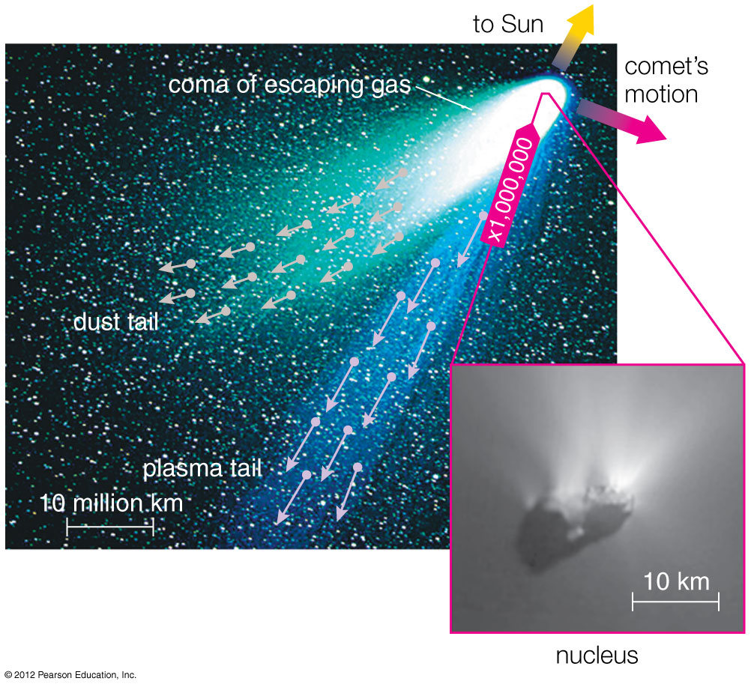
Comet
A relatively small and icy object that orbits a star
Notes:
Also worth noting: (1) the basic difference between an asteroid and a comet is composition; (2) comets have tails ONLY when they come close to the Sun, not when they are much farther away.

Slide 9
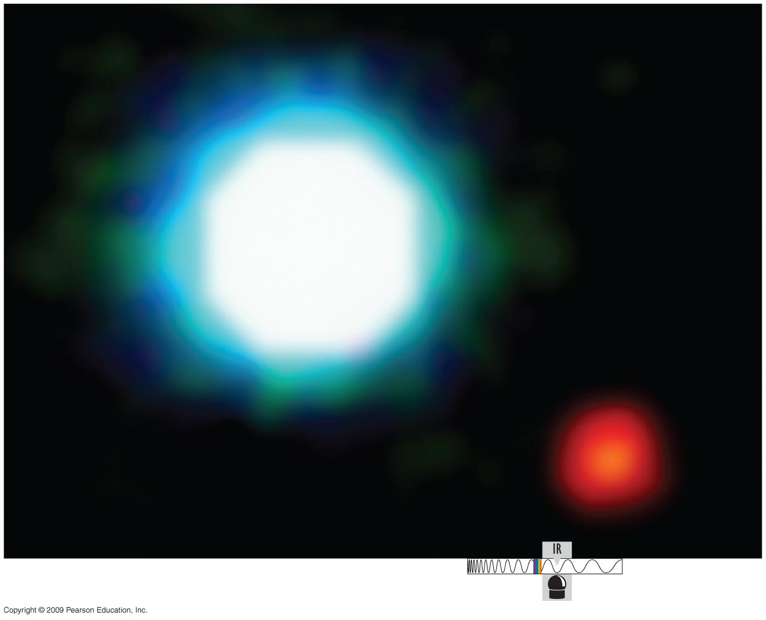
Solar (Star) System
A star and all the material that orbits it, including its planets and moons

Slide 10
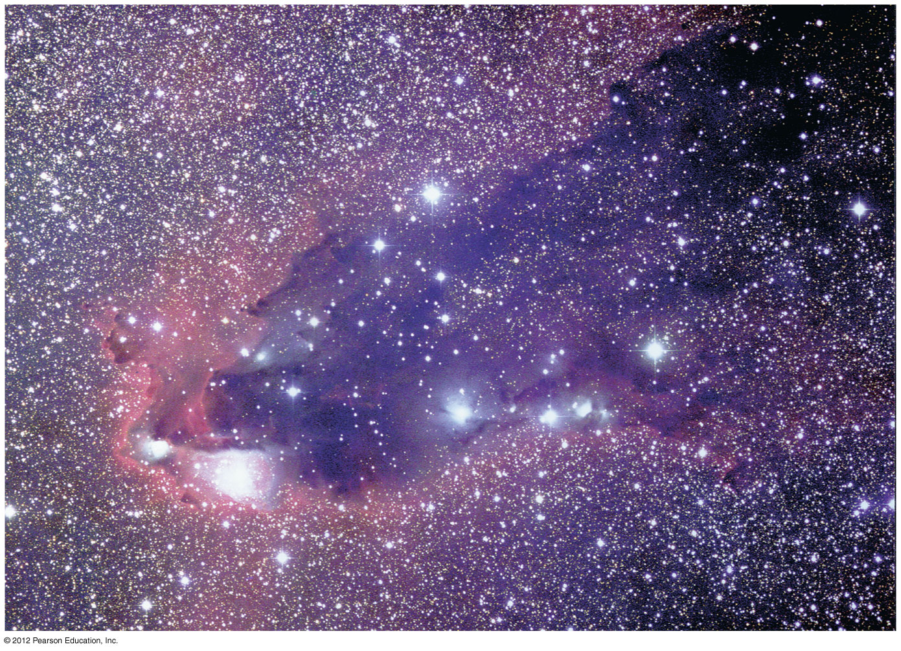
Nebula
An interstellar cloud of gas and/or dust
Notes:
Note: We do not include "nebula" in our list of basic definitions in Ch. 1, because it is a less important term at this point in the course. However, you may find yourself talking about nebulae (e.g., Orion Nebula) if you are doing any early-term observing with your students, in which case you may find this slide useful.

Slide 11
Galaxy
A great island of stars in space, all held together by gravity and orbiting a common center
M31, the great galaxy in Andromeda
Notes:
Remember that one of the most common student problems is confusion between the terms "solar system" and "galaxy." You can use these slides of basic definitions to help combat this problem.

Slide 12
Universe
The sum total of all matter and energy; that is, everything within and between all galaxies

Slide 13
Looking back in time
Light travels at a finite speed (300,000 km/s).
Thus, we see objects as they were in the past:
The farther away we look in distance, the further back we look in time.
Destination | Light travel time
Moon | 1 second
Sun | 8 minutes
Sirius | 8 years
Andromeda Galaxy | 2.5 million years
Notes:
Point out how fast the speed of light is: could circle Earth 8 times in one second….
Also note that the speed of light is always the same…

Slide 14
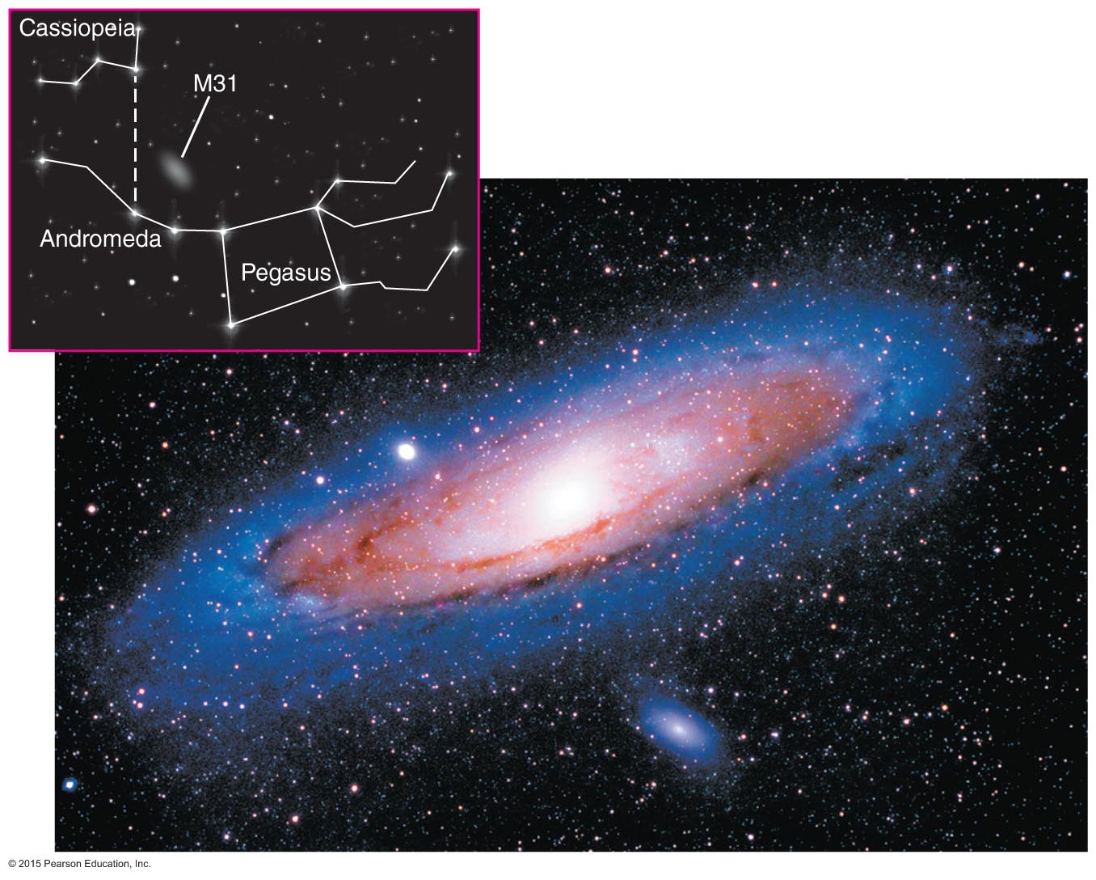
Example:
This photo shows the Andromeda Galaxy as it looked about 2 1/2 million years ago.
Question: When will we be able to see what it looks like now?
Notes:
Answer to question: in about 2.5 million years. But point out that for a galaxy, not much will change in that time.
Also worth noting: This photo shows 100,000 years of time, because the galaxy is about 100,000 light-years in diameter. Thus, we see the near side as it was 100,000 years later than the time at which we see the far side.

Slide 15
Definition: Light-Year
The distance light can travel in 1 year
About 10 trillion kilometers (6 trillion miles)
Notes:
Emphasize that a light-year is a unit of distance, NOT a unit of time. Remind students of Common Misconception box in text (p. 8). Equation is optional: it is not given in the book, but should be easy for most students to follow.

Slide 16
At great distances, we see objects as they were when the universe was much younger.
Notes:
This slide shows part of Figure 1.3, which you can use to emphasize that we are seeing galaxies as they were in the distant past -- which means when they were YOUNG. (Note: Students often equate "past" with "old," so it's important to emphasize that galaxies that we see in the past are in fact the ones we are seeing at young ages… .)

Slide 17
Can we see the entire universe?
Notes:
This slide shows the rest of Figure 1.3, which you can use to show how the age of the universe limits the extent of our observable universe.

Slide 18
Thought Question
Why can't we see a galaxy 15 billion light-years away? (Assume the universe is 14 billion years old.)
No galaxies exist at such a great distance.
Galaxies may exist at that distance, but their light would be too faint for our telescopes to see.
Looking 15 billion light-years away means looking to a time before the universe existed.
Notes:
This is an optional question to ask your students, to see if they have grasped the idea of the observable universe.

Slide 19
Thought Question
Why can't we see a galaxy 15 billion light-years away? (Assume the universe is 14 billion years old.)
No galaxies exist at such a great distance.
Galaxies may exist at that distance, but their light would be too faint for our telescopes to see.
Looking 15 billion light-years away means looking to a time before the universe existed.
Notes:
This is an optional question to ask your students, to see if they have grasped the idea of the observable universe. Answer highlighted.

Slide 20
How big is the universe?

Slide 21
How big is Earth compared to our solar system?
Let's reduce the size of the solar system by a factor of 10 billion; the Sun is now the size of a large grapefruit (14 cm diameter). How big is Earth on this scale?
an atom
a tip of a ballpoint pen
a marble
a golf ball
Notes:
This slide begins our discussion of the scale of the solar system, introducing the 1-to-10 billion scale used in the book. As shown here, a good way to start is to show students the size of the Sun on this scale, then ask them to guess the size of Earth in comparison.
Suggestion: Bring a large grapefruit (or similar size ball) to class to represent the Sun; also have a 1-mm ball bearing to represent Earth for the correct answer to the multiple choice question.

Slide 22
How big is Earth compared to our solar system?
Let's reduce the size of the solar system by a factor of 10 billion; the Sun is now the size of a large grapefruit (14 cm diameter). How big is Earth on this scale?
an atom
a tip of a ballpoint pen
a marble
a golf ball
Notes:
Here is the answer to the question. Emphasize the incredible difference in size; then ask students to think about how far from the Sun they think Earth would be on this scale…

Slide 23
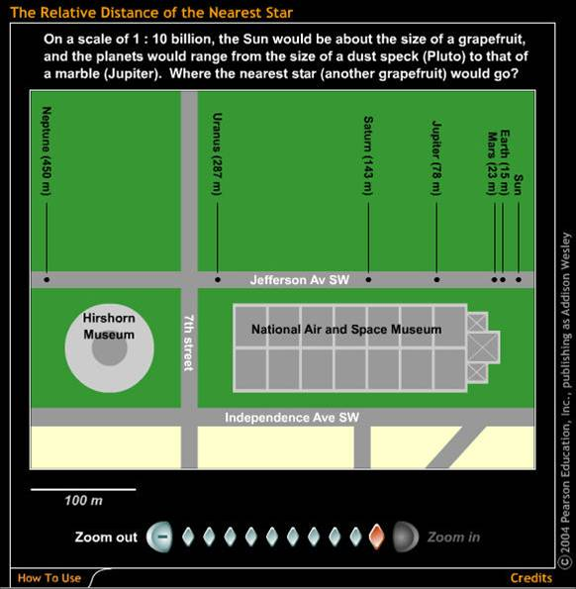
The scale of the solar system
On a 1-to-10 billion scale:
Sun is the size of a large grapefruit (14 centimeters).
Earth is the size of a tip of a ballpoint pen, 15 meters away.
Relative Distance of the Nearest Star
Notes:
Use this slide/tool to introduce the Voyage scale (Voyage is the name of the model solar system using this scale on the National Mall in Washington, DC). At this point, we suggest that you stick to the solar system in using this tool; we'll move out to the stars in the next couple of slides. Other points to emphasize:
This tool was taken from the Scale of the Universe tutorial on the Web site; encourage students to try it for themselves.
Voyage shows a straight line, but remember that planets orbit. In class, put the grapefruit for the Sun on a table, then walk 15 meters to Earth position, and ask students to imagine it going around Sun once a year.
A major lesson from all this is that the solar system is almost entirely made of nearly empty space. (That's why they call it "space"!)

Slide 24
How far away are the stars?
On our 1-to-10 billion scale, it's just a few minutes' walk to Pluto. How far would you have to walk to reach Alpha Centauri?
1 mile
10 miles
100 miles
the distance across the United States (2500 miles)
Notes:
Now we continue outward to the stars. Try asking this question of your students; most are quite surprised at how far away the stars are…

Slide 25
Answer: D, the distance across the United States
Relative Distance of the Nearest Star
Notes:
Again use this slide/tool, this time zooming out to see the correct answer to the question. Then review the idea: If we visualize the Sun as a grapefruit, we'd have to go 2500 miles to find the next grapefruit… Other points worth noting:
Imagine trying to look across the United States to see the pinhead size Earth orbiting the grapefruit size Sun—this gives students an idea of the challenge of detecting extrasolar planets.
Point out that the orbit of the Moon around Earth would fit in the palm of your hand, then note the incredible challenge of traveling to other stars in comparison. A useful point about "UFOs": If aliens truly are able to travel easily among the stars, imagine how much more advanced their technology must be than ours…

Slide 26
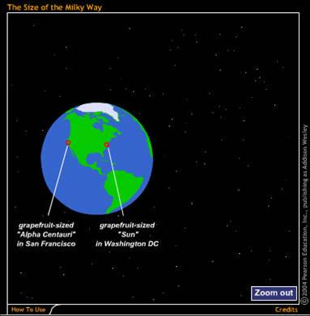
How big is the Milky Way Galaxy?
The Milky Way has about 100 billion stars.
On the same 1-to-10 billion scale…
The Size of the Milky Way
Notes:
Use this tool to show that the scale essentially breaks down for the galaxy as a whole, because the scale model itself becomes astronomical in size. So we need alternative ways to think about the scale of the galaxy:
Can discuss compressing the scale by another factor of 1 billion, so the galaxy fits on a football field… distance to Alpha Centaur is now just 4 mm, and our solar system sits around the 20-yard line if galactic center is at midfield.
And think about the NUMBER of stars, as on next slide…

Slide 27
Thought Question
Suppose you tried to count the more than 100 billion stars in our galaxy, at a rate of one per second…
How long would it take you?
a few weeks
a few months
a few years
a few thousand years
Notes:
Ask this question to get students thinking about the vast number of stars in our galaxy…

Slide 28
Thought Question
Suppose you tried to count the more than 100 billion stars in our galaxy, at a rate of one per second…
How long would it take you?
a few weeks
a few months
a few years
a few thousand years
Notes:
Ask this question to get students thinking about the vast number of stars in our galaxy…

Slide 29
How big is the universe?
The Milky Way is one of about 100 billion galaxies.
10¹¹ stars/galaxy x 10¹¹ galaxies = 10²² stars
It has as many stars as grains of (dry) sand on all Earth's beaches.
Notes:
This slide gives our favorite way of giving students a sense of the size of the observable universe; be sure to note we are talking about the OBSERVABLE universe, since we do not know the extent of the ENTIRE universe.

Slide 30
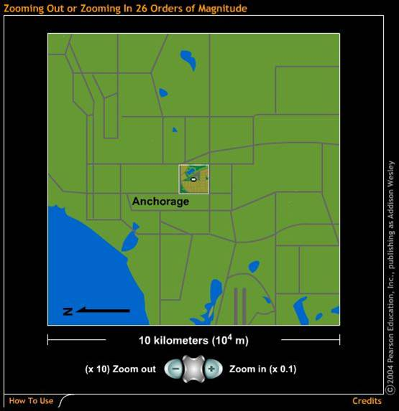
Now let's step through the universe in powers of 10.
Zooming Out or Zooming In 26 Orders of Magnitude
Notes:
Here's another way to review the scales of the universe, using the famous power of 10 motif. Again, this tool comes from the "Scale of the Universe" tutorial on the book Web site. Also a good way to review power-of-10 notation…

Slide 31
What have we learned?
What is our place in the universe?
Earth is part of the solar system, which is the Milky Way Galaxy, which is a member of the Local Group of galaxies in the Local Supercluster.
How big is the universe?
The observable universe dwarfs our Milky Way Galaxy, which in turn dwarfs our solar system. Scale models can help with visualizing such distances.

Slide 32
1.2 The History of the Universe
Our goals for learning:
How did we come to be?
How do our lifetimes compare to the age of the universe?

Slide 33
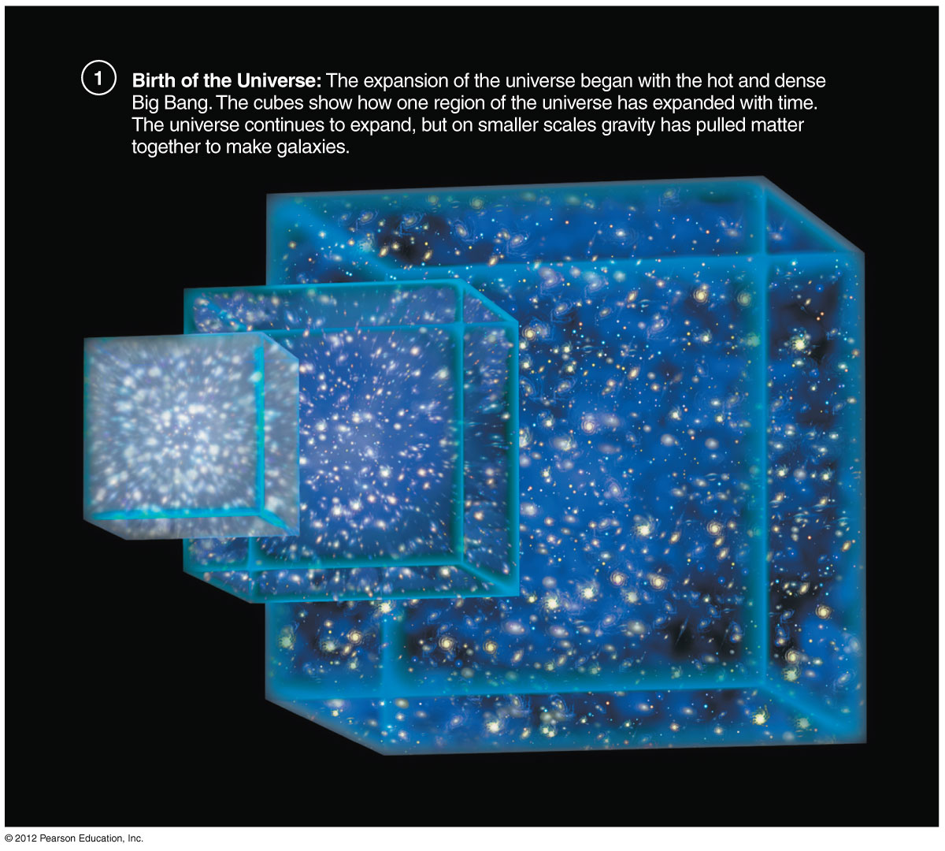
How did we come to be?
Notes:
This slide (Figure 1.9) packs in a lot of basic information. You might go through the frames slowly as follows:
The universe is expanding, from which we infer a beginning in what we call the Big Bang. Note that, based on the observed rate of expansion, we conclude that the universe is about 14 billion years old. (WMAP results from 2003 were 13.7 ± .2 billion years.)
The expansion continues to this day except where gravity has "won": stars, galaxies, clusters.
Galaxies make possible the formation of stars, and recycle material through generations of stars.
Although the universe began with only the chemical elements H and He, stars have created the elements from which rocky planets are made.
Life begins from this "star stuff" on at least one particularly friendly planet.

Slide 34
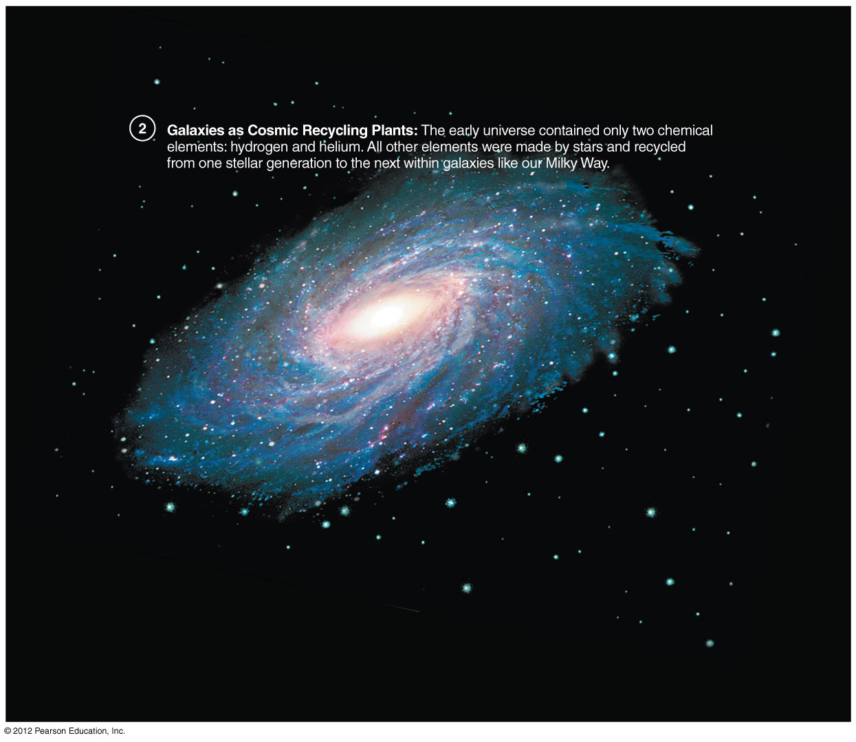
How did we come to be?
Notes:
This slide (Figure 1.9) packs in a lot of basic information. You might go through the frames slowly as follows:
The universe is expanding, from which we infer a beginning in what we call the Big Bang. Note that, based on the observed rate of expansion, we conclude that the universe is about 14 billion years old. (WMAP results from 2003 were 13.7 ± .2 billion years.)
The expansion continues to this day except where gravity has "won": stars, galaxies, clusters.
Galaxies make possible the formation of stars, and recycle material through generations of stars.
Although the universe began with only the chemical elements H and He, stars have created the elements from which rocky planets are made.
Life begins from this "star stuff" on at least one particularly friendly planet.

Slide 35
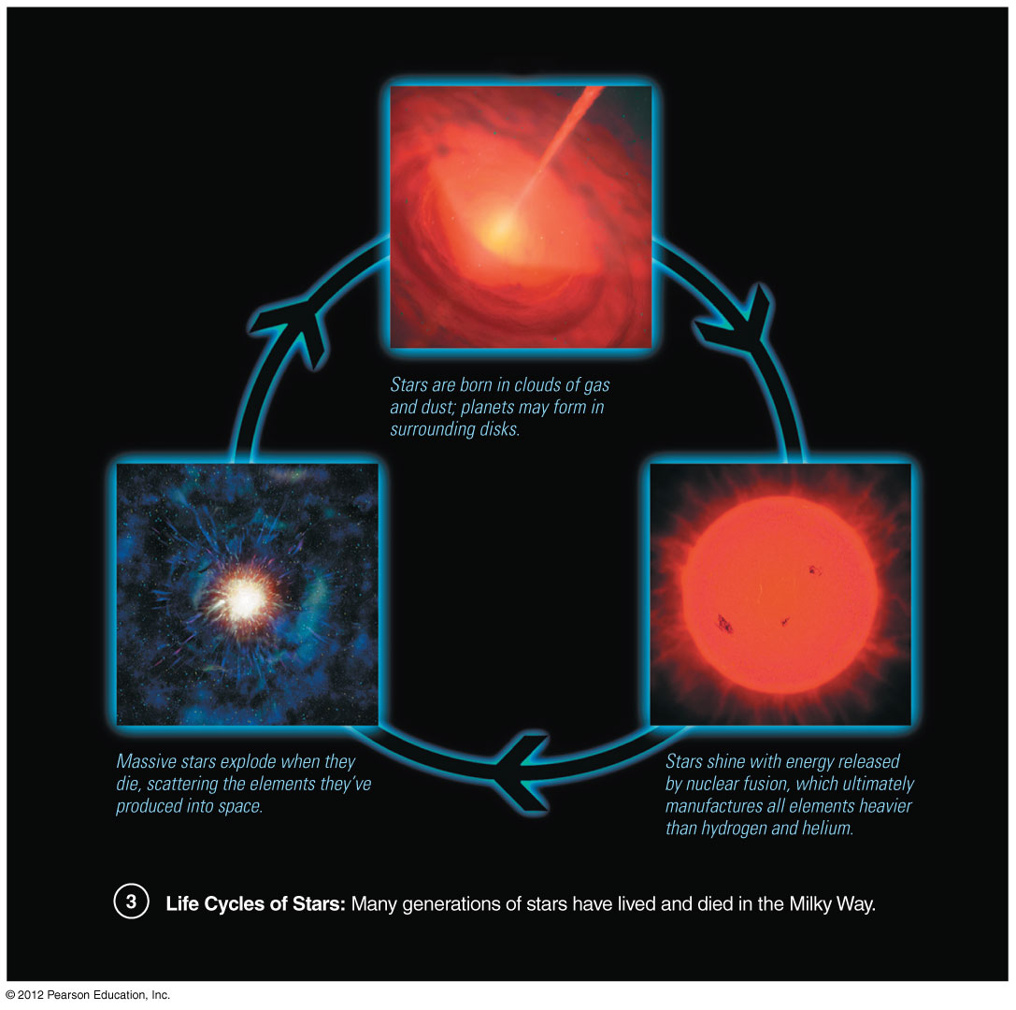
How did we come to be?
Notes:
This slide (Figure 1.9) packs in a lot of basic information. You might go through the frames slowly as follows:
The universe is expanding, from which we infer a beginning in what we call the Big Bang. Note that, based on the observed rate of expansion, we conclude that the universe is about 14 billion years old. (WMAP results from 2003 were 13.7 ± .2 billion years.)
The expansion continues to this day except where gravity has "won": stars, galaxies, clusters.
Galaxies make possible the formation of stars, and recycle material through generations of stars.
Although the universe began with only the chemical elements H and He, stars have created the elements from which rocky planets are made.
Life begins from this "star stuff" on at least one particularly friendly planet.

Slide 36
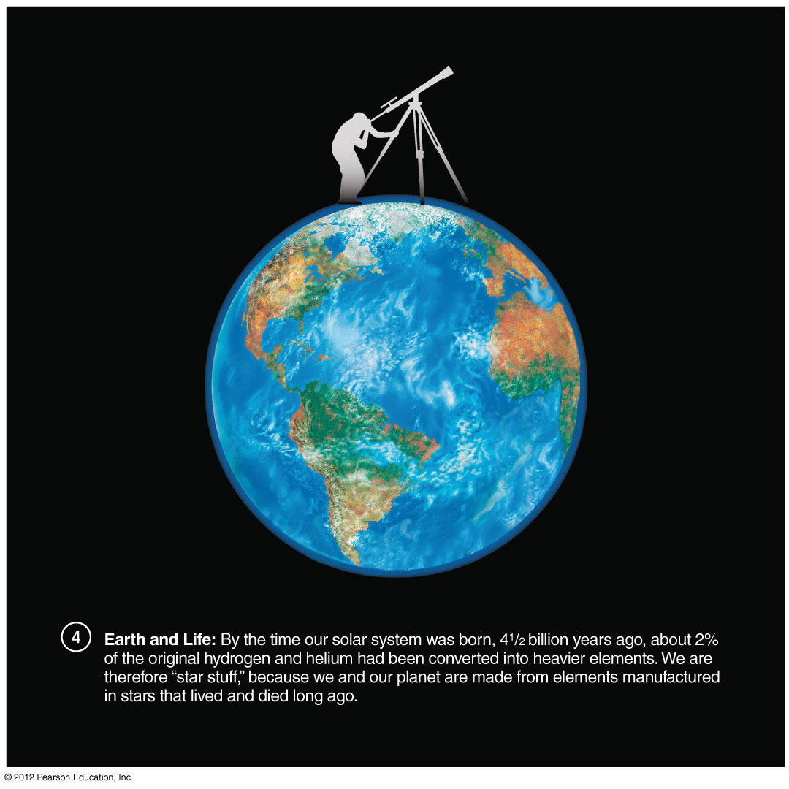
How did we come to be?
Notes:
This slide (Figure 1.9) packs in a lot of basic information. You might go through the frames slowly as follows:
The universe is expanding, from which we infer a beginning in what we call the Big Bang. Note that, based on the observed rate of expansion, we conclude that the universe is about 14 billion years old. (WMAP results from 2003 were 13.7 ± .2 billion years.)
The expansion continues to this day except where gravity has "won": stars, galaxies, clusters.
Galaxies make possible the formation of stars, and recycle material through generations of stars.
Although the universe began with only the chemical elements H and He, stars have created the elements from which rocky planets are made.
Life begins from this "star stuff" on at least one particularly friendly planet.

Slide 37
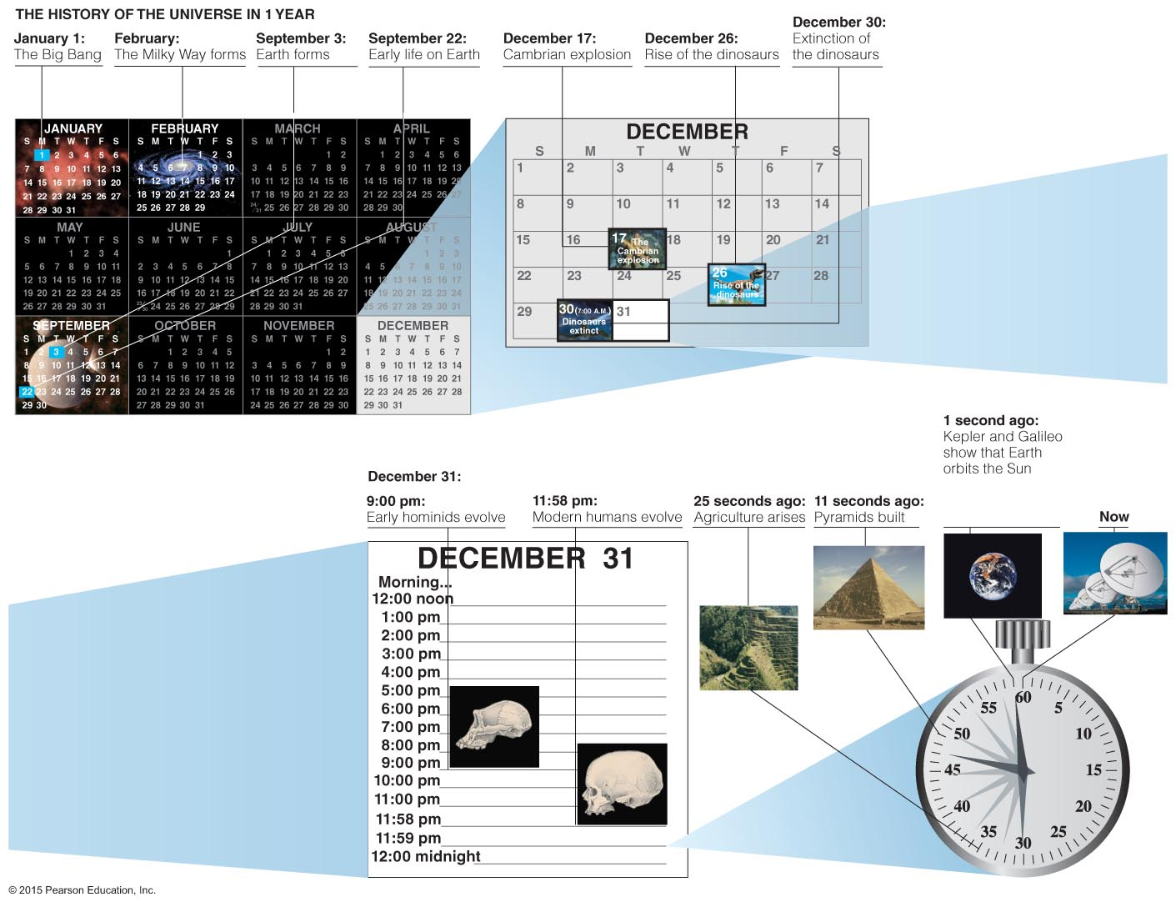
How do our lifetimes compare to the age of the universe?
The cosmic calendar: A scale on which we compress the history of the universe into 1 year
Notes:
Our favorite way to present the scale of time: a modified version of Carl Sagan's Cosmic Calendar. Worth noting:
Since we are compressing the 14-billion-year history of the universe into one calendar year, 1 month represents about 1.2 billion real years, 1 day represents about 40 million years; 1 second represents about 440 years.
The universe was already two-thirds of the way through its history before our solar system even formed.
Dinosaurs arose the day after Christmas and died yesterday.
All of (recorded) human history occurs in the last 30 seconds.
You and I were born about 0.05 seconds before midnight, Dec. 31.

Slide 38
What have we learned?
How did we come to be?
The matter in our bodies came from the Big Bang, which produced hydrogen and helium.
All other elements were constructed from H and He in stars and then recycled into new star systems, including our solar system.
How do our lifetimes compare to the age of the universe?
On a cosmic calendar that compresses the history of the universe into 1 year, human civilization is just a few seconds old, and a human lifetime is a fraction of a second.

Slide 39
1.3 Spaceship Earth
Our goals for learning:
How is Earth moving in through space?
How do galaxies move within the universe?

Slide 40
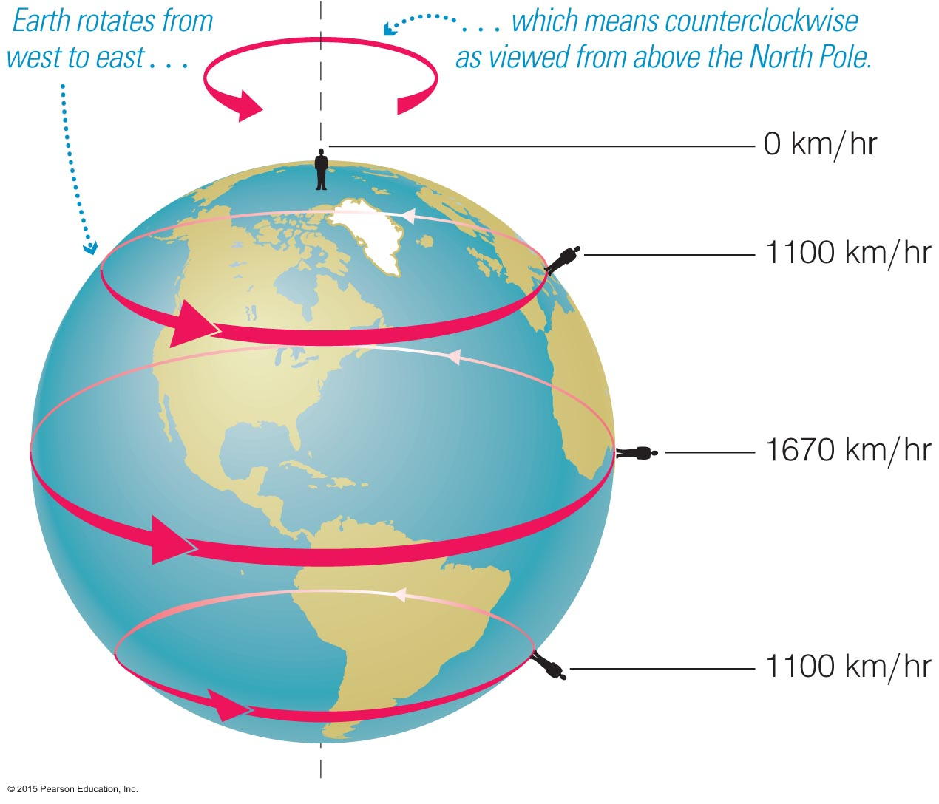
How is Earth moving through space?
Contrary to our perception, we are not "sitting still."
We are moving with the Earth in several ways, and at surprisingly fast speeds.
Earth rotates around its axis once every day.
Notes:
Our first motion is ROTATION.
Point out that most of us are moving in circles around the axis at speeds far faster than commercial jets travel, which is why jets cannot keep up with the Sun when going opposite Earth's rotation…

Slide 41
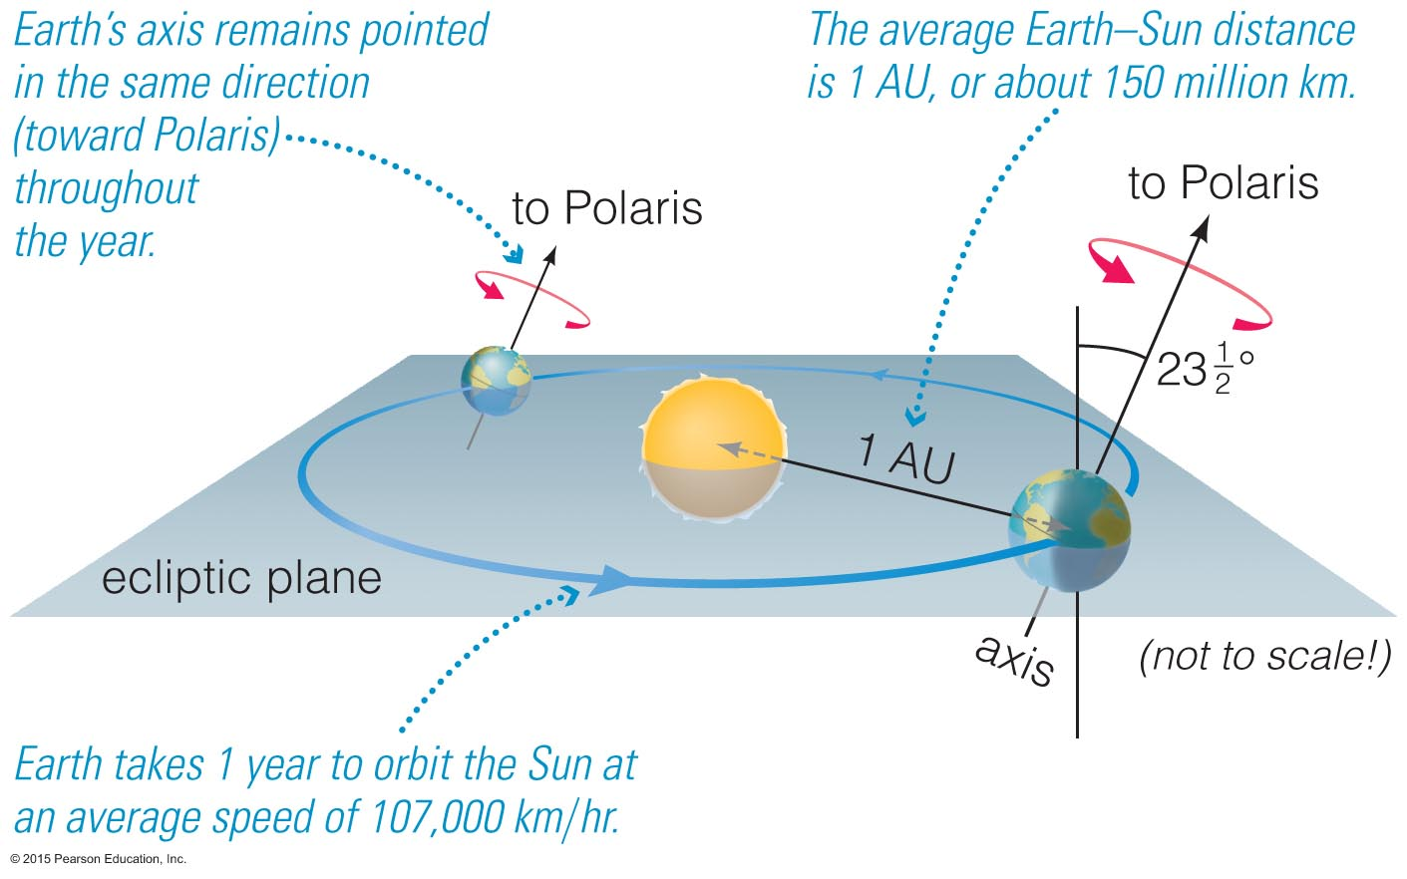
Earth orbits the Sun (revolves) once every year…
at an average distance of 1 AU ≈ 150 million km.
with Earth's axis tilted by 23.5º (pointing to Polaris).
and rotates in the same direction it orbits, counter-clockwise as viewed from above the North Pole.
Notes:
Our second motion is ORBIT. Point out the surprisingly high speed of over 100,000 km/hr.

Slide 42
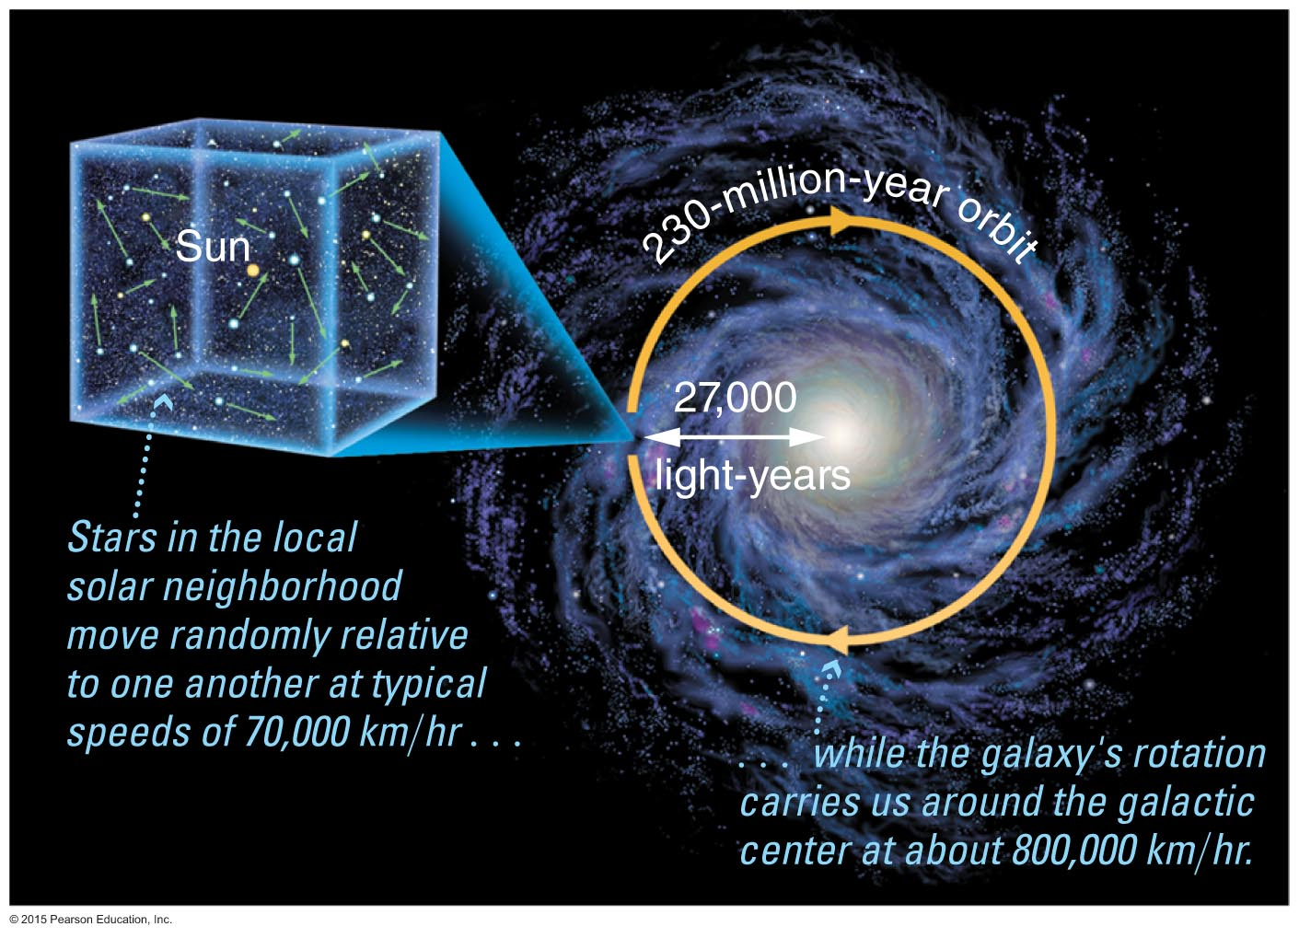
Our Sun moves randomly relative to the other stars in the local solar neighborhood…
at typical relative speeds of more than 70,000 km/hr
but stars are so far away that we cannot easily notice their motion
… and it orbits the galaxy every 230 million years.
Notes:
Our third and fourth motions are MOTION WITH THE LOCAL SOLAR NEIGHBORHOOD and ROTATION OF THE MILKY WAY GALAXY.

Slide 43
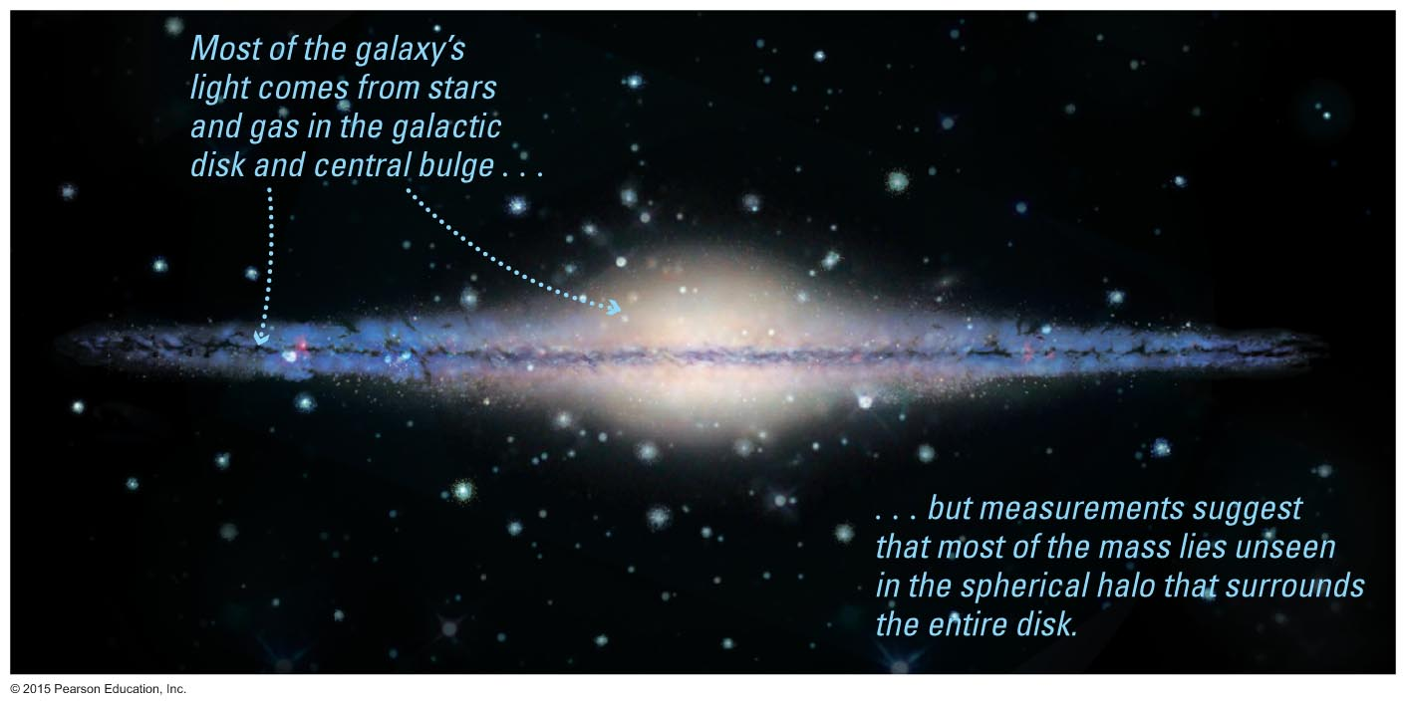
More detailed study of the Milky Way's rotation reveals one of the greatest mysteries in astronomy…
Notes:
Although we won't discuss dark matter until much later in the course, you might wish to mention it now to whet students' appetites…

Slide 44
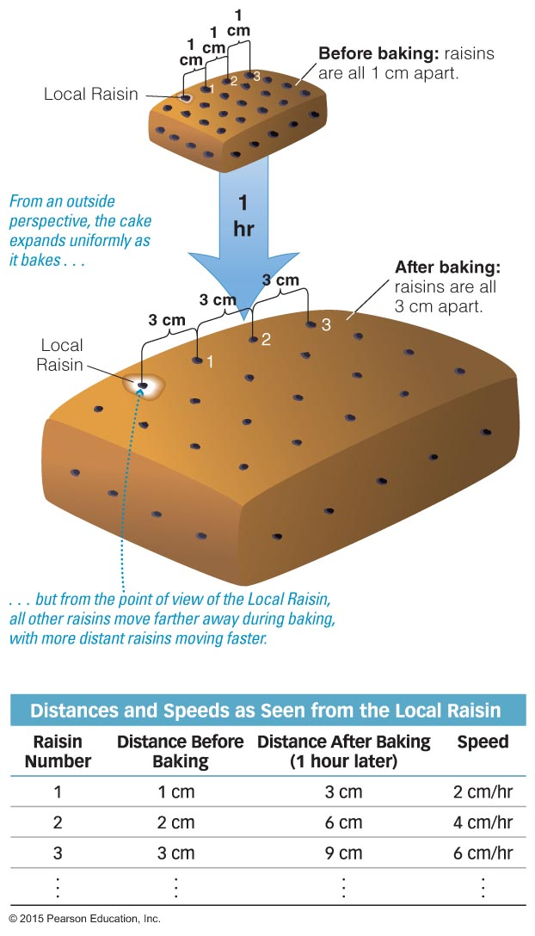
How do galaxies move within the universe?
Galaxies are carried along with the expansion of the universe. But how did Hubble figure out that the universe is expanding?
Notes:
Describe the raisin cake analogy, and have students work through the numbers with you to make the table. (E.g., "How far away is Raisin 1 at the beginning of the hour? [1 cm] How far is it at the end of the hour? [3 cm] So how far would you have seen it move during the hour? [2 cm] So how fast is it moving away from you? [2 cm/hr]")

Slide 45
Hubble discovered that…
all galaxies outside our Local Group are moving away from us.
the more distant the galaxy, the faster it is racing away.
Conclusion: We live in an expanding universe.
Notes:
Now relate the raisin cake analogy to the real universe…

Slide 46
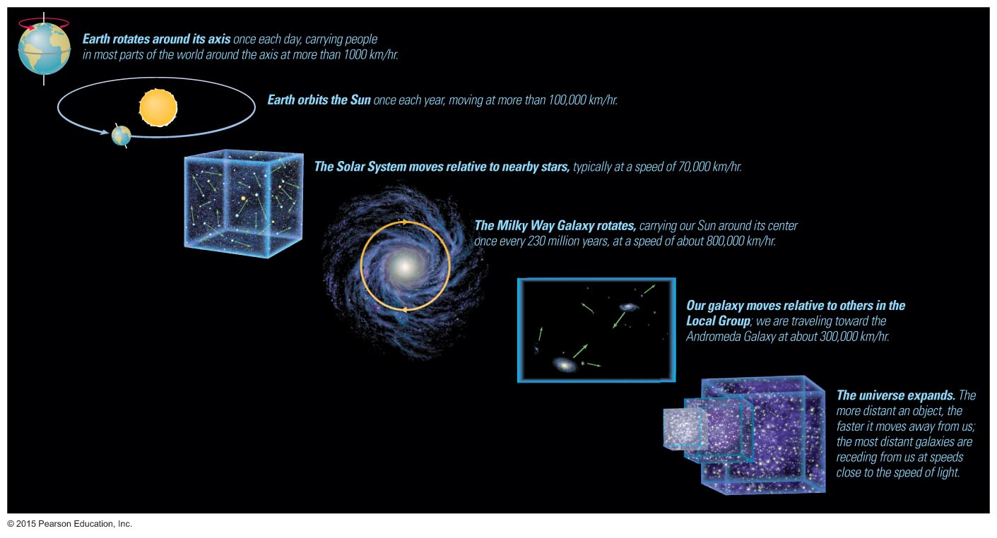
Are we ever sitting still?
Notes:
This slide summarizes our motion with spaceship Earth…

Slide 47
What have we learned?
How is Earth moving in our solar system?
It rotates on its axis once a day and orbits the Sun at a distance of 1 AU = 150 million km.
Stars in the local neighborhood move randomly relative to one another and orbit the center of the Milky Way in about 230 million years.
How do galaxies move within the universe?
All galaxies beyond the Local Group are moving away from us with expansion of the universe: the more distant they are, the faster they're moving.

