Slide 1
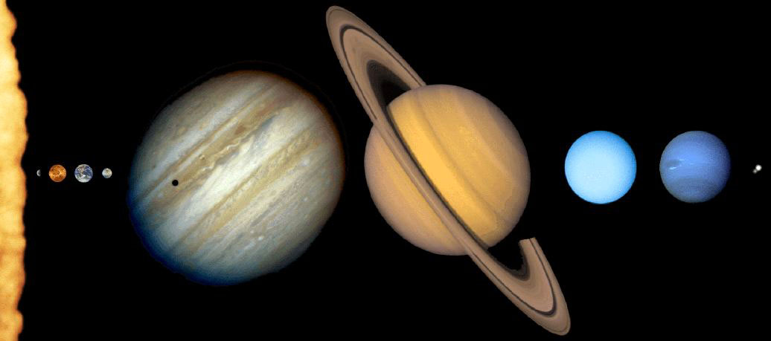
6.1 A Brief Tour of the Solar System
Our goals for learning:
What does the solar system look like?

Slide 2
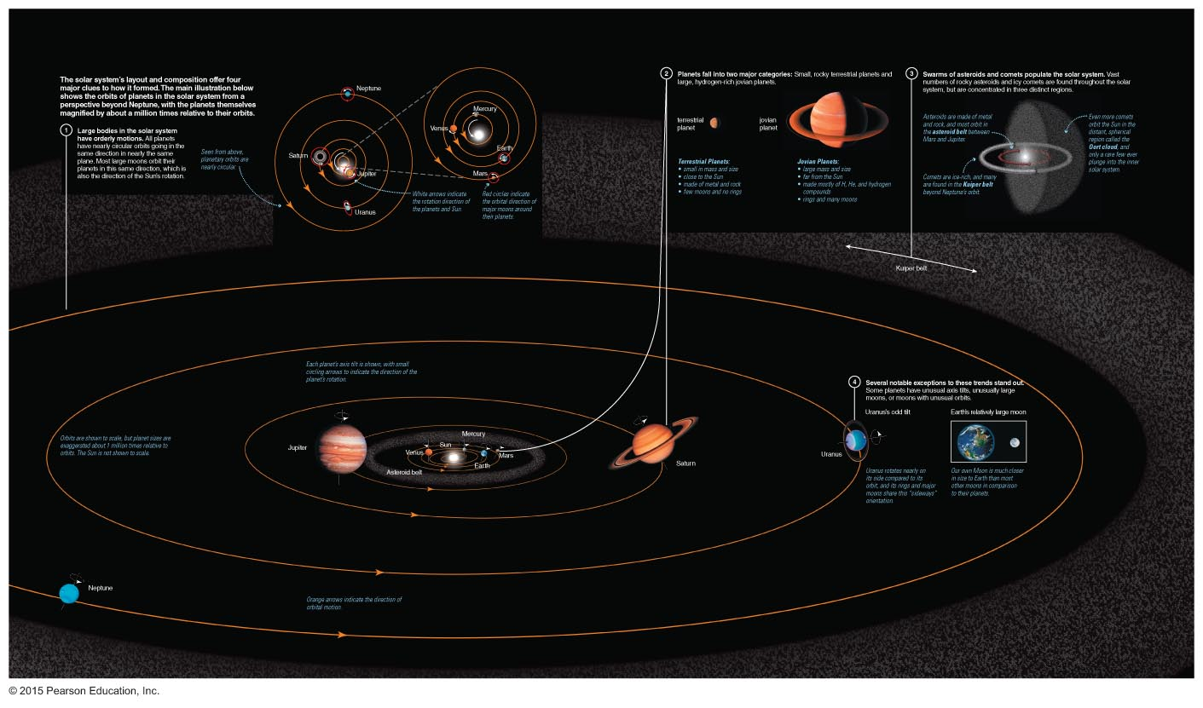
What does the solar system look like?
The solar system exhibits clear patterns of composition and motion.
These patterns are far more important and interesting than numbers, names, and other trivia.

Slide 3
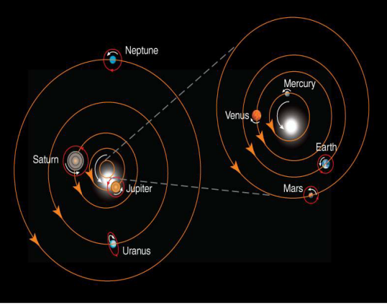
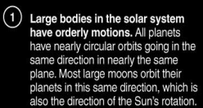
What does the solar system look like?

Slide 4
What does the solar system look like?

Slide 5
What does the solar system look like?

Slide 6
What does the solar system look like?

Slide 8
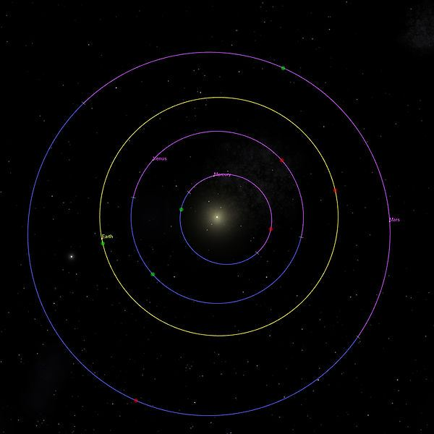
Planets are very tiny compared to distances between them.

Slide 9
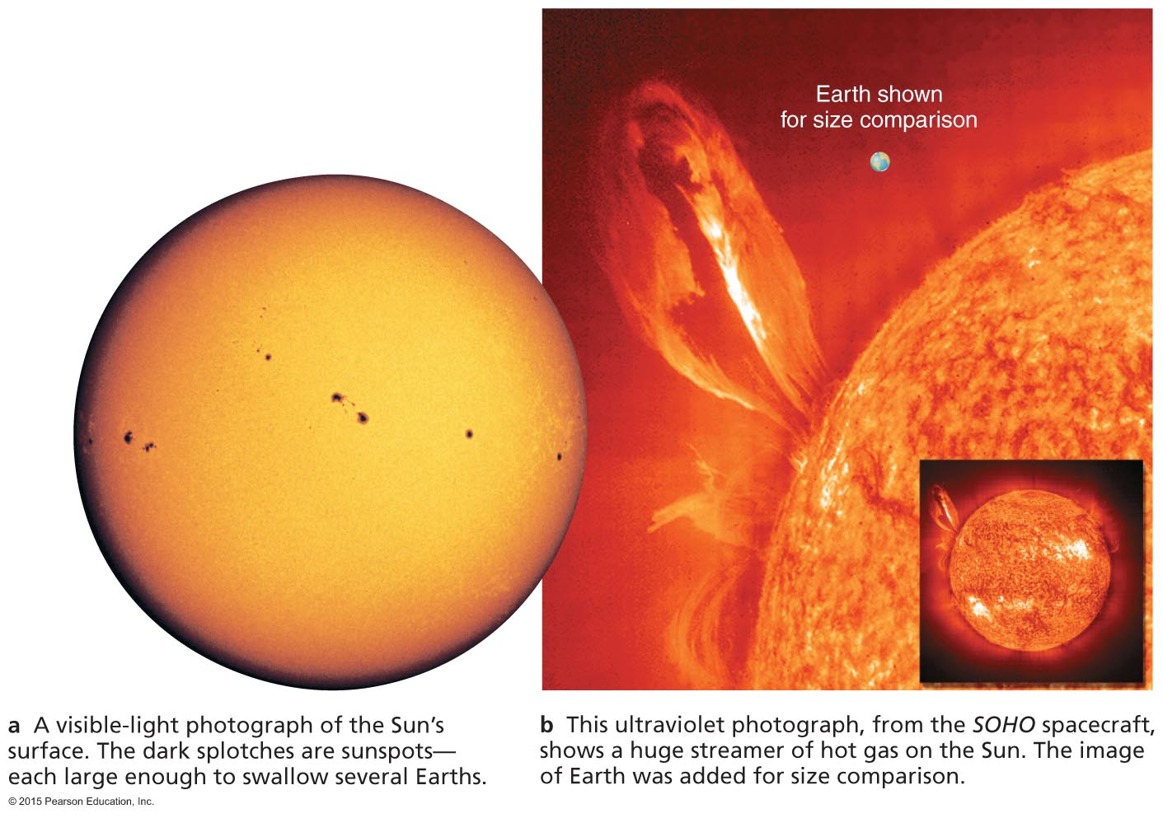
Sun
Over 99.8% of solar system's mass
Made mostly of H/He gas (plasma)
Converts 4 million tons of mass into energy each second
Notes:
These slides follow the planetary tour pages in Ch. 6.

Slide 10
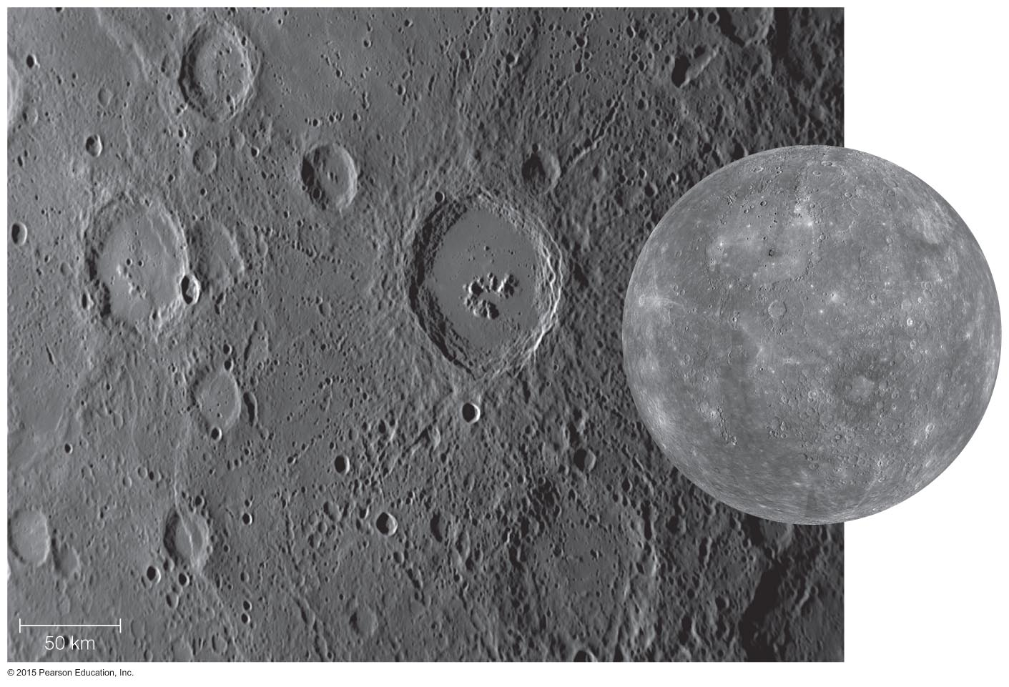
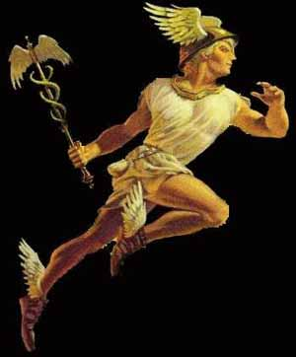
Mercury
Made of metal and rock; large iron core
Desolate, cratered; long, tall, steep cliffs
Very hot and very cold: 425°C (day), –170°C (night)

Slide 11
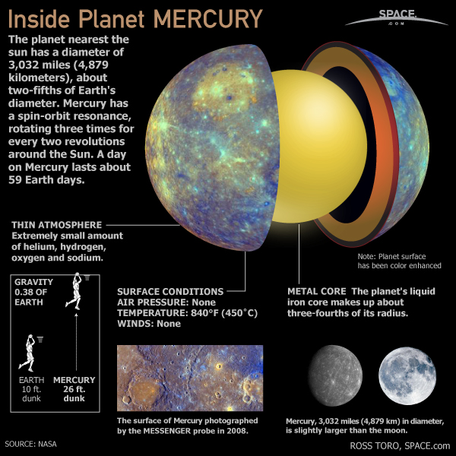

Slide 12
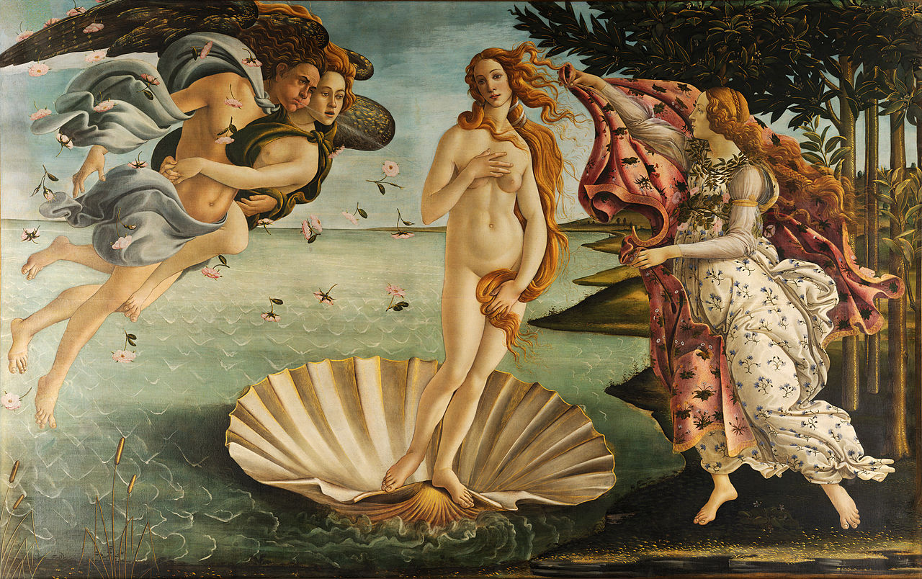
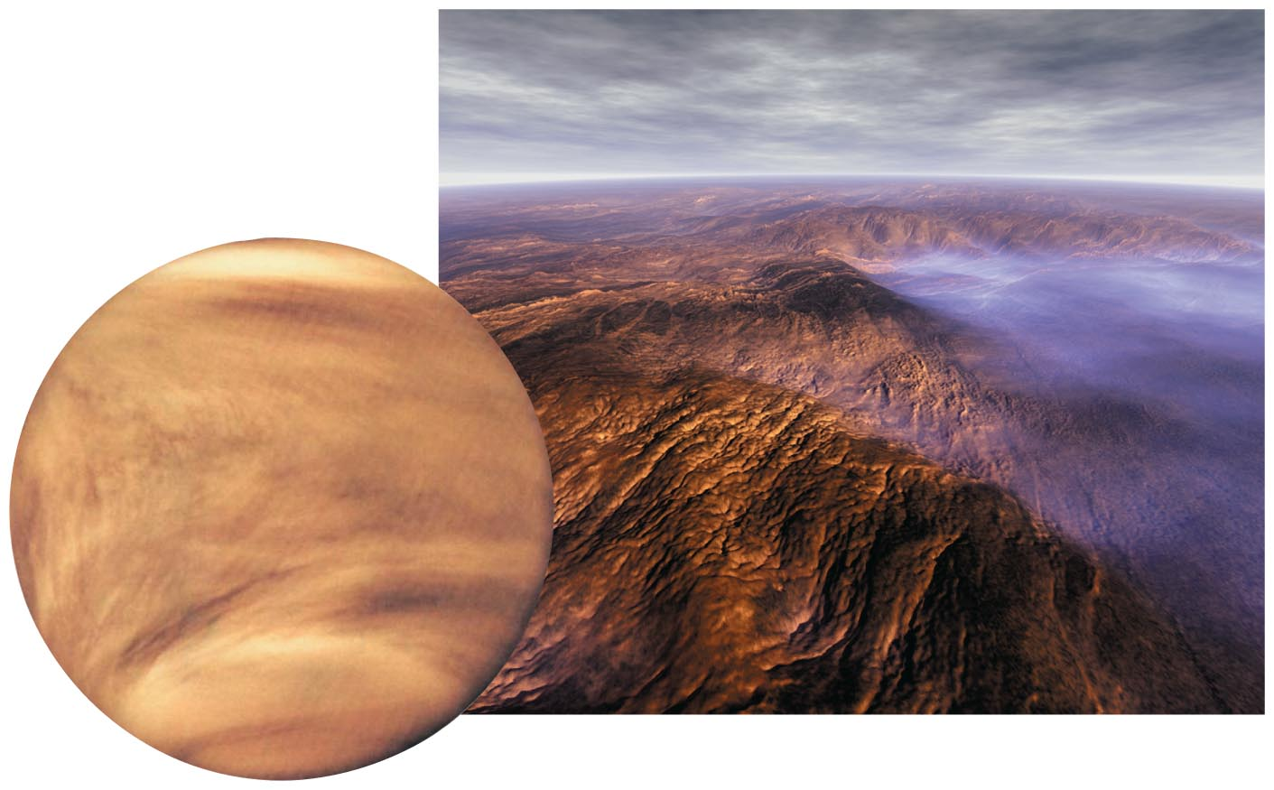
Venus
Nearly identical in size to Earth; surface hidden by clouds
Hellish conditions due to an extreme greenhouse effect
Even hotter than Mercury: 470°C, day and night

Slide 13
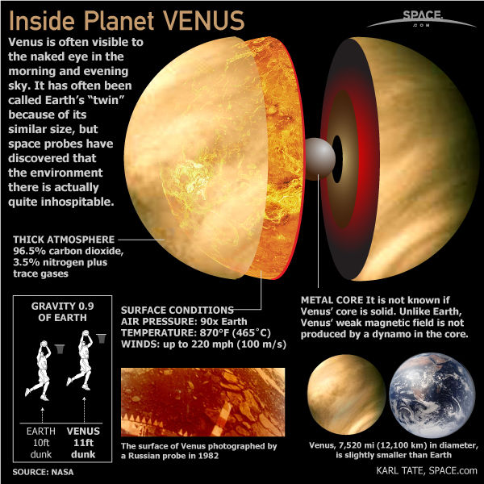

Slide 14
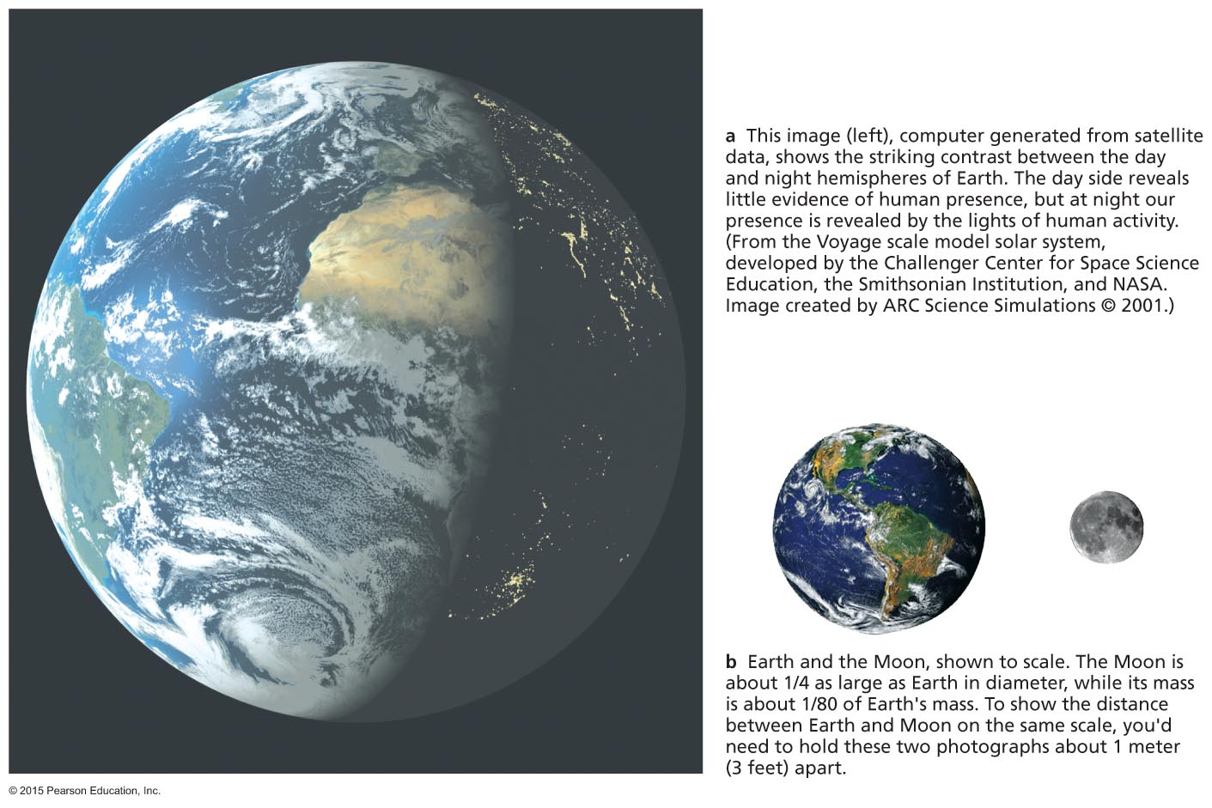
Earth
Earth and Moon to scale
An oasis of life
The only surface liquid water in the solar system
A surprisingly large moon

Slide 15
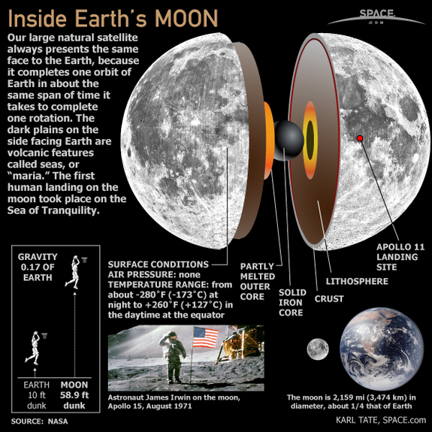

Slide 16
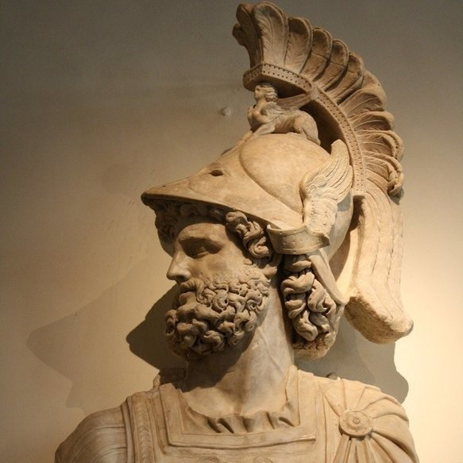
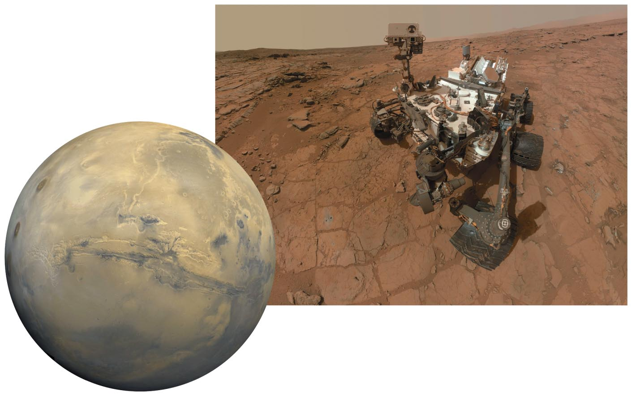
Mars
Looks almost Earth-like, but don't go without a spacesuit!
Giant volcanoes, a huge canyon, polar caps, and more
Water flowed in the distant past; could there have been life?

Slide 17
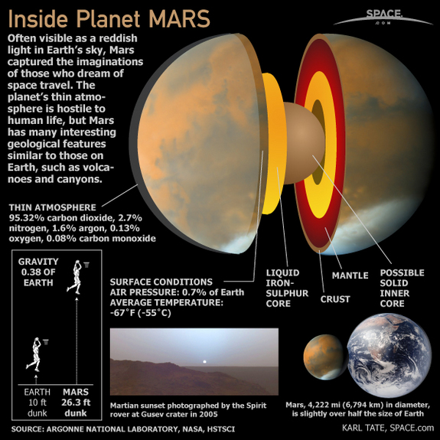

Slide 18
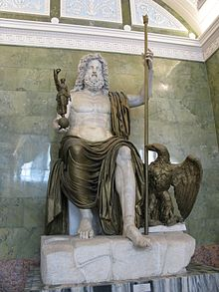
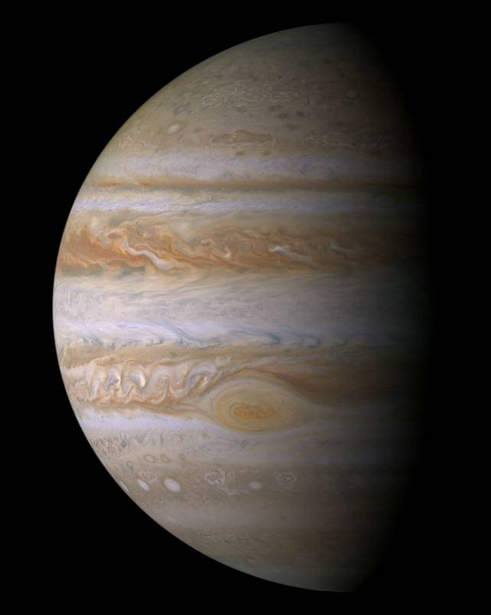
Jupiter
Much farther from Sun than inner planets
Mostly H/He; no solid surface
300 times more massive than Earth
Many moons, rings

Slide 19
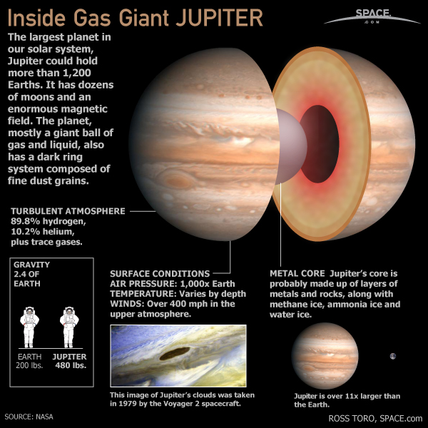

Slide 20
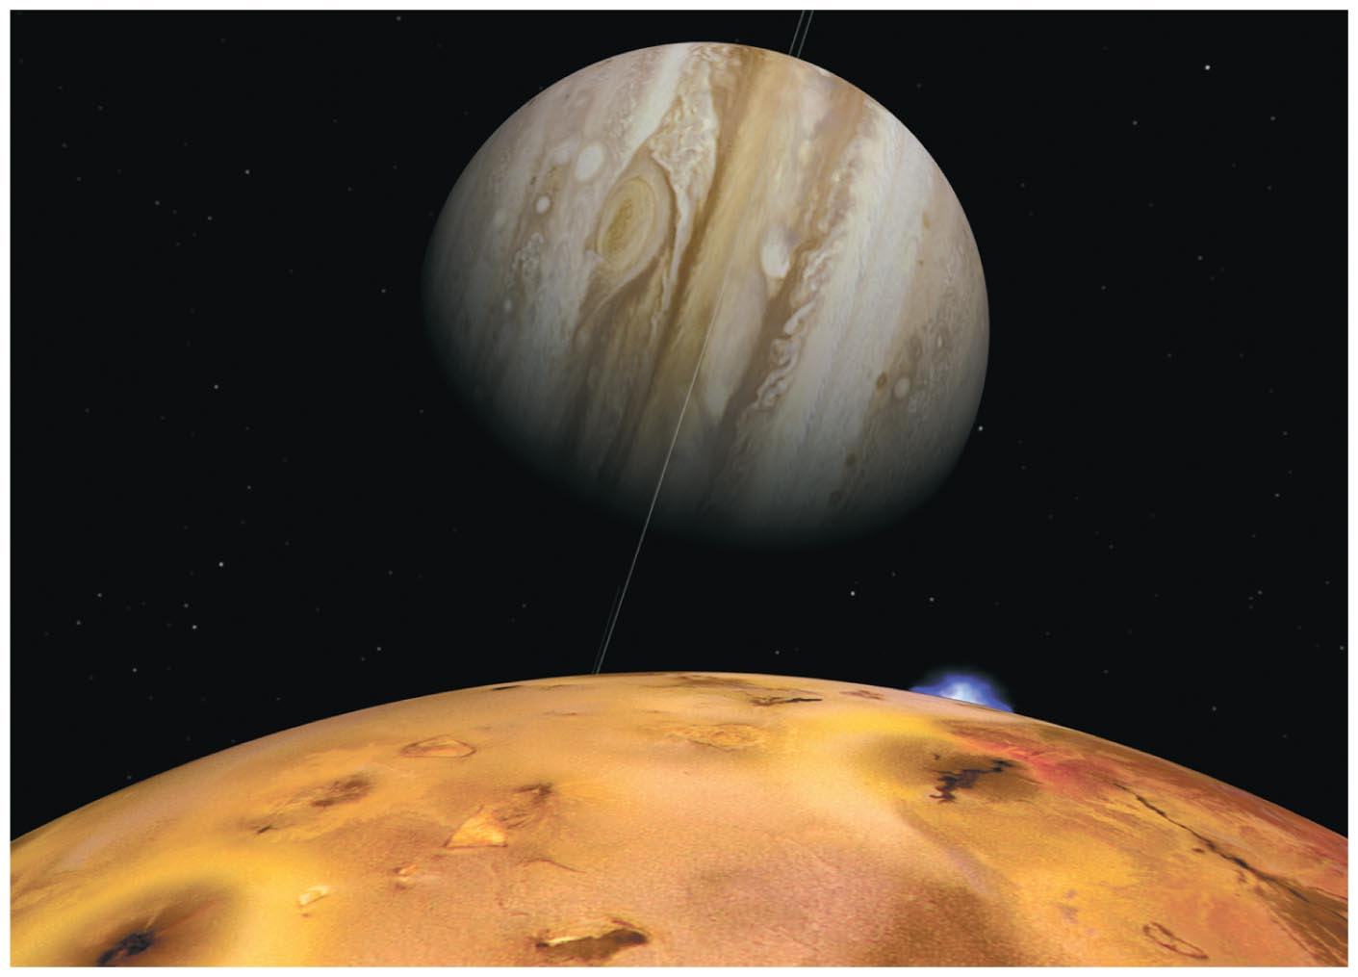
Jupiter's moons can be as interesting as planets themselves, especially Jupiter's four Galilean moons.
Io (shown here): Active volcanoes all over
Europa: Possible subsurface ocean
Ganymede: Largest moon in solar system
Callisto: A large, cratered "ice ball"

Slide 21
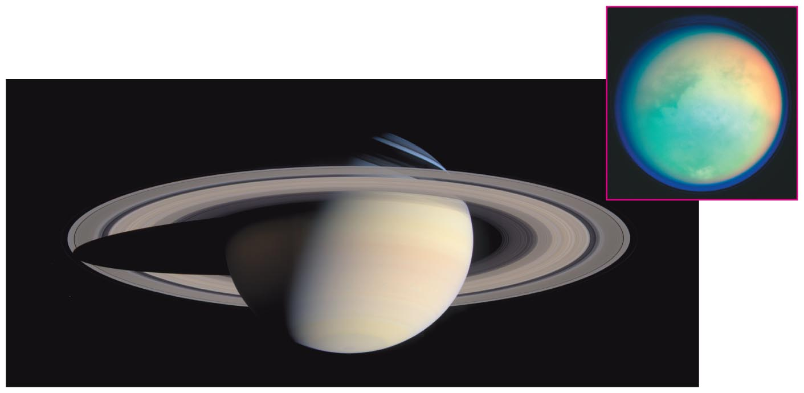
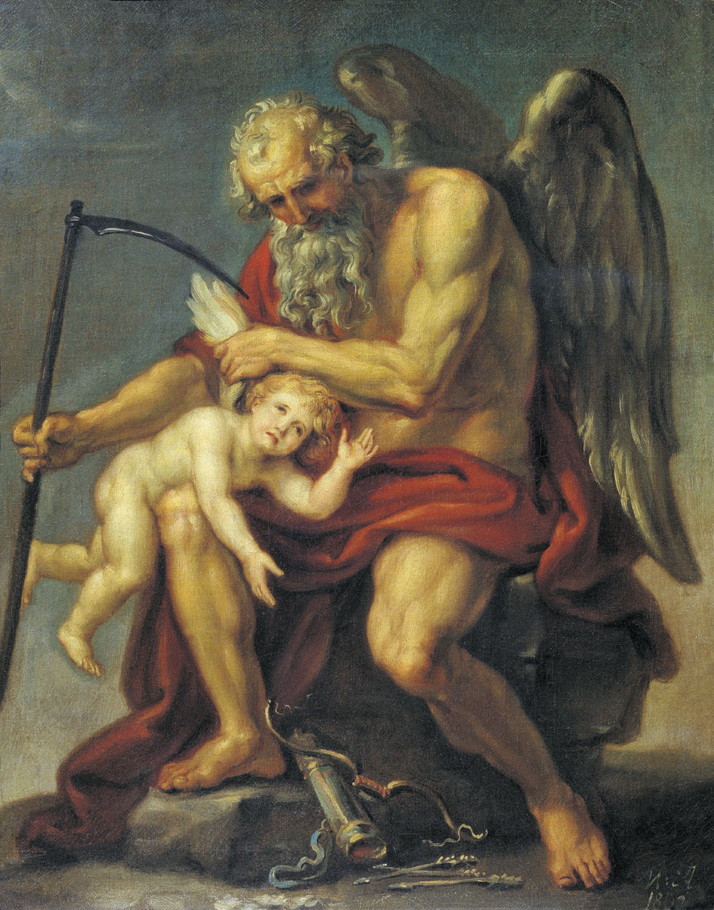
Saturn
Giant and gaseous like Jupiter
Spectacular rings
Many moons, including cloudy Titan
Cassini spacecraft currently studying it

Slide 22
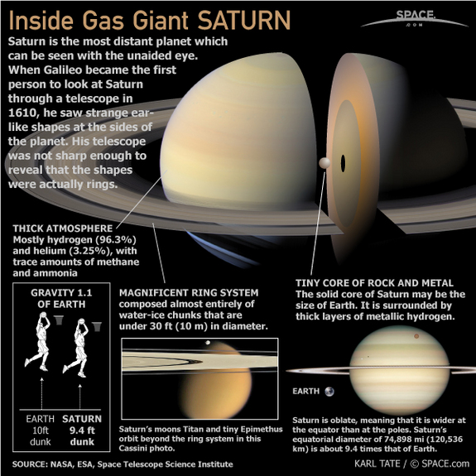

Slide 23
Artist's conception of Saturn's rings
Rings are NOT solid; they are made of countless small chunks of ice and rock, each orbiting like a tiny moon.

Slide 24
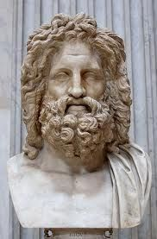
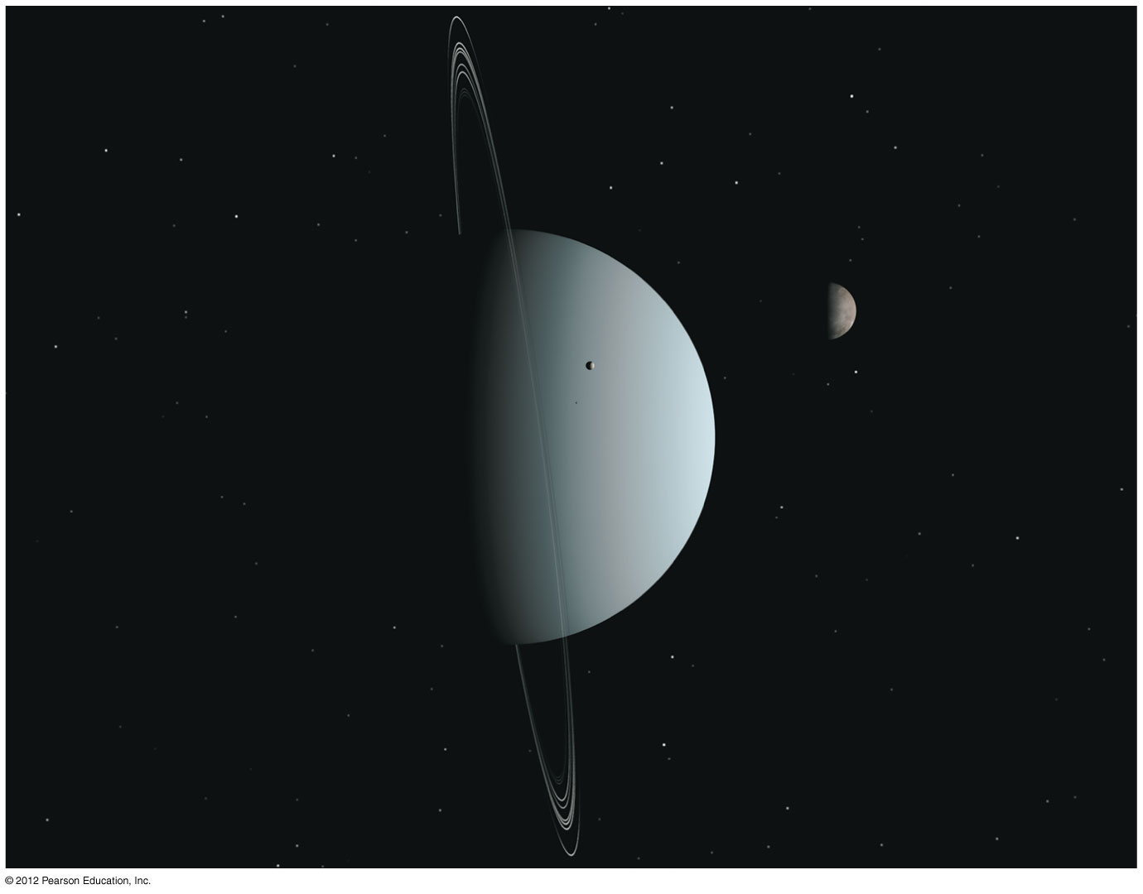
Uranus
Smaller than Jupiter/Saturn; much larger than Earth
Made of H/He gas and hydrogen compounds (H₂O, NH₃, CH₄)
Extreme axis tilt
Moons and rings

Slide 25
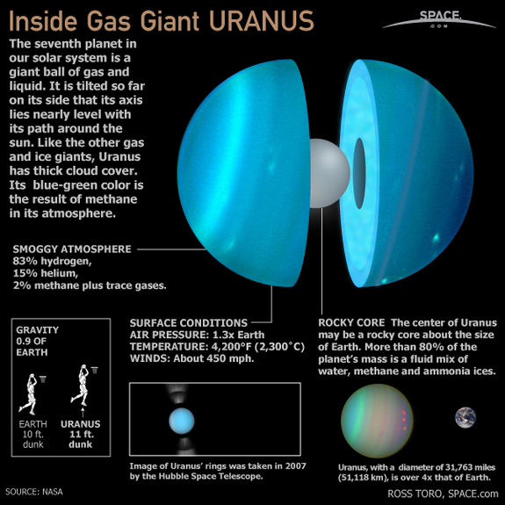

Slide 26
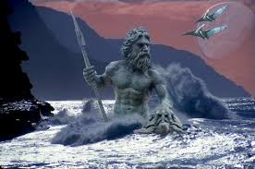
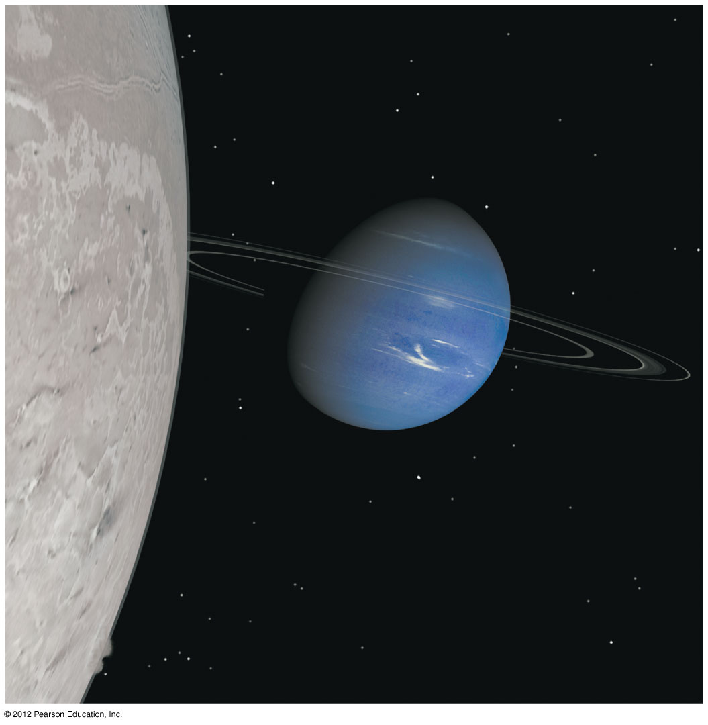
Neptune
Similar to Uranus (except for axis tilt)
Many moons (including Triton)

Slide 27
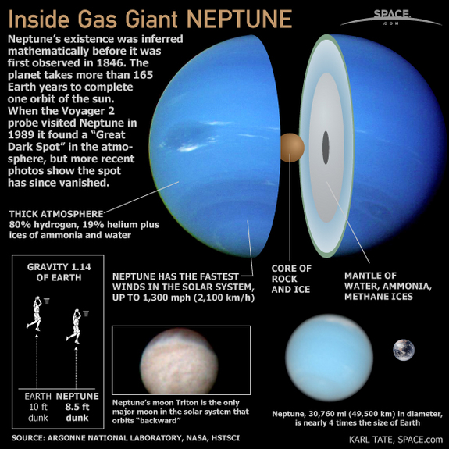

Slide 28
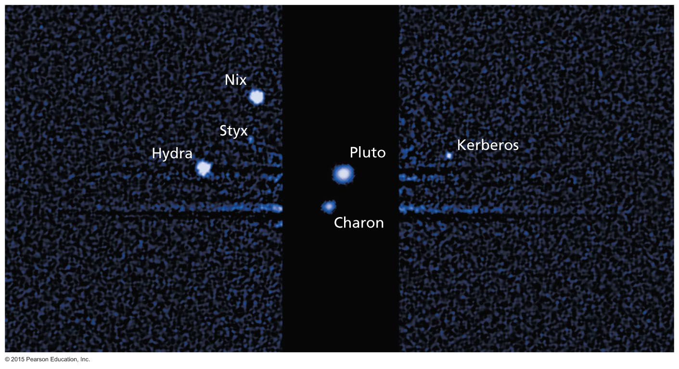
Pluto and Other Dwarf Planets
Much smaller than other planets
Icy, comet-like composition
Pluto's moon Charon is similar in size to Pluto

Slide 29
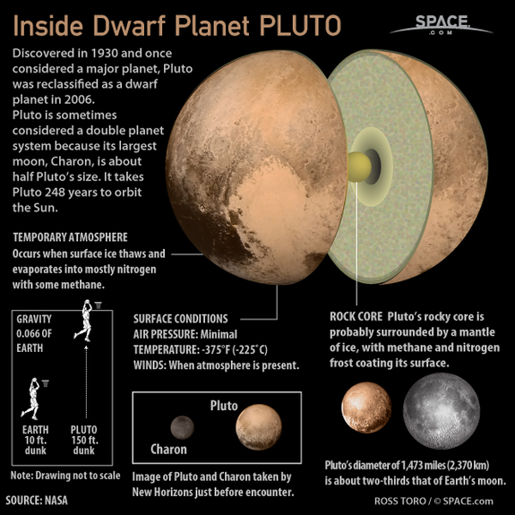

Slide 30
What have we learned?
What does the solar system look like?
Planets are tiny compared to the distances between them.
Each world has its own character, but there are many clear patterns.

Slide 31
6.2 The Nebular Theory of Solar System Formation
Our goals for learning:
What features of our solar system provide clues to how it formed?
What is the nebular theory?

Slide 32
What features of our solar system provide clues to how it formed?

Slide 33
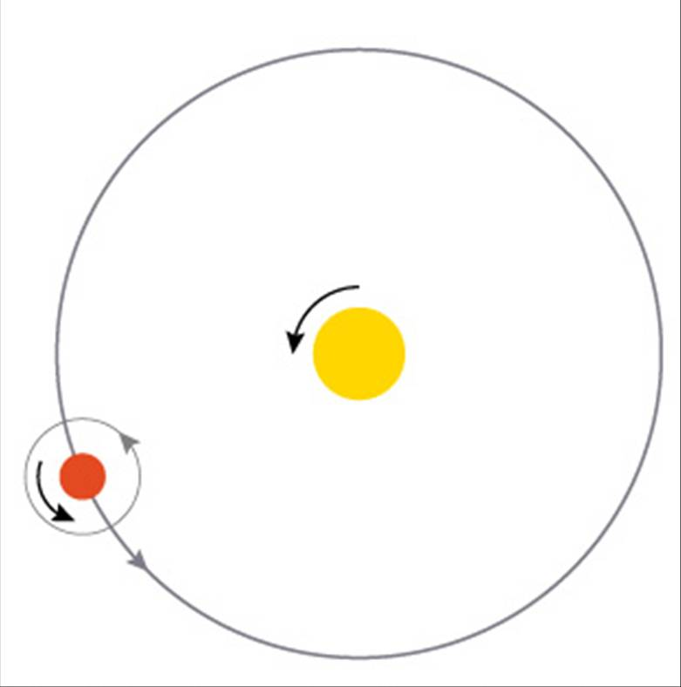
Motion of Large Bodies
All large bodies in the solar system orbit in the same direction and in nearly the same plane.
Most also rotate in that direction.

Slide 34
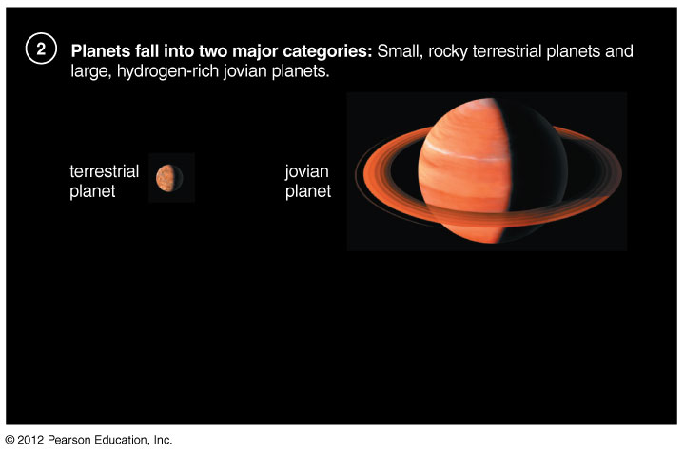
Two Major Planet Types
Terrestrial planets are rocky, relatively small, and close to the Sun.
Jovian planets are gaseous, larger, and farther from the Sun.

Slide 35
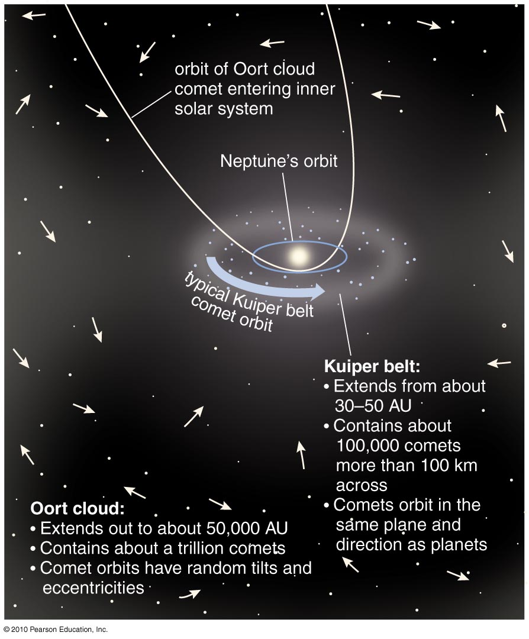
Swarms of Smaller Bodies
Many rocky asteroids and icy comets populate the solar system.

Slide 36
Notable Exceptions
Several exceptions to normal patterns need to be explained.

Slide 37
What is the nebular theory?

Slide 38
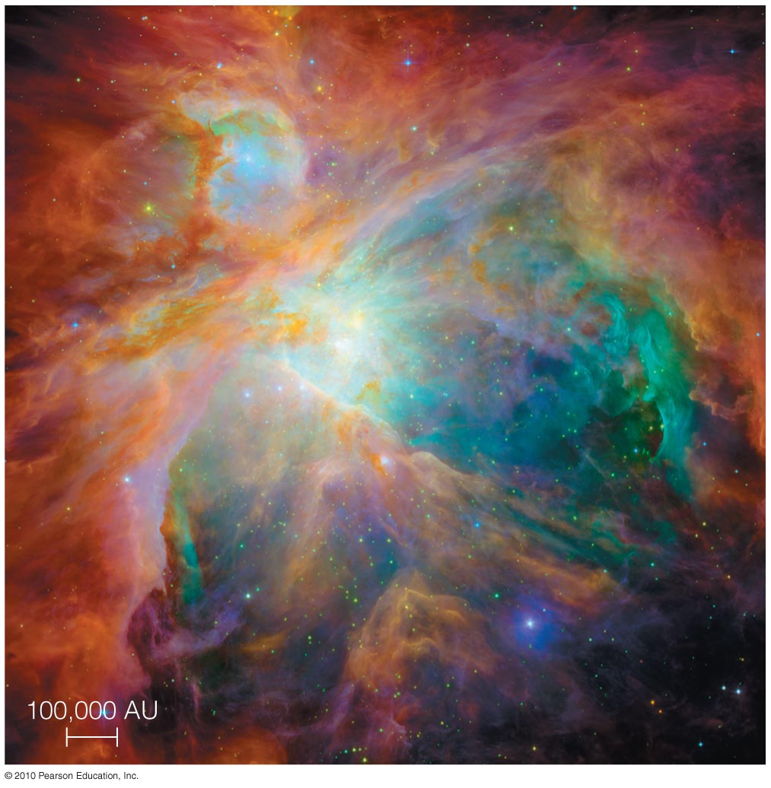
According to the nebular theory, our solar system formed from a giant cloud of interstellar gas.
(nebula = cloud)

Slide 39
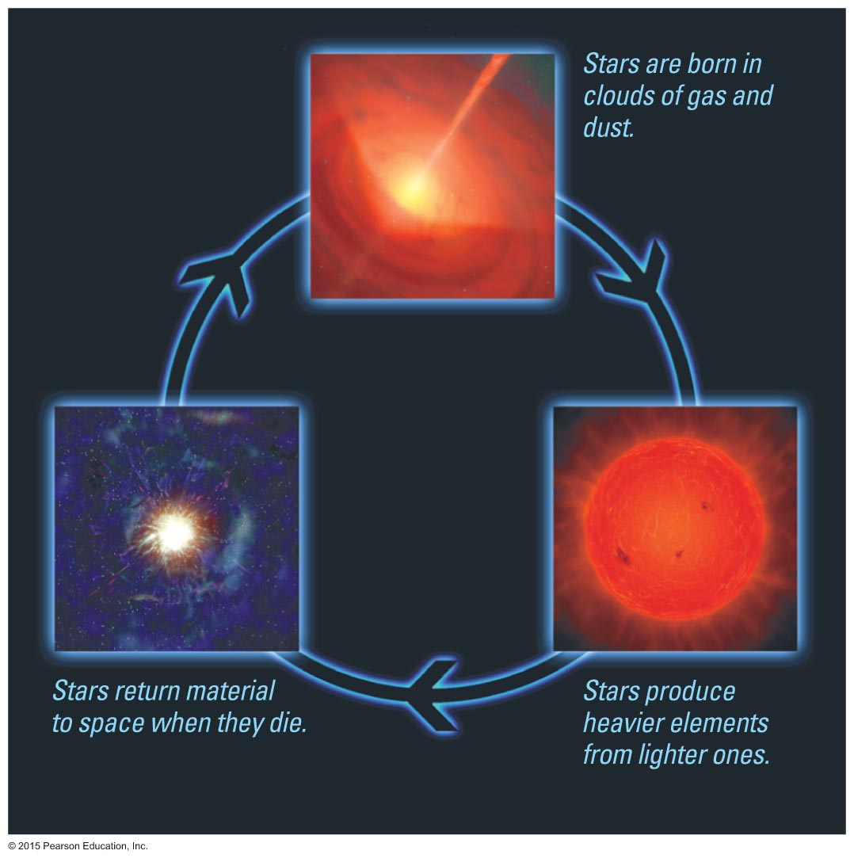
Origin of the Nebula
Elements that formed planets were made in stars and then recycled through interstellar space.

Slide 40
Evidence from Other Gas Clouds
We can see stars forming in other interstellar gas clouds, lending support to the nebular theory.

Slide 41
6.3 Explaining the Major Features of the Solar System
Our goals for learning:
What caused the orderly patterns of motion?
Why are there two major types of planets?
Where did asteroids and comets come from?
How do we explain the "exceptions to the rules"?

Slide 42
What caused the orderly patterns of motion?

Slide 43
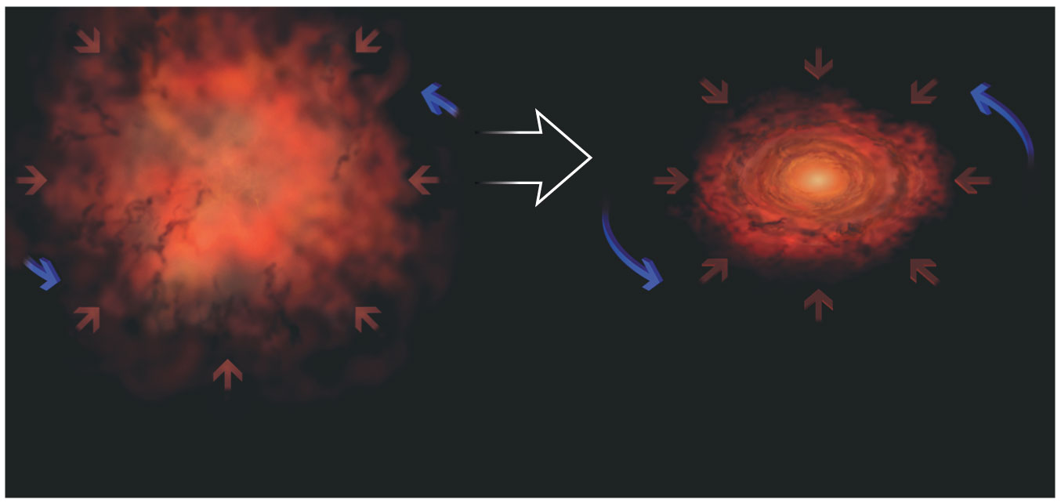
Conservation of Angular Momentum
The rotation speed of the cloud from which our solar system formed must have increased as the cloud contracted.

Slide 44
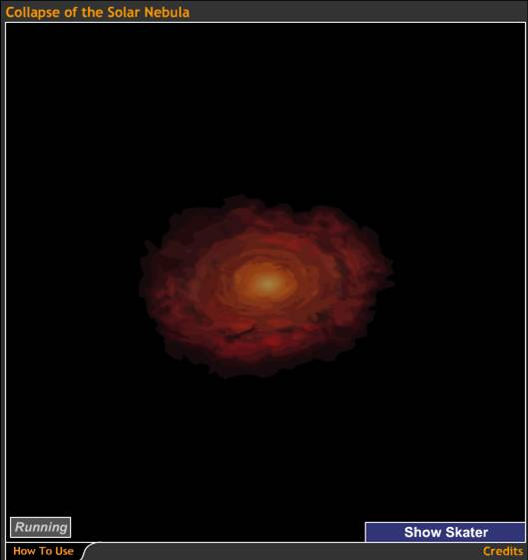
Rotation of a contracting cloud speeds up for the same reason a skater speeds up as she pulls in her arms.
Collapse of the Solar Nebula

Slide 45
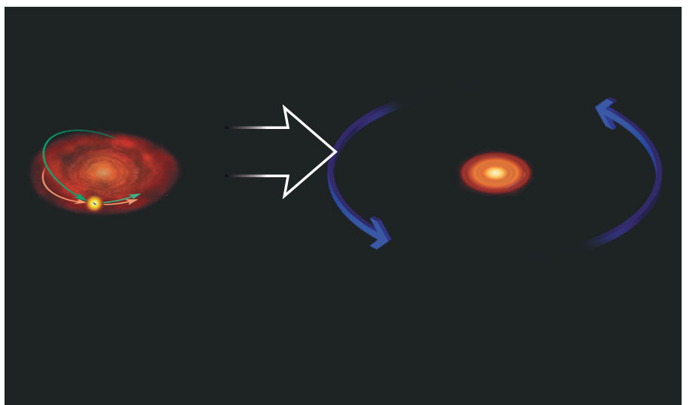
Flattening
Collisions between particles in the cloud caused it to flatten into a disk.

Slide 46
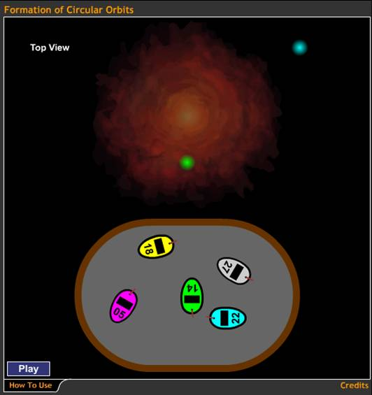
Collisions between gas particles in a cloud gradually reduce random motions.
INSERT Formation_Circular_Orbits.jpg
Formation of Circular Orbits

Slide 47
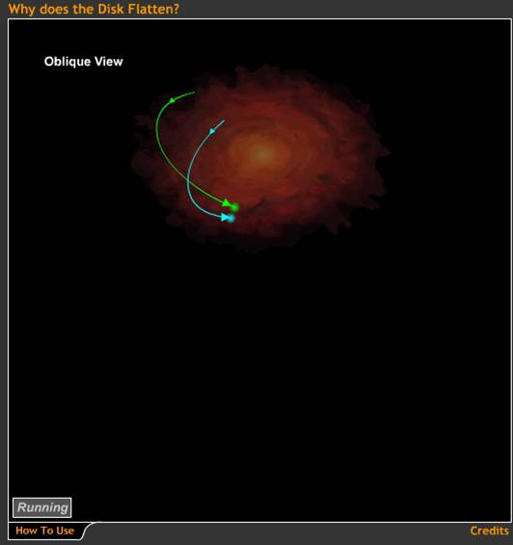
Collisions between gas particles also reduce up and down motions.
Why Does the Disk Flatten?

Slide 48
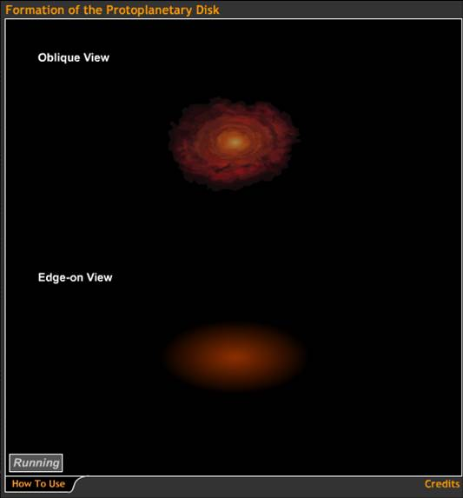
The spinning cloud flattens as it shrinks.
Formation of the Protoplanetary Disk

Slide 49
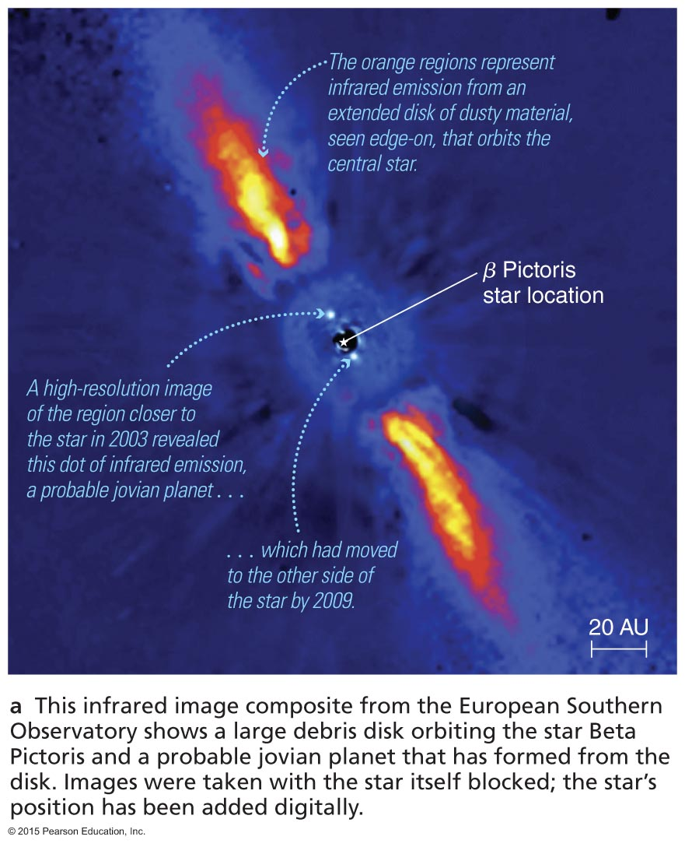
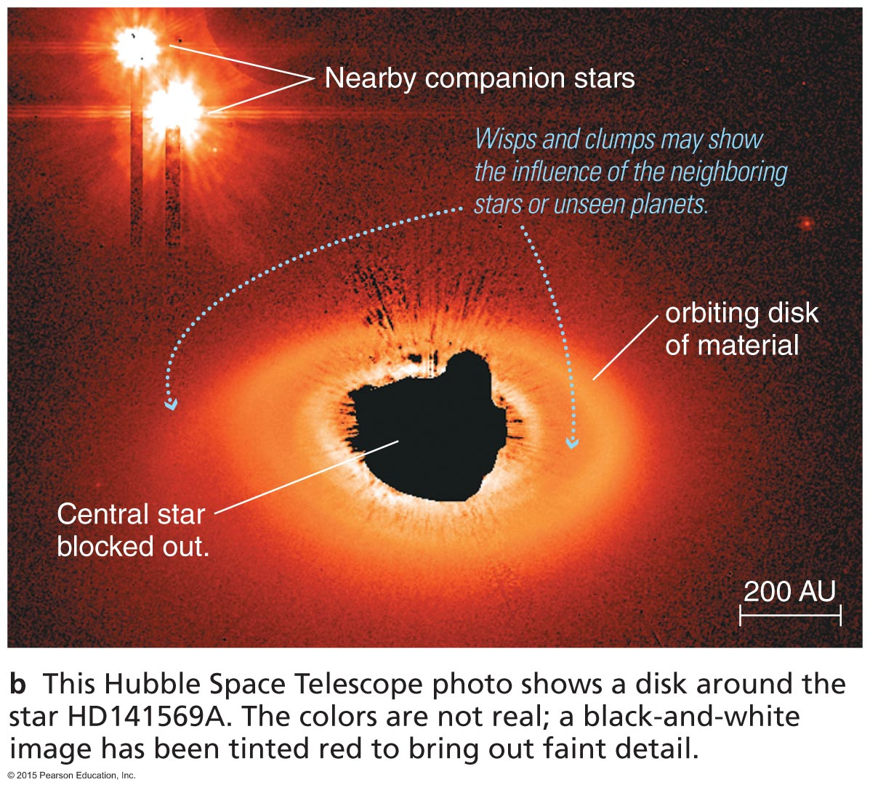
Disks Around Other Stars
Observations of disks around other stars support the nebular hypothesis.

Slide 50
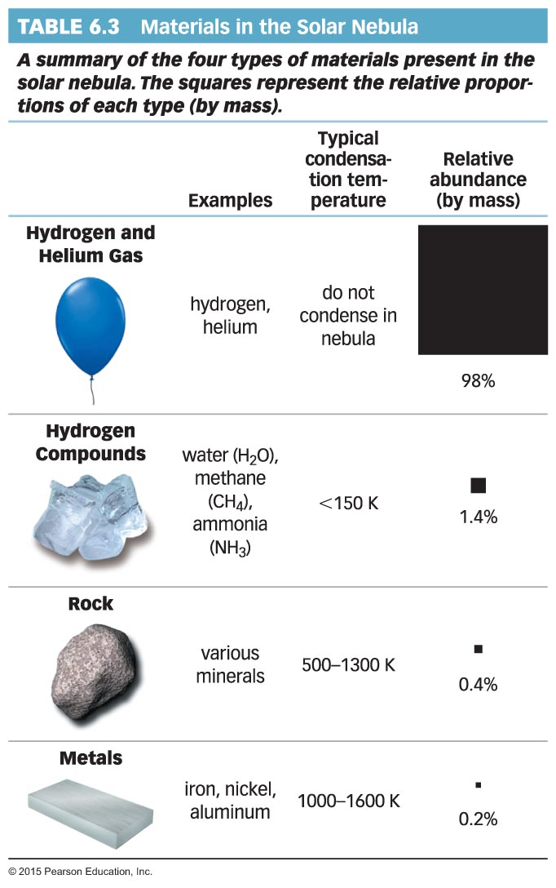
Why are there two major types of planets?

Slide 51
Conservation of Energy
As gravity causes the cloud to contract, it heats up.
Collapse of the Solar Nebula

Slide 52
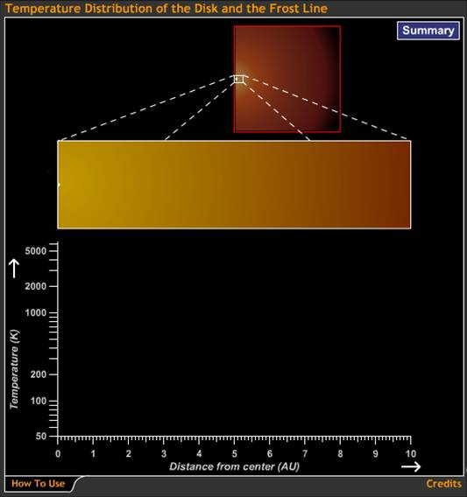
Inner parts of the disk are hotter than outer parts.
Rock can be solid at much higher temperatures than ice.
Temperature Distribution of the Disk and the Frost Line

Slide 53
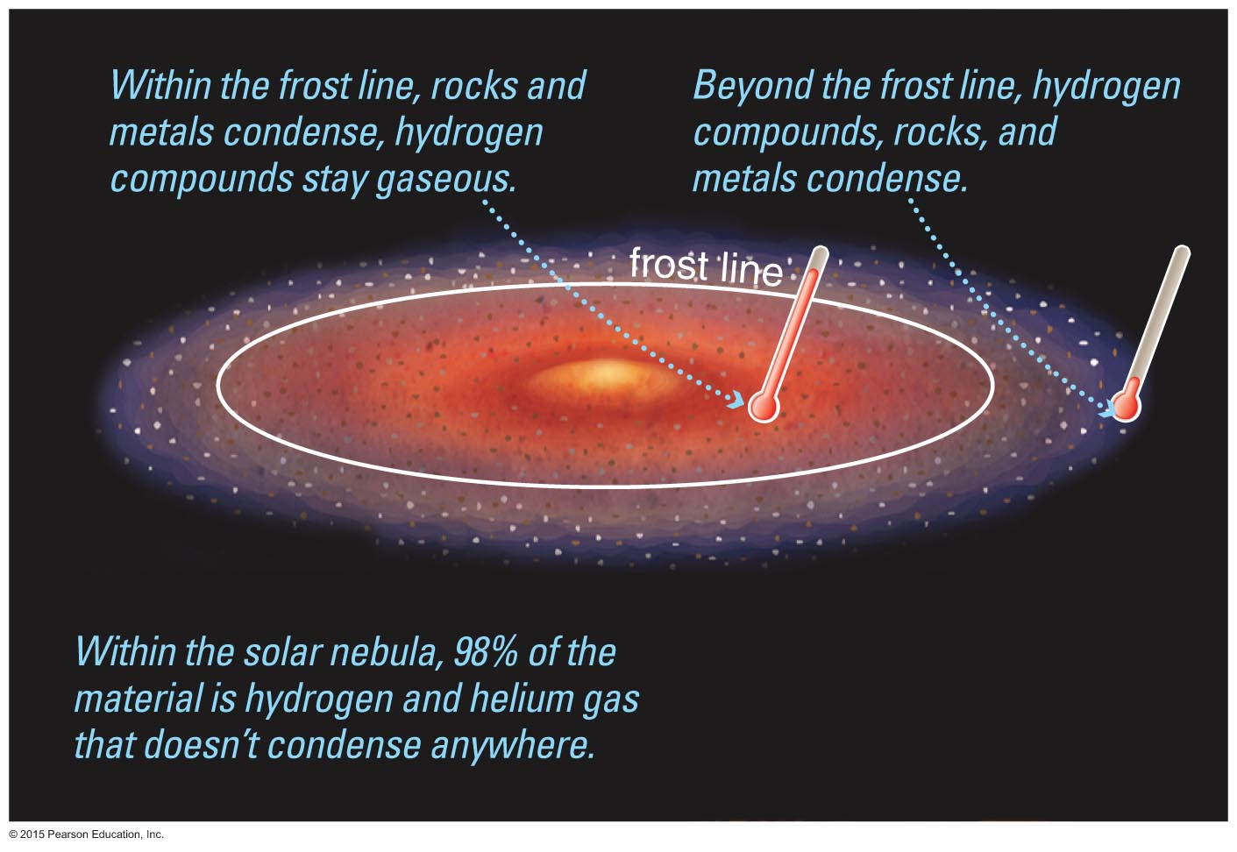
Inside the frost line: Too hot for hydrogen compounds to form ices
Outside the frost line: Cold enough for ices to form

Slide 54
Formation of Terrestrial Planets
Small particles of rock and metal were present inside the frost line.
Planetesimals of rock and metal built up as these particles collided.
Gravity eventually assembled these planetesimals into terrestrial planets.

Slide 55
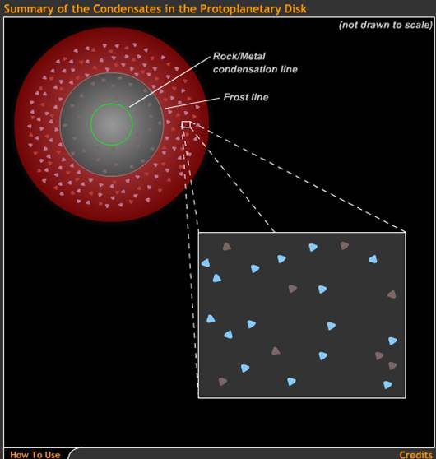
Tiny solid particles stick to form planetesimals.
Summary of the Condensates in the Protoplanetary Disk

Slide 56
Gravity draws planetesimals together to form planets.
This process of assembly
is called accretion.
Summary of the Condensates in the Protoplanetary Disk

Slide 57
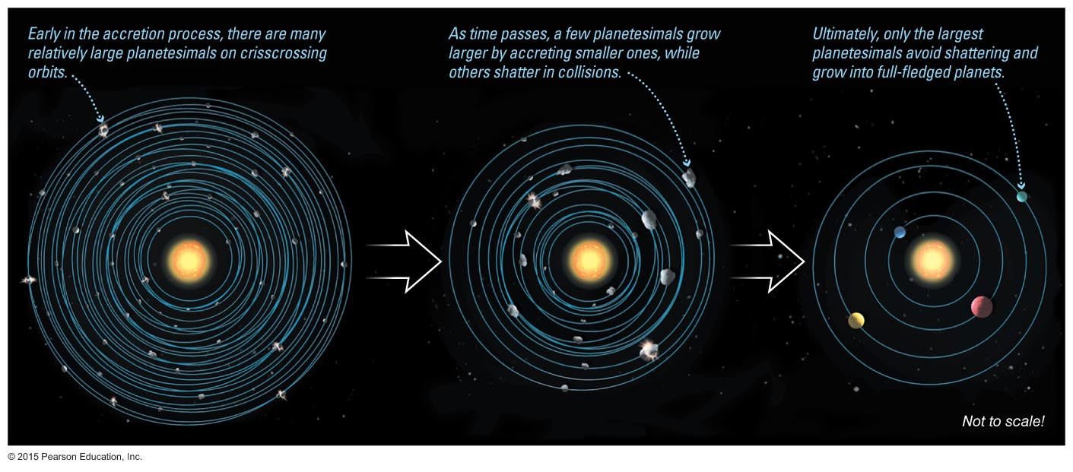
Accretion of Planetesimals
Many smaller objects collected into just a few large ones.

Slide 58
Formation of Jovian Planets
Ice could also form small particles outside the frost line.
Larger planetesimals and planets were able to form.
The gravity of these larger planets was able to draw in surrounding H and He gases.

Slide 59
The gravity of rock and ice in jovian planets draws in H and He gases.
Nebular Capture and the Formation of the Jovian Planets

Slide 60
Moons of jovian planets form in miniature disks.

Slide 61
Radiation and outflowing matter from the Sun—the solar wind— blew away the leftover gases.
The Solar Wind

Slide 62
Where did asteroids and comets come from?

Slide 63
Asteroids and Comets
Leftovers from the accretion process
Rocky asteroids inside frost line
Icy comets outside frost line

Slide 64
Heavy Bombardment
Leftover planetesimals bombarded other objects in the late stages of solar system formation.

Slide 65
Origin of Earth's Water
Water may have come to Earth by way of icy planetesimals from the outer solar system.

Slide 66
How do we explain "exceptions to the rules"?

Slide 67
Captured Moons
The unusual moons of some planets may be captured planetesimals.

Slide 68
Giant Impact
…then accreted into the Moon.

Slide 69
Odd Rotation
Giant impacts might also explain the different rotation axes of some planets.

Slide 70
Review of the nebular theory

Slide 71
Thought Question
How would the solar system be different if the solar nebula had cooled with a temperature half its current value?
Jovian planets would have formed closer to the Sun.
There would be no asteroids.
There would be no comets.
Terrestrial planets would be larger.

Slide 72
Thought Question
How would the solar system be different if the solar nebula had cooled with a temperature half its current value?
Jovian planets would have formed closer to the Sun.
There would be no asteroids.
There would be no comets.
Terrestrial planets would be larger.

Slide 73
Thought Question
Which of these facts is NOT explained by the nebular theory?
There are two main types of planets: terrestrial and jovian.
Planets orbit in the same direction and plane.
Asteroids and comets exist.
There are four terrestrial and four jovian planets.

Slide 74
Thought Question
Which of these facts is NOT explained by the nebular theory?
There are two main types of planets: terrestrial and jovian.
Planets orbit in the same direction and plane.
Asteroids and comets exist.
There are four terrestrial and four jovian planets.

Slide 75
What have we learned?
What caused the orderly patterns of motion?
The solar nebula spun faster as it contracted because of conservation of angular momentum.
Collisions between gas particles then caused the nebula to flatten into a disk.
We have observed such disks around newly forming stars.

Slide 76
What have we learned?
Why are there two major types of planets?
Rock, metals, and ices condensed outside the frost line, but only rock and metals condensed inside the frost line.
Small solid particles collected into planetesimals that then accreted into planets.
Planets inside the frost line were made of rock and metals.
Additional ice particles outside the frost line made planets there more massive, and the gravity of these massive planets drew in H and He gases.

Slide 77
What have we learned?
Where did asteroids and comets come from?
They are leftover planetesimals, according to the nebular theory.
How do we explain "exceptions to the rules"?
The bombardment of newly formed planets by planetesimals may explain the exceptions.
Material torn from Earth's crust by a giant impact formed the Moon.

Slide 78
6.4 The Age of the Solar System
Our goals for learning:
How do we know the age of the solar system?

Slide 79
How do we know the age of the solar system?
We cannot find the age of a planet, but we can find the ages of the rocks that make it up.
We can determine the age of a rock through careful analysis of the proportions of various atoms and isotopes within it.

Slide 80
Radioactive Decay
Some isotopes decay into other nuclei.
A half-life is the time for half the nuclei in a substance to decay.

Slide 81
Thought Question
Suppose you find a rock originally made of potassium-40, half of which decays into argon-40 every 1.25 billion years. You open the rock and find 15 atoms of argon-40 for every atom of potassium-40. How long ago did the rock form?
1.25 billion years ago
2.5 billion years ago
3.75 billion years ago
5 billion years ago

Slide 82
Thought Question
Suppose you find a rock originally made of potassium-40, half of which decays into argon-40 every 1.25 billion years. You open the rock and find 15 atoms of argon-40 for every atom of potassium-40. How long ago did the rock form?
1.25 billion years ago
2.5 billion years ago
3.75 billion years ago
5 billion years ago

Slide 83
Dating the Solar System
Age dating of meteorites that are unchanged since they condensed and accreted tells us that the solar system is about 4.6 billion years old.

Slide 84
Dating the Solar System
Radiometric dating tells us that the oldest moon rocks are 4.4 billion years old.
The oldest meteorites are 4.55 billion years old.
Planets probably formed 4.5 billion years ago.

Slide 85
What have we learned?
How do we know the age of the solar system?
Astronomers use radiometric dating to determine the ages of meteorites and rocks from various solar system bodies.
This technique indicates that planets formed 4.5 billion years ago.

