Slide 1
VIBRATIONS AND WAVES
Things that Wiggle and Jiggle
VIBRATIONS AND WAVES

Slide 2
The Vibration of a Pendulum
A FEW IMPORTANT TERMS :
Vibration = a wiggle in a period of time
Wave = a wiggle in an amount of space and in a period of time.
Pendulum = A weight swinging through a small arc at the end of a length of string or wire.
Period = The time it takes a pendulum to make one back-and-forth swing.

Slide 3
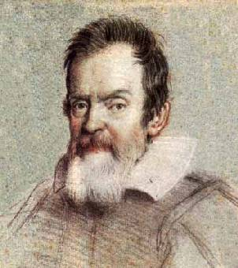
The Vibration of a Pendulum
Pendulums swing back and forth with such regularity that they have been used for a long time to control the motions of clocks.
Galileo discovered that the time a pendulum takes to swing back and forth through small angles does not depend on the mass of the pendulum or the distance through which it swings,
but ONLY on the length (l)
of the pendulum and the acceleration due to
gravity (g).

Slide 4
The Vibration of a Pendulum
The exact relationship for the period of a simple pendulum is :
T = 2 π
Where L = length of the pendulum in meters
T = time in seconds
and g = acceleration due to gravity (9.8 m/ sec² )
Thus, a long pendulum has a longer period than a short pendulum
L
g

Slide 5
Wave Description
Simple Harmonic Motion = the back-and-forth swinging motion of a pendulum (or a spring! – also called oscillatory motion)
Sine Wave = The shape of a curve made by simple harmonic motion graphed through time.
Springs oscillate according to Hooke’s Law . F = k Δx
F = the force stretching or compressing a spring
k = the spring constant for that spring
Δx = the distance the spring is stretched or compressed

Slide 6
Wave Description
Terms in a sine wave
Frequency = how often a vibration occurs in cycles per second (hertz = Hz)
WAVELENGTH
AMPLITUDE
CREST
TROUGH

Slide 7
Wave Description
If the frequency of a vibrating object is known, its period can be calculated.
and vice versa.
frequency =
period =
The transmissions of radio, TV, and cell antennas as well as sound travel in waves.
1
period
1
frequency

Slide 8
Wave Motion
When energy is transferred by a wave from a vibrating source to a distant receiver, there is no transfer of matter between the two points.
The energy is carried by a disturbance in a medium, not by matter moving from one place to another within the medium.
The disturbance moves through (or across) the medium (water, a string, a slinky etc.), the parts of the medium only move up and down (or closer and farther apart).

Slide 9
Wave Speed
The speed of a wave depends on the medium through which it is moving.
Sound moves at 331.4 m/sec in air, but about 4 times faster through water at 1500 m/sec.
The general equation for calculating wave speed is
wave speed = wavelength x frequency
Or v = λf
Notice long wavelengths have lower frequencies and short wavelengths have high frequencies.

Slide 10
Wave Speed
Low notes High notes
Same volume (amplitude) and velocity, different frequencies
A wavelength of 1 meter passing a post at 1 wavelength per second has a wave speed of 1 m/sec.

Slide 11

Transverse Waves
Transverse Wave = When the motion of the medium (a rope or string, water or a spring) is at right angles to the direction that the wave is traveling.
Waves in musical instruments (guitars, violins), on the surface of liquids, radio and light waves are transverse waves.

Slide 12
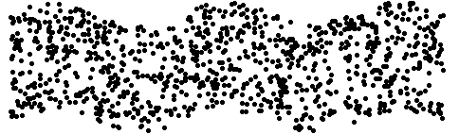

Slide 13
Longitudinal Waves
Longitudinal Waves = A wave in which the particles of the medium move back and forth along the direction of motion of the wave rather than at right angles to it.
Moving the end of a spring or slinky in and out or sound waves are examples of longitudinal waves.

Slide 14
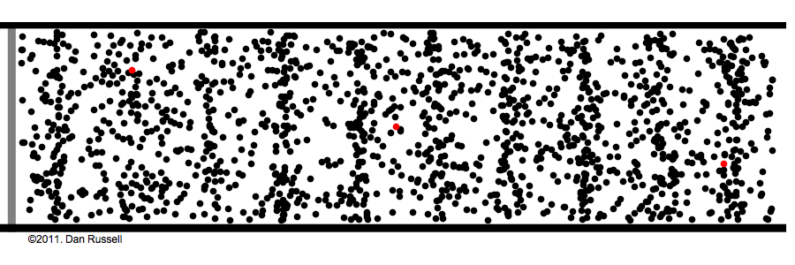
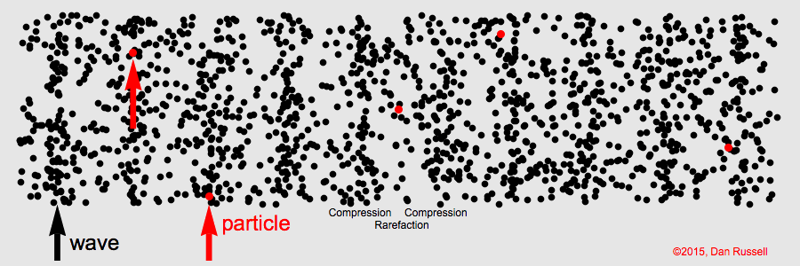

Slide 15
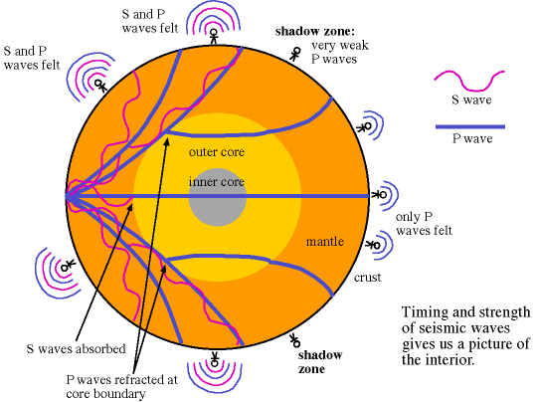
Boundary Behavior (or whatever happens to the wave when the medium changes or runs out?)
The behavior of a wave when it reaches the end of its medium is called the wave’s BOUNDARY BEHAVIOR.
When one medium ends and another begins, that is called a boundary.

Slide 16
Reflection
the turning back of a wave when
it reaches the boundary of the
medium through which it is traveling

Slide 17
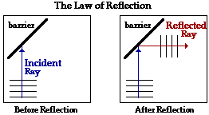
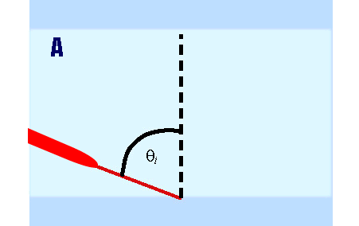
Law of Reflection
the angle of incidence is equal
to the angle of reflection

Slide 18
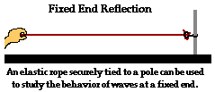
Fixed End
One type of boundary that a wave may encounter is that it may be attached to a fixed end.
In this case, the end of the medium will not be able to move.
What is going to happen if a wave pulse goes down this string and encounters the fixed end?

Slide 19
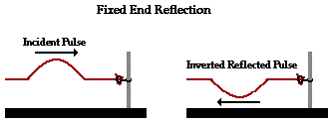
Fixed End
Here the incident pulse is an upward pulse.
The reflected pulse is upside-down. It is inverted.
The reflected pulse has the same speed, wavelength, and amplitude as the incident pulse.

Slide 20
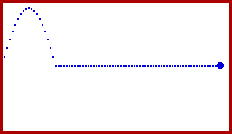
Fixed End Animation

Slide 21
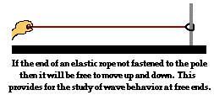
Free End
Another boundary type is when a wave’s medium is attached to a stationary object as a free end.
In this situation, the end of the medium is allowed to slide up and down.
What would happen in this case?

Slide 22
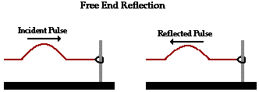
Free End
Here the reflected pulse is not inverted.
It is identical to the incident pulse, except it is moving in the opposite direction.
The speed, wavelength, and amplitude are the same as the incident pulse.

Slide 23
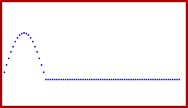
Free End Animation

Slide 24

Change in Medium
Our third boundary condition is when the medium of a wave changes.
Think of a thin rope attached to a thin rope. The point where the two ropes are attached is the boundary.
At this point, a wave pulse will transfer from one medium to another.
What will happen here?

Slide 25
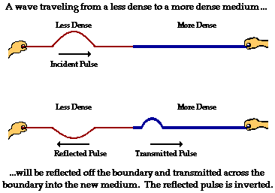
Change in Medium
In this situation part of the wave is reflected, and part of the wave is transmitted.
Part of the wave energy is transferred to the more dense medium, and part is reflected.
The transmitted pulse is upright, while the reflected pulse is inverted.

Slide 26
Change in Medium
The speed and wavelength of the reflected wave remain the same, but the amplitude decreases.
The speed, wavelength, and amplitude of the transmitted pulse are all smaller than in the incident pulse.

Slide 27
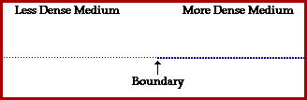
Change in Medium Animation

Slide 28
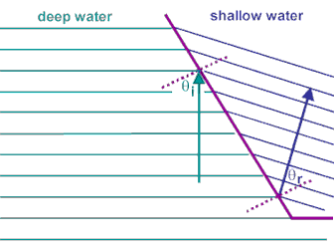
Refraction
the bending of a wave as it passes obliquely from one medium into another of different propagation speed
For refraction to occur, the wave
must change speed and must enter
the new medium at an oblique angle.

Slide 29
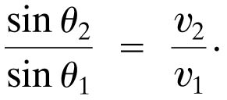
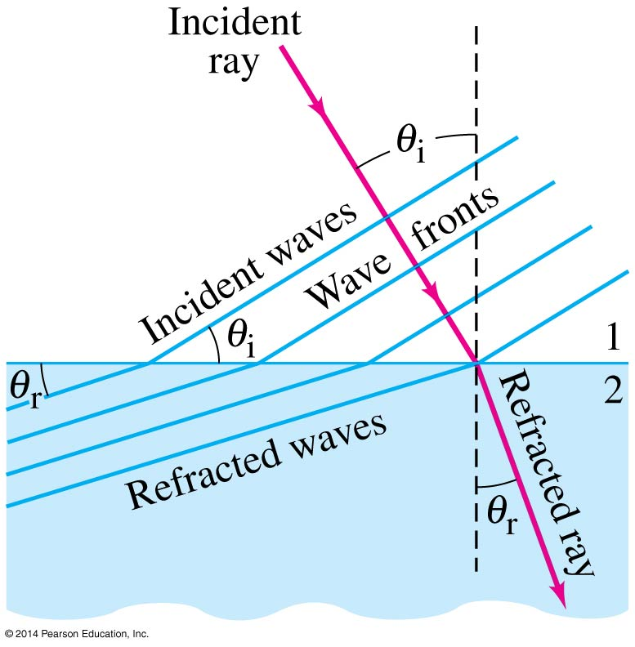
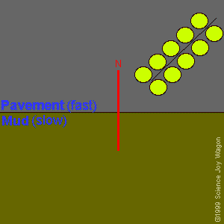
Refraction
If the wave enters a medium where the wave speed is different, it will be refracted—its wave fronts and rays will change direction.
We can calculate the angle of refraction, which depends
on both wave speeds:
(11-20)

Slide 30
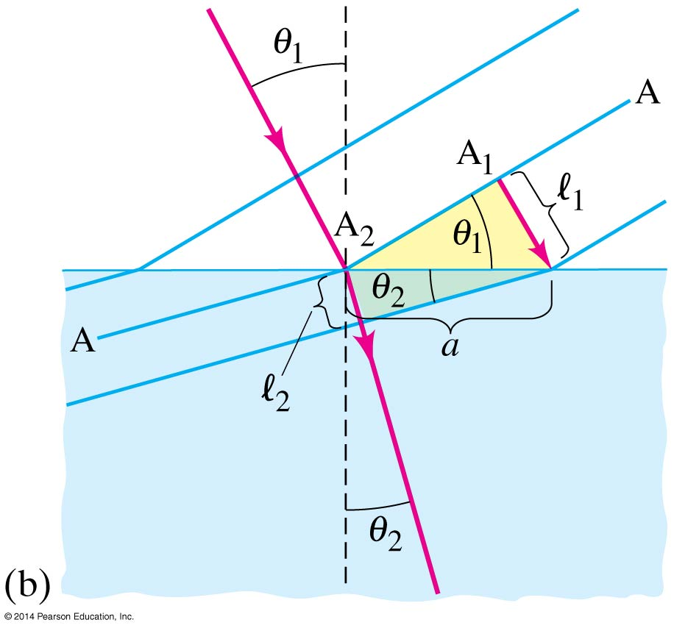
Refraction
The law of refraction works
both ways—a wave going
from a slower medium to
a faster one would follow
the red line in the
other direction.

Slide 31

Diffraction
the spreading of a wave
around a barrier or
through an opening

Slide 32
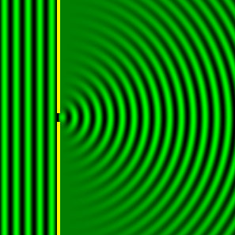
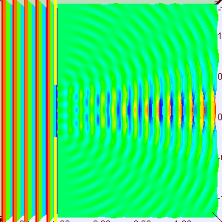
11-14 Diffraction
When waves encounter an obstacle, they bend around
it, leaving a “shadow region.” This is called diffraction.

Slide 33
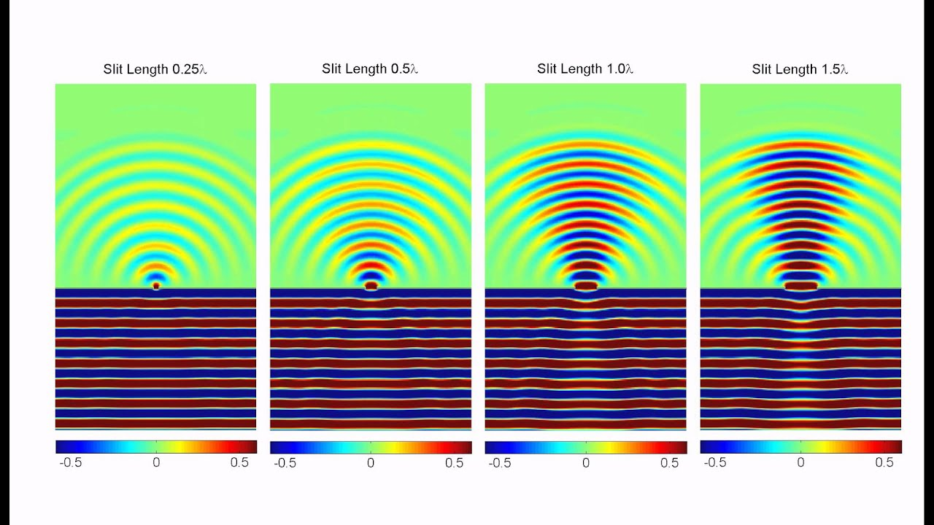
Diffraction
The amount of diffraction depends on the size of the obstacle compared to the wavelength. If the obstacle is much smaller than the wavelength, the wave is barely affected. If the object is comparable to, or larger than, the wavelength, diffraction is much more significant.

Slide 34
Standing Waves
If the incident (original) wave and its reflected wave through a medium balance each other, a standing wave can be formed.
In a standing wave, certain points of the medium don’t move, these are called nodes.
The positions on a standing wave with the largest amplitude occur halfway between nodes and are called antinodes.
Standing waves are the result of interference when 2 waves of equal amplitude and wavelength pass through each other.

Slide 35
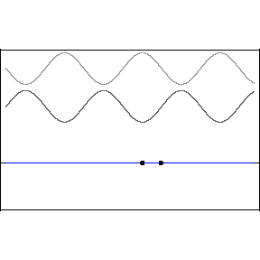
Standing Waves
What makes a standing wave occur ?
INCIDENT WAVE
IN
PHASE
NODE
REFLECTED WAVE
OUT OF
PHASE
REFLECTED WAVE
NODE
INCIDENT WAVE
IN
PHASE
INCIDENT WAVE
NODE
REFLECTED WAVE
NODE

Slide 36
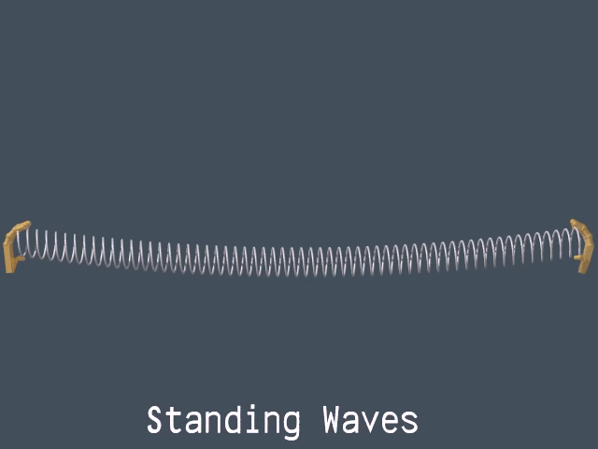

Slide 37
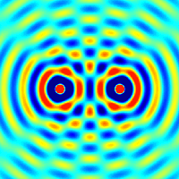
Wave Interaction
All we have left to discover is how waves interact with each other.
When two waves meet while traveling along the same medium it is called INTERFERENCE.

Slide 38
Constructive Interference
Let’s consider two waves moving towards each other, both having a positive upward amplitude.
What will happen when they meet?

Slide 39


Constructive Interference
They will ADD together to produce a greater amplitude.
This is known as CONSTRUCTIVE INTERFERENCE.

Slide 40
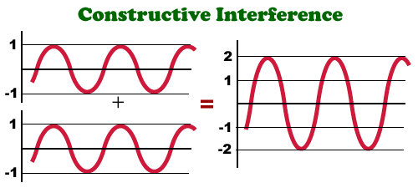

Slide 41
Destructive Interference
Now let’s consider the opposite, two waves moving towards each other, one having a positive (upward) and one a negative (downward) amplitude.
What will happen when they meet?

Slide 42

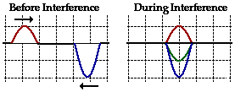

Destructive Interference
This time when they add together they will produce a smaller amplitude.
This is know as DESTRUCTIVE INTERFERENCE.

Slide 43
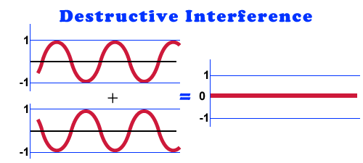

Slide 44
Interference
Waves from different sources can be in phase or out of phase.
Reinforcement
In phase
+
=
Cancellation
Out of phase
+
=

Slide 45
Interference
Waves produced by 2 vibrating objects can overlap and form Interference Patterns
Constructive Interference or reinforcement. When the crest of one wave overlaps the crest of another, the individual effects add together increasing the amplitude.
Destructive Interference or cancellation. When the crest of one wave overlaps the trough of another, the individual effects are reduced

Slide 46
Interference
Sheets of interference waves can make what is called a Moire` Pattern

Slide 47
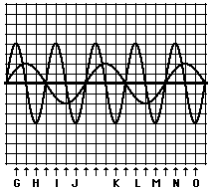
Check Your Understanding
Which points will produce constructive interference and which will produce destructive interference?
Constructive
  G, J, M, N
Destructive
  H, I, K, L, O

Slide 48
