Slide 1
Chapter 9: Asteroids, Comets, and Dwarf Planets: Their Nature, Orbits, and Impacts

Slide 2
9.1 Asteroids and Meteorites
Our goals for learning:
What are asteroids like?
Why is there an asteroid belt?
How are meteorites related to asteroids?

Slide 3
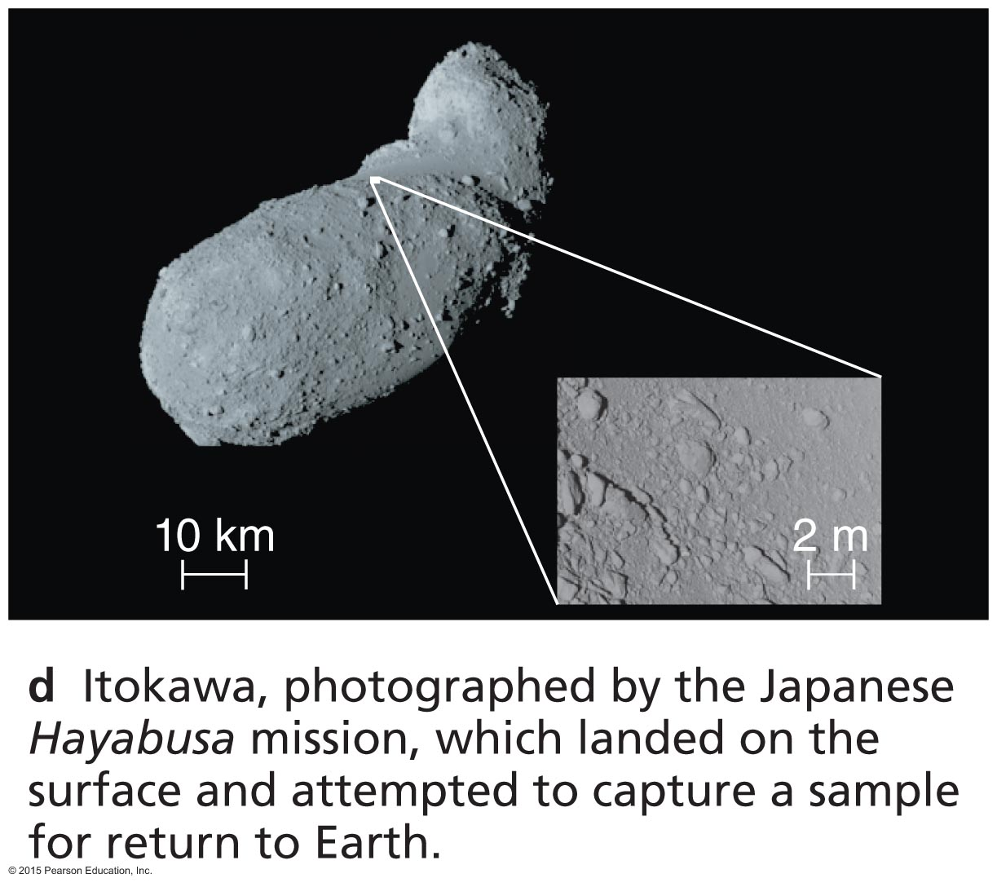
What are asteroids like?

Slide 4
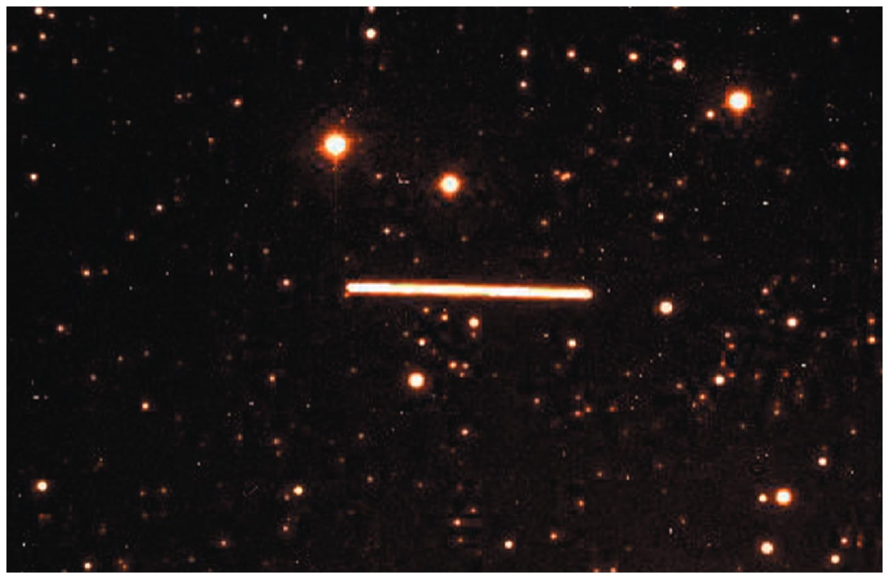
Discovering Asteroids
Asteroids leave trails in long-exposure images because of their orbital motion around the Sun.

Slide 5
Asteroid Facts
Asteroids are rocky leftovers of planet formation.
The largest is Ceres, diameter ~1000 km.
There are 150,000 listed in catalogs, and probably over a million with diameter >1 km.
Small asteroids are more common than large asteroids.
All the asteroids in the solar system wouldn't add up to even a small terrestrial planet.

Slide 6
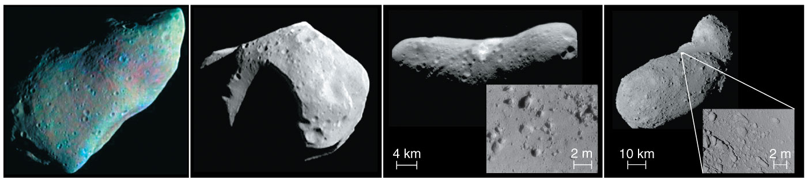
Asteroids are cratered and not round.
Notes:
Thought question: Were these pictures taken from Earth?
One of these has a satellite (Ida is orbitted by Dactyl, lower left).

Slide 7
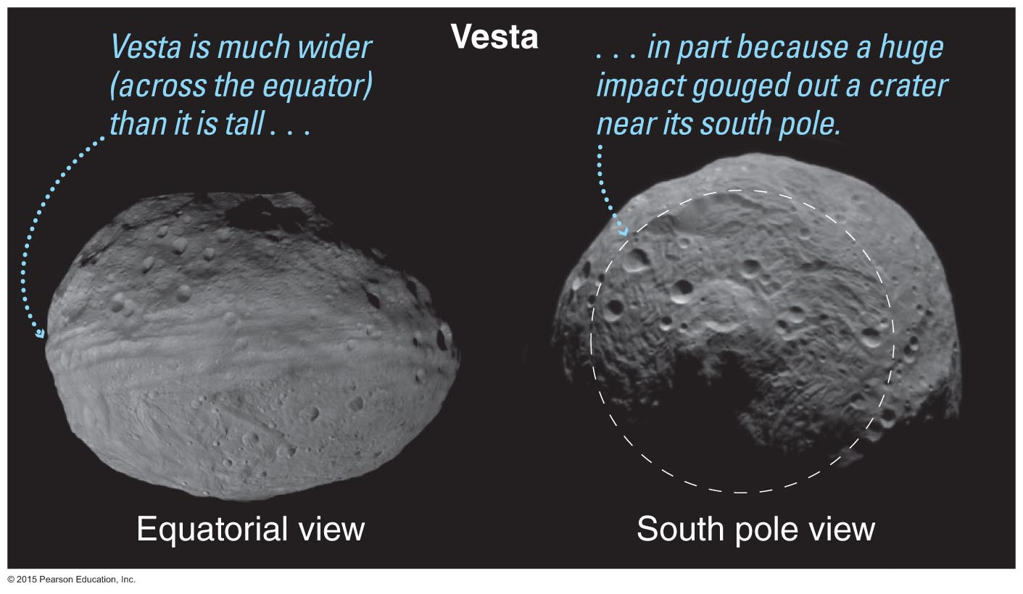
Vesta from Dawn

Slide 8
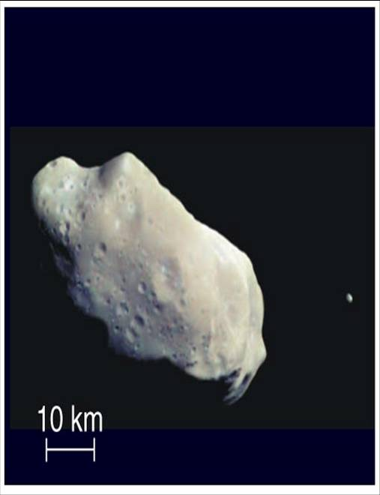
Asteroids with Moons
Some large asteroids have their own moons.
Asteroid Ida has a tiny moon named Dactyl.

Slide 9
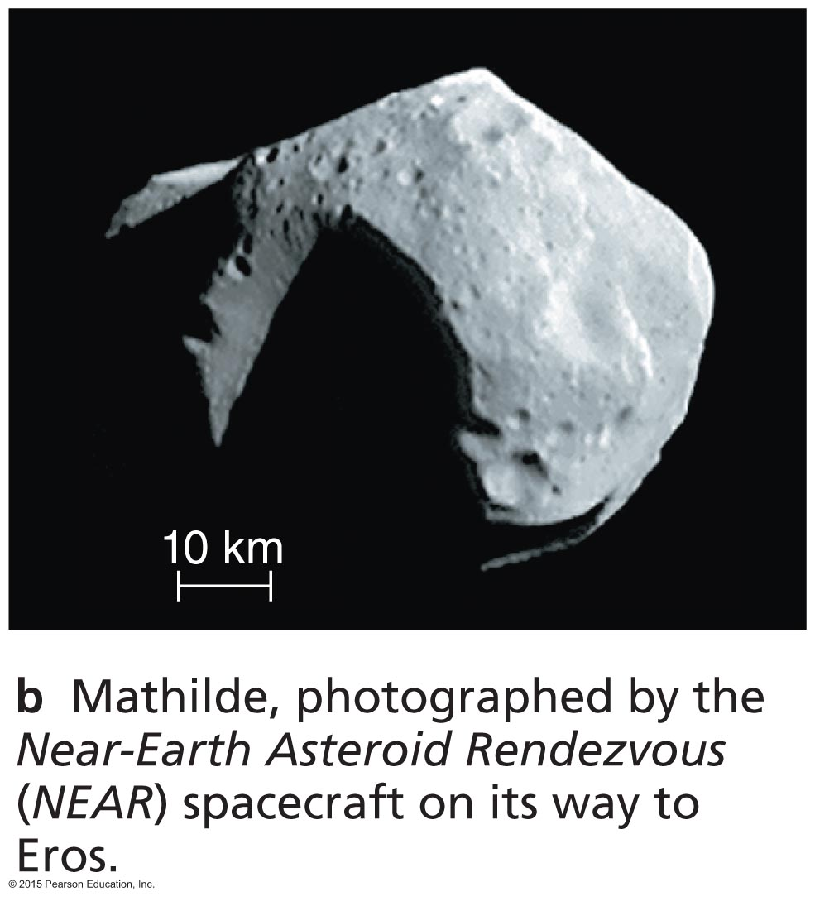
Why is there an asteroid belt?

Slide 10
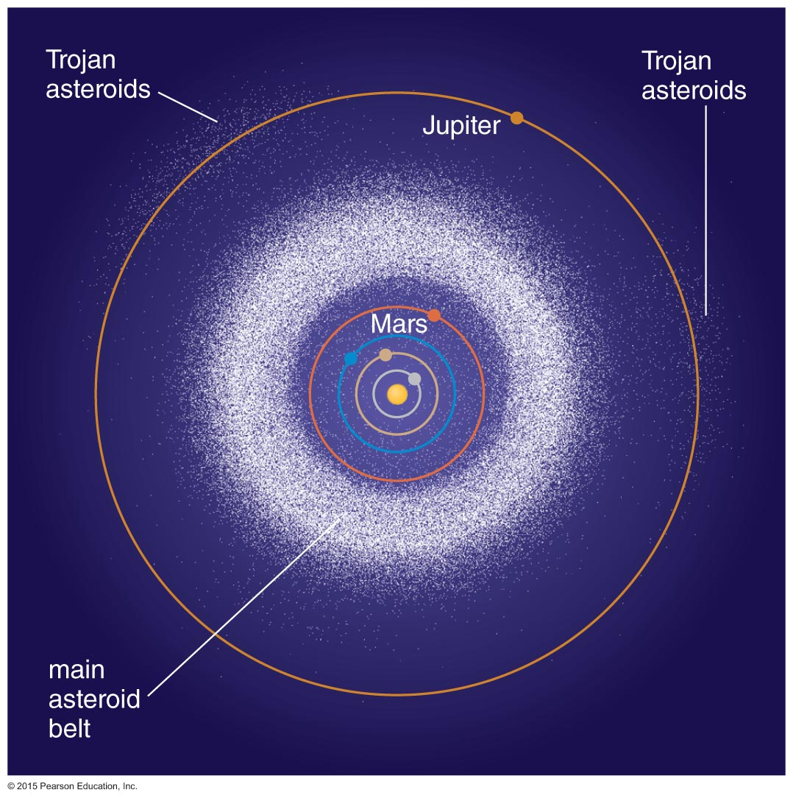
Asteroid Orbits
Most asteroids orbit in a belt between Mars and Jupiter.
Trojan asteroids follow Jupiter's orbit.
Orbits of near-Earth asteroids cross Earth's orbit.

Slide 11
Thought Question
Why are there very few asteroids beyond Jupiter's orbit?
There was no rocky material beyond Jupiter's orbit.
The heaviest rocks sank toward the center of the solar system.
Ice could form in the outer solar system.
A passing star probably stripped away all of those asteroids, even if they were there at one time.
Notes:
A: Rocky material condensed everywhere. B: The students often get confused by the differentiation ideas they've just heard about in planet formation. D: If a passing star ripped off asteroids, it would have stripped away comets and planets, too. (That may be one explanation for the truncation of the Kuiper belt…)

Slide 12
Thought Question
Why are there very few asteroids beyond Jupiter's orbit?
There was no rocky material beyond Jupiter's orbit.
The heaviest rocks sank toward the center of the solar system.
Ice could form in the outer solar system.
A passing star probably stripped away all of those asteroids, even if they were there at one time.

Slide 13
Thought Question
Which explanation for the asteroid belt seems the most plausible?
The belt is where all the asteroids happened to form.
The belt is the remnant of a large terrestrial planet that used to be between Mars and Jupiter.
The belt is where all the asteroids happened to survive.
Notes:
Discussion: A: Planetesimals formed EVERYWHERE in the solar system.
B: There's not enough mass in the asteroid belt to be the remnant of even a small terrestrial planet.

Slide 14
Thought Question
Which explanation for the asteroid belt seems the most plausible?
The belt is where all the asteroids happened to form.
The belt is the remnant of a large terrestrial planet that used to be between Mars and Jupiter.
The belt is where all the asteroids happened to survive.
But WHY didn't they form a little planet?

Slide 15
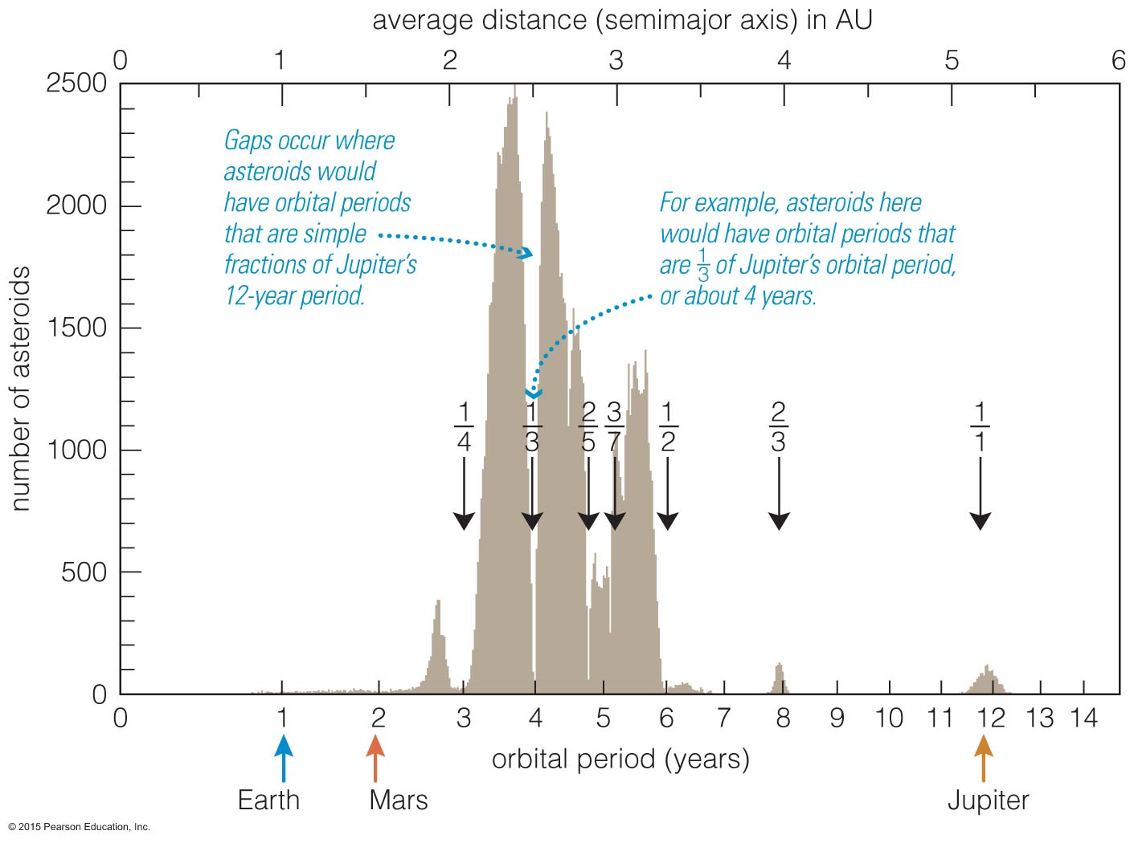
Orbital Resonances
Asteroids in orbital resonance with Jupiter experience periodic nudges.
Eventually those nudges move asteroids out of resonant orbits, leaving gaps in the belt.

Slide 16
Origin of Asteroid Belt
Rocky planetesimals between Mars and Jupiter did not accrete into a planet.
Jupiter's gravity, through influence of orbital resonances, stirred up asteroid orbits and prevented their accretion into a planet.

Slide 17
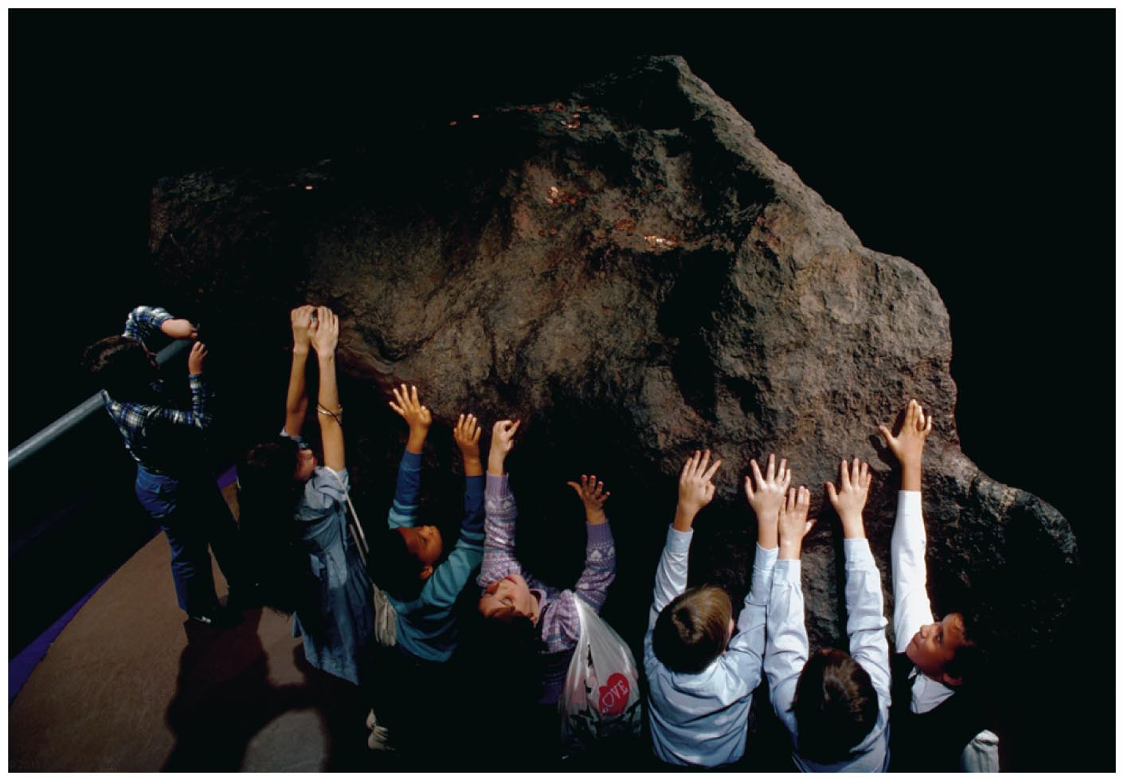
How are meteorites related to asteroids?

Slide 18
Origin of Meteorites
Most meteorites are pieces of asteroids.

Slide 19
Meteor Terminology
Meteorite: A rock from space that falls through Earth's atmosphere.
Meteor: The bright trail left by a meteorite.

Slide 20
Meteorite Types
Primitive: Unchanged in composition since they first formed 4.6 billion years ago
Processed: Younger, have experienced processes such as volcanism or differentiation

Slide 21
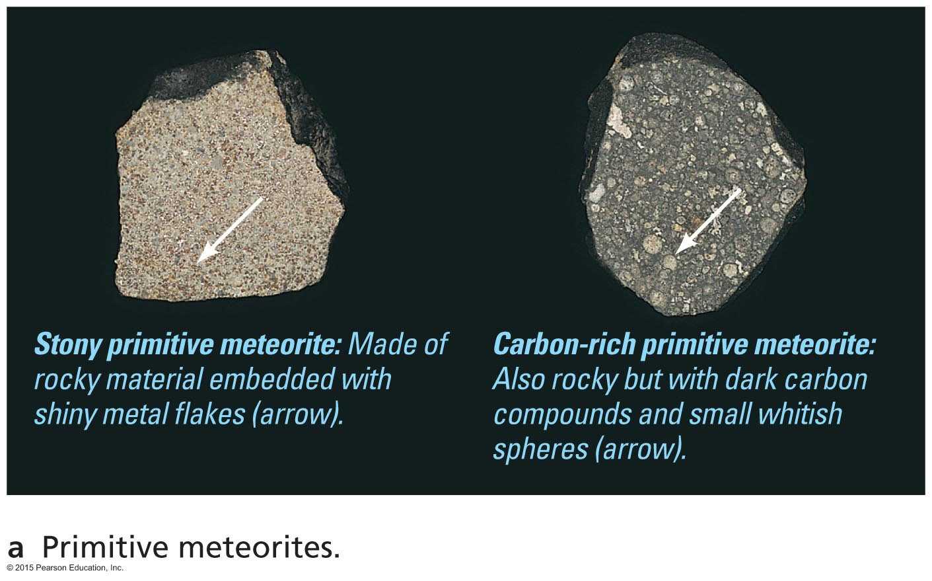
Primitive Meteorites
Notes:
Simple rocks and metal, occasionally carbon compounds and water.
Shiny bits are metal flakes, first to condense.
White features are solidified droplets of material that splashed out during impacts during accretion.

Slide 22
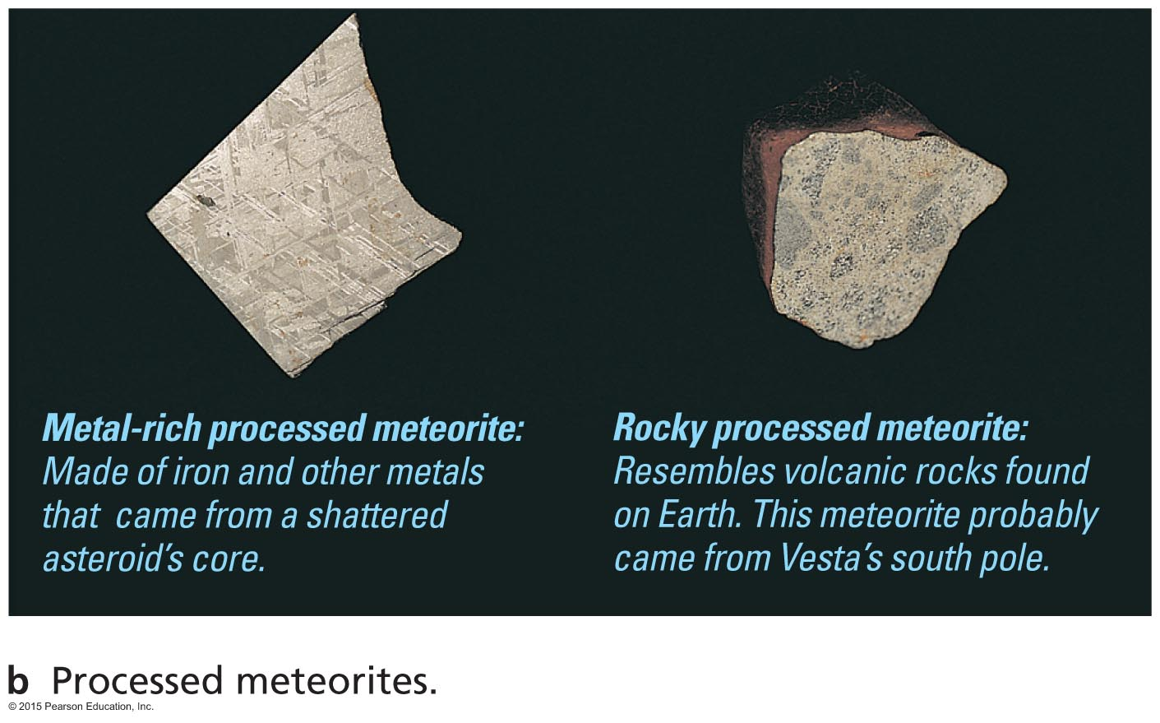
Processed Meteorites

Slide 23
Meteorites from the Moon and Mars
A few meteorites arrive on Earth from the Moon and Mars.
Composition differs from the asteroid fragments.
This is a cheap (but slow) way to acquire moon rocks and Mars rocks.

Slide 24
What have we learned?
What are asteroids like?
Asteroids are rocky leftovers from the era of planet formation.
Why is there an asteroid belt?
Orbital resonances with Jupiter prevented rocky planetesimals between Jupiter and Mars from forming a planet.

Slide 25
What have we learned?
How are meteorites related to asteroids?
Most meteorites are pieces of asteroids.
Primitive meteorites are remnants from solar nebula.
Processed meteorites are fragments of larger bodies that underwent differentiation.

Slide 26
9.2 Comets
Our goals for learning:
How do comets get their tails?
Where do comets come from?

Slide 27
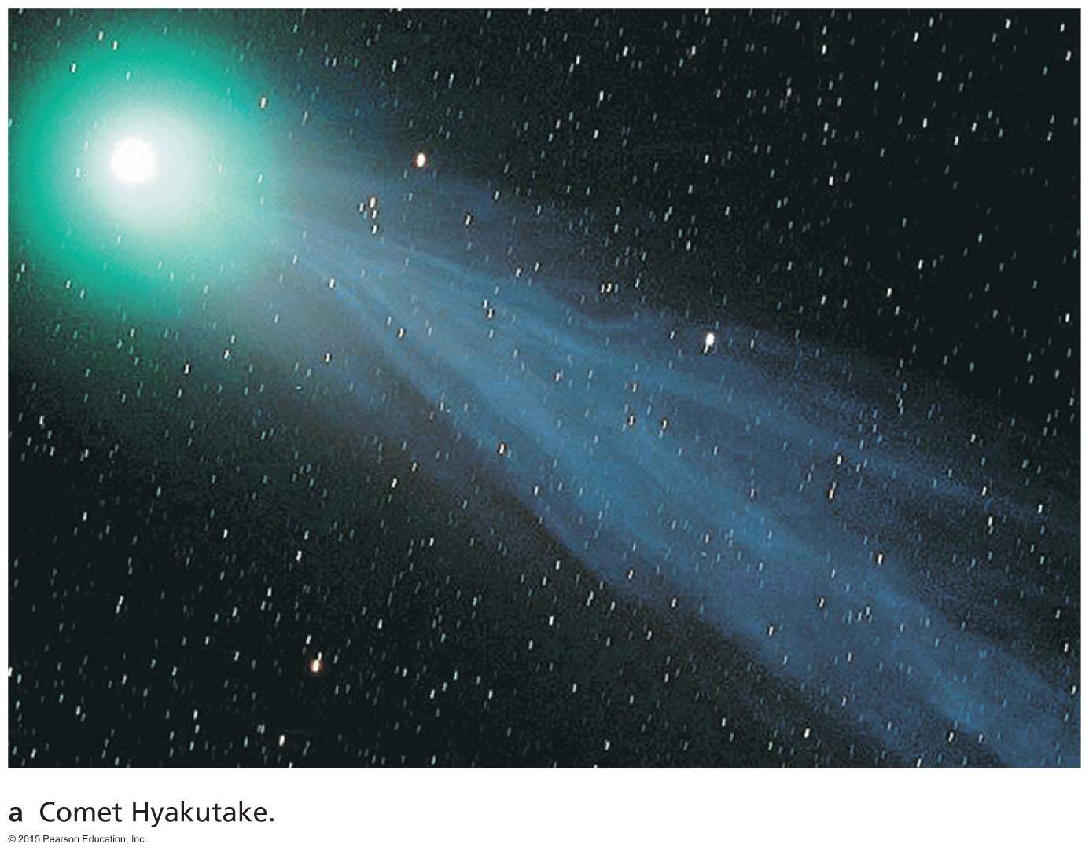
How do comets get their tails?

Slide 28
Comet Facts
Formed beyond the frost line, comets are icy counterparts to asteroids.
The nucleus of a comet is like a "dirty snowball."
Most comets do not have tails.
Most comets remain perpetually frozen in the outer solar system.
Only comets that enter the inner solar system grow tails.

Slide 29
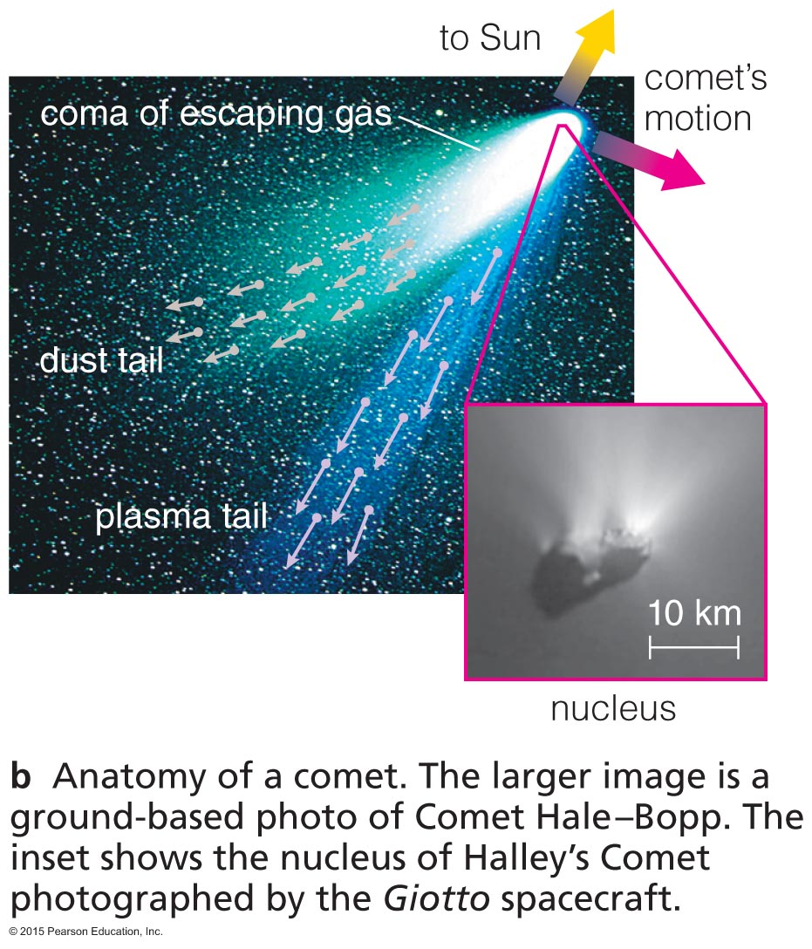
Nucleus of Comet
A "dirty snowball”
Source of material for comet's tail

Slide 30
Anatomy of a Comet
Coma is atmosphere that comes from heated nucleus.
Plasma tail is gas escaping from coma, pushed by solar wind.
Dust tail is pushed by photons.

Slide 31
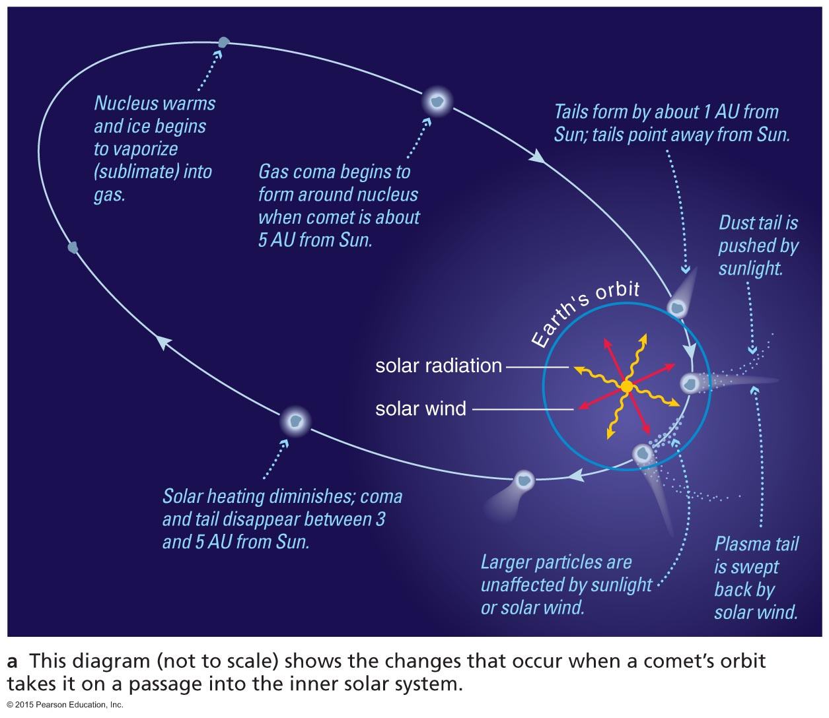
Growth of Tail

Slide 32
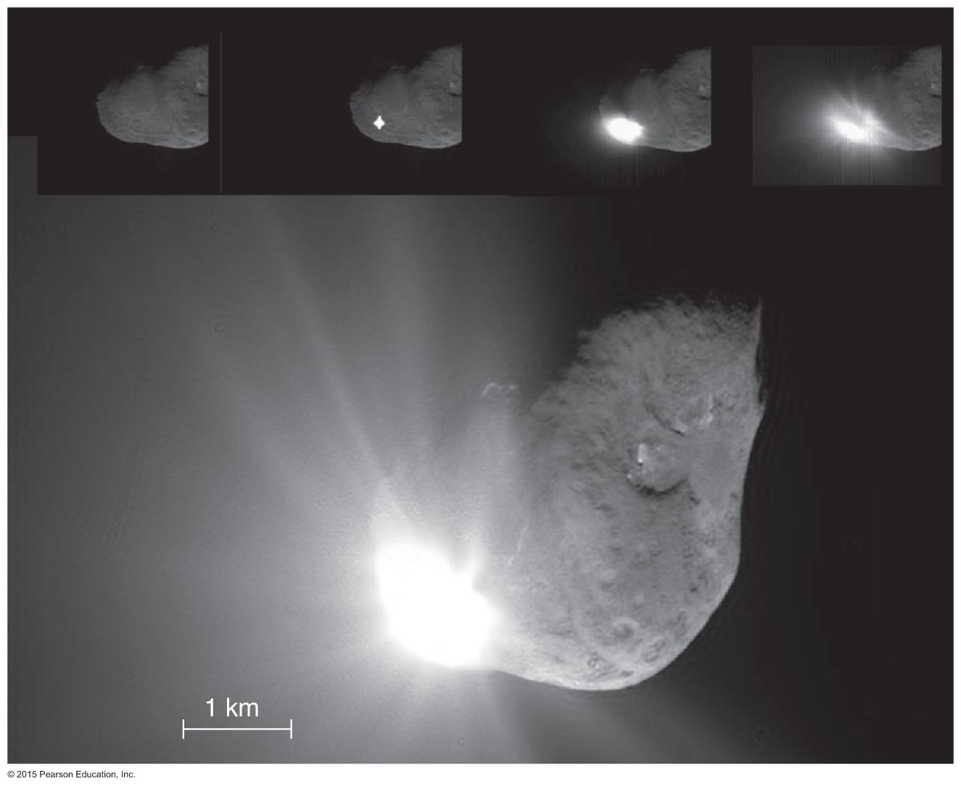
Deep Impact
Mission to study nucleus of Comet Tempel 1
Projectile hit surface on July 4, 2005.
Many telescopes studied aftermath of impact.

Slide 33
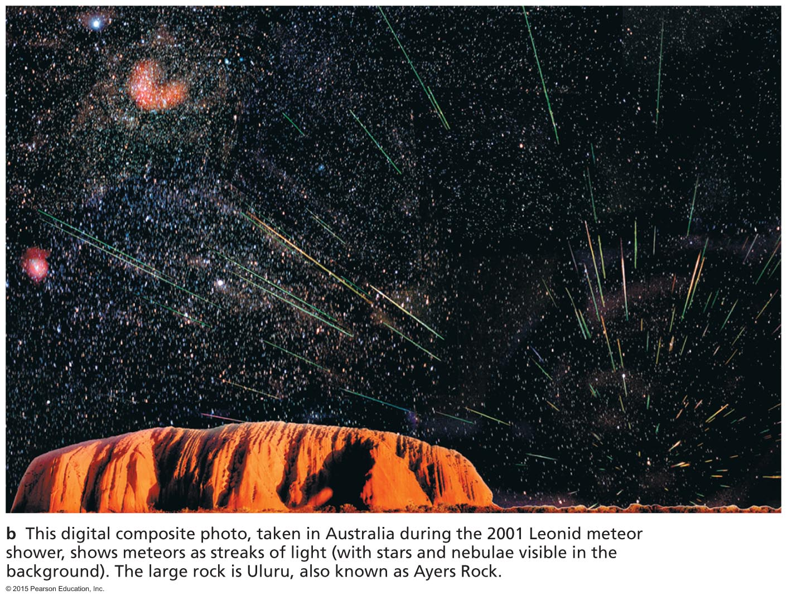
Comets eject small particles that follow the comet around in its orbit and cause meteor showers when Earth crosses the comet's orbit.

Slide 34
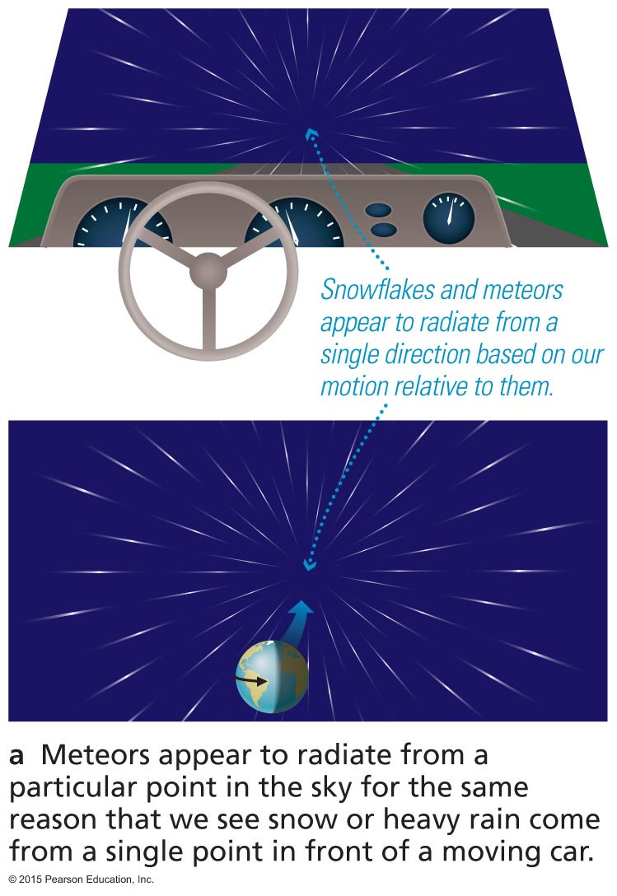
Meteors in a shower appear to emanate from the same area of sky because of Earth's motion through space.

Slide 35
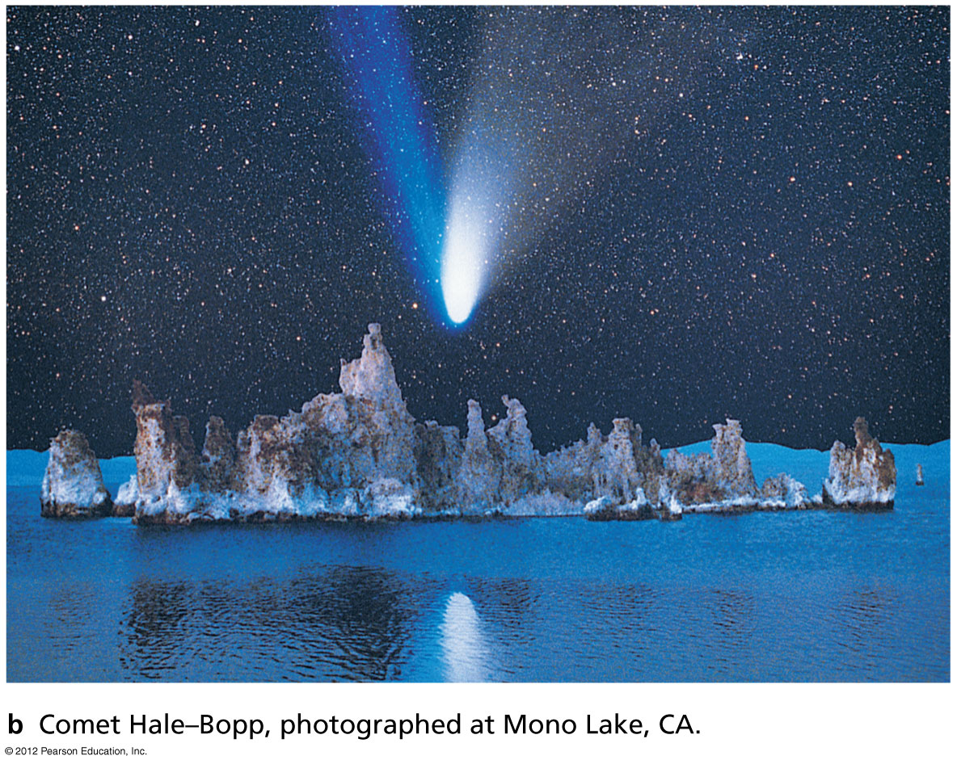
Where do comets come from?

Slide 36
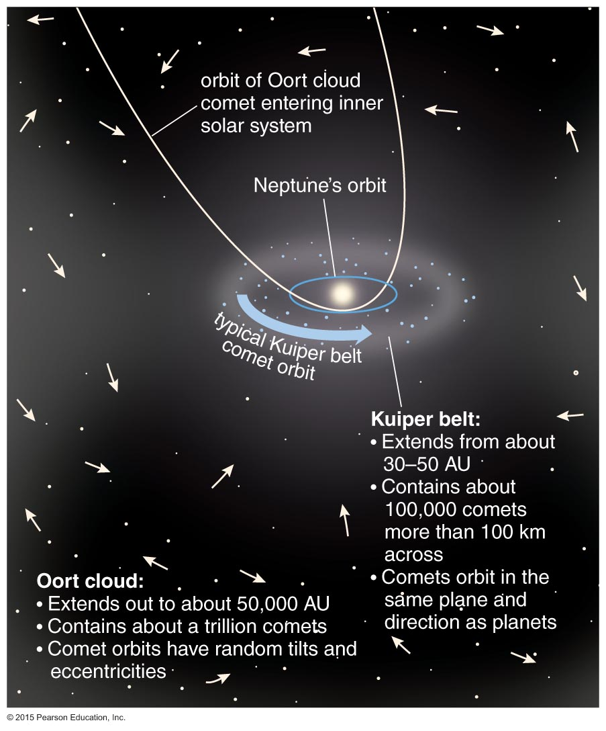
Only a tiny number of comets enter the inner solar system; most stay far from the Sun.
Oort Cloud: Comets on random orbits extending to about 50,000 AU
Kuiper Belt: Comets on orderly orbits at 30-100 AU in disk of solar system

Slide 37
How did they get there?
Kuiper Belt comets formed in the Kuiper Belt.
Flat plane aligned with the plane of planetary orbits
Orbiting in the same direction as the planets
Oort Cloud comets were once closer to the Sun, but they were kicked farther out by gravitational interactions with jovian planets.
Spherical distribution
Orbiting in any direction

Slide 38
What have we learned?
How do comets get their tails?
Comets are like dirty snowballs.
Most are far from the Sun and do not have tails.
Tails grow when comet nears the Sun and nucleus heats up.
Where do comets come from?
Comets in plane of solar system come from Kuiper Belt.
Comets on random orbits come from Oort Cloud.

Slide 39
9.3 Pluto: Lone Dog No More
Our goals for learning:
How big can a comet be?
What are Pluto and other large objects of the Kuiper Belt like?

Slide 40
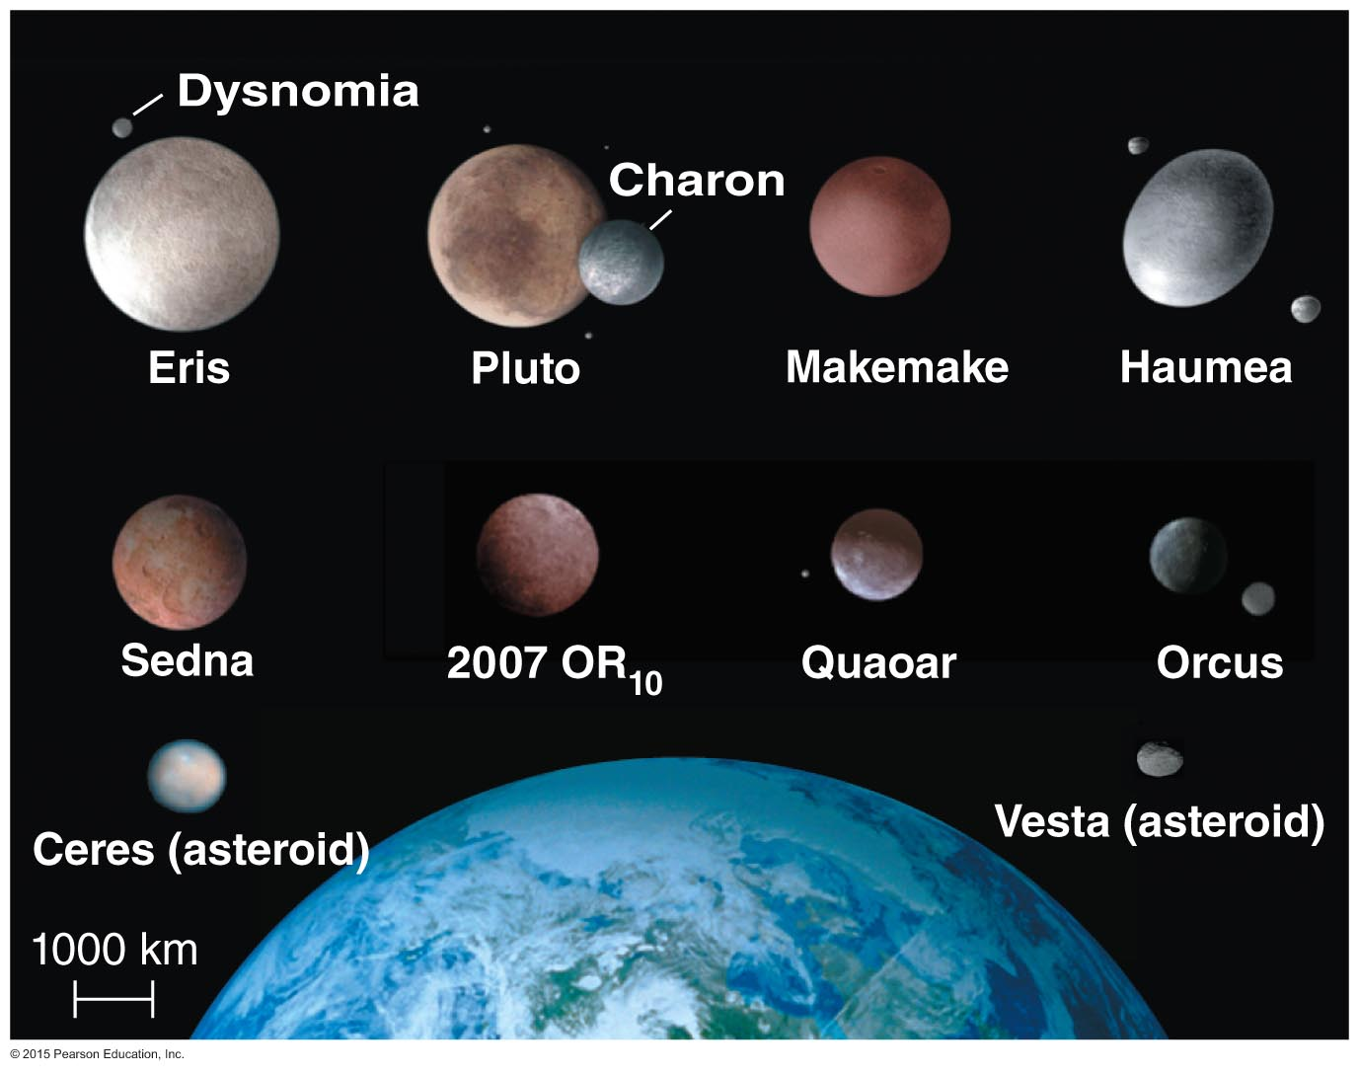
How big can a comet be?

Slide 41
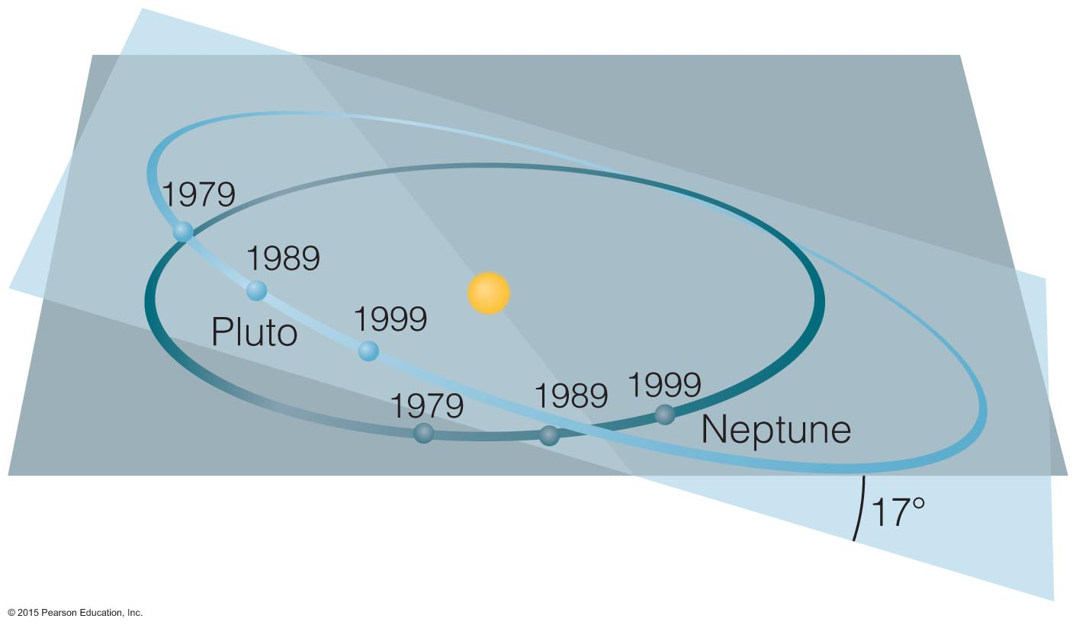
Pluto's Orbit
Pluto's orbit is tilted and significantly elliptical.
Neptune orbits three times during the time Pluto orbits twice—resonance prevents a collision.

Slide 42
Is Pluto a planet?
Much smaller than the eight major planets
Not a gas giant like the outer planets
Has an icy composition like a comet
Has a very elliptical, inclined orbit
Pluto has more in common with comets than with the eight major planets.

Slide 43
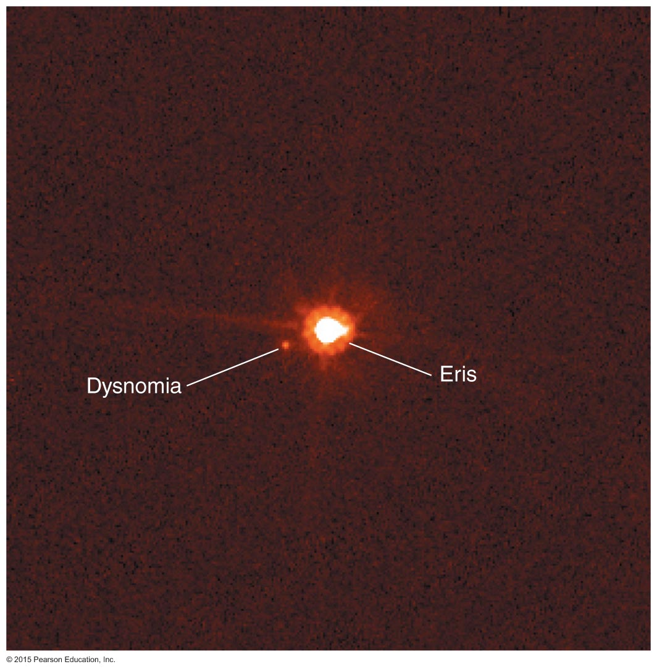
Discovering Large Iceballs
In summer 2005, astronomers discovered Eris, an iceball even larger than Pluto.
Eris even has a moon: Dysnomia.

Slide 44
Other Icy Bodies
There are many icy objects like Pluto on elliptical, inclined orbits beyond Neptune.
The largest ones are comparable in size to Earth's Moon.

Slide 45
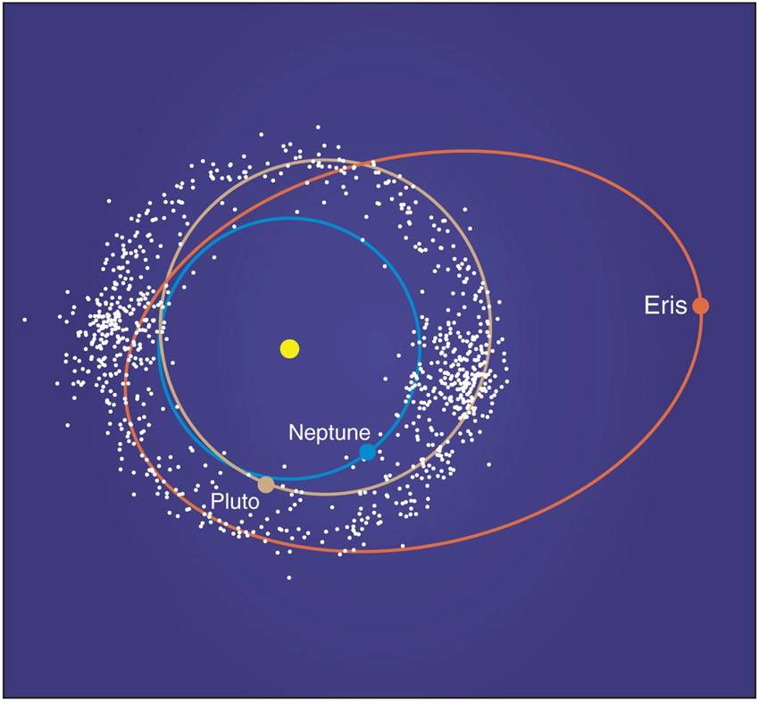
Kuiper Belt Objects
These large, icy objects have orbits similar to the smaller objects in the Kuiper Belt that become short period comets.
So are they very large comets or very small planets?

Slide 46
Is Pluto a planet?
In 2006, the International Astronomical Union decided to call Pluto and objects like it "dwarf planets."

Slide 47
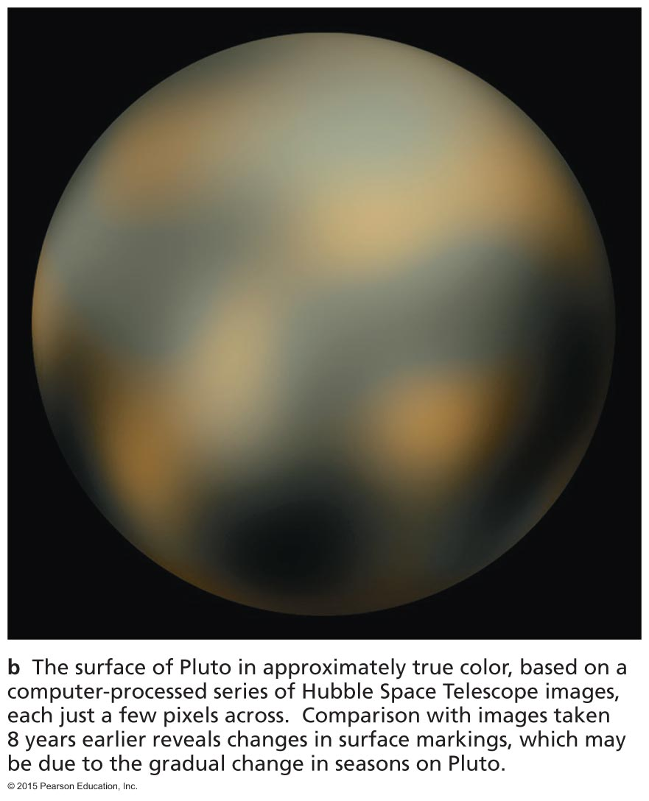
What are Pluto and other large objects of the Kuiper Belt like?

Slide 48
What is Pluto like?
Its largest moon, Charon, is nearly as large as Pluto itself (probably made by a major impact).
Pluto is very cold (40 K).
Pluto has a thin nitrogen atmosphere that refreezes onto the surface as Pluto's orbit takes it farther from the Sun.

Slide 49
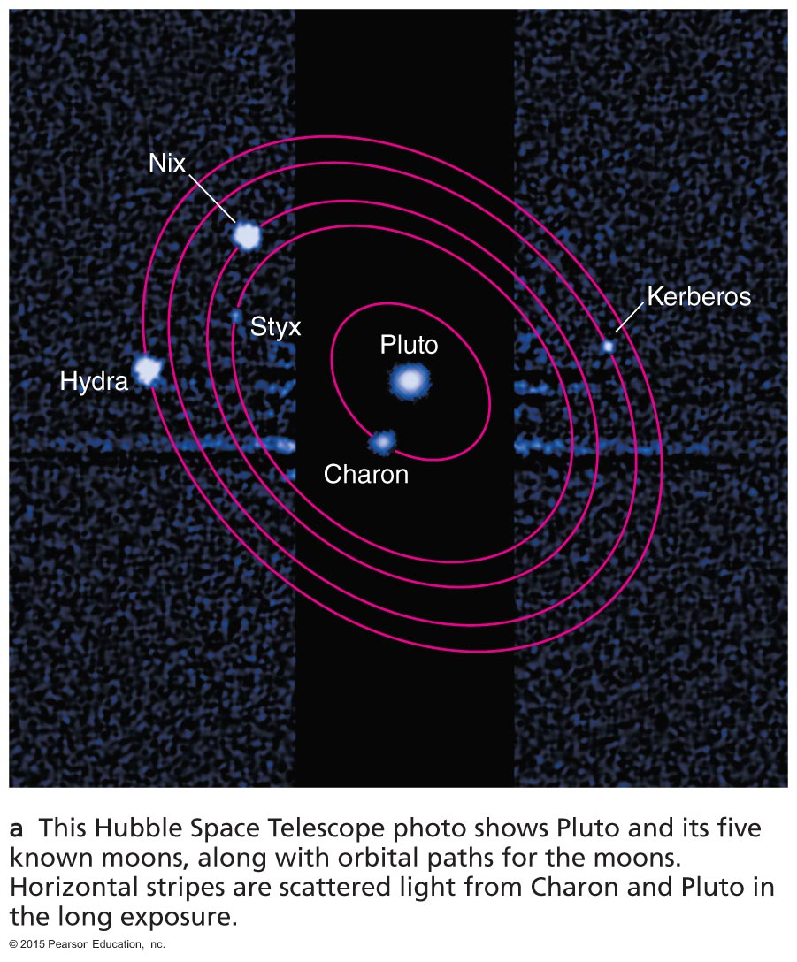
HST's View of Pluto and Its Moons

Slide 50
Other Kuiper Belt Objects
Most have been discovered very recently so little is known about them.
NASA's New Horizons mission will study Pluto in a planned flyby and will attempt to visit a few other Kuiper Belt Objects.

Slide 51
What have we learned?
How big can a comet be?
The Kuiper Belt from which comets come contains objects as large as Pluto.
Pluto and other "dwarf planets" are more like large comets than like major planets.
What are Pluto and other large objects of the Kuiper Belt like?
Large objects in the Kuiper Belt have tilted, elliptical orbits and icy compositions like those of comets.

Slide 52
9.4 Cosmic Collisions: Impacts on Earth
Our goals for learning:
Did an impact kill the dinosaurs?
How great is the impact risk?
How do jovian planets affect impact rates and life on Earth?

Slide 53
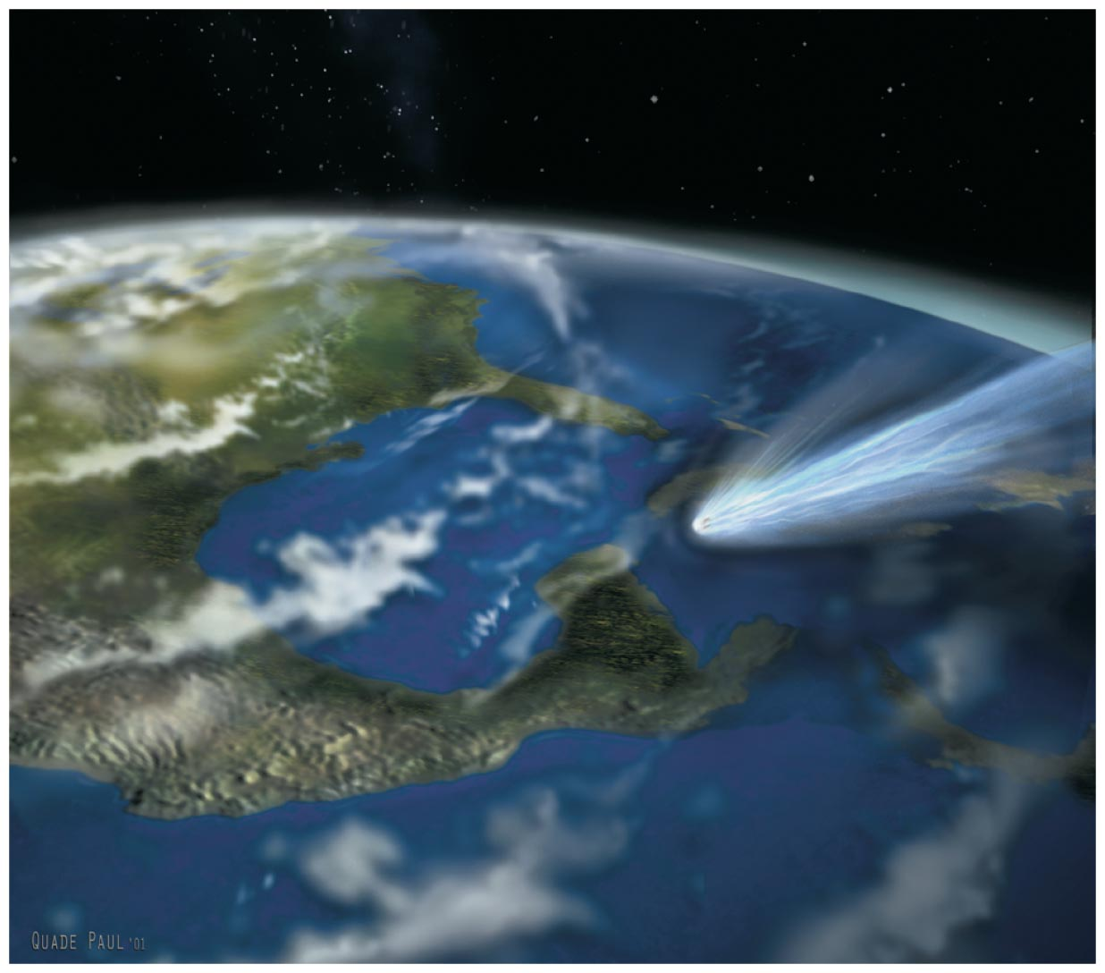
Did an impact kill the dinosaurs?

Slide 54
Major Impacts
Small objects impact all of the planets every day
Evidence suggests larger impacts are also still occurring, such as the impact of comet Shoemaker-Levy 9 into Jupiter in 1994.

Slide 55
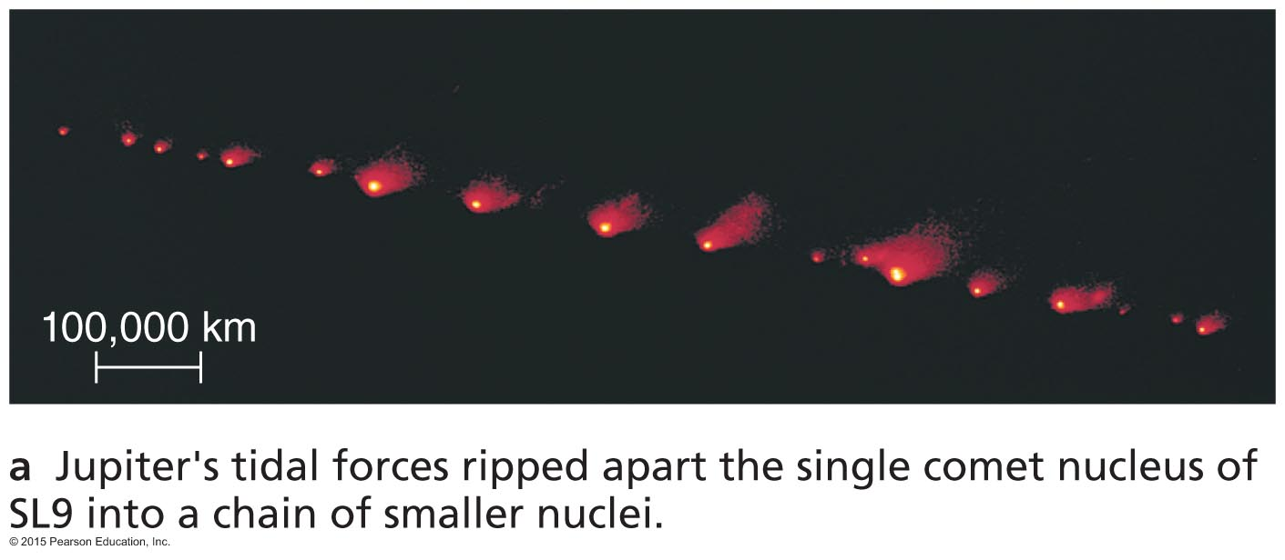
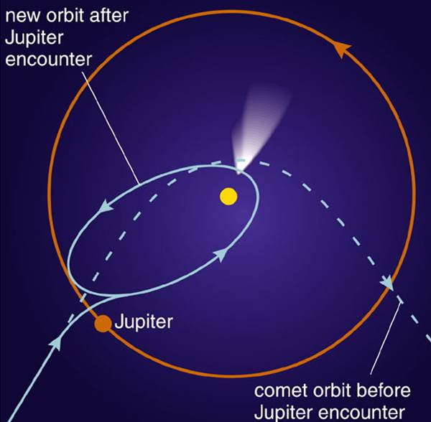
Comet SL9 caused a string of violent impacts on Jupiter in 1994, reminding us that catastrophic collisions still happen.
Tidal forces tore it apart during a previous encounter with Jupiter.

Slide 56
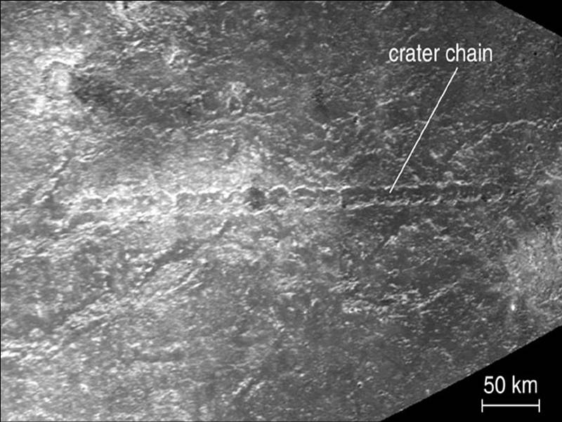
This crater chain on Callisto probably came from another comet that tidal forces tore to pieces.

Slide 57
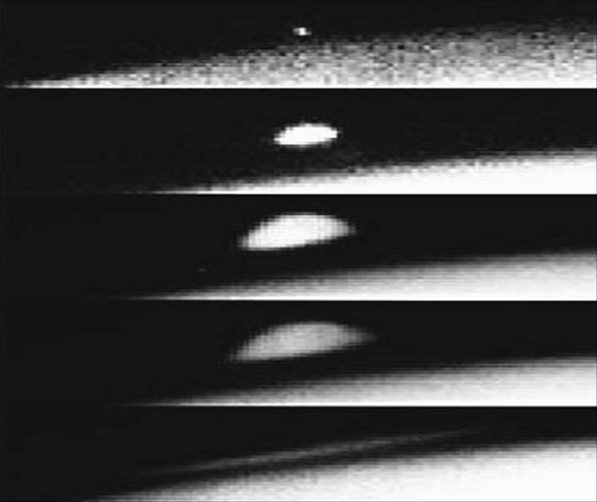
Impact plume from a fragment of comet SL9 rises high above Jupiter's surface.

Slide 58
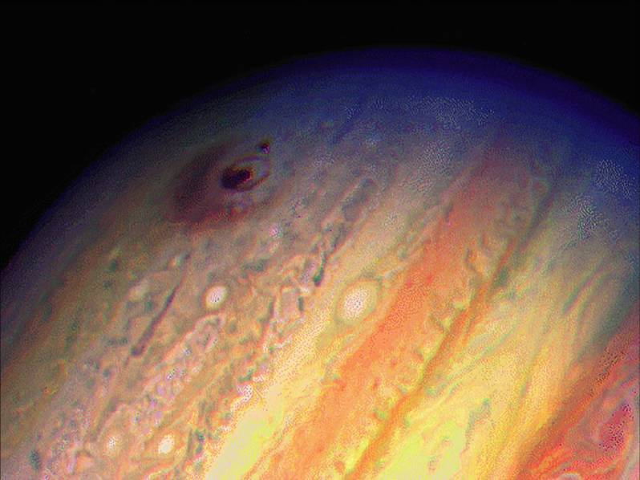
Dusty debris at an impact site

Slide 59
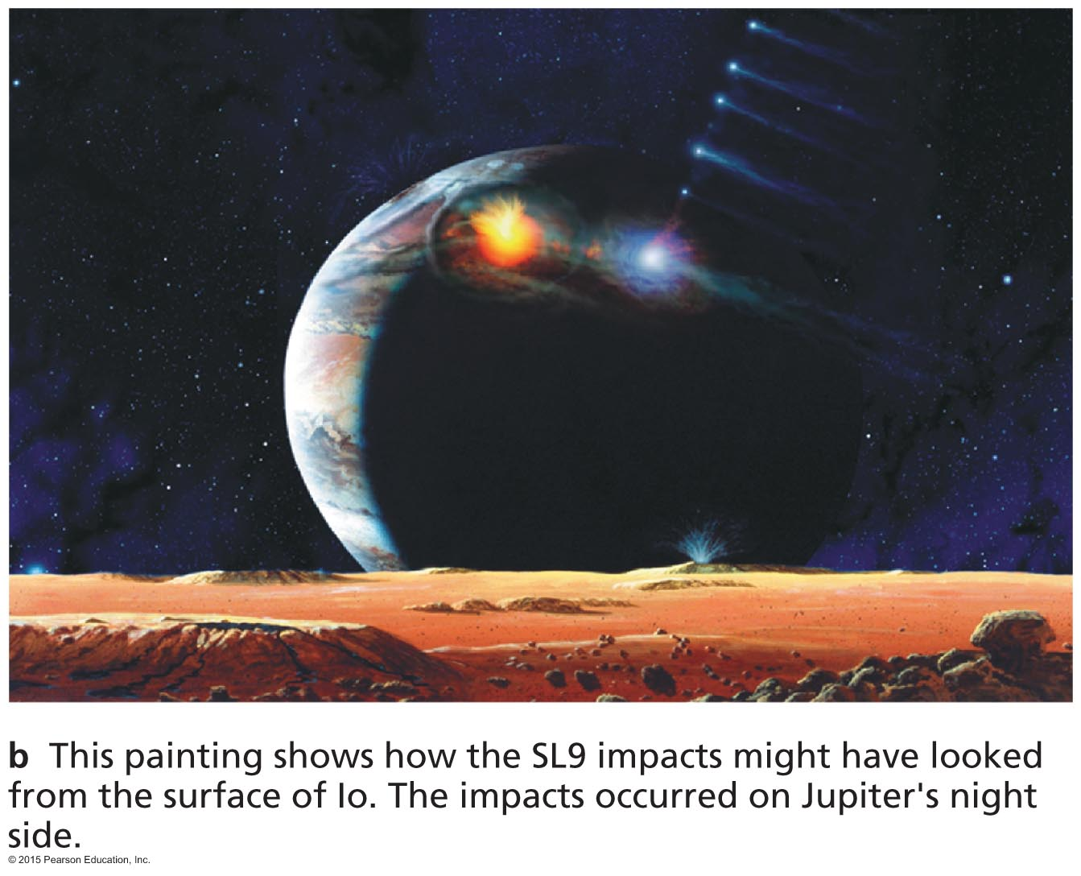
Artist's conception of SL9 impact

Slide 60
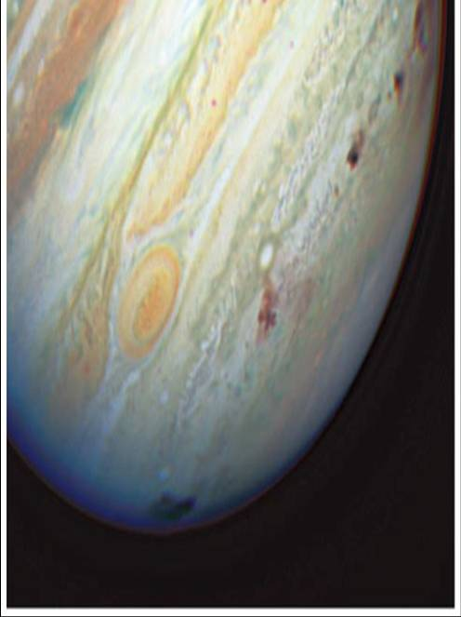
Several impact sites

Slide 61
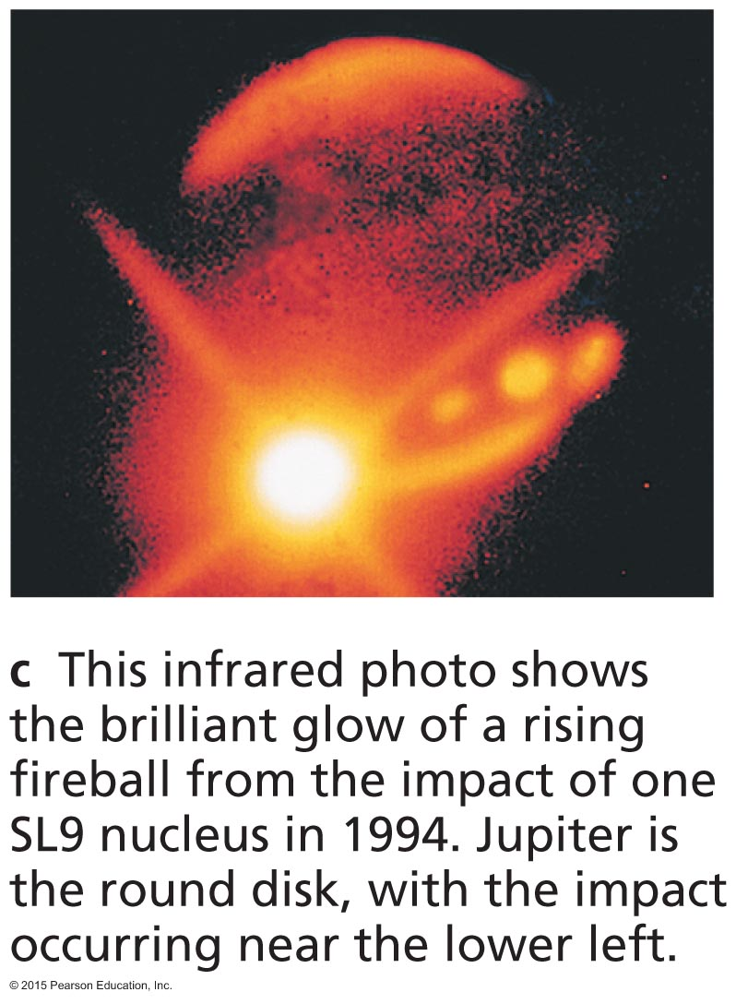
Impact sites in infrared light

Slide 62
Mass Extinctions
Fossil record shows occasional large dips in the diversity of species: mass extinctions.
The most recent was 65 million years ago, ending the reign of the dinosaurs.

Slide 63
Iridium: Evidence of an Impact
Iridium is very rare in Earth surface rocks but is often found in meteorites.
Luis and Walter Alvarez found a worldwide layer containing iridium, laid down 65 million years ago, probably by a meteorite impact.
Dinosaur fossils all lie below this layer.

Slide 64
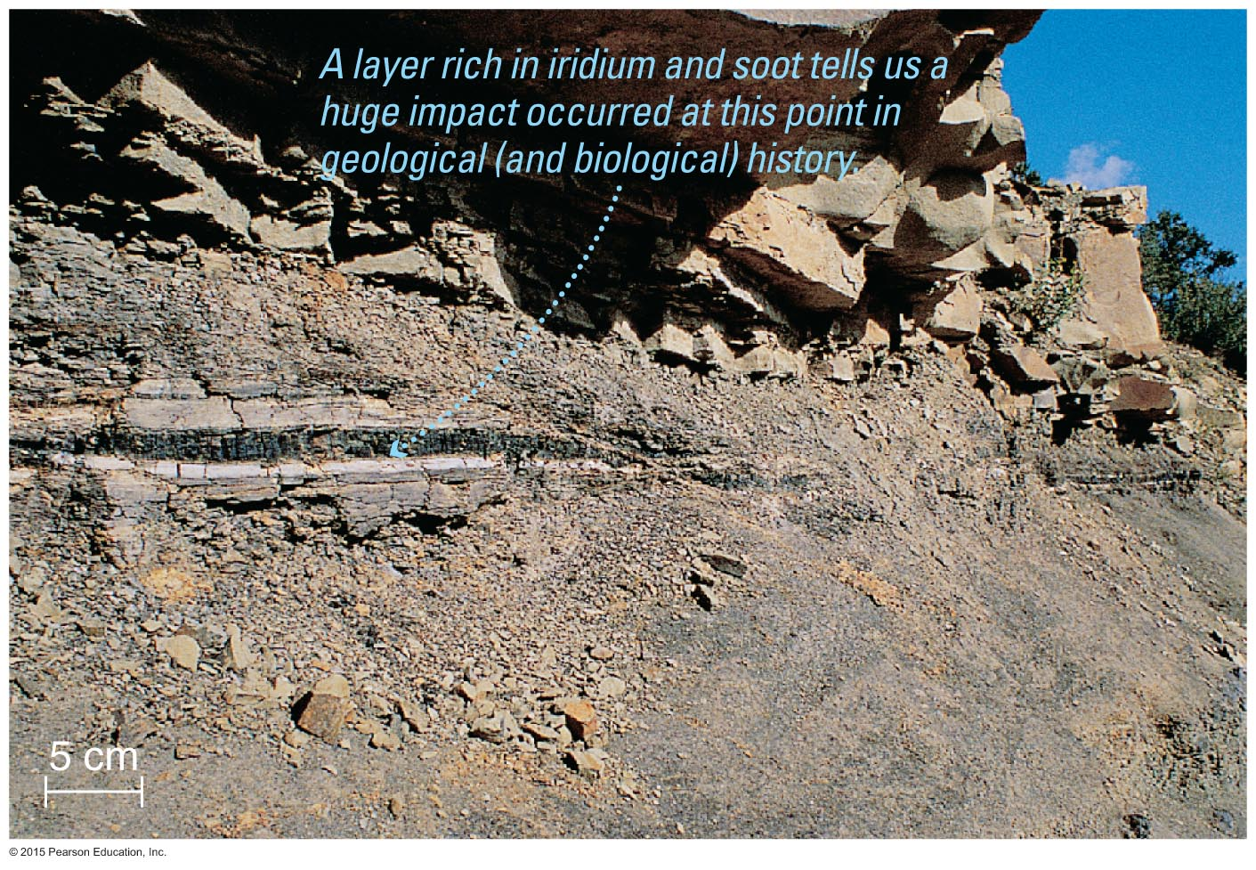
Iridium Layer
No dinosaur fossils in upper rock layers
Thin layer containing the rare element iridium
Dinosaur fossils in lower rock layers

Slide 65
Consequences of an Impact
A meteorite 10 km in size would send large amounts of debris into the atmosphere.
Debris would reduce the amount of sunlight reaching Earth's surface.
The resulting climate change may have caused mass extinction.

Slide 66
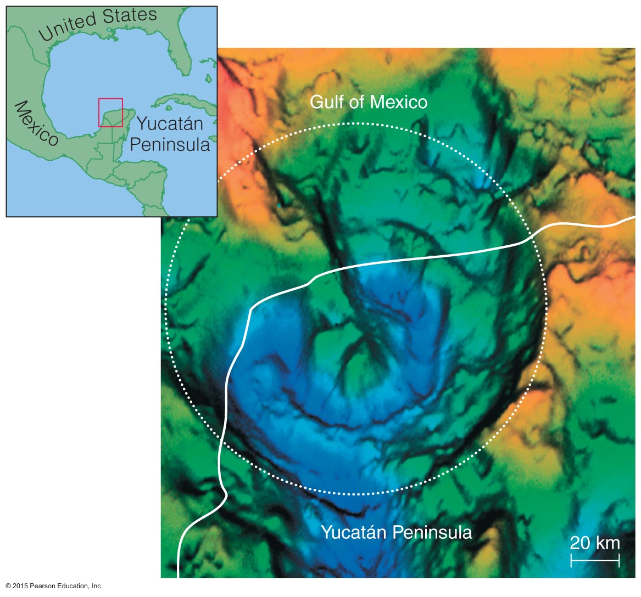
Likely Impact Site
Geologists found a large subsurface crater about 65 million years old in Mexico.

Slide 67
Comet or asteroid about 10 km in diameter approaches Earth.

Slide 68
Likely Impact Site
Size of crater suggests impacting object was ~10 km in diameter.
Impact of such a large object would have ejected debris high into Earth's atmosphere.

Slide 69
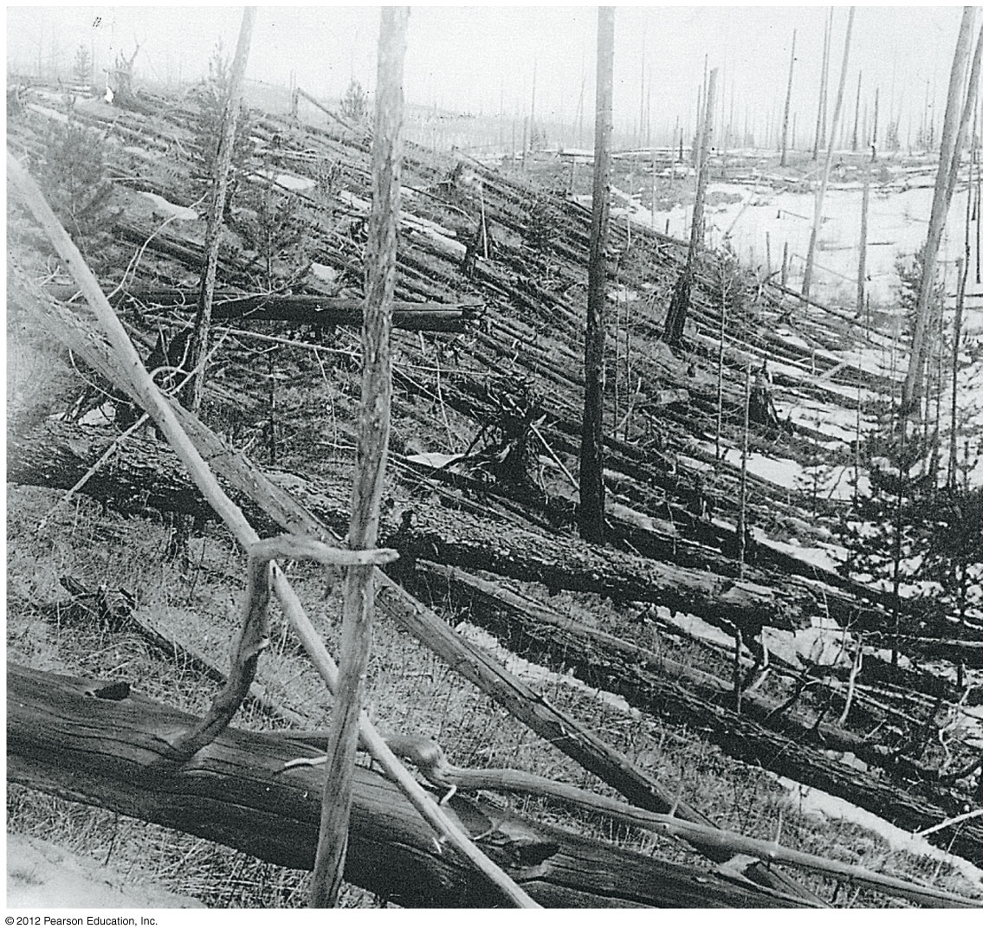
How great is the impact risk?

Slide 70
Facts About Impacts
Asteroids and comets have hit Earth.
A major impact is only a matter of time: not IF but WHEN.
Major impacts are very rare.
Extinction level events ~ millions of years
Major damage ~ tens to hundreds of years

Slide 71
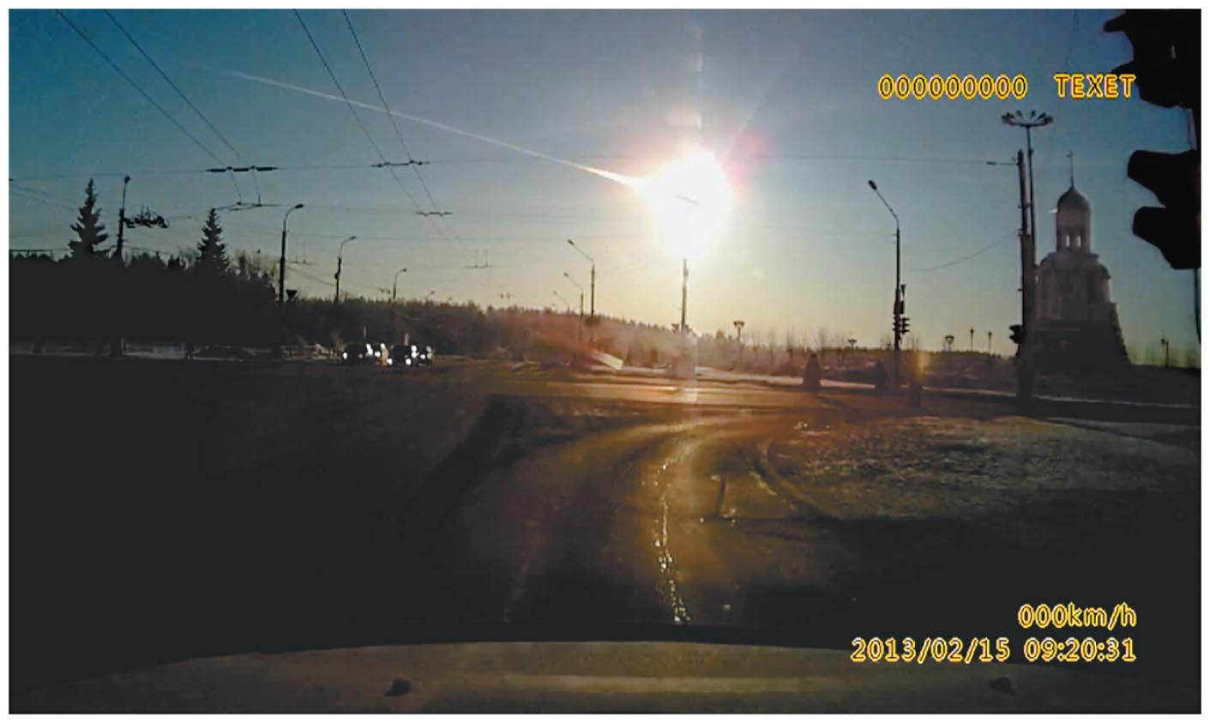
An asteroid detonates in the sky above Chelyabinsk, Russia in February 2013, releasing energy equivalent to a 500 kiloton nuclear bomb.

Slide 72
Tunguska, Siberia: June 30,1908 A ~40-meter object disintegrated and exploded in the atmosphere.
Notes:
Several atomic bombs' worth of energy.

Slide 73
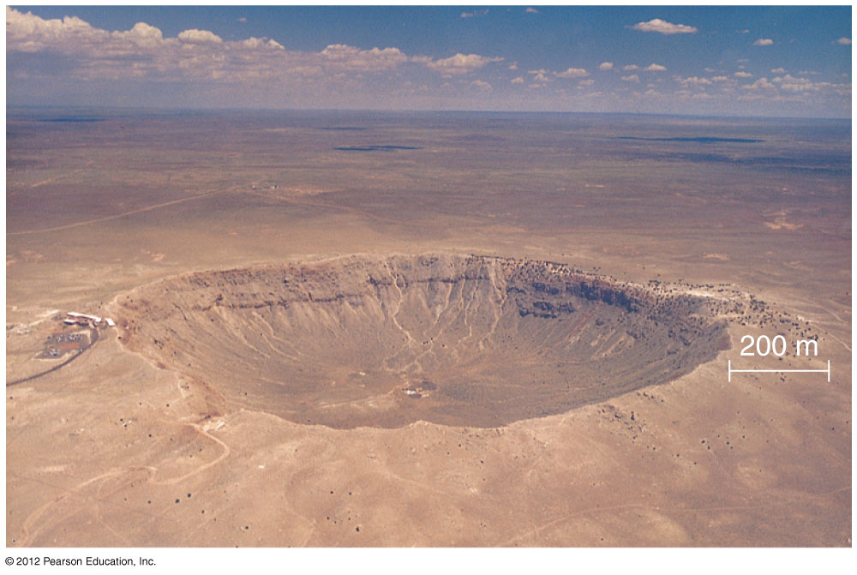
Meteor Crater, Arizona: 50,000 years ago (50-meter object)
Notes:
Crater is 1 km in diameter.
Impact was 20 megatons.
Privately owned National Landmark.

Slide 74
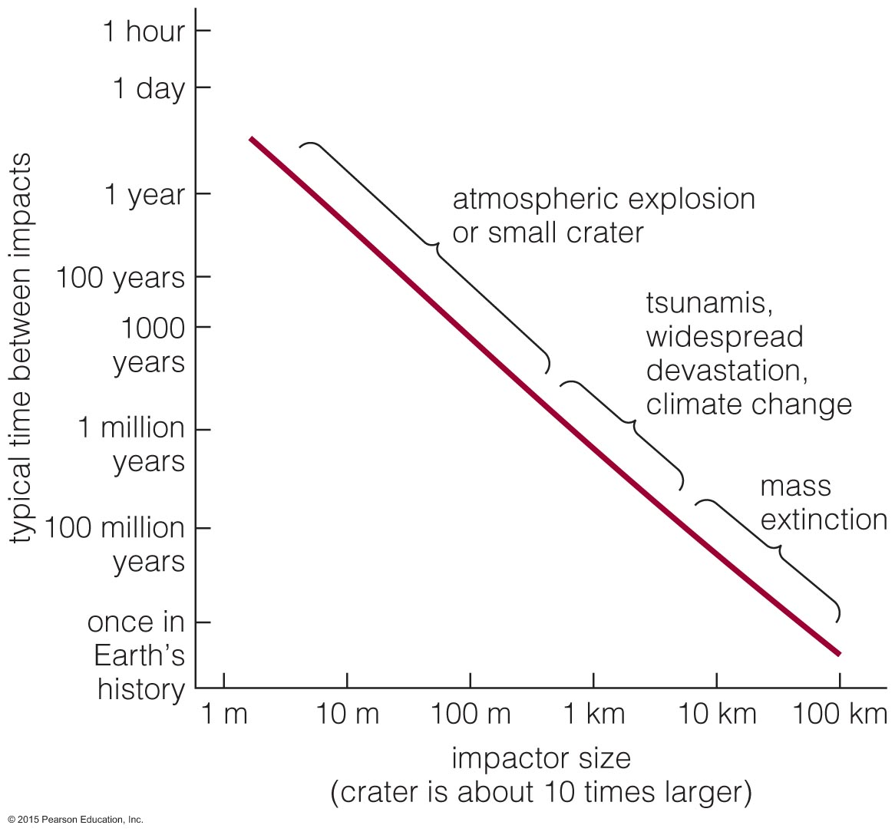
Frequency of Impacts
Small impacts happen almost daily.
Impacts large enough to cause mass extinctions are many millions of years apart.

Slide 75
The Asteroid with Our Name on It
We haven't seen it yet.
Deflection is more probable with years of advance warning.
Control is critical: Breaking a big asteroid into a bunch of little asteroids is unlikely to help.
We get less advance warning of a killer comet.

Slide 76
What are we doing about it?
Stay tuned to http://impact.arc.nasa.gov

Slide 77
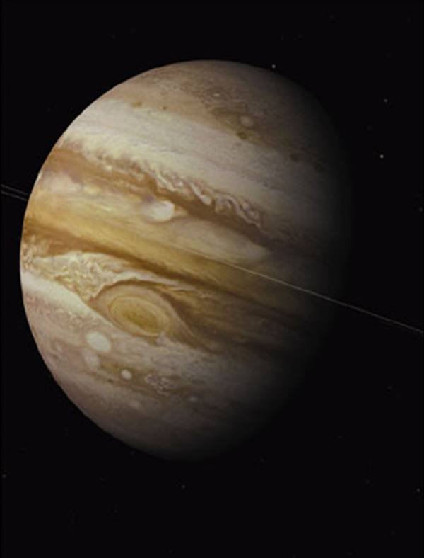
How do jovian planets affect impact rates and life on Earth?

Slide 78
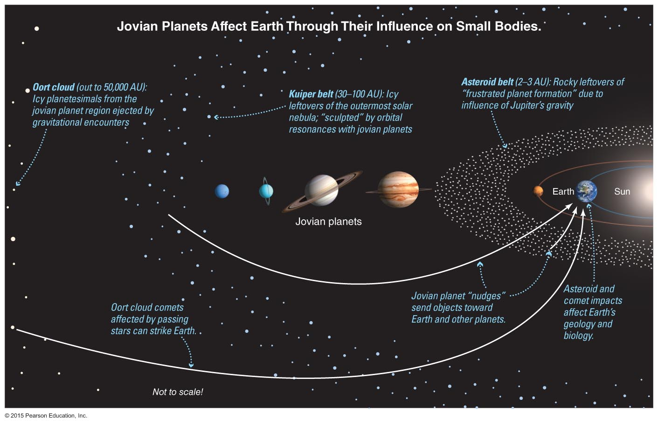
Influence of Jovian Planets
The gravity of a jovian planet (especially Jupiter) can redirect a comet.

Slide 79
Influence of Jovian Planets
Jupiter has directed some comets toward Earth but has ejected many more into the Oort Cloud.

Slide 80
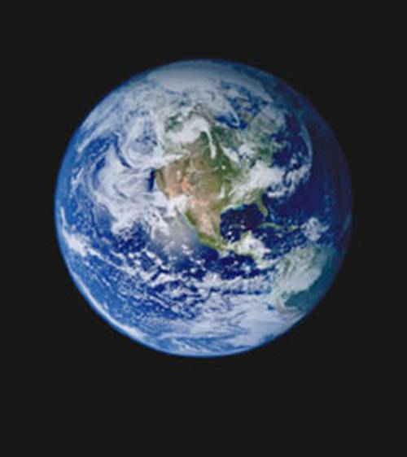
Was Jupiter necessary for life on Earth?
Impacts can extinguish life.
But were they necessary for "life as we know it"?

Slide 81
What have we learned?
Did an impact kill the dinosaurs?
An iridium layer just above dinosaur fossils suggests that an impact caused mass extinction 65 million years ago.
A large crater of that age has been found in Mexico.

Slide 82
What have we learned?
How great is the impact risk?
Large impacts do happen, but they are rare.
They can cause major extinctions about every 100 million years.
How do jovian planets affect impact rates and life on Earth?
Jovian planets sometimes deflect comets toward Earth but send many more out to the Oort Cloud.

