Slide 1
Chapter 12: Surveying the Stars

Slide 2
12.1 Properties of Stars
Our goals for learning:
How do we measure stellar luminosities?
How do we measure stellar temperatures?
How do we measure stellar masses?

Slide 3
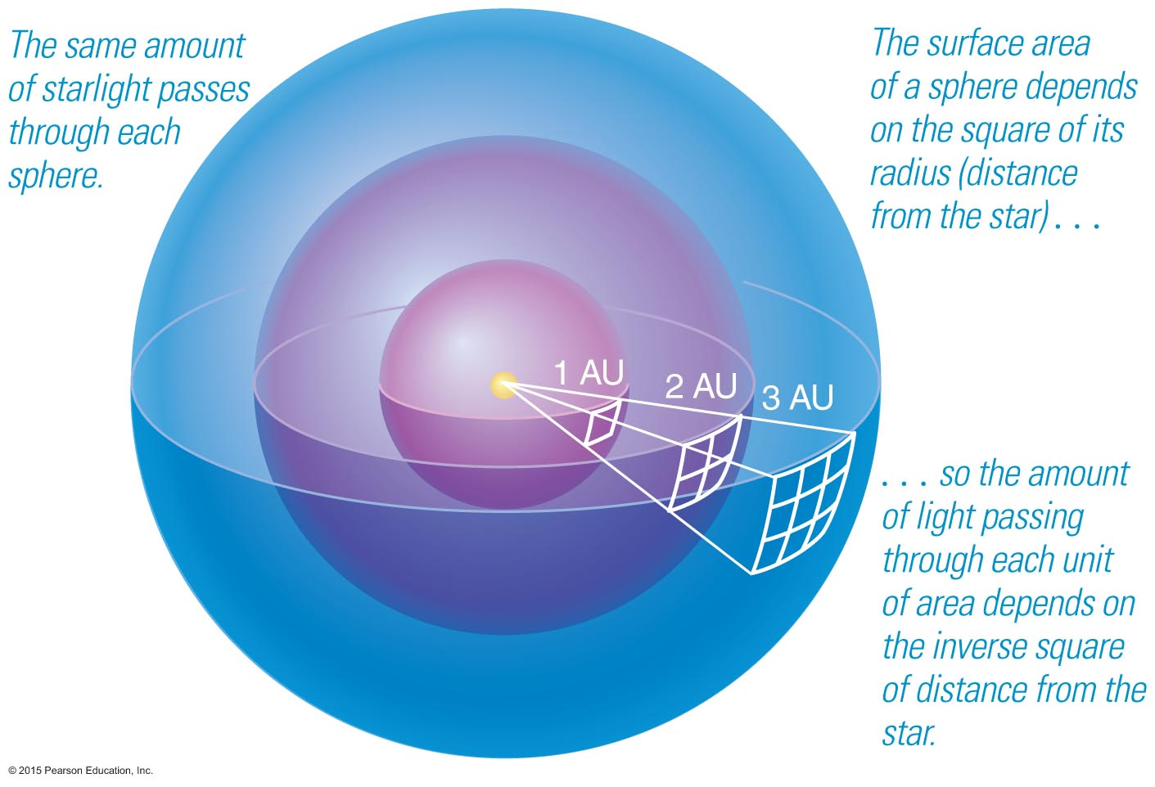
How do we measure stellar luminosities?

Slide 4
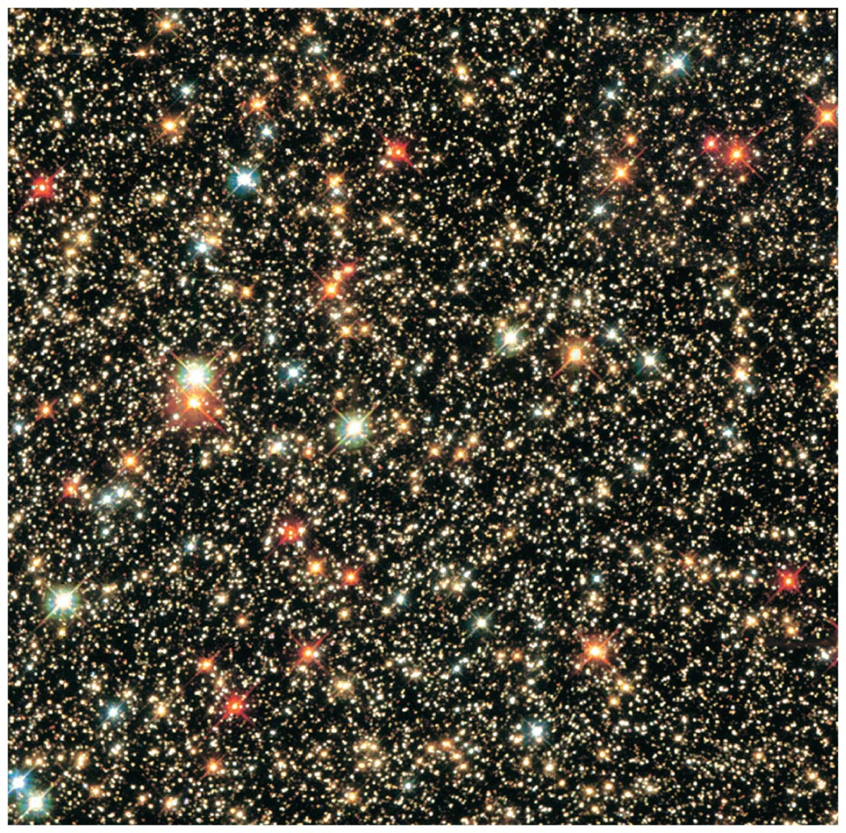
Brightness of a star depends on both distance and luminosity.

Slide 5
Luminosity:
Amount of power a star radiates (energy per second = watts)
Apparent brightness:
Amount of starlight that reaches Earth (energy per second per square meter)

Slide 6
Thought Question
These two stars have about the same luminosity— which one appears brighter?
Alpha Centauri
The Sun

Slide 7
Thought Question
These two stars have about the same luminosity— which one appears brighter?
Alpha Centauri
The Sun

Slide 8
Luminosity passing through each sphere is the same.
Area of sphere:
4π (radius)²
Divide luminosity by area to get brightness.

Slide 9
The relationship between apparent brightness and luminosity depends on distance:
Luminosity
Brightness =
4π (distance)²
We can determine a star's luminosity if we can measure its distance and apparent brightness:
Luminosity = 4π (distance)² × (Brightness)

Slide 10
Thought Question
How would the apparent brightness of Alpha Centauri change if it were three times farther away?
It would be only 1/3 as bright.
It would be only 1/6 as bright.
It would be only 1/9 as bright.
It would be three times as bright.

Slide 11
Thought Question
How would the apparent brightness of Alpha Centauri change if it were three times farther away?
It would be only 1/3 as bright.
It would be only 1/6 as bright.
It would be only 1/9 as bright.
It would be three times as bright.

Slide 12
So how far away are these stars?

Slide 13
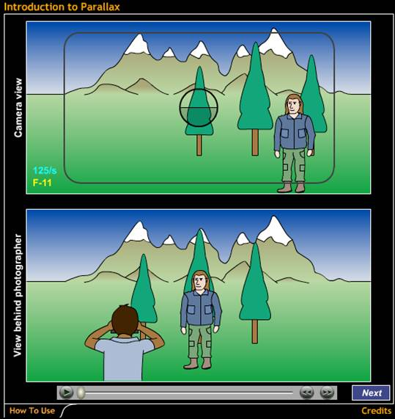
Parallax is the apparent shift in position of a nearby object against a background of more distant objects.
Introduction to Parallax

Slide 14
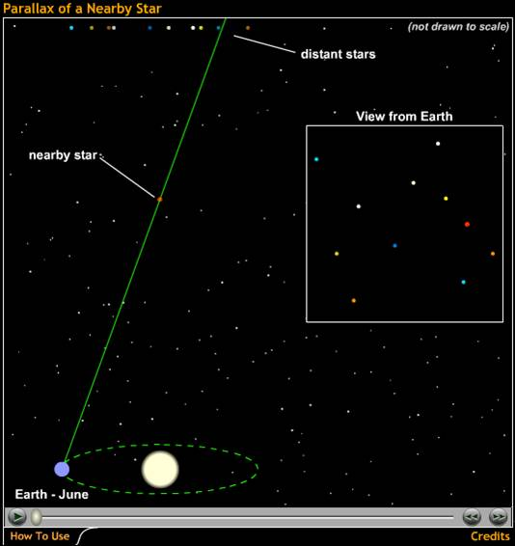
Apparent positions of the nearest stars shift by about an arcsecond as Earth orbits the Sun.
Parallax of a Nearby Star

Slide 15
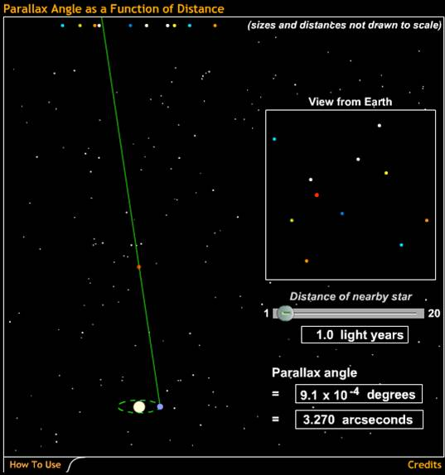
The parallax angle depends on distance.
Parallax Angle as a Function of Distance

Slide 16
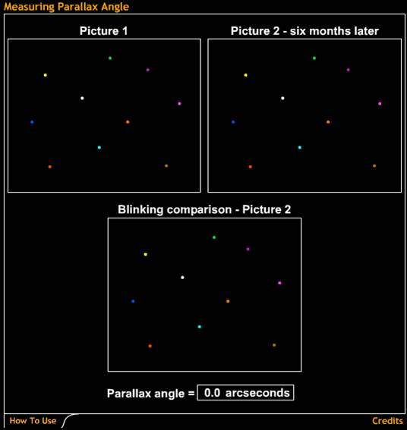
Parallax is measured by comparing snapshots taken at different times and measuring the shift in angle to star.
Measuring Parallax Angle

Slide 17
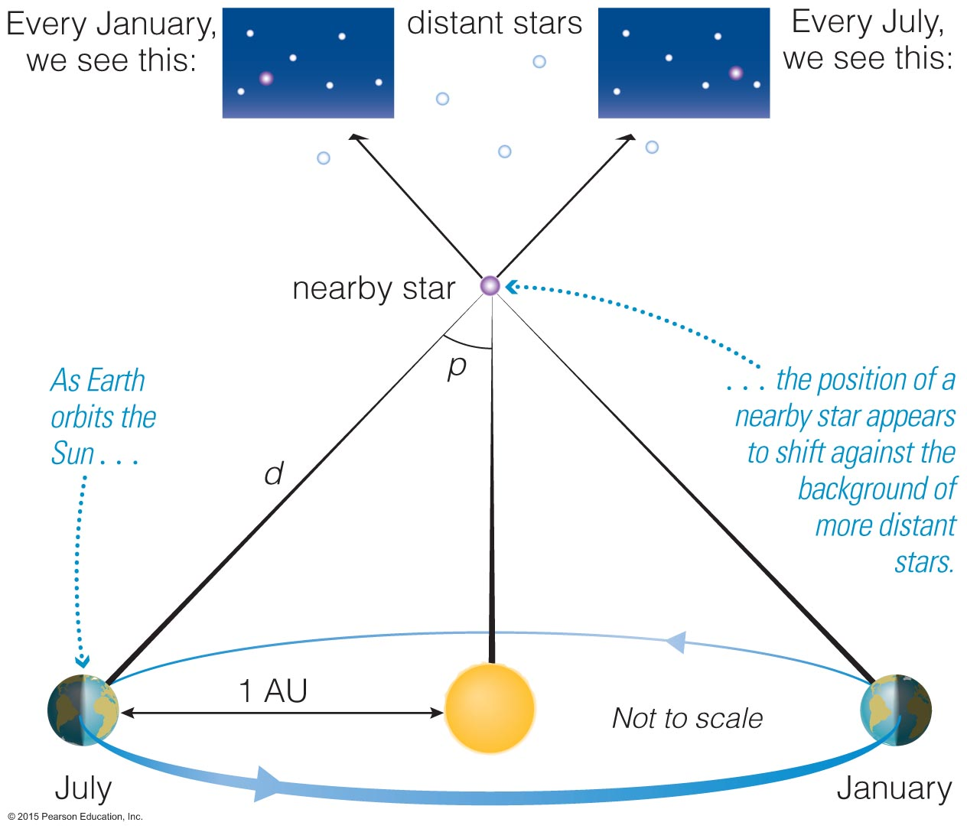

Slide 18
Parallax and Distance
p = parallax angle
1
d (in parsecs) =
p (in arcseconds)
1
d (in light-years) = 3.26 ×
p (in arcseconds)

Slide 19
Most luminous stars:
10⁶L_{Sun}
Least luminous stars:
10⁻⁴L_{Sun}
(L_{Sun} is luminosity of the Sun)

Slide 20
The Magnitude Scale
m = apparent magnitude
M = absolute magnitude
apparent brightness of Star 1
= (100^{1/5})^{m1–m2}
apparent brightness of Star 2
luminosity of Star 1
= (100^{1/5})^{M1–M2}
luminosity of Star 2
Notes:
The magnitude system is not discussed in this detail in the text, but should you want to…

Slide 21
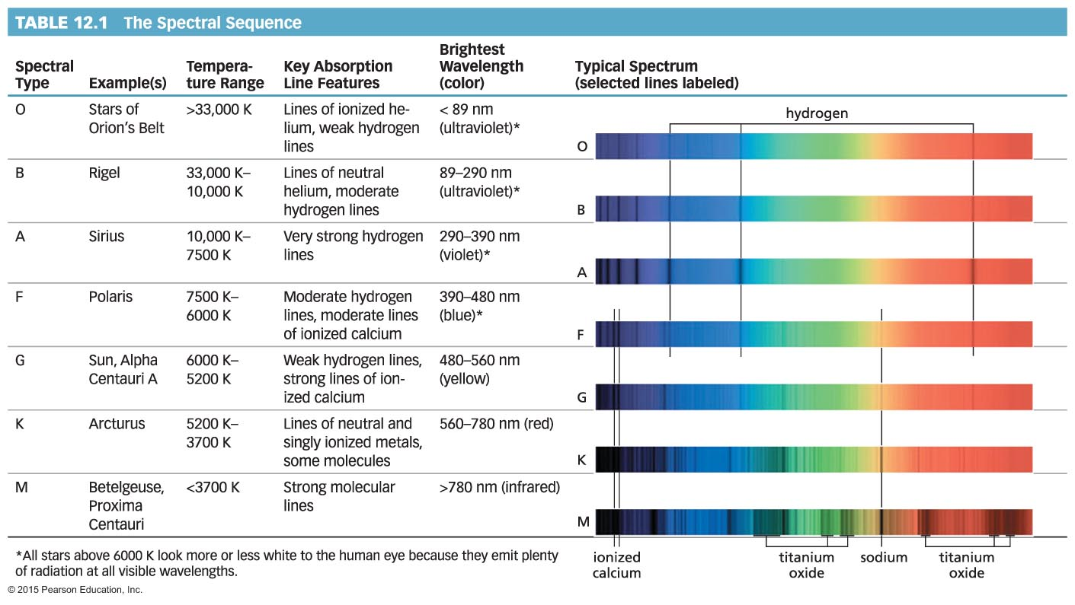
How do we measure stellar temperatures?

Slide 22
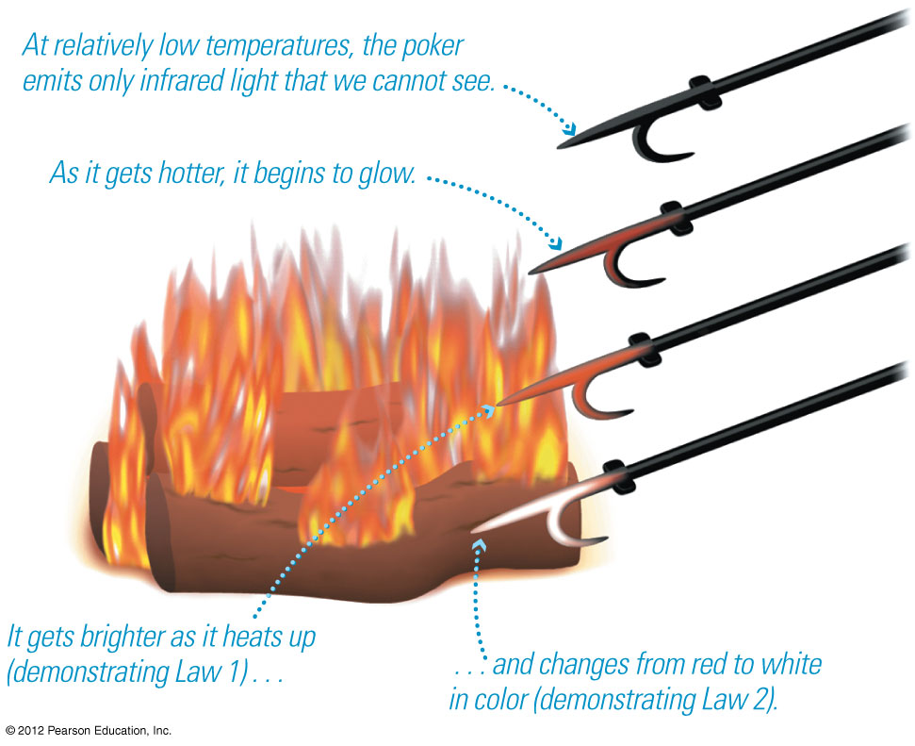
Every object emits thermal radiation with a spectrum that depends on its temperature.

Slide 23
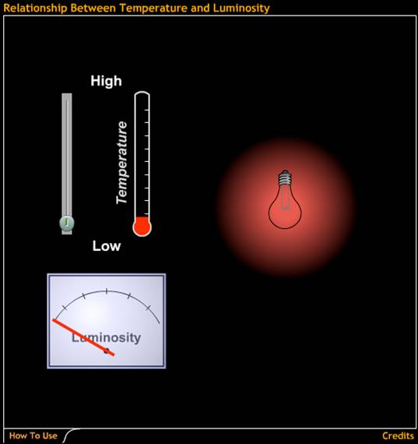
An object of fixed size grows more luminous as its temperature rises.
Relationship Between Temperature and Luminosity

Slide 24
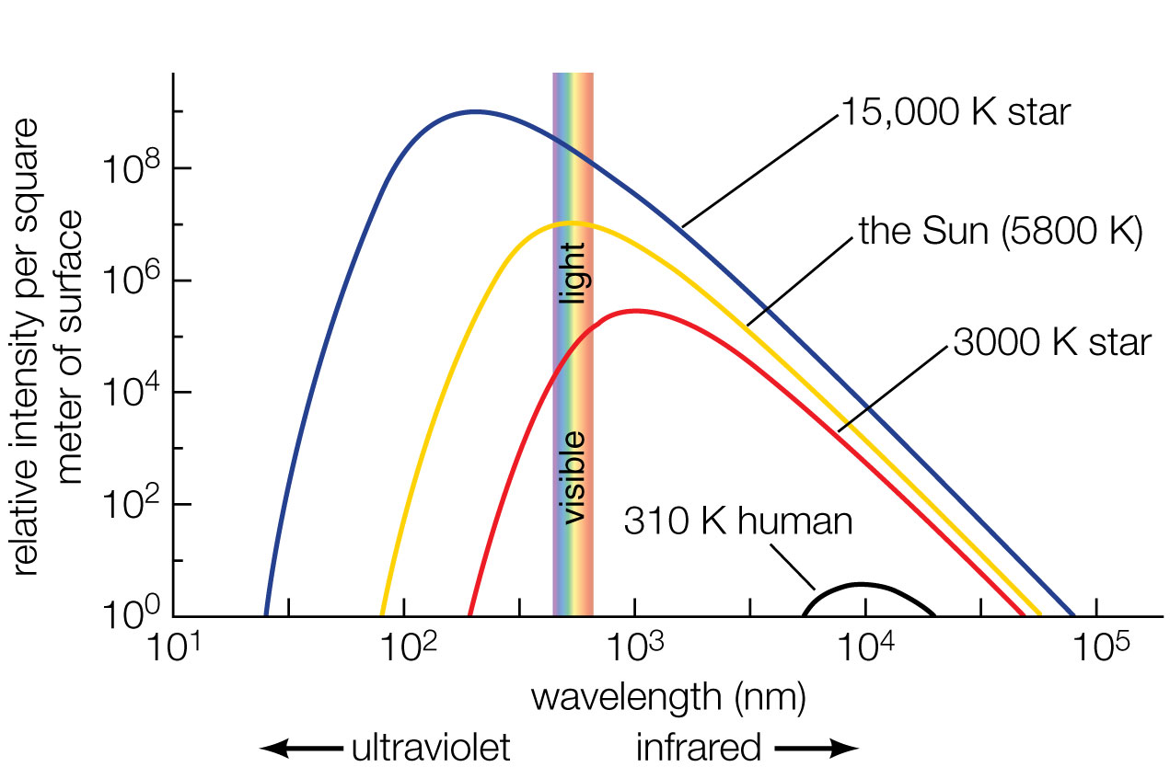
Properties of Thermal Radiation
Hotter objects emit more light per unit area at all frequencies.
Hotter objects emit photons with a higher average energy.
Notes:
Remind students that the intensity is per area; larger objects can emit more total light even if they are cooler.

Slide 25
Hottest stars:
50,000 K
Coolest stars:
3000 K
(Sun's surface is 5800 K)

Slide 26
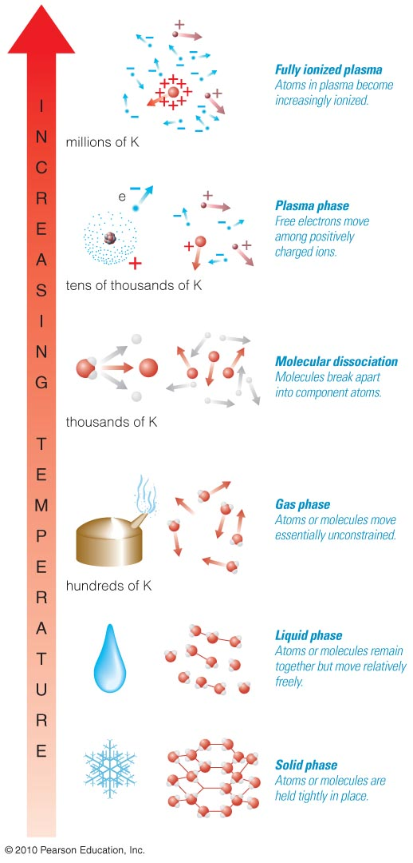
10⁶ K
Level of ionization also reveals a star's temperature.
10⁵ K
Ionized
Gas
(Plasma)
10⁴ K
10³ K
Neutral Gas
10² K
Molecules
10 K
Solid

Slide 27
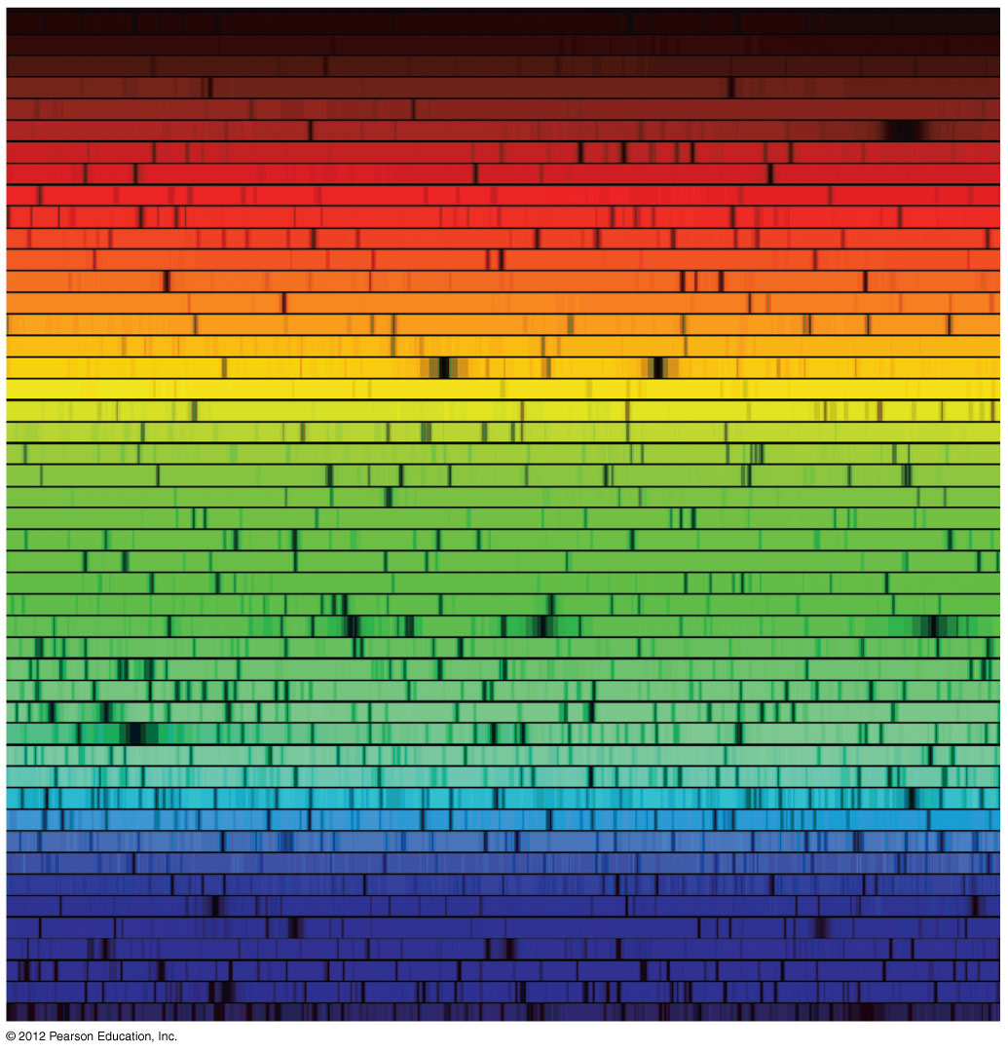
Absorption lines in a star's spectrum tell us its ionization level.

Slide 28
Lines in a star's spectrum correspond to a spectral type that reveals its temperature:
(Hottest) O B A F G K M (Coolest)

Slide 29
Remembering Spectral Types
(Hottest) O B A F G K M (Coolest)
Oh, Be A Fine Girl/Guy, Kiss Me
Only Boys Accepting Feminism Get Kissed Meaningfully

Slide 30
Thought Question
Which of the stars below is hottest?
M star
F star
A star
K star

Slide 31
Thought Question
Which of the stars below is hottest?
M star
F star
A star
K star

Slide 32
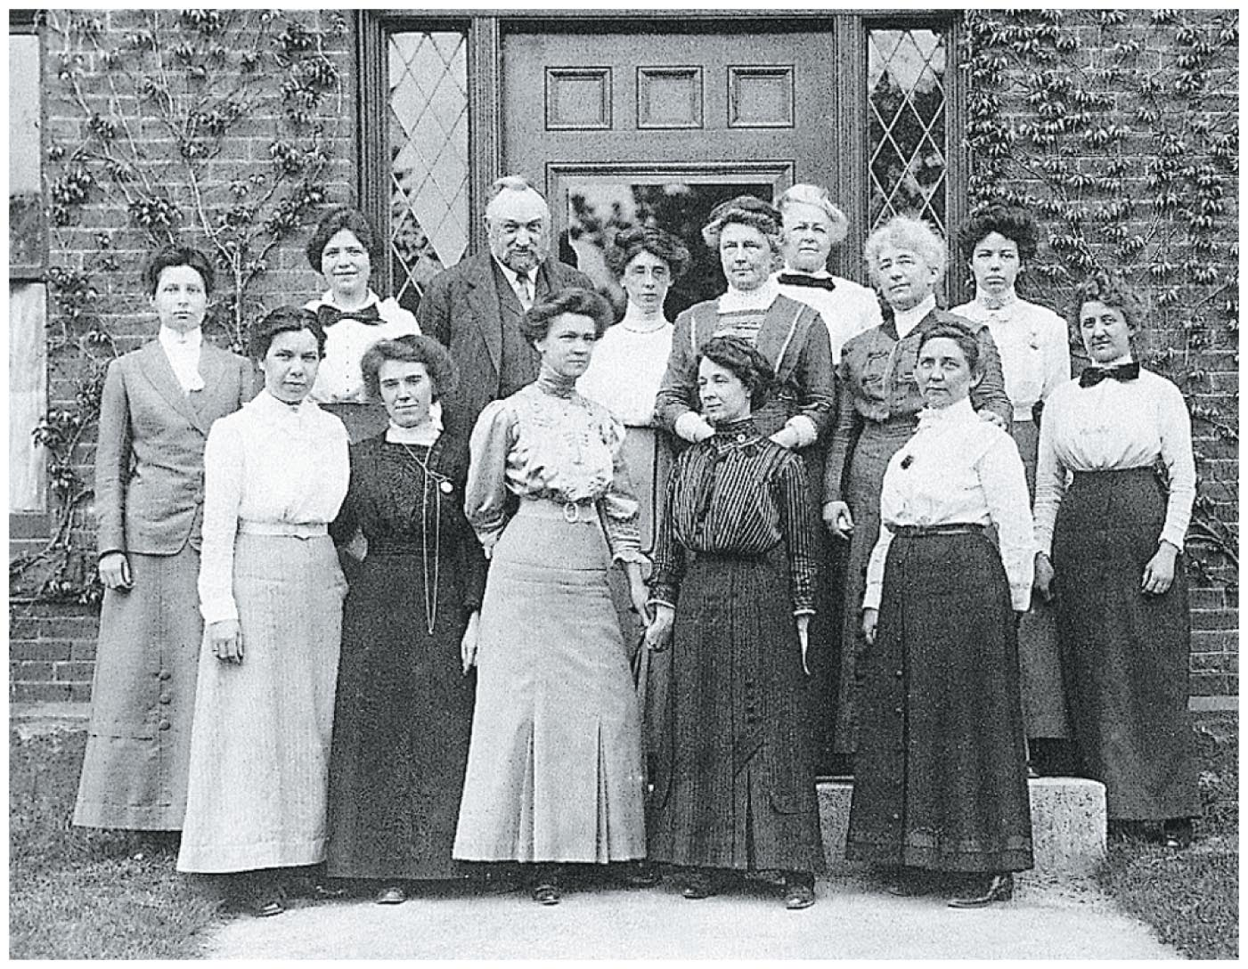
Pioneers of Stellar Classification
Annie Jump Cannon and the "calculators" at Harvard laid the foundation of modern stellar classification.

Slide 33
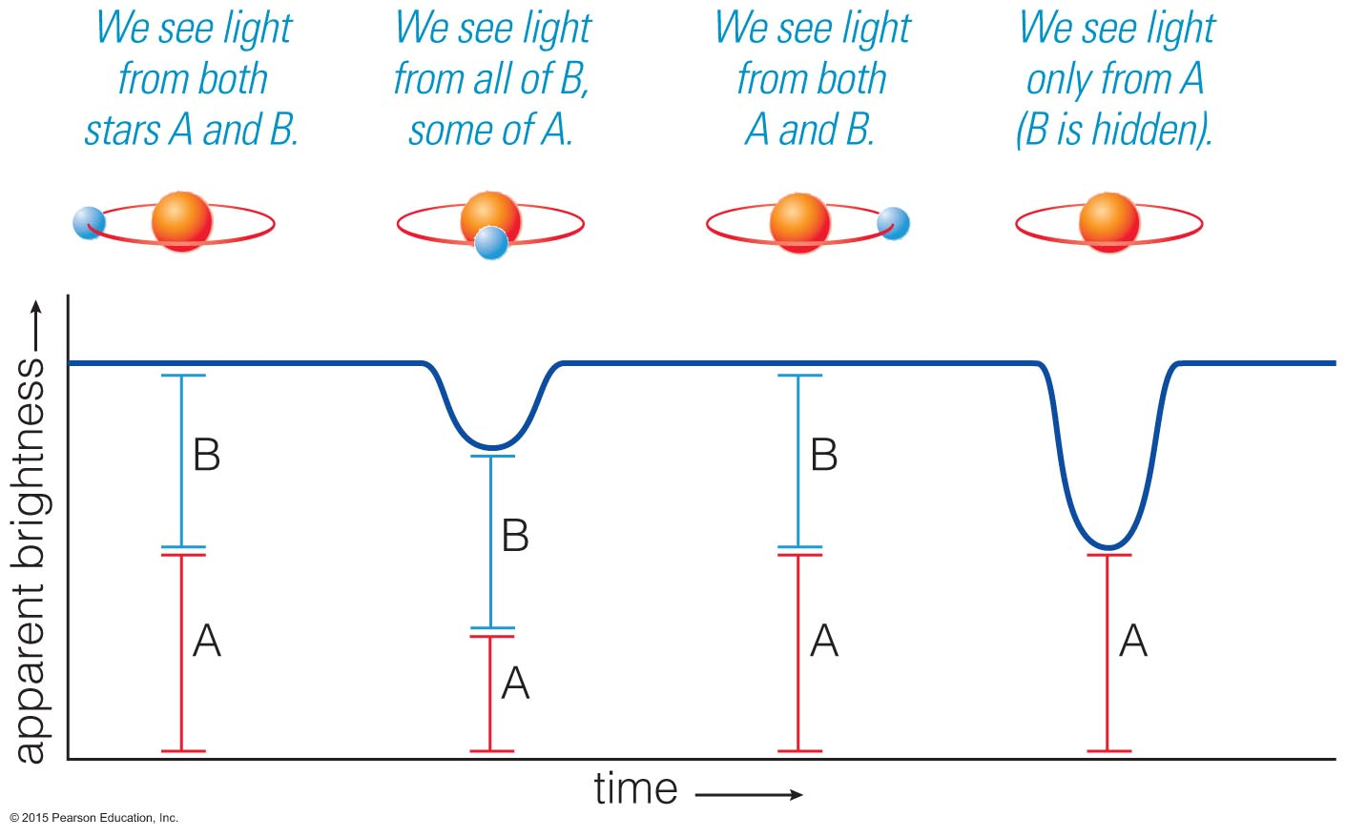
How do we measure stellar masses?

Slide 34
Binary Star Orbits
Orbit of a binary star system depends on the strength of gravity.

Slide 35
Types of Binary Star Systems
Visual binary
Eclipsing binary
Spectroscopic binary
About half of all stars are in binary systems.

Slide 36
Visual Binary
We can directly observe the orbital motions of these stars.

Slide 37
Eclipsing Binary
We can measure periodic eclipses.
http://www.astronomy.ohio-state.edu/~pogge/TeachRes/Movies162/eclbin.gif
Notes:
Download an eclipsing binary animation from
http://www.astronomy.ohio-state.edu/~pogge/TeachRes/Movies162/eclbin.gif

Slide 38
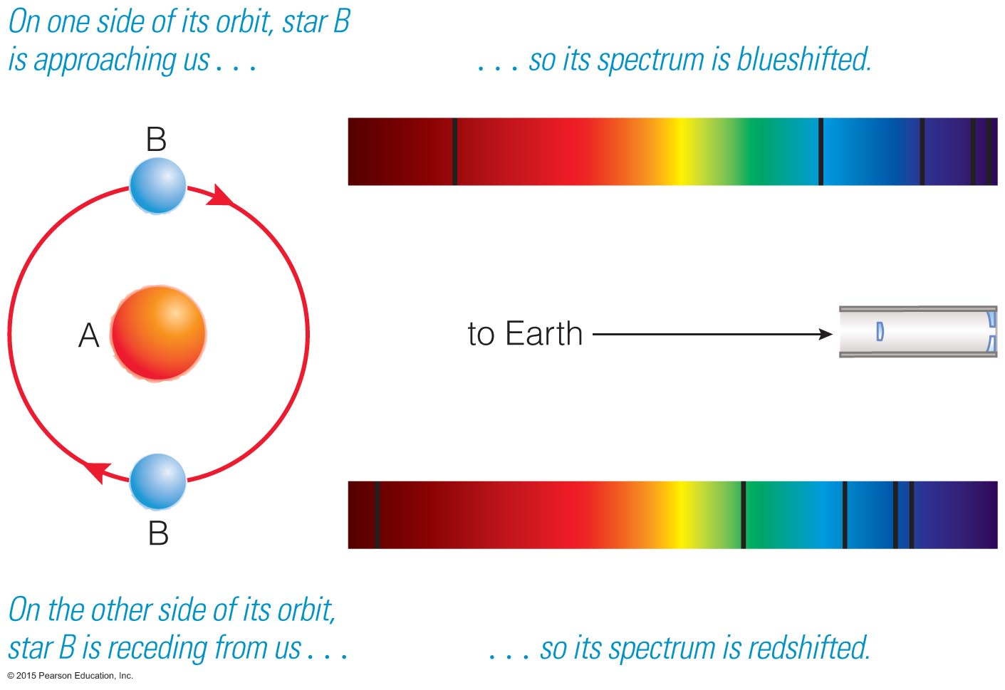
Spectroscopic Binary
We determine the orbit by measuring Doppler shifts.
http://www.astronomy.ohio-state.edu/~pogge/Ast162/Movies/
Notes:
Download a spectroscopic binary animation from
http://www-astronomy.ohio-state.edu/~pogge/teachRes/Movies162/spanim.gif
R. Pogge, Ohio State University.

Slide 39
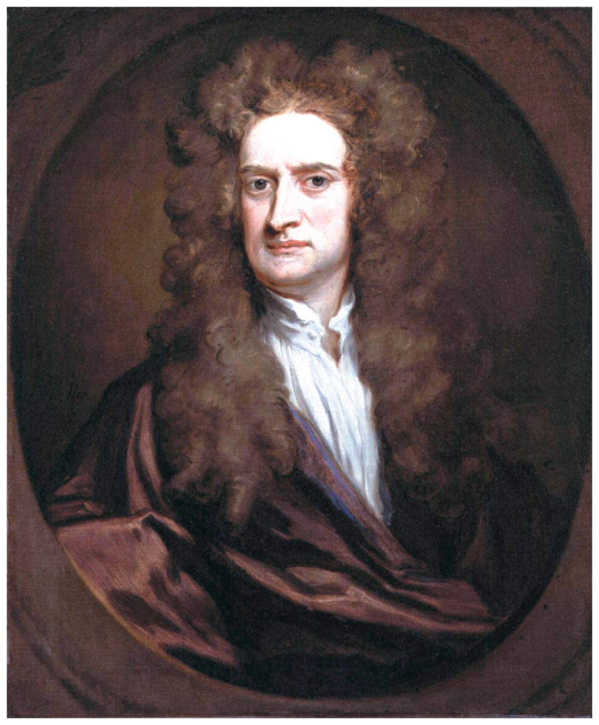
We measure mass using gravity.
Direct mass measurements are possible only for stars in binary star systems.
p = period
a = average separation
4π²
G (M₁ + M₂)
p² = a³
Isaac Newton

Slide 40
Need two out of three observables to measure mass:
Orbital period (p)
Orbital separation (a or r = radius)
Orbital velocity (v)
For circular orbits, v = 2πr / p
v
r
M

Slide 41
Most massive stars:
100M_{Sun}
Least massive stars:
0.08M_{Sun}
(M_{Sun} is the mass of the Sun.)

Slide 42
Most massive stars:
100M_{Sun}
Least massive stars:
0.08M_{Sun}
(M_{Sun} is the mass of the Sun.)
(some very rare stars may have > 100 M_{Sun})

Slide 43
What have we learned?
How do we measure stellar luminosities?
If we measure a star's apparent brightness and distance, we can compute its luminosity with the inverse square law for light.
Parallax tells us distances to the nearest stars.
How do we measure stellar temperatures?
A star's color and spectral type both reflect its temperature.

Slide 44
What have we learned?
How do we measure stellar masses?
Newton's version of Kepler's third law tells us the total mass of a binary system, if we can measure the orbital period (p) and average orbital separation of the system (a).

Slide 45
12.2 Patterns Among Stars
Our goals for learning:
What is a Hertzsprung–Russell diagram?
What is the significance of the main sequence?
What are giants, supergiants, and white dwarfs?

Slide 46
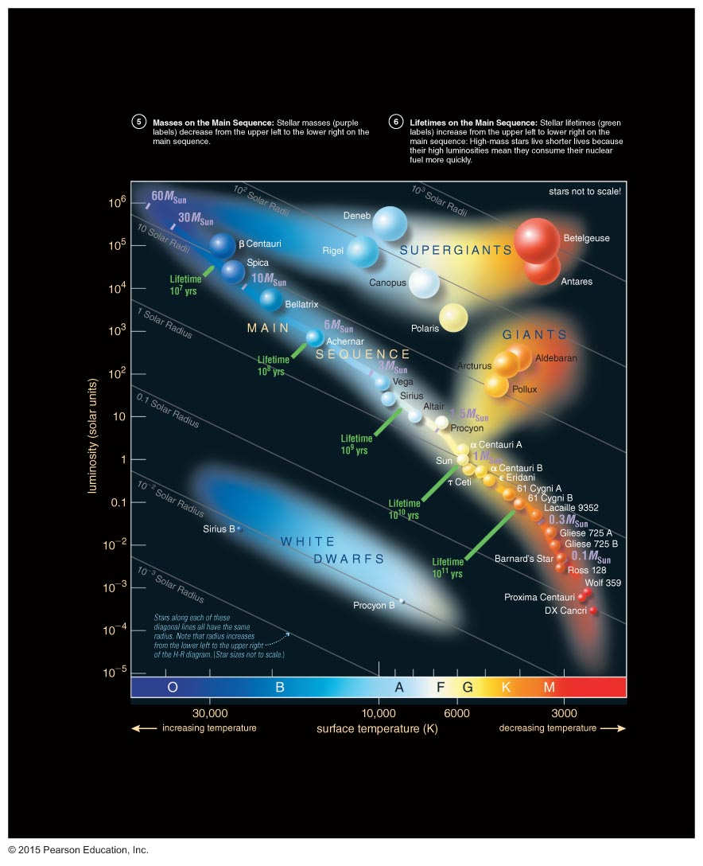
What is a Hertzsprung–Russell diagram?

Slide 47
An H-R diagram plots the luminosities and temperatures of stars.
Luminosity
Temperature

Slide 48
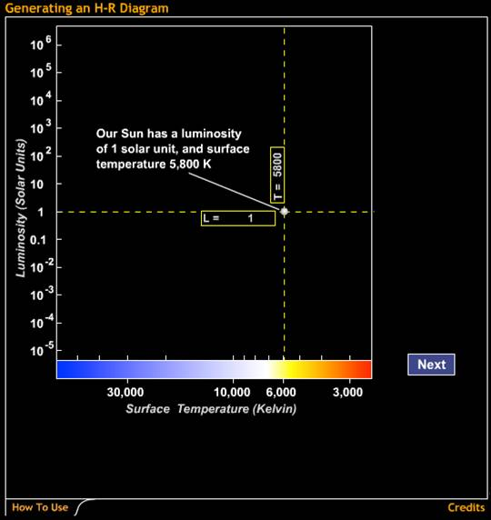
Generating an H-R Diagram

Slide 49
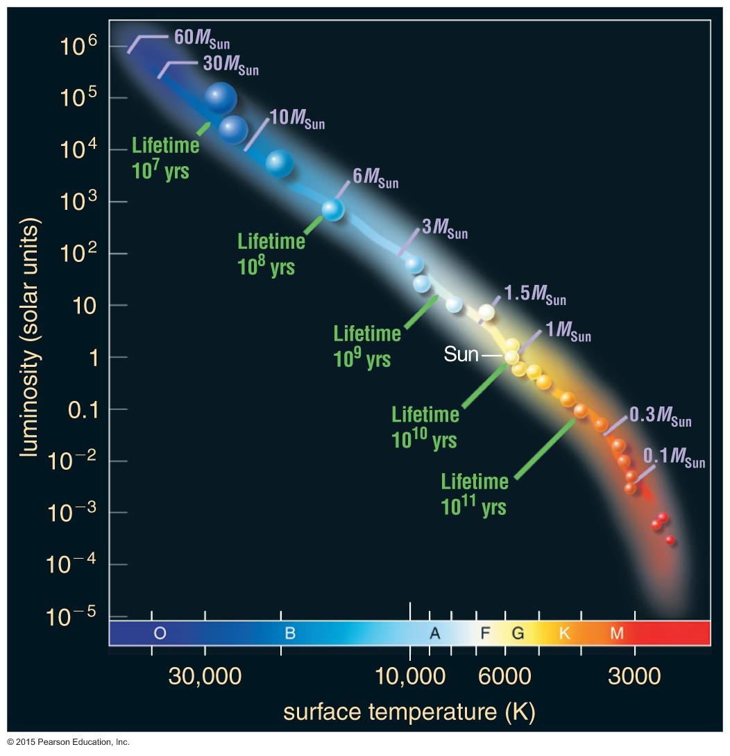
Most stars fall somewhere on the main sequence of the H-R diagram.

Slide 50
large radius
Stars with lower T and higher L than main-sequence stars must have larger radii:
giants and supergiants

Slide 51
Stars with higher T and lower L than main-sequence stars must have smaller radii:
white dwarfs
small radius

Slide 52
A star's full classification includes spectral type (line identities) and luminosity class (line shapes, related to the size of the star):
I — supergiant
II — bright giant
III — giant
IV — subgiant
V — main sequence
Examples: Sun — G2 V
Sirius — A1 V
Proxima Centauri — M5.5 V
Betelgeuse — M2 I

Slide 53
H-R diagram depicts:
Temperature
Color
Spectral type
Luminosity
Radius
Luminosity
Temperature

Slide 54
Which star is the hottest?
B
C
D
A

Slide 55
Which star is the hottest?
C
A
B
D
A

Slide 56
Which star is the most luminous?
B
C
D
A

Slide 57
Which star is the most luminous?
B
C
C
D
A

Slide 58
Which star is a main-sequence star?
B
C
D
A

Slide 59
Which star is a main-sequence star?
B
C
D
D
A

Slide 60
Which star has the largest radius?
B
C
D
A

Slide 61
Which star has the largest radius?
B
C
C
D
A

Slide 62
What is the significance of the main sequence?

Slide 63
Main-sequence stars are fusing hydrogen into helium in their cores, like the Sun.
Luminous main-sequence stars are hot (blue).
Less luminous ones are cooler (yellow or red).

Slide 64
High-mass stars
Mass measurements of main-sequence stars show that the hot, blue stars are much more massive than the cool, red ones.
Low-mass stars

Slide 65
High-mass stars
The mass of a normal, hydrogen-fusing star determines its luminosity and spectral type.
Low-mass stars

Slide 66
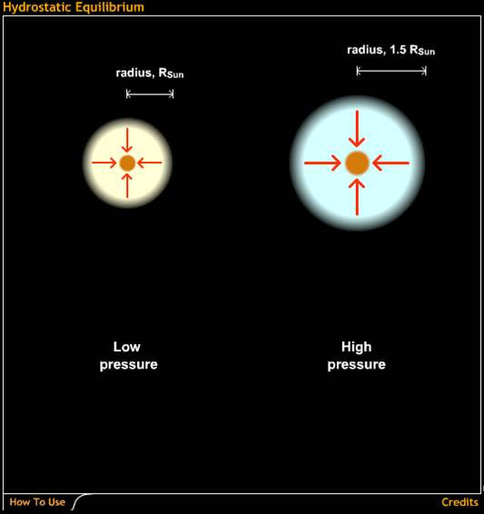
The core temperature of a higher-mass star needs to be higher in order to balance gravity.
A higher core temperature boosts the fusion rate, leading to greater luminosity.
Hydrostatic Equilibrium

Slide 67
Stellar Properties Review
Luminosity: from brightness and distance
10⁻⁴L_{Sun} – 10⁶L_{Sun}
Temperature: from color and spectral type
3000 K – 50,000 K
Mass: from period (p) and average separation (a) of binary-star orbit
0.08M_{Sun} – 100M_{Sun}

Slide 68
Stellar Properties Review
Luminosity: from brightness and distance
(0.08M_{Sun}) 10⁻⁴L_{Sun} – 10⁶L_{Sun} (100M_{Sun})
Temperature: from color and spectral type
(0.08M_{Sun}) 3000 K – 50,000 K (100M_{Sun})
Mass: from period (p) and average separation (a) of binary-star orbit
0.08M_{Sun} – 100M_{Sun}

Slide 69
Mass and Lifetime
Sun's life expectancy: 10 billion years

Slide 70
Mass and Lifetime
Until core hydrogen
(10% of total) is
used up
Sun's life expectancy: 10 billion years

Slide 71
Mass and Lifetime
Until core hydrogen
(10% of total) is
used up
Sun's life expectancy: 10 billion years
Life expectancy of a 10M_{Sun} star:
10 times as much fuel, uses it 10⁴ times as fast
10 million years ~ 10 billion years × 10/10⁴

Slide 72
Mass and Lifetime
Until core hydrogen
(10% of total) is
used up
Sun's life expectancy: 10 billion years
Life expectancy of a 10M_{Sun} star:
10 times as much fuel, uses it 10⁴ times as fast
10 million years ~ 10 billion years × 10/10⁴
Life expectancy of a 0.1M_{Sun} star:
0.1 times as much fuel, uses it 0.01 times as fast
100 billion years ~ 10 billion years × 0.1/0.01

Slide 73
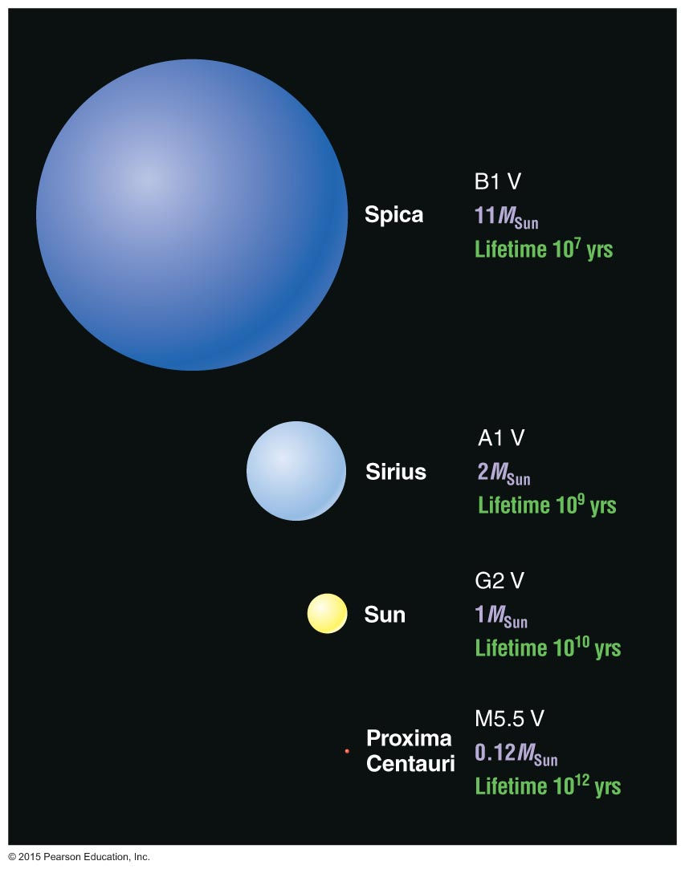
Main-Sequence Star Summary
High-mass:
High luminosity
Short-lived
Large radius
Blue
Low-mass:
Low luminosity
Long-lived
Small radius
Red

Slide 74
What are giants, supergiants, and white dwarfs?

Slide 75
Off the Main Sequence
Stellar properties depend on both mass and age: those that have finished fusing H to He in their cores are no longer on the main sequence.
All stars become larger and redder after exhausting their core hydrogen: giants and supergiants.
Most stars end up small and white after fusion has ceased: white dwarfs.

Slide 76
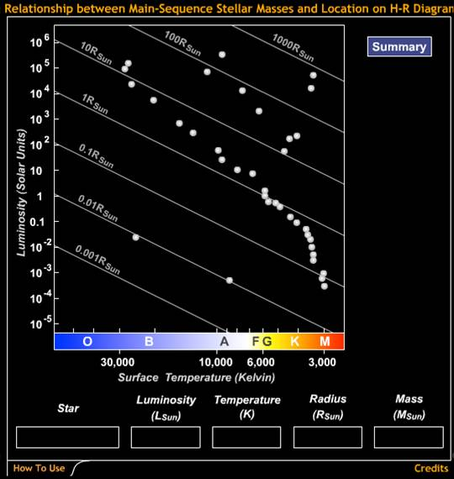
Relationship Between Main-Sequence Stellar Masses and Location on H-R Diagram

Slide 77
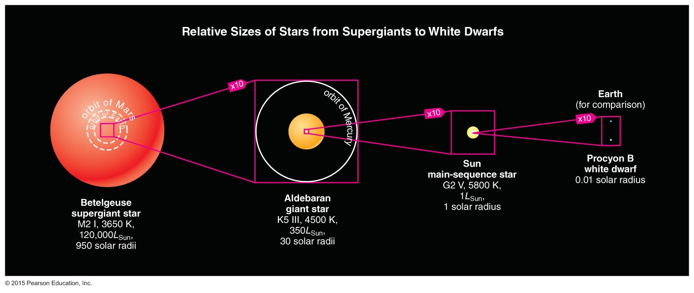
Giants and supergiants are far larger than main-sequence stars and white dwarfs.

Slide 78
Which star is most like our Sun?
B
C
D
A

Slide 79
Which star is most like our Sun?
B
C
D
D
A

Slide 80
Which of these stars will have changed the least 10 billion years from now?
B
C
D
A

Slide 81
Which of these stars will have changed the least 10 billion years from now?
B
C
D
A
A

Slide 82
What have we learned?
What is a Hertzsprung–Russell diagram?
An H-R diagram plots the stellar luminosity of stars versus surface temperature (or color or spectral type).
What is the significance of the main sequence?
Normal stars that fuse H to He in their cores fall on the main sequence of an H-R diagram.
A star's mass determines its position along the main sequence (high mass: luminous and blue; low mass: faint and red).

Slide 83
What have we learned?
What are giants, supergiants, and white dwarfs?
All stars become larger and redder after core hydrogen is exhausted: giants and supergiants.
Most stars end up as tiny white dwarfs after fusion has ceased.

Slide 84
12.3 Star Clusters
Our goals for learning:
What are the two types of star clusters?
How do we measure the age of a star cluster?

Slide 85
What are the two types of star clusters?

Slide 86
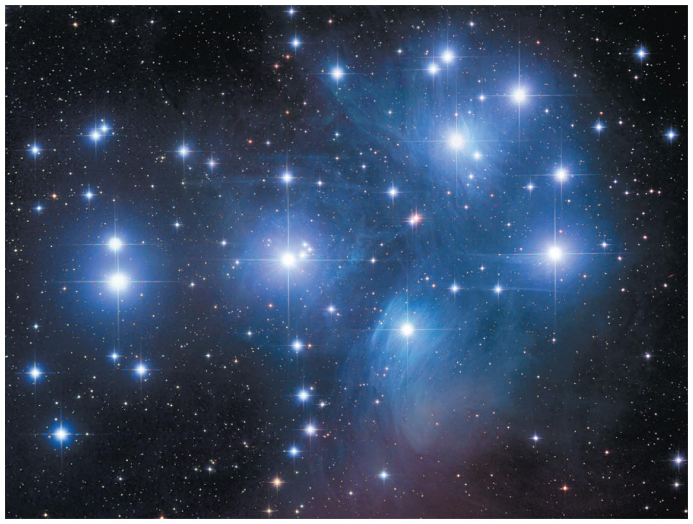
Open cluster: A few thousand loosely packed stars

Slide 87
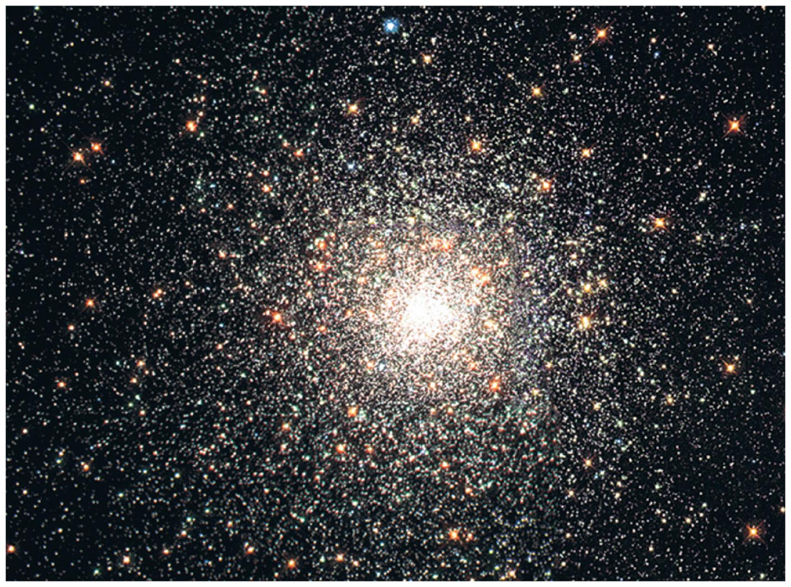
Globular cluster: Up to a million or more stars in a dense ball bound together by gravity
Notes:
Useful movies to download:
Globular cluster visualization
http://terpsichore.stsci.edu/~summers/viz/scviz/spz.html
Stellar collision simulation:
http://www.ifa.hawaii.edu/faculty/barnes/research/stellar_collisions/

Slide 88
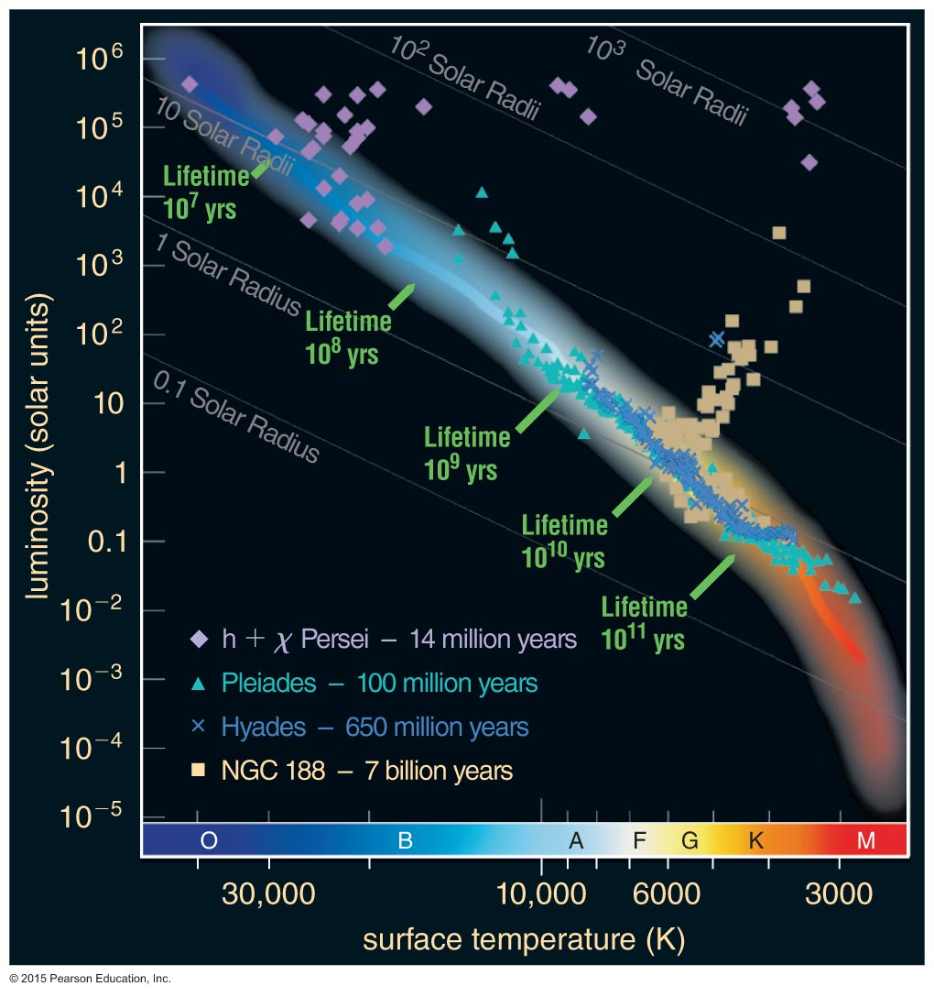
How do we measure the age of a star cluster?

Slide 89
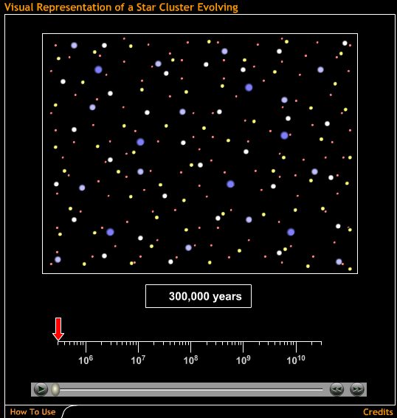
Massive blue stars die first, followed by white, yellow, orange, and
red stars.
Visual Representation of a Star Cluster Evolving

Slide 90
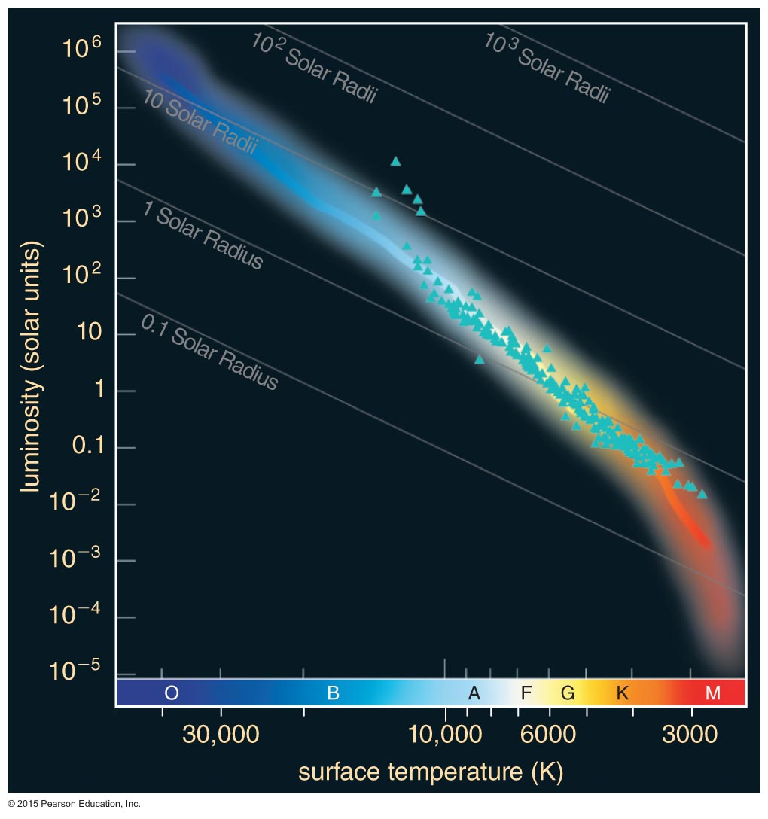
Pleiades now has no stars with a life expectancy less than around 100 million years.
Main-sequence
turnoff

Slide 91
The main-sequence turnoff point of a cluster tells us its age.

Slide 92
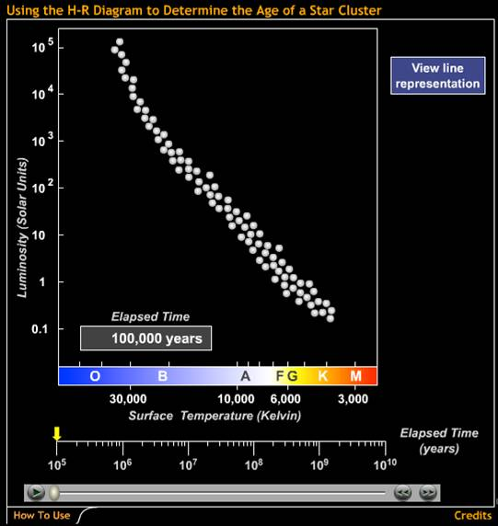
To determine accurate ages, we compare models of stellar evolution to the cluster data.
Using the H-R Diagram to Determine the Age of a Star Cluster

Slide 93
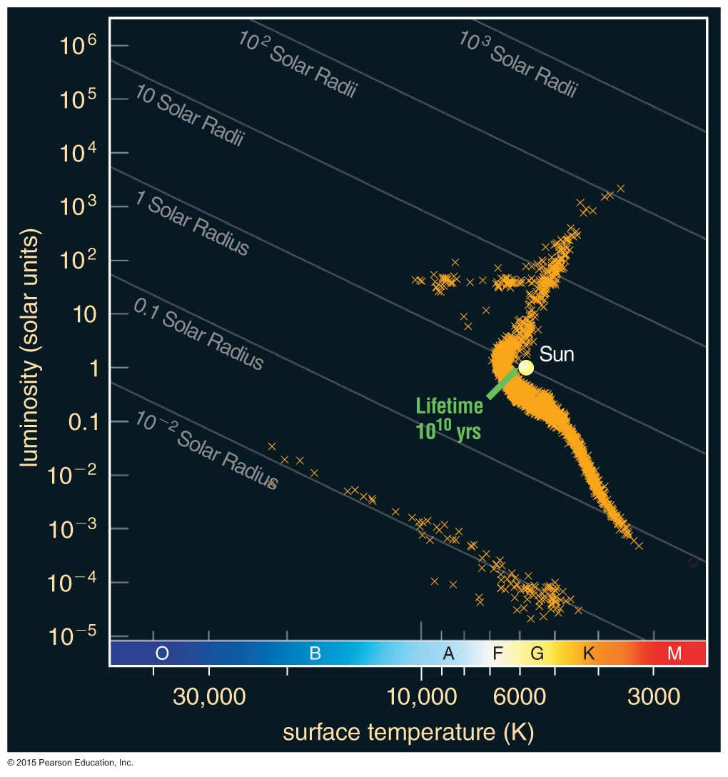
Detailed modeling of the oldest globular clusters reveals that they are about 13 billion years old.

Slide 94
What have we learned?
What are the two types of star clusters?
Open clusters are loosely packed and contain up to a few thousand stars.
Globular clusters are densely packed and contain hundreds of thousands of stars.
How do we measure the age of a star cluster?
A star cluster's age roughly equals the life expectancy of its most massive stars still on the main sequence.

