Slide 1
Chapter 13: Star Stuff

Slide 2
13.1 Star Birth
Our goals for learning:
How do stars form?
How massive are newborn stars?

Slide 3
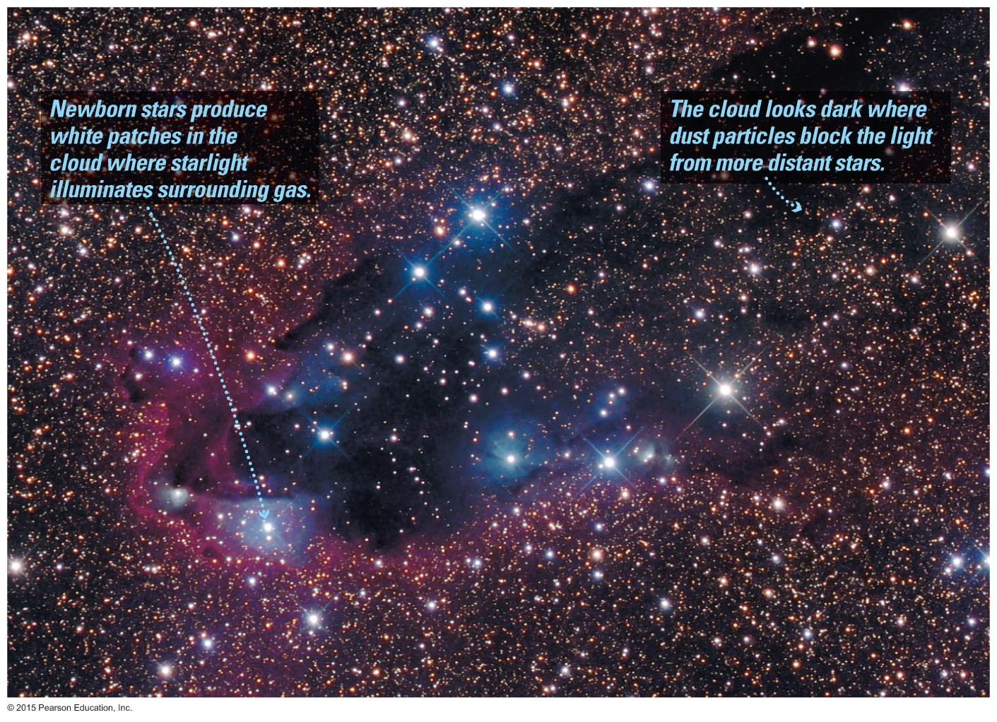
How do stars form?

Slide 4
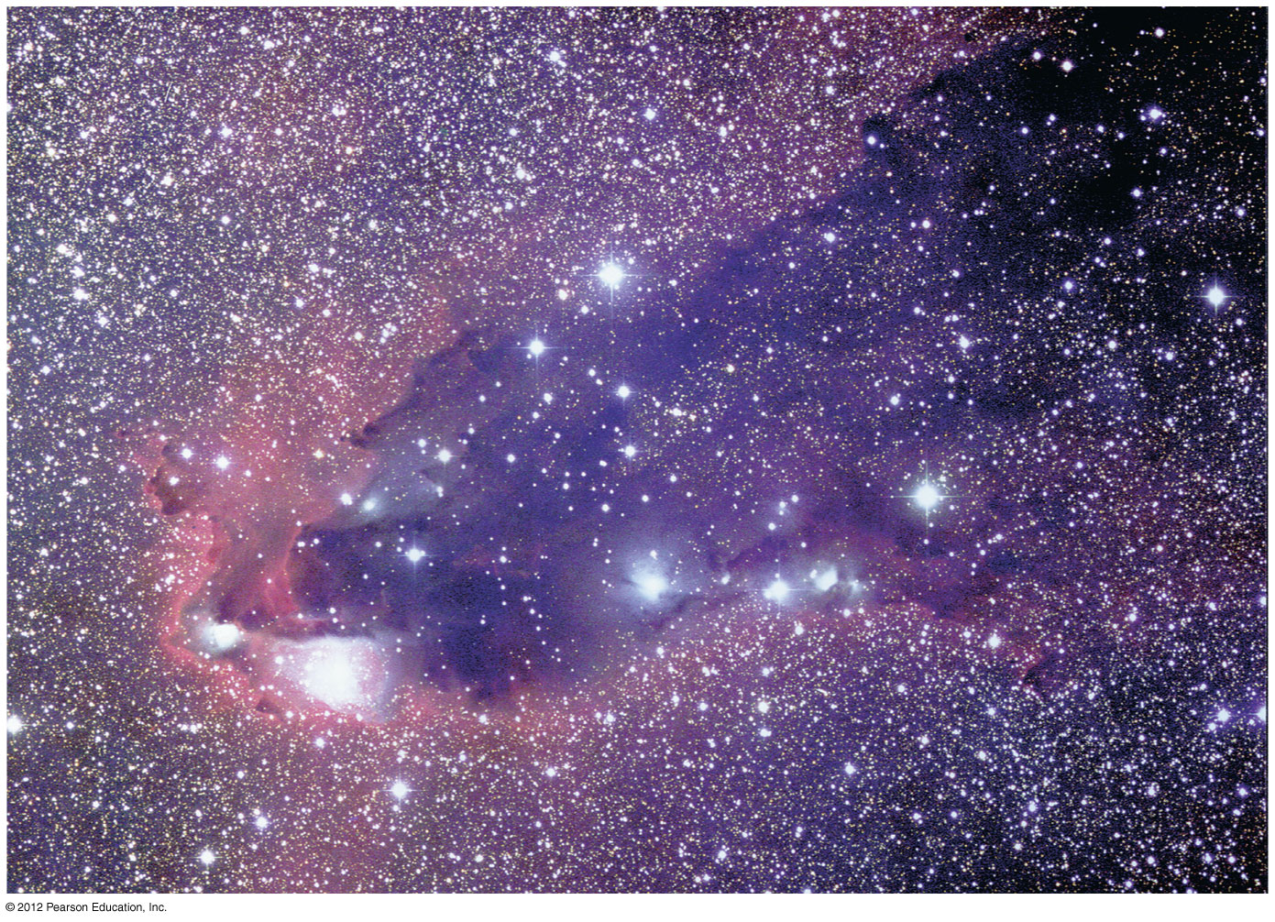
Star-Forming Clouds
Stars form in dark clouds of dusty gas in interstellar space.
The gas between the stars is called the interstellar medium.

Slide 5
Gravity Versus Pressure
Gravity can create stars only if it can overcome the force of thermal pressure in a cloud.
Gravity within a contracting gas cloud becomes stronger as the gas becomes denser.

Slide 6
Mass of a Star-Forming Cloud
A typical molecular cloud (T~ 30 K, n ~ 300 particles/cm³) must contain at least a few hundred solar masses for gravity to overcome pressure.
The cloud can prevent a pressure buildup by converting thermal energy into infrared and radio photons that escape the cloud.

Slide 7
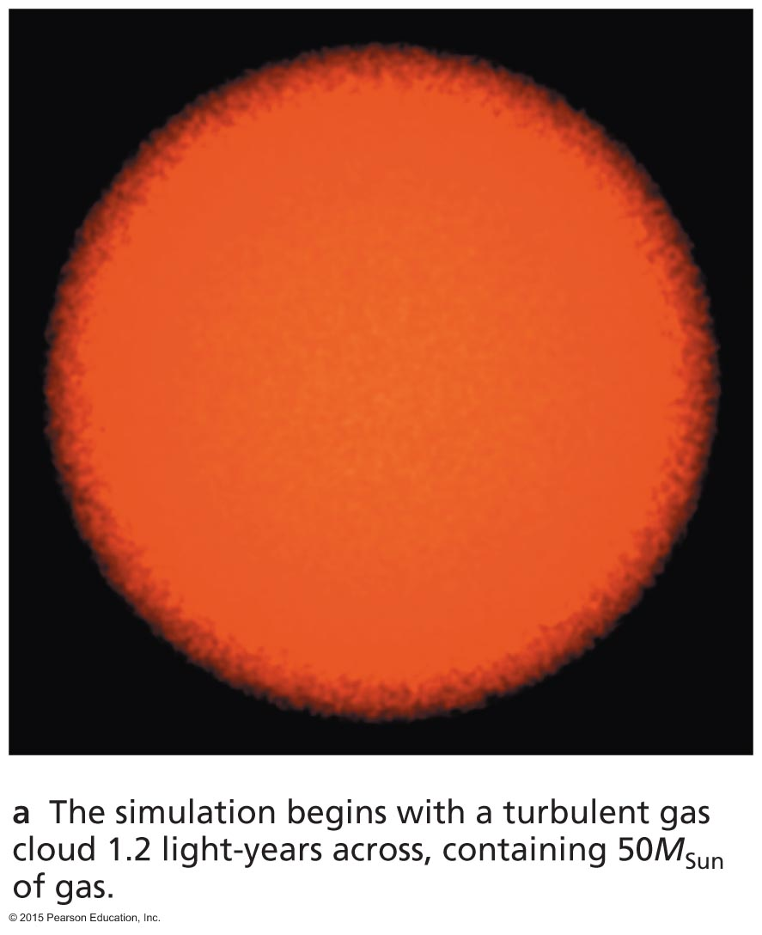
Fragmentation of a Cloud
This simulation begins with a turbulent cloud containing 50 solar masses of gas.

Slide 8
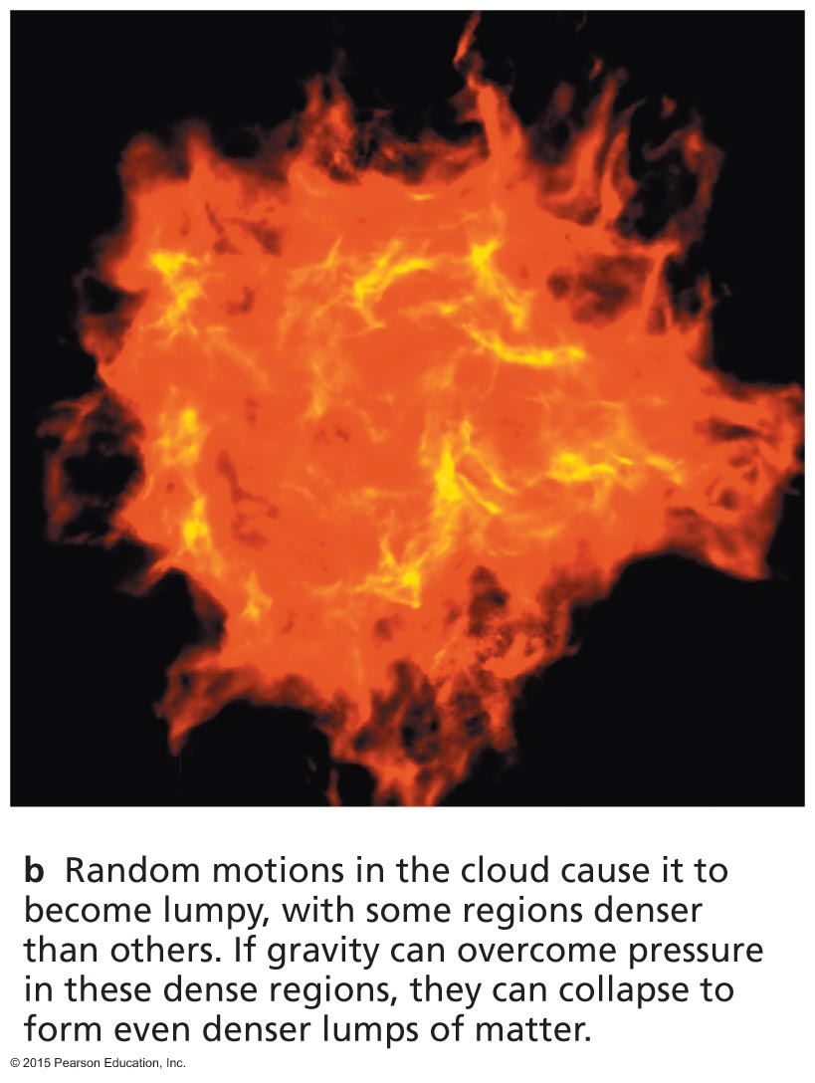
Fragmentation of a Cloud
The random motions of different sections of the cloud cause it to become lumpy.

Slide 9
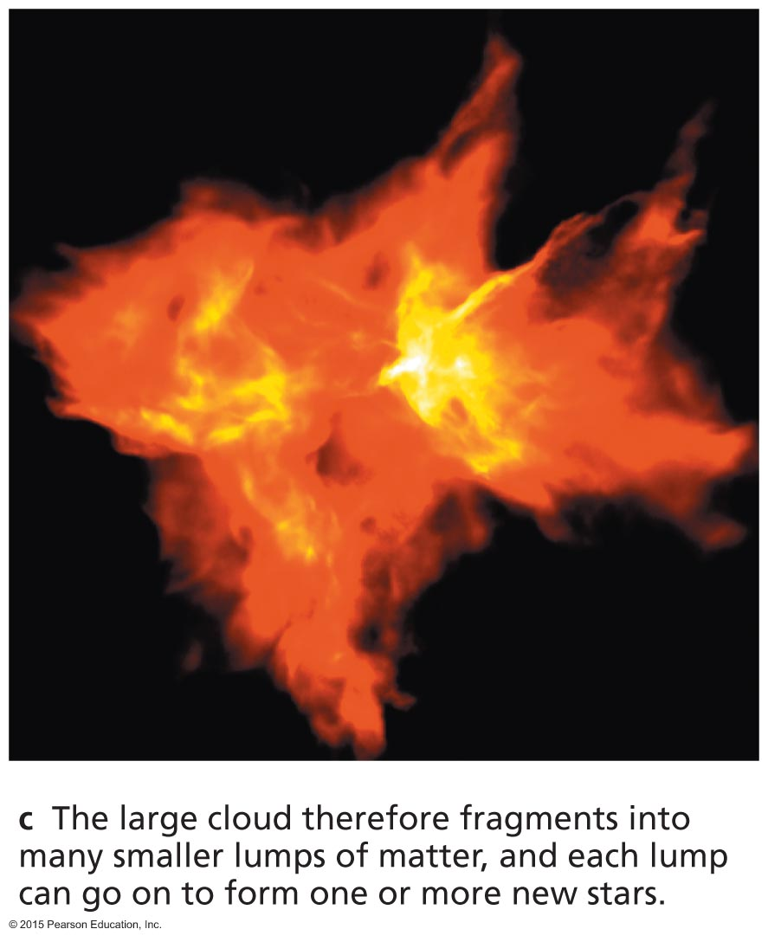
Fragmentation of a Cloud
Each lump of the cloud in which gravity can overcome pressure can go on to become a star.
A large cloud can make a whole cluster of stars.

Slide 10
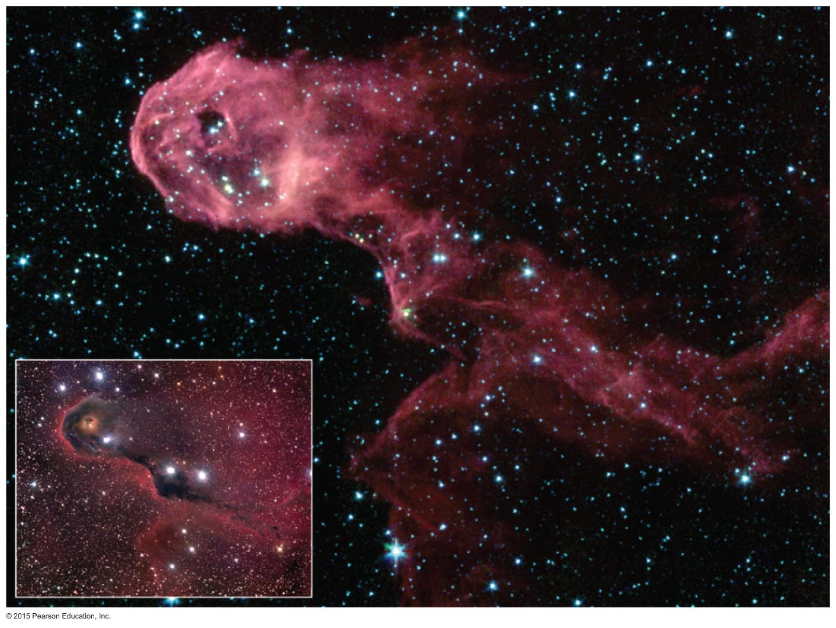
Glowing Dust Grains
As stars begin to form, dust grains that absorb visible light heat up and emit infrared light.

Slide 11
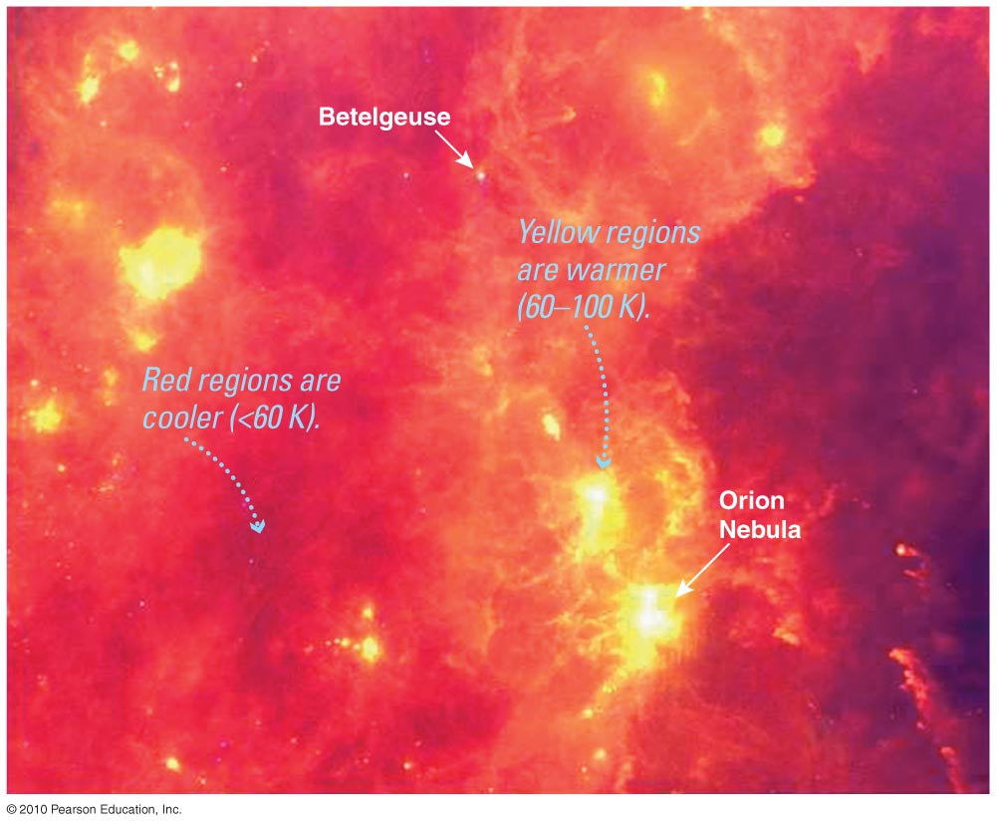
Glowing Dust Grains
Long-wavelength infrared light is brightest from regions where many stars are currently forming.

Slide 12
Thought Question
What would happen to a contracting cloud fragment if it were not able to radiate away its thermal energy?
It would continue contracting, but its temperature would not change.
Its mass would increase.
Its internal pressure would increase.

Slide 13
Thought Question
What would happen to a contracting cloud fragment if it were not able to radiate away its thermal energy?
It would continue contracting, but its temperature would not change.
Its mass would increase.
Its internal pressure would increase.

Slide 14
Solar system formation is a good example of star birth.

Slide 15
Cloud heats up as gravity causes it to contract due to conservation of energy. Contraction can continue if thermal energy is radiated away.

Slide 16
As gravity forces a cloud to become smaller, it begins to spin faster and faster, due to conservation of angular momentum.

Slide 17
As gravity forces a cloud to become smaller, it begins to spin faster and faster, due to conservation of angular momentum. Gas settles into a spinning disk because spin hampers collapse perpendicular to the spin axis.

Slide 18
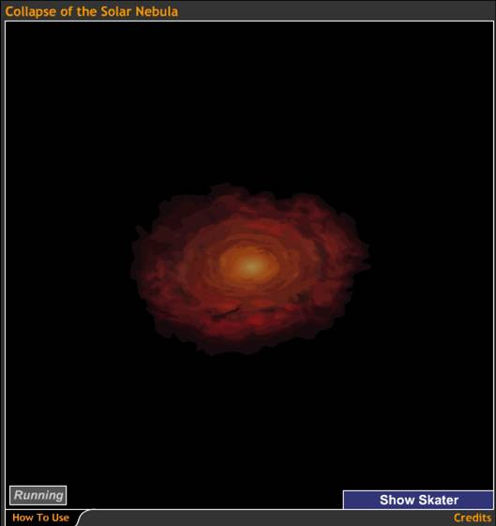
Rotation of a contracting cloud speeds up for the same reason a skater speeds up as she pulls in her arms.
Collapse of the Solar Nebula

Slide 19
Flattening
Collisions between particles in the cloud cause it to flatten into a disk.

Slide 20
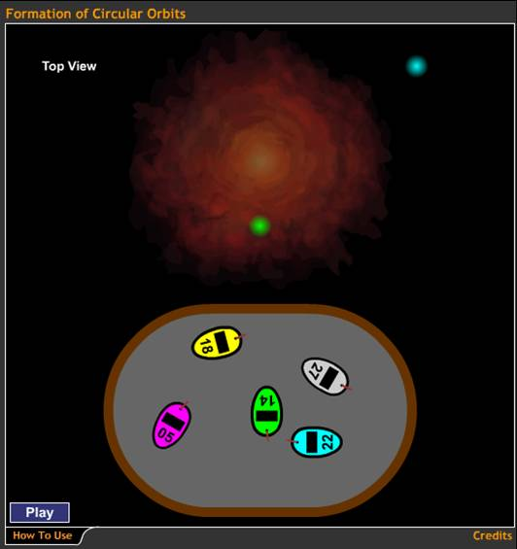
Collisions between gas particles in a cloud gradually reduce random motions.
Formation of Circular Orbits

Slide 21
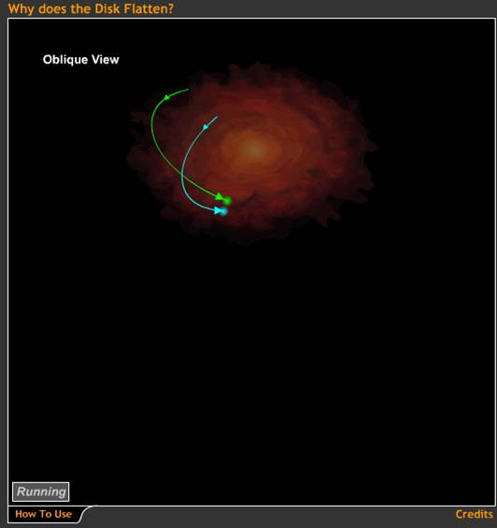
Collisions between gas particles also reduce up and down motions.
Why Does the Disk Flatten?

Slide 22
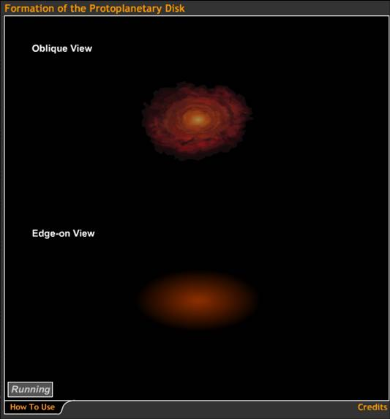
The spinning cloud flattens as it shrinks.
Formation of the Protoplanetary Disk

Slide 23
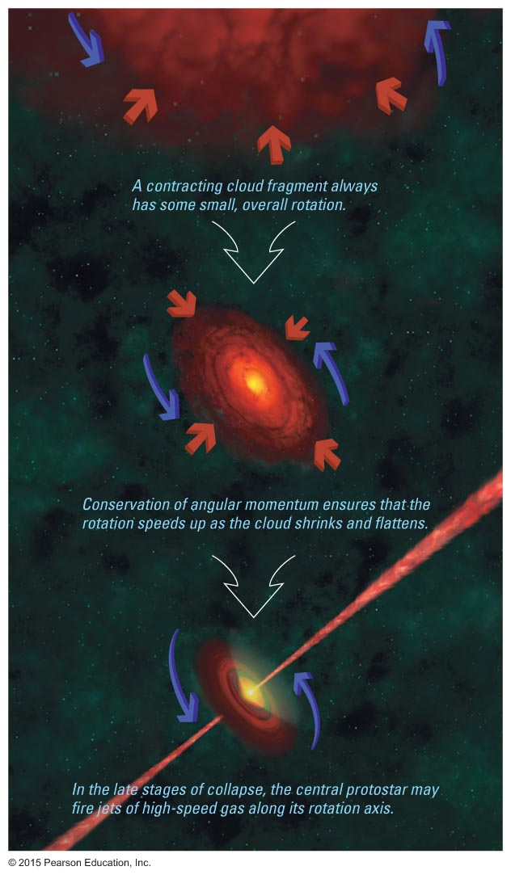
Formation of Jets
Rotation also causes jets of matter to shoot out along the rotation axis.

Slide 24
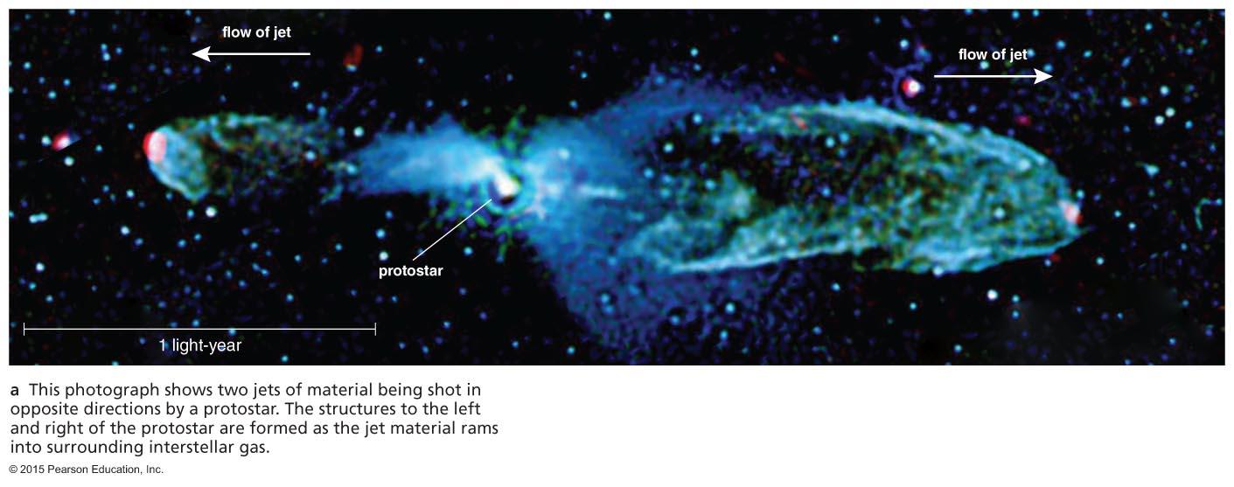
Jets are observed coming from the centers of disks around protostars.

Slide 25
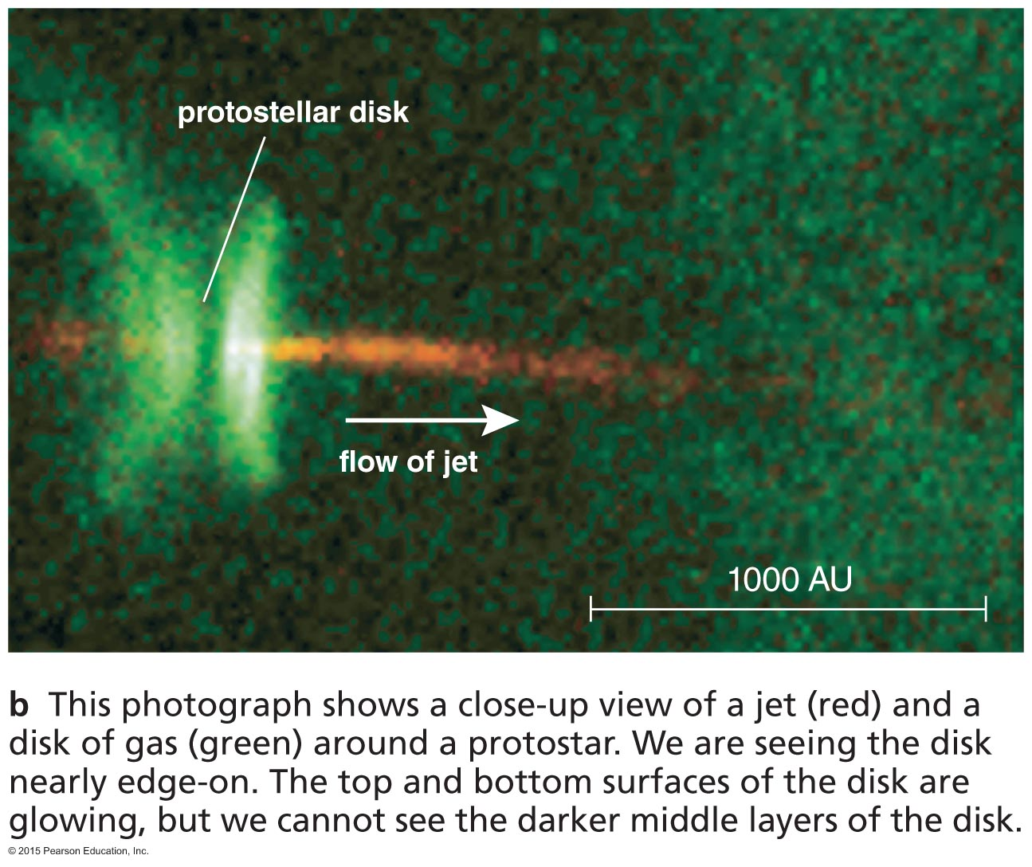

Slide 26
Thought Question
What would happen to a protostar that formed without any rotation at all?
Its jets would go in multiple directions.
It would not have planets.
It would be very bright in infrared light.
It would not be round.

Slide 27
Thought Question
What would happen to a protostar that formed without any rotation at all?
Its jets would go in multiple directions.
It would not have planets.
It would be very bright in infrared light.
It would not be round.

Slide 28
Protostar to Main Sequence
A protostar contracts and heats until the core temperature is sufficient for hydrogen fusion.
Contraction ends when energy released by hydrogen fusion balances energy radiated from the surface.
It takes 30 million years for a star like the Sun (less time for more massive stars).

Slide 29
Summary of Star Birth
Gravity causes gas cloud to shrink and fragment.
Core of shrinking cloud heats up.
When core gets hot enough, fusion begins and stops the shrinking.
New star achieves long-lasting state of balance

Slide 30
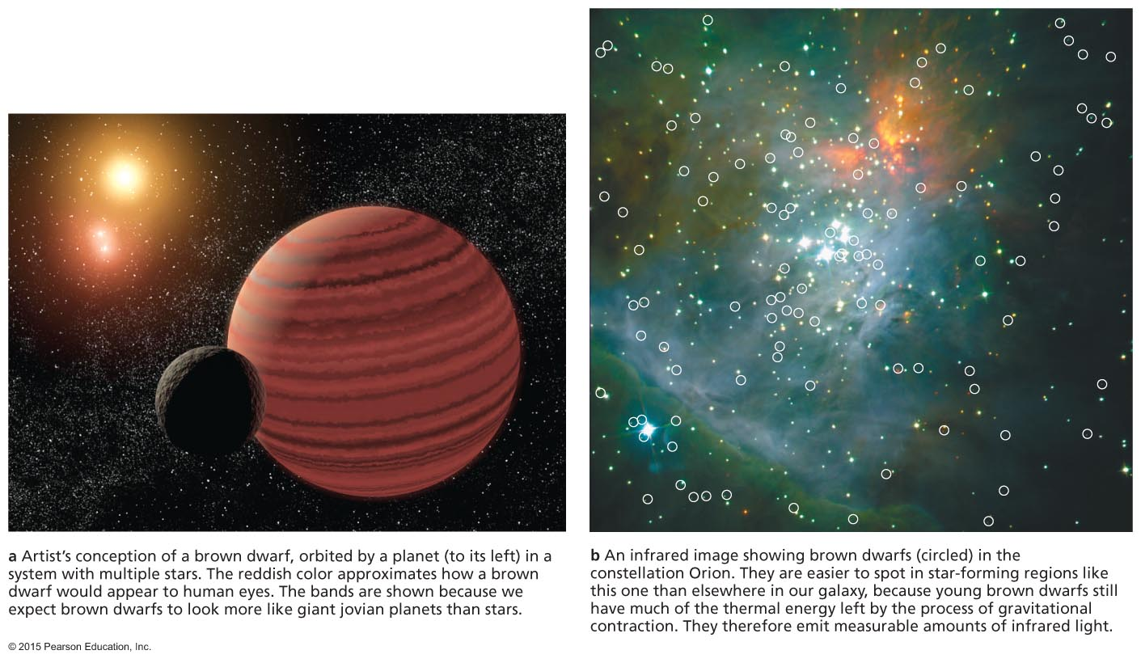
How massive are newborn stars?

Slide 31
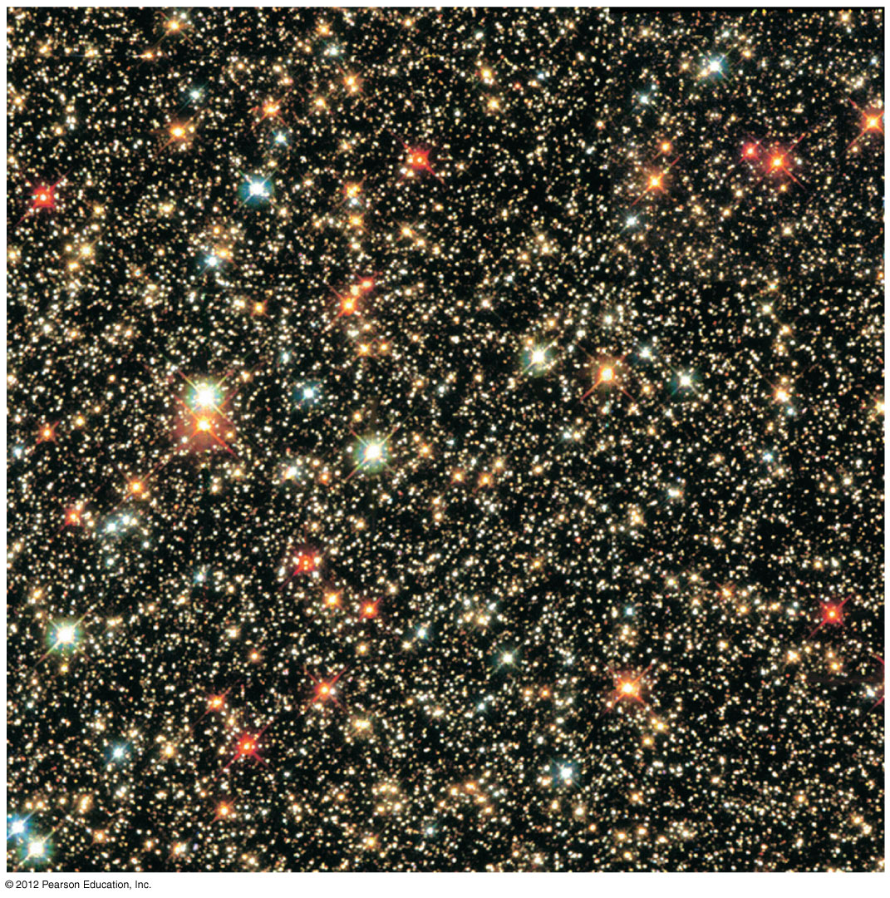
A cluster of many stars can form out of a single cloud.

Slide 32
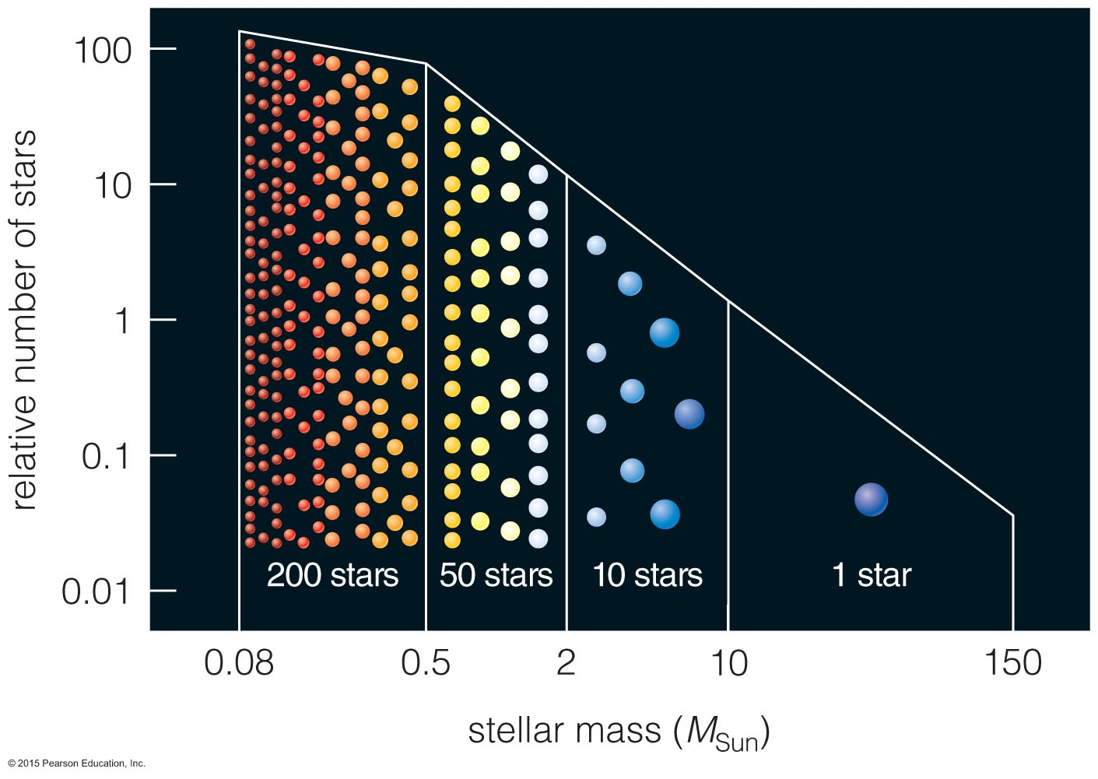
Very massive stars are rare.
Low-mass stars are common.

Slide 33
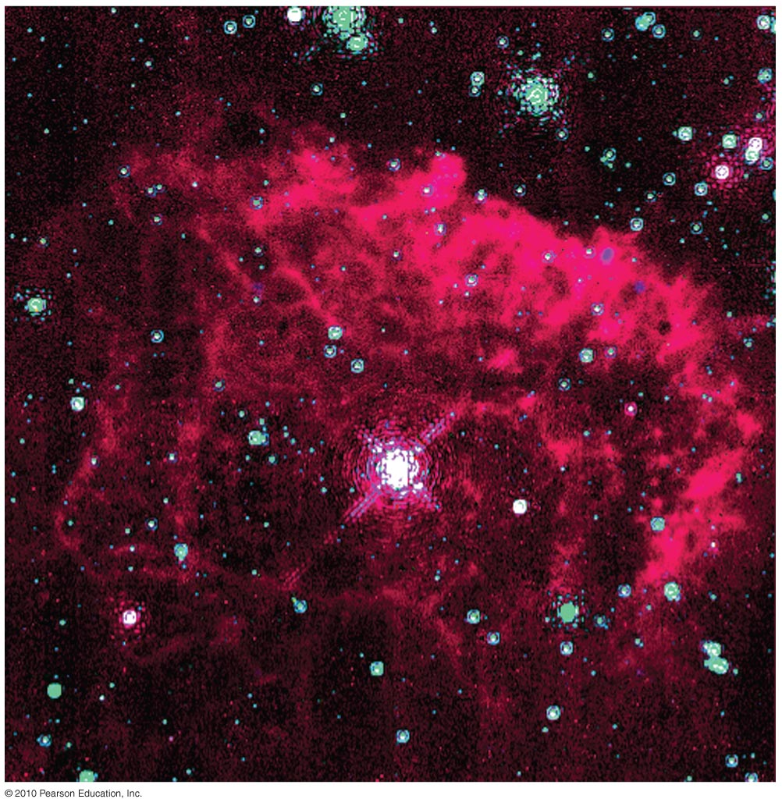
Upper Limit on a Star's Mass
Photons exert a slight amount of pressure when they strike matter.
Very massive stars are so luminous that the collective pressure of photons drives their matter into space.

Slide 34
Upper Limit on a Star's Mass
Models of stars suggest that radiation pressure limits how massive a star can be without blowing itself apart.
Observations have not found stars more massive than about 300M_{Sun}.

Slide 35
Lower Limit on a Star's Mass
Fusion will not begin in a contracting cloud if some sort of force stops contraction before the core temperature rises above 10⁷ K.
Thermal pressure cannot stop contraction because the star is constantly losing thermal energy from its surface through radiation.
Is there another form of pressure that can stop contraction?

Slide 36
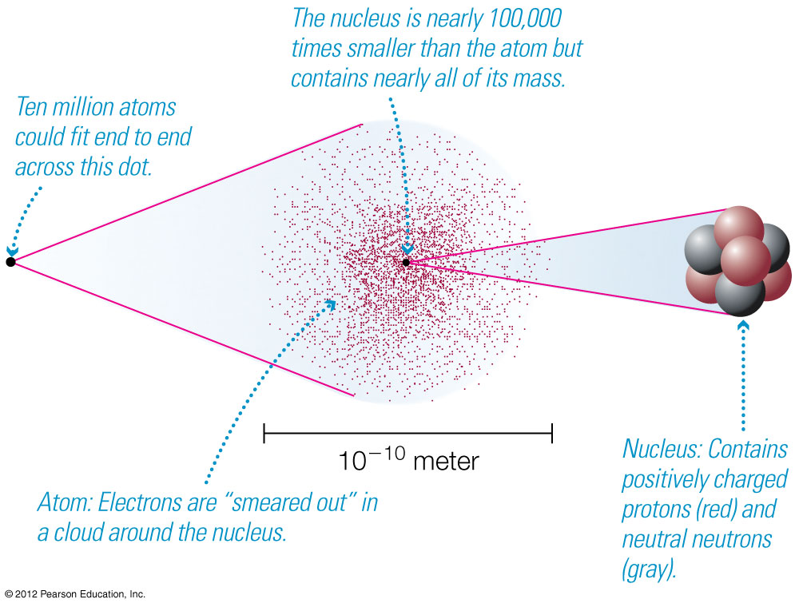
Degeneracy Pressure:
Laws of quantum mechanics prohibit two electrons from occupying the same state in the same place.

Slide 37
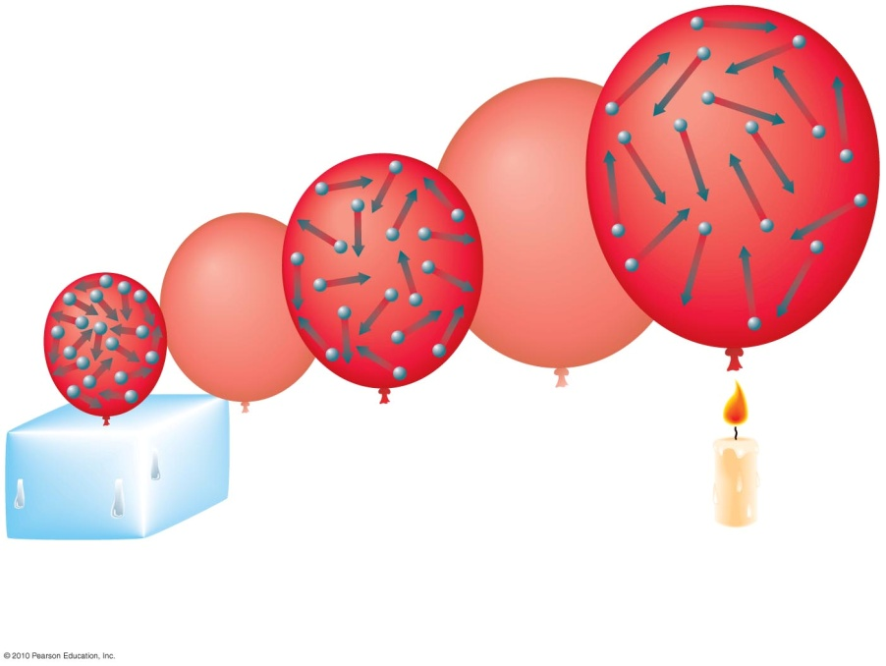
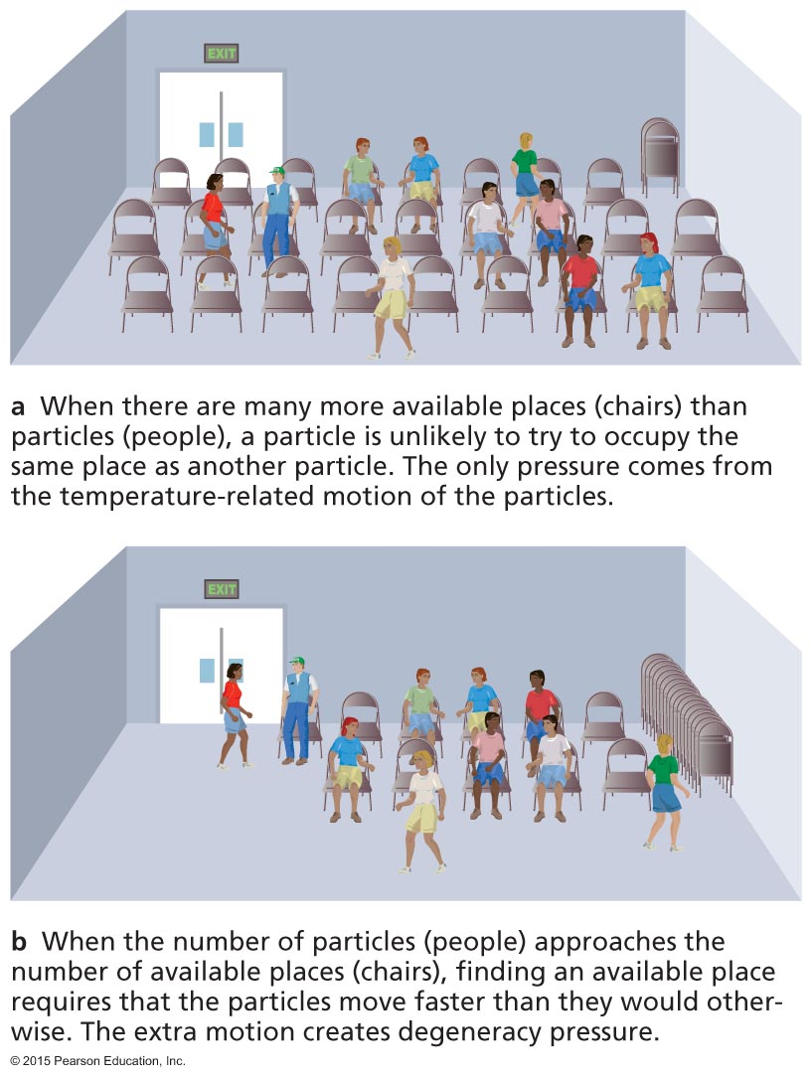
Thermal Pressure:
Depends on heat content
The main form of pressure in most stars
Degeneracy Pressure:
Particles can't be in same state in same place
Doesn't depend on heat content

Slide 38
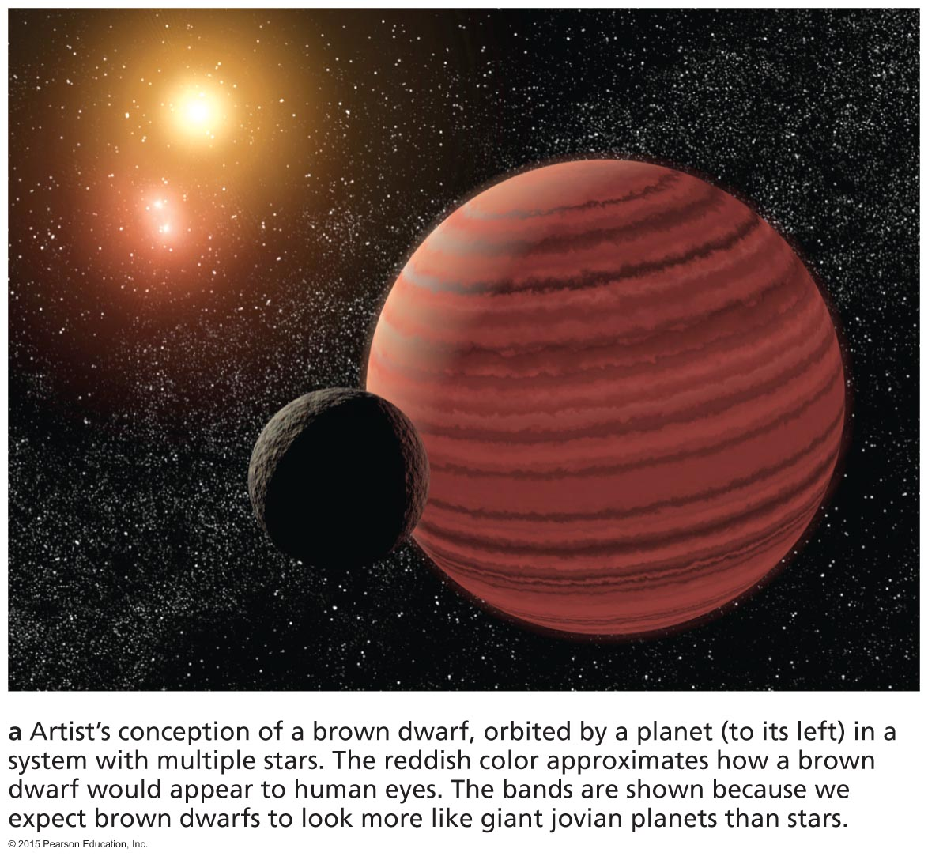
Brown Dwarfs
Degeneracy pressure halts the contraction of objects with <0.08M_{Sun} before the core temperature becomes hot enough for fusion.
Starlike objects not massive enough to start fusion are brown dwarfs.

Slide 39
Brown Dwarfs
A brown dwarf emits infrared light because of heat left over from contraction.
Its luminosity gradually declines with time as it loses thermal energy.

Slide 40
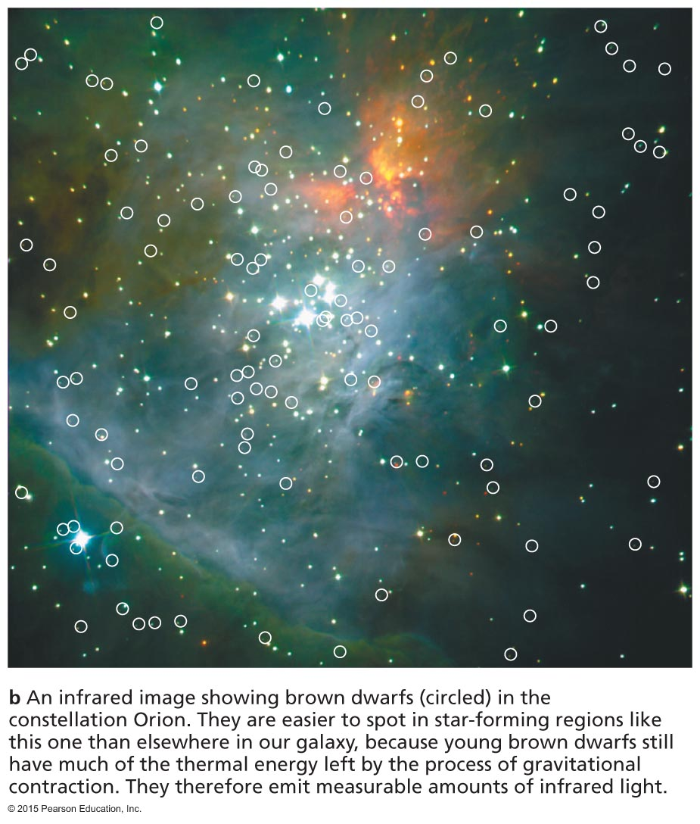
Brown Dwarfs in Orion
Infrared observations can reveal recently formed brown dwarfs because they are still relatively warm and luminous.

Slide 41
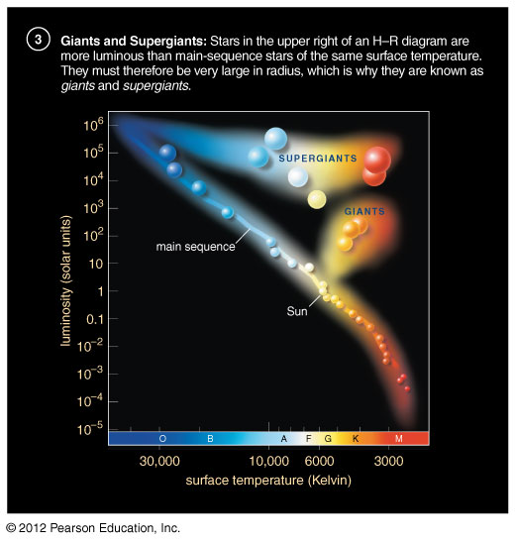
Stars more massive than 300M_{Sun} would blow apart.
Stars less massive than 0.08M_{Sun} can't sustain fusion.

Slide 42
What have we learned?
How do stars form?
Stars are born in cold, relatively dense molecular clouds.
As a cloud fragment collapses under gravity, it becomes a protostar surrounded by a spinning disk of gas.
The protostar may also fire jets of matter outward along its poles.

Slide 43
What have we learned?
How massive are newborn stars?
Stars greater than about 300M_{Sun} would be so luminous that radiation pressure would blow them apart.
Degeneracy pressure stops the contraction of objects <0.08M_{Sun} before fusion starts.

Slide 44
13.2 Life as a Low-Mass Star
Our goals for learning:
What are the life stages of a low-mass star?
How does a low-mass star die?

Slide 45
What are the life stages of a low-mass star?

Slide 46
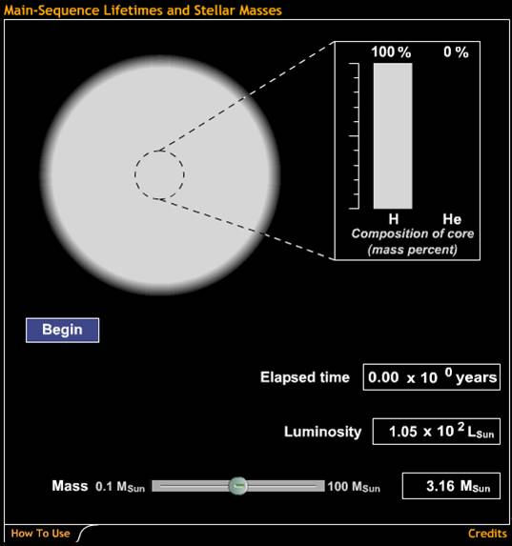
A star remains on the main sequence as long as it can fuse hydrogen into helium in its core.
Main-Sequence Lifetimes and Stellar Masses

Slide 47
Thought Question
What happens when a star can no longer fuse hydrogen to helium in its core?
Its core cools off.
Its core shrinks and heats up.
Its core expands and heats up.
Helium fusion immediately begins.

Slide 48
Thought Question
What happens when a star can no longer fuse hydrogen to helium in its core?
Its core cools off.
Its core shrinks and heats up.
Its core expands and heats up.
Helium fusion immediately begins.

Slide 49
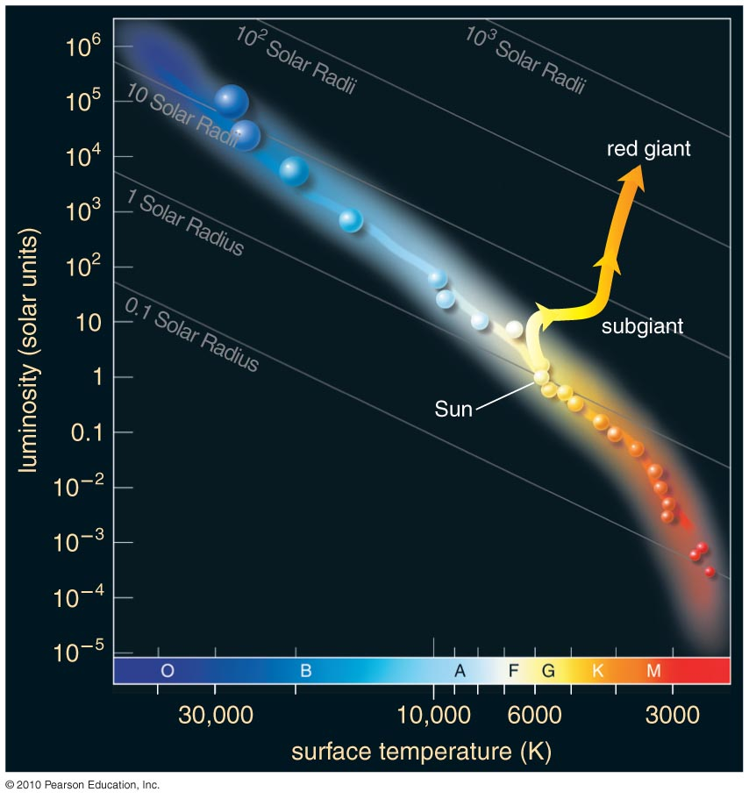
Life Track After Main Sequence
Observations of star clusters show that a star becomes larger, redder, and more luminous after its time on the main sequence is over.

Slide 50
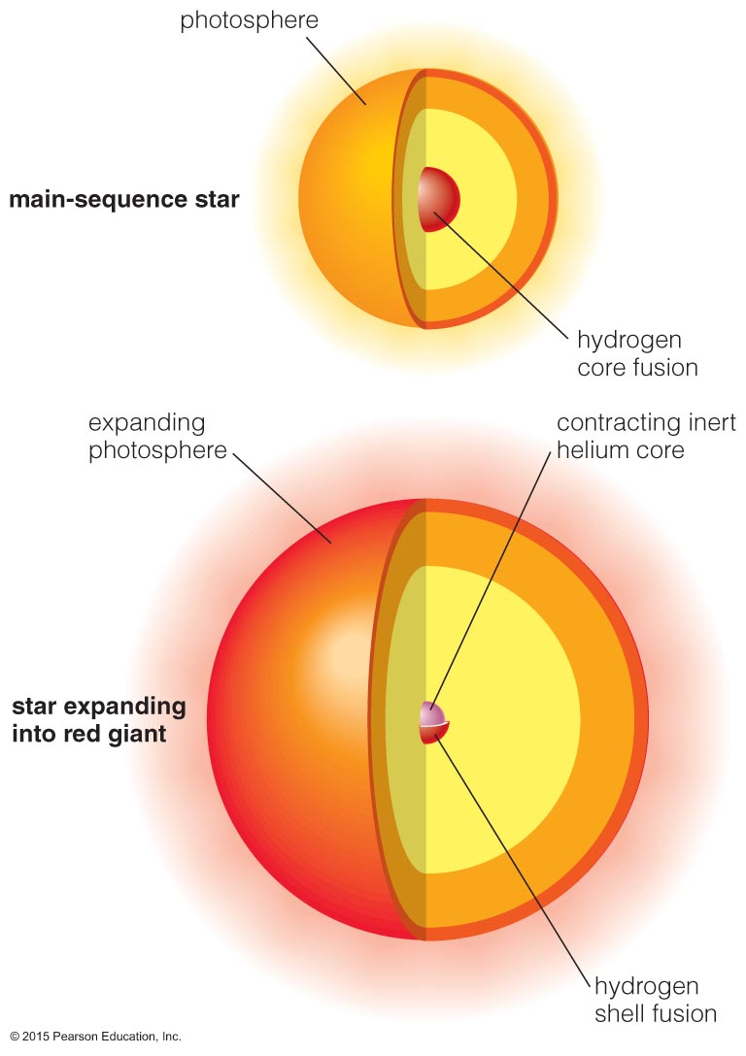
Broken Thermostat
As the core contracts, H begins fusing to He in a shell around the core.
Luminosity increases because the core thermostat is broken—the increasing fusion rate in the shell does not stop the core from contracting.

Slide 51
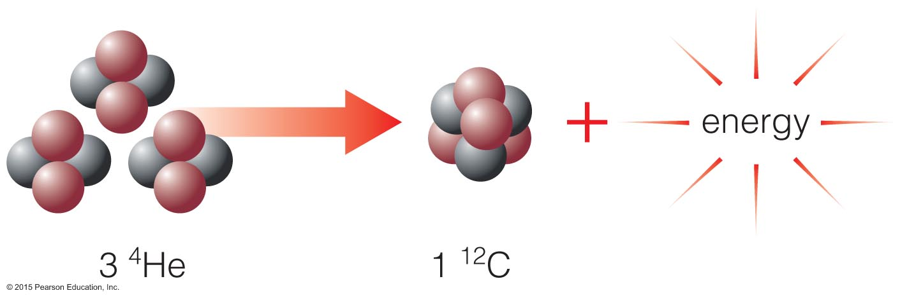
Helium fusion does not begin right away because it requires higher temperatures than hydrogen fusion—larger charge leads to greater repulsion.
The fusion of two helium nuclei doesn't work, so helium fusion must combine three He nuclei to make carbon.

Slide 52
Thought Question
What happens in a low-mass star when core temperature rises enough for helium fusion to begin?
Helium fusion slowly starts up.
Hydrogen fusion stops.
Helium fusion rises very sharply.
(Hint: Degeneracy pressure is the main form of pressure in the inert helium core.)

Slide 53
Thought Question
What happens in a low-mass star when core temperature rises enough for helium fusion to begin?
Helium fusion slowly starts up.
Hydrogen fusion stops.
Helium fusion rises very sharply.
(Hint: Degeneracy pressure is the main form of pressure in the inert helium core.)

Slide 54
Helium Flash
The thermostat is broken in a low-mass red giant because degeneracy pressure supports the core.
The core temperature rises rapidly when helium fusion begins.
The helium fusion rate skyrockets until thermal pressure takes over and expands the core again.

Slide 55
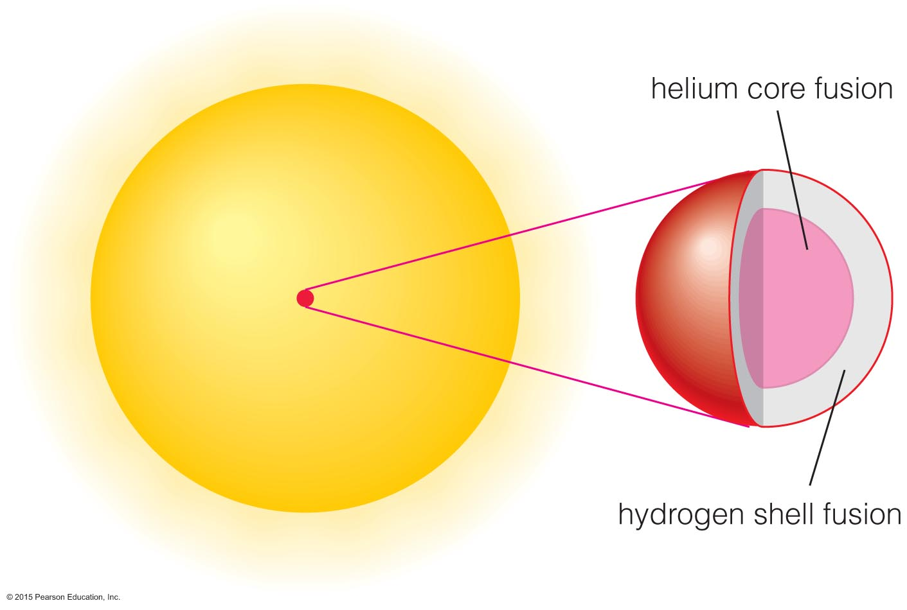
Helium core-fusion stars neither shrink nor grow because the core thermostat is temporarily fixed.

Slide 56
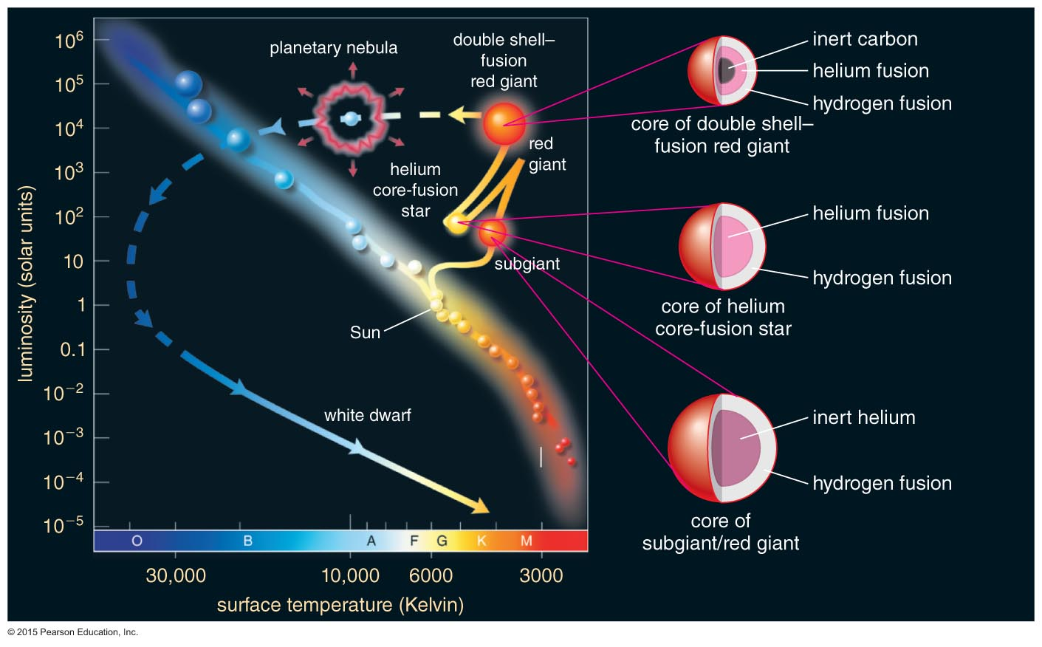
Life Track After Helium Flash
Models show that a red giant should shrink and become less luminous after helium fusion begins in the core.

Slide 57
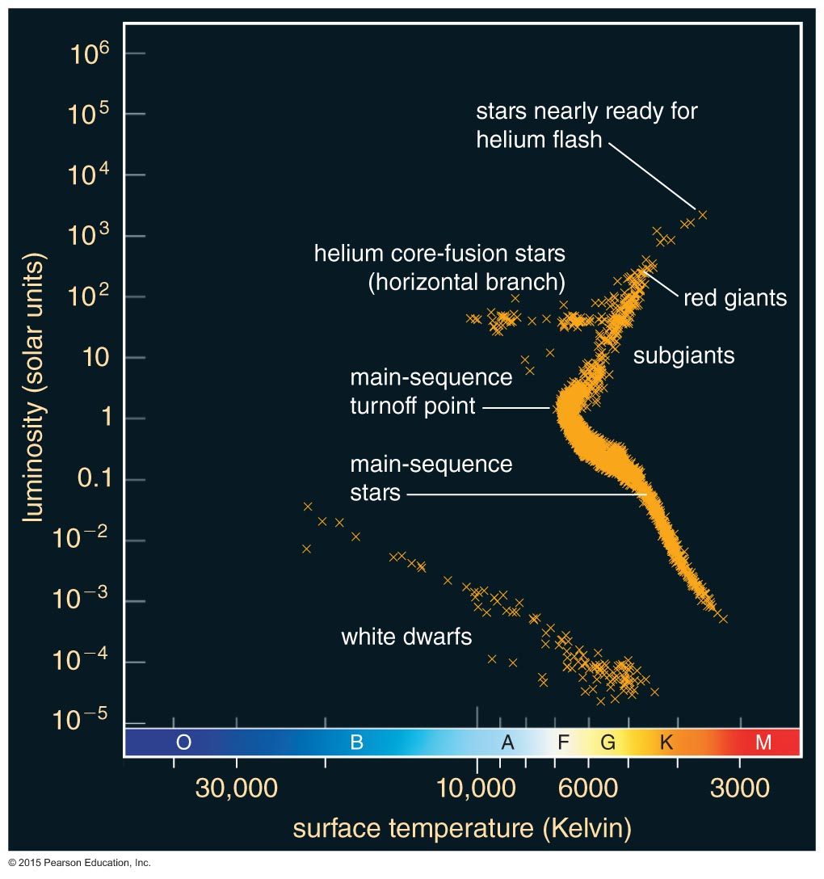
Life Track After Helium Flash
Observations of star clusters agree with these models.
Helium core-fusion stars are found in a horizontal branch on the H-R diagram.

Slide 58
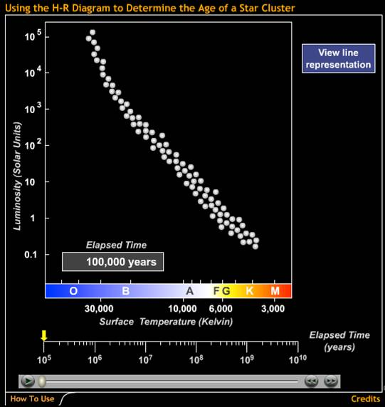
Combining models of stars of similar age but different mass helps us to age-date star clusters.
Using the H-R Diagram to Determine the Age of a Star Cluster

Slide 59
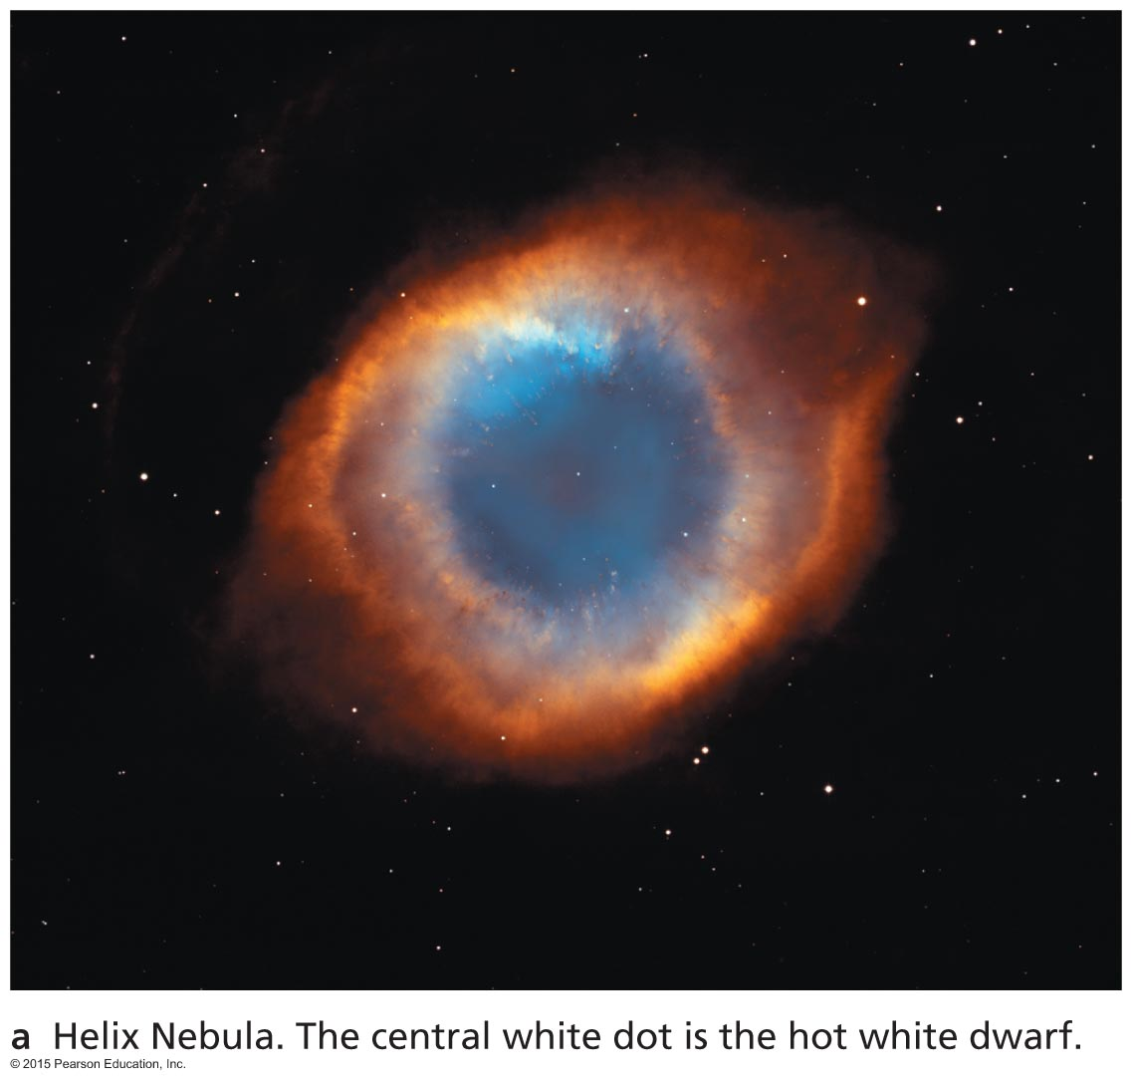
How does a low-mass star die?

Slide 60
Thought Question
What happens when a star's core runs out of helium?
The star explodes.
Carbon fusion begins.
The core cools off.
Helium fuses in a shell around the core.

Slide 61
Thought Question
What happens when a star's core runs out of helium?
The star explodes.
Carbon fusion begins.
The core cools off.
Helium fuses in a shell around the core.

Slide 62
Double Shell Fusion
After core helium fusion stops, He fuses into carbon in a shell around the carbon core, and H fuses to He in a shell around the helium layer.
This double shell–fusion stage never reaches equilibrium—the fusion rate periodically spikes upward in a series of thermal pulses.
With each spike, convection dredges carbon up from the core and transports it to the surface.

Slide 63
Planetary Nebulae
Double shell–fusion ends with a pulse that ejects the H and He into space as a planetary nebula.
The core left behind becomes a white dwarf.

Slide 64
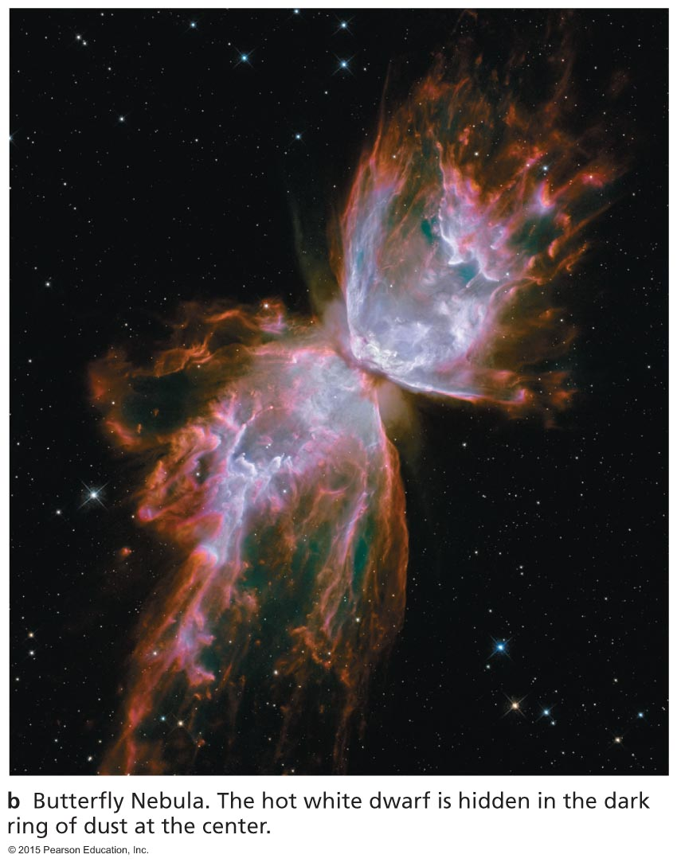
Planetary Nebulae
Double shell–fusion ends with a pulse that ejects the H and He into space as a planetary nebula.
The core left behind becomes a white dwarf.

Slide 65
End of Fusion
Fusion progresses no further in a low-mass star because the core temperature never grows hot enough for fusion of heavier elements (some He fuses to C to make oxygen).
Degeneracy pressure supports the white dwarf against gravity.

Slide 66
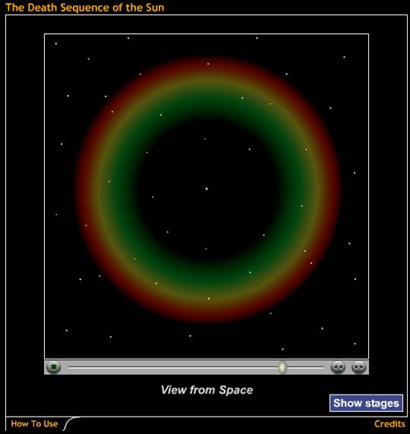
Life stages of a low-mass star such as the Sun
The Death Sequence of the Sun

Slide 67
Life Track of a Sun-Like Star

Slide 68
What have we learned?
What are the life stages of a low-mass star?
H fusion in core (main sequence)
H fusion in shell around contracting core (red giant)
He fusion in core (horizontal branch)
Double shell–fusion (red giant)
How does a low-mass star die?
Ejection of H and He in a planetary nebula leaves behind an inert white dwarf.

Slide 69
13.3 Life as a High-Mass Star
Our goals for learning:
What are the life stages of a high-mass star?
How do high-mass stars make the elements necessary for life?
How does a high-mass star die?

Slide 70
What are the life stages of a high-mass star?

Slide 71
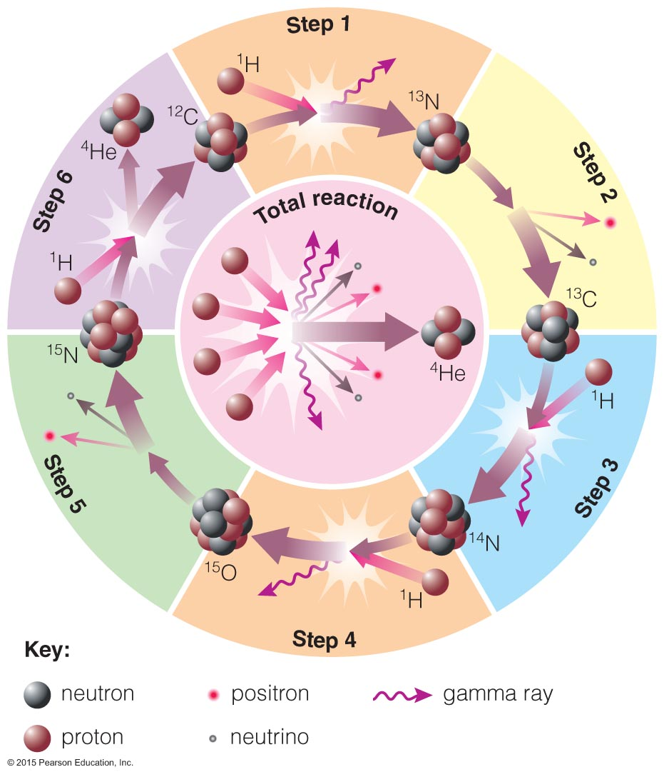
CNO Cycle
High-mass main- sequence stars fuse H to He at a higher rate using carbon, nitrogen, and oxygen as catalysts.
A greater core temperature enables H nuclei to overcome greater repulsion.

Slide 72
Life Stages of High-Mass Stars
Late life stages of high-mass stars are similar to those of low-mass stars:
Hydrogen core fusion (main sequence)
Hydrogen shell fusion (supergiant)
Helium core fusion (supergiant)

Slide 73
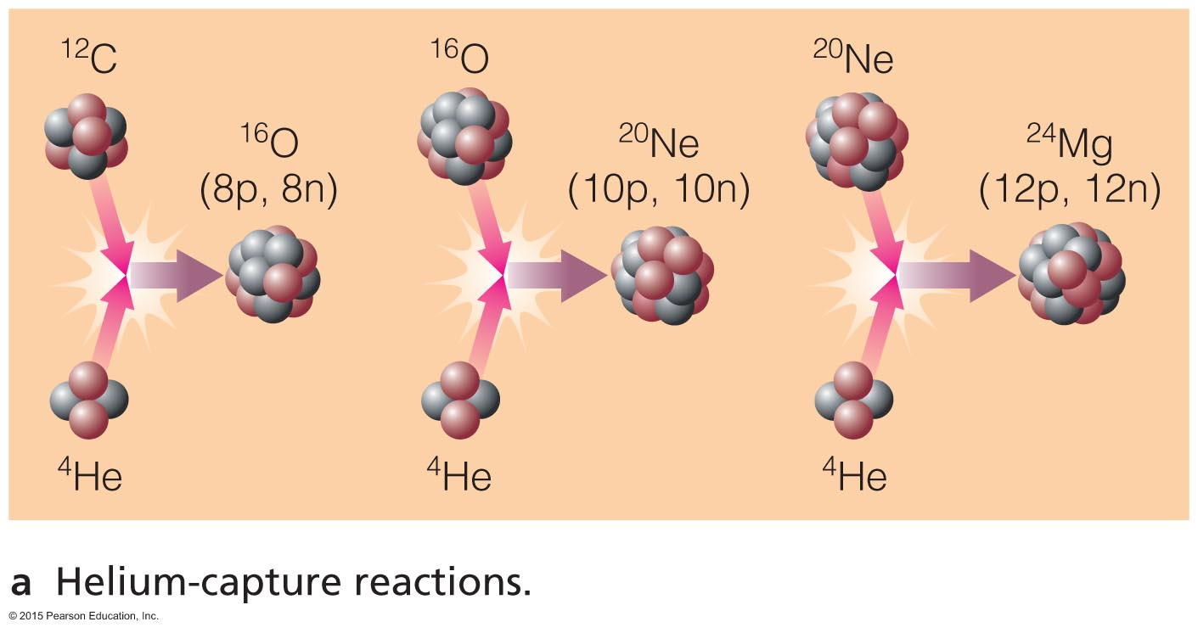
How do high-mass stars make the elements necessary for life?

Slide 74
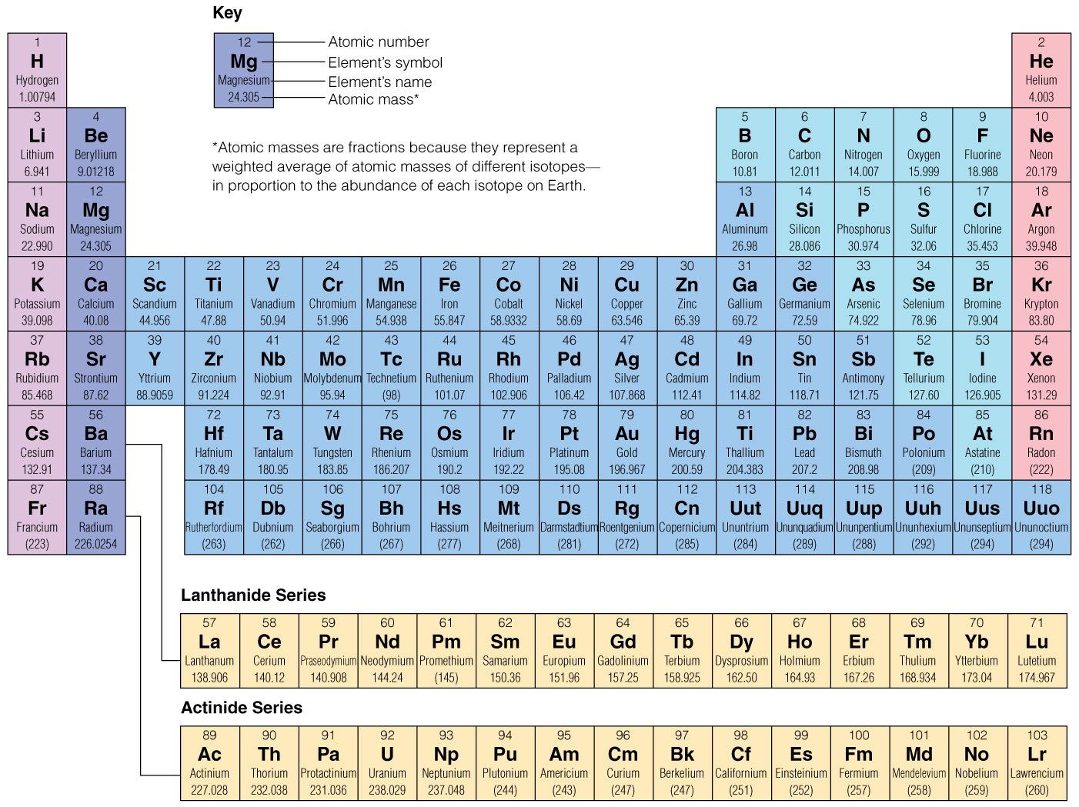
Big Bang made 75% H, 25% He—stars make everything else.

Slide 75
Helium fusion can make carbon in low-mass stars.

Slide 76
The CNO cycle can change C into N and O

Slide 77
Helium Capture
High core temperatures allow helium to fuse with heavier elements.

Slide 78
Helium capture builds C into O, Ne, Mg …

Slide 79
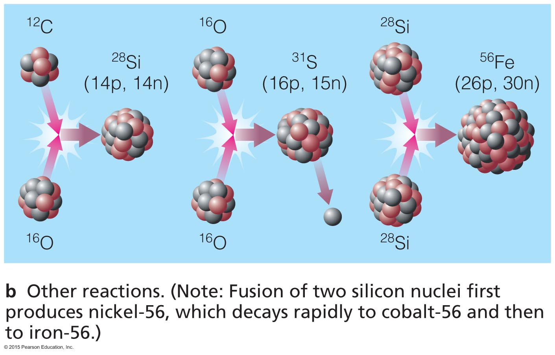
Advanced Nuclear Burning
Core temperatures in stars with >8M_{Sun} allow fusion of elements as heavy as iron.

Slide 80
Advanced reactions in stars make elements such as Si, S, Ca, and Fe.

Slide 81
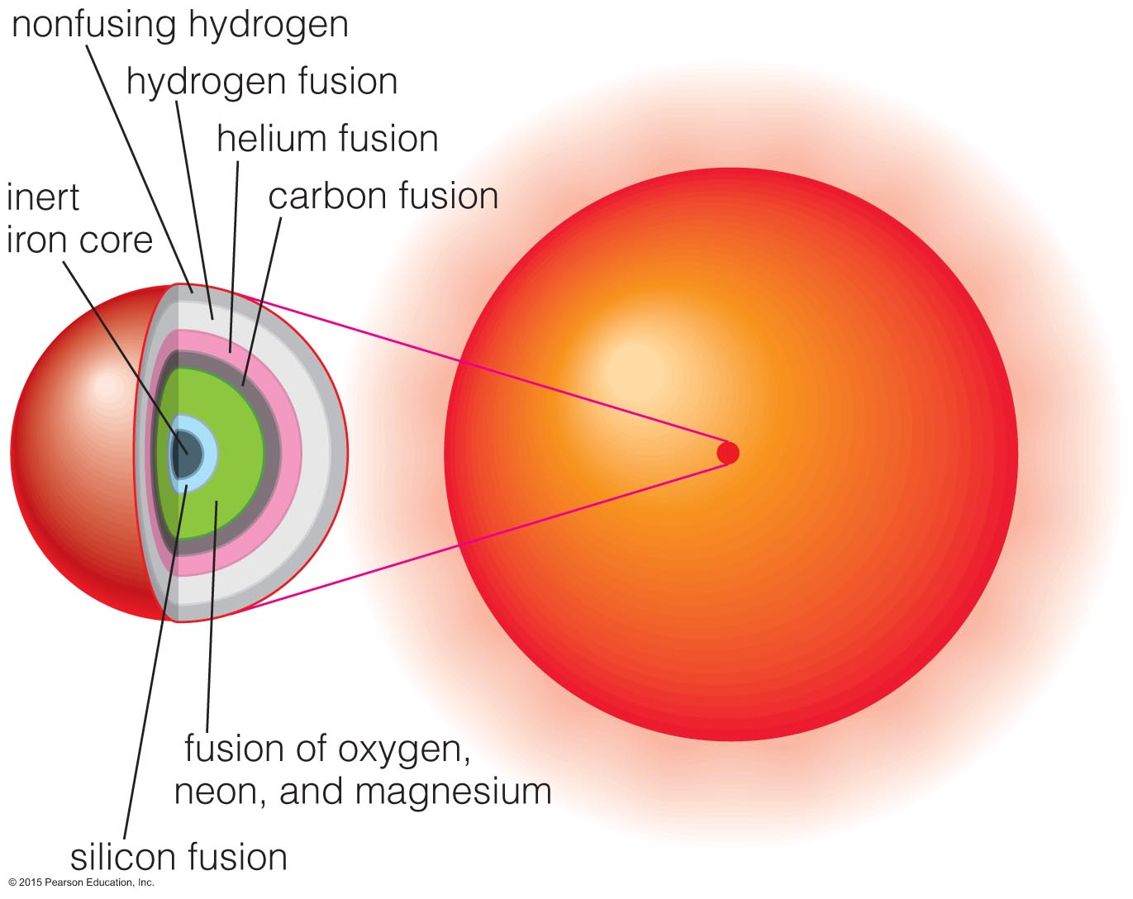
Multiple Shell Burning
Advanced nuclear burning proceeds in a series of nested shells.

Slide 82
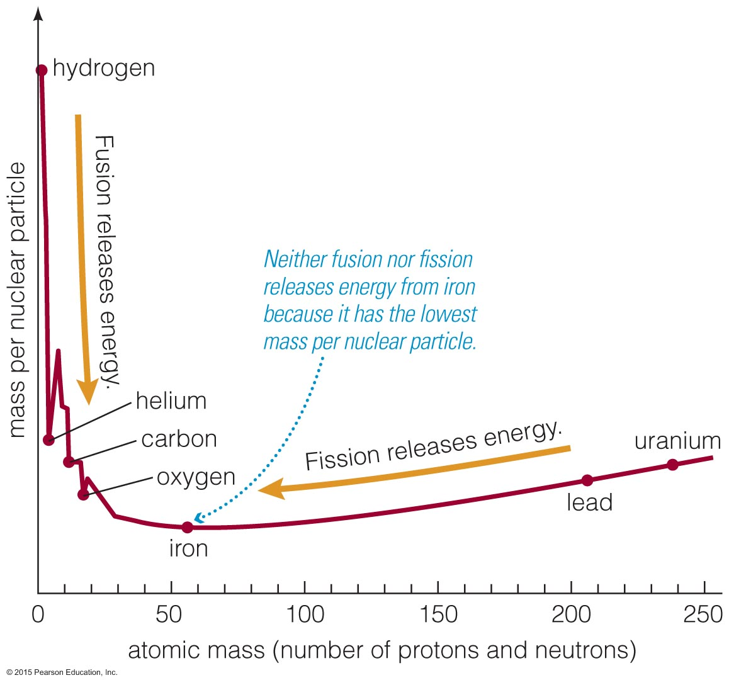
Iron is a dead end for fusion because nuclear reactions involving iron do not release energy.
(Fe has lowest mass per nuclear particle.)

Slide 83
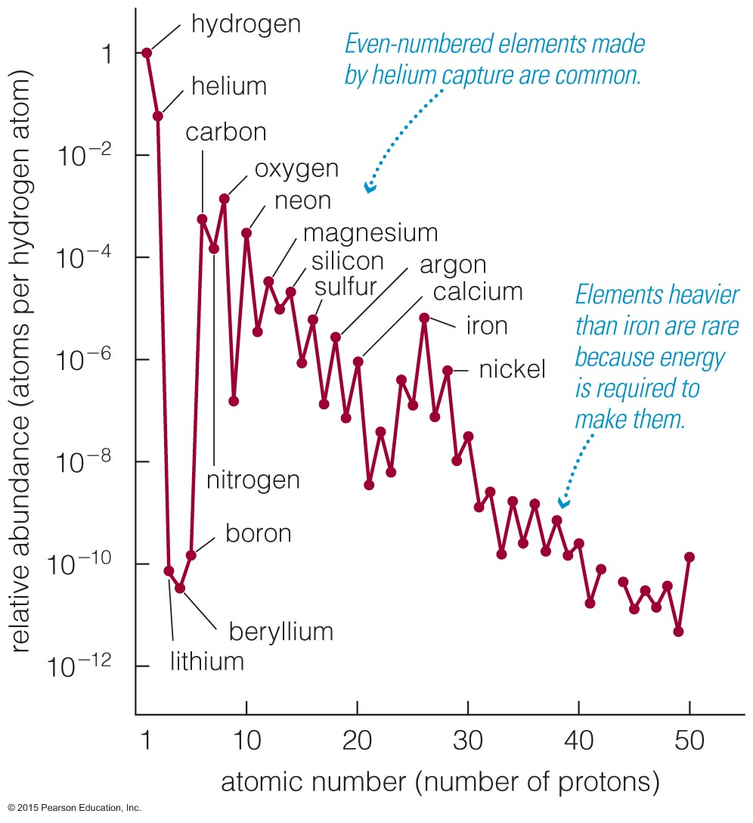
Evidence for helium capture:
Higher abundances of elements with even numbers of protons

Slide 84
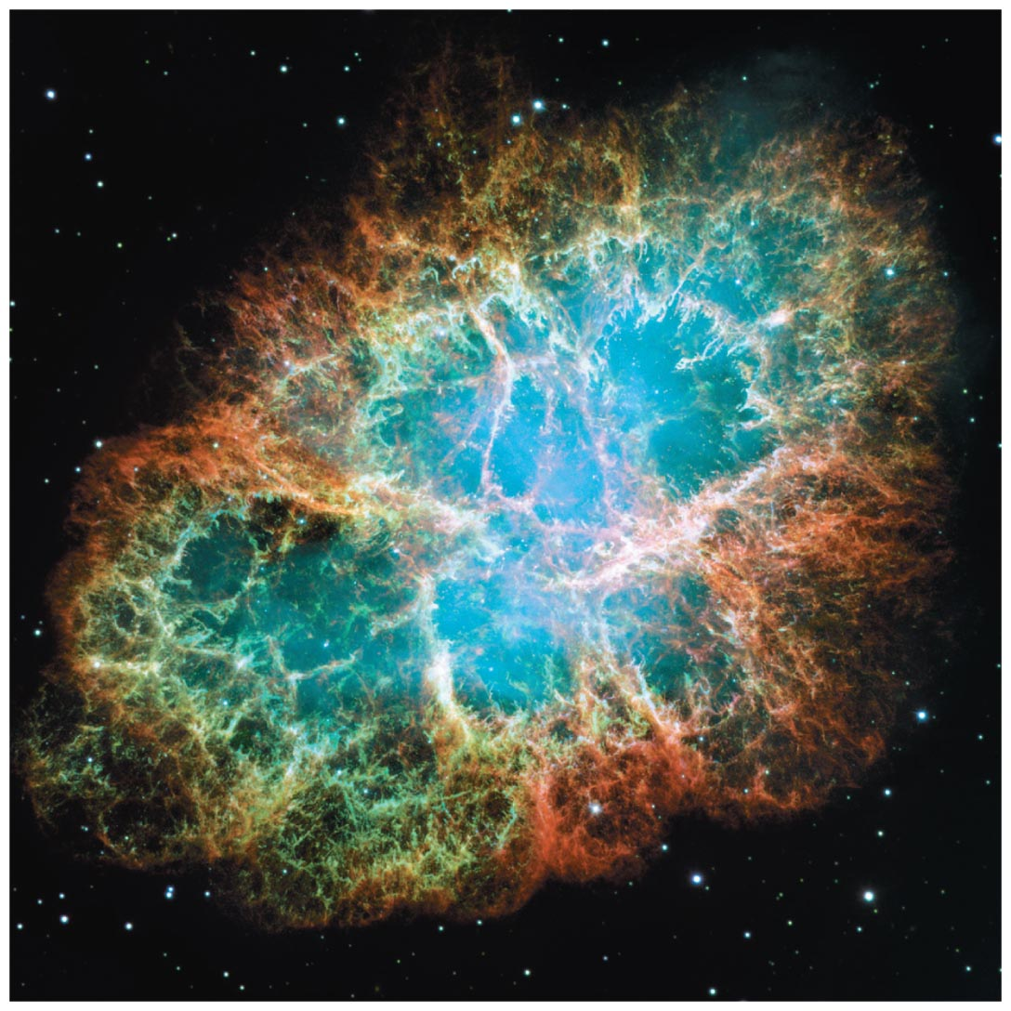
How does a high-mass star die?

Slide 85
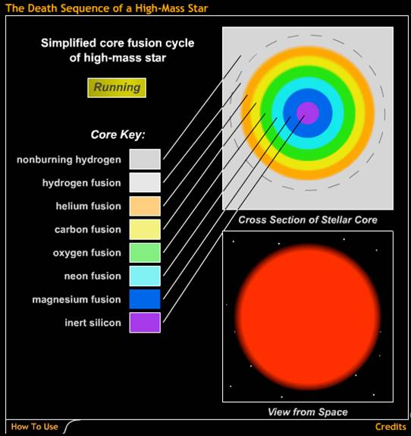
Iron builds up in the core until degeneracy pressure can no longer resist gravity.
The core then suddenly collapses, creating a supernova explosion.
The Death Sequence of a High-Mass Star
Notes:
Download a good supernova explosion movie from the Chandra Science Center (chandra.harvard.edu).

Slide 86
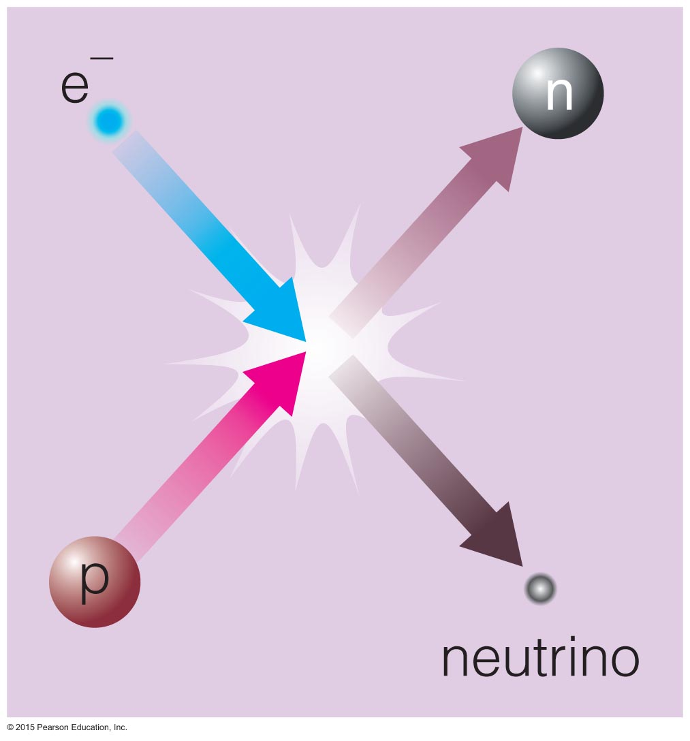
Supernova Explosion
Core degeneracy pressure goes away because electrons combine with protons, making neutrons and neutrinos.
Neutrons collapse to the center, forming a neutron star.

Slide 87
Energy and neutrons released in a supernova explosion enable elements heavier than iron to form, including Au and U.

Slide 88
Supernova Remnant
Energy released by the collapse of the core drives outer layers into space.
The Crab Nebula is the remnant of the supernova seen in A.D. 1054.

Slide 89
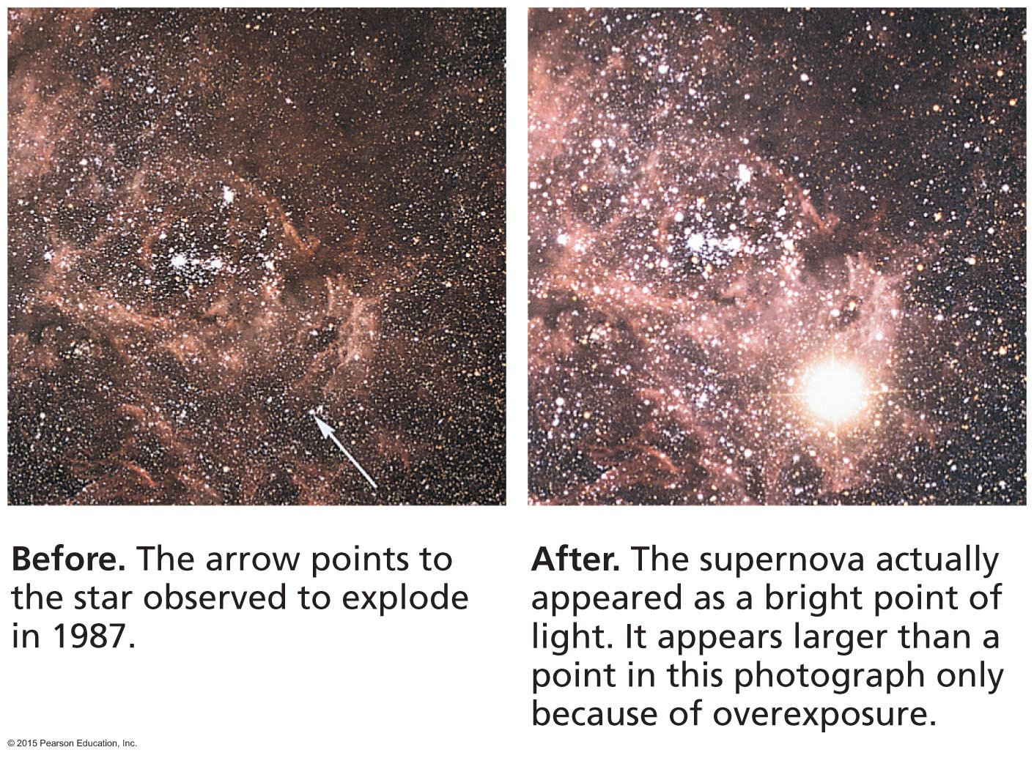
Supernova 1987A
The closest supernova in the last four centuries was seen in 1987.

Slide 90
Summary - Role of Mass
A star's mass determines its entire life story because it determines its core temperature.
High-mass stars have short lives, eventually becoming hot enough to make iron, and end in supernova explosions.
Low-mass stars have long lives, never become hot enough to fuse carbon nuclei, and end as white dwarfs.

Slide 91
Summary - Life Stages of Low-Mass Star
Main Sequence: H fuses to He in core
Red Giant: H fuses to He in shell around He core
Helium Core Fusion: He fuses to C in core while H fuses to He in shell
Double Shell Fusion: H and He both fuse in shells
Planetary Nebula: leaves white dwarf behind
Not to scale!

Slide 92
Summary - Reasons for Life Stages
Core shrinks and heats until it's hot enough for fusion.
Nuclei with larger charge require higher temperature for fusion.
Core thermostat is broken while core is not hot enough for fusion (shell burning).
Core fusion can't happen if degeneracy pressure keeps core from shrinking.
Not to scale!

Slide 93
Summary - Life Stages of High-Mass Star
Main Sequence: H fuses to He in core
Red Supergiant: H fuses to He in shell around He core
Helium Core Fusion: He fuses to C in core while H fuses to He in shell
Multiple Shell Fusion: many elements fuse in shells
Supernova leaves neutron star behind
Not to scale!

Slide 94
What have we learned?
What are the life stages of a high-mass star?
They are similar to the life stages of a low-mass star.
How do high-mass stars make the elements necessary for life?
Higher masses produce higher core temperatures that enable fusion of heavier elements.
How does a high-mass star die?
The iron core collapses, leading to a supernova.

Slide 95
13.4 Stars in Close Binaries
Our goals for learning:
How are the lives of stars with close companions different?

Slide 96
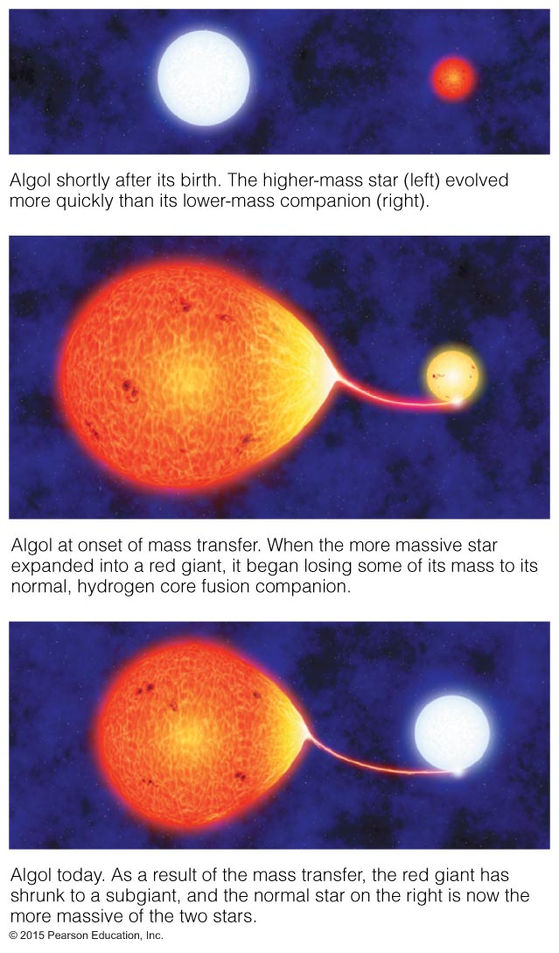
How are the lives of stars with close companions different?

Slide 97
Thought Question
The binary star Algol consists of a 3.7M_{Sun} main- sequence star and a 0.8M_{Sun} subgiant star.
What's strange about this pairing?
How did it come about?

Slide 98
Stars in Algol are close enough that matter can flow from the subgiant onto the main-sequence star.

Slide 99
The star that is now a subgiant was originally more massive.
As it reached the end of its life and started to grow, it began to transfer mass to its companion (mass exchange).
Now the companion star is more massive.

Slide 100
What have we learned?
How are the lives of stars with close companions different?
Stars with close companions can exchange mass, altering the usual life stories of stars.

