Slide 1
Chapter 18: Dark Matter, Dark Energy, and the Fate of the Universe

Slide 2
18.1 Unseen Influences in the Cosmos
Our goals for learning:
What do we mean by dark matter and dark energy?

Slide 3
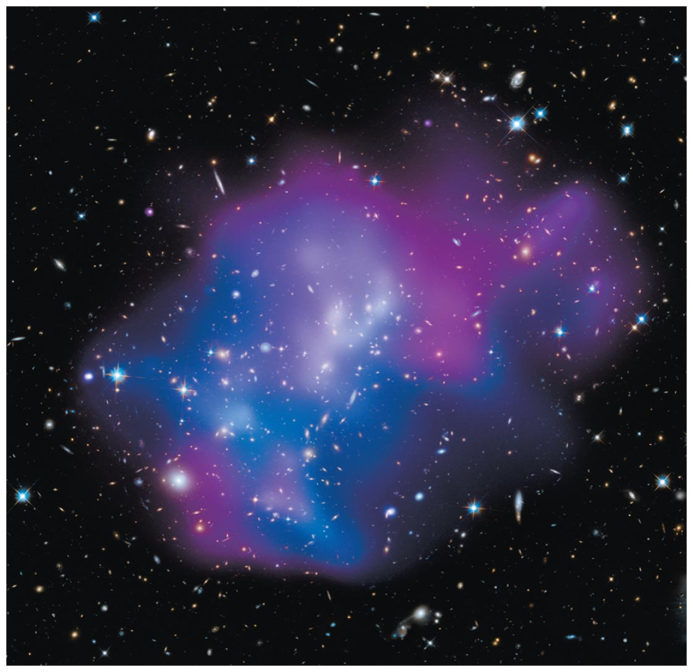
What do we mean by dark matter and dark energy?

Slide 4
Unseen Influences
Dark matter: An undetected form of mass that emits little or no light but whose existence we infer from its gravitational influence
Dark energy: An unknown form of energy that seems to be the source of a repulsive force causing the expansion of the universe to accelerate

Slide 5
Contents of Universe
Normal matter: ~ 5%
Normal matter inside stars: ~ 0.5%
Normal matter outside stars: ~ 4.5%
Dark matter: ~ 27%
Dark energy: ~ 68%

Slide 6
What have we learned?
What do we mean by dark matter and dark energy?
Dark matter is the name given to the unseen mass whose gravity governs the observed motions of stars and gas clouds.
Dark energy is the name given to whatever might be causing the expansion of the universe to accelerate.

Slide 7
18.2 Evidence for Dark Matter
Our goals for learning:
What is the evidence for dark matter in galaxies?
What is the evidence for dark matter in clusters of galaxies?
Does dark matter really exist?
What might dark matter be made of?

Slide 8
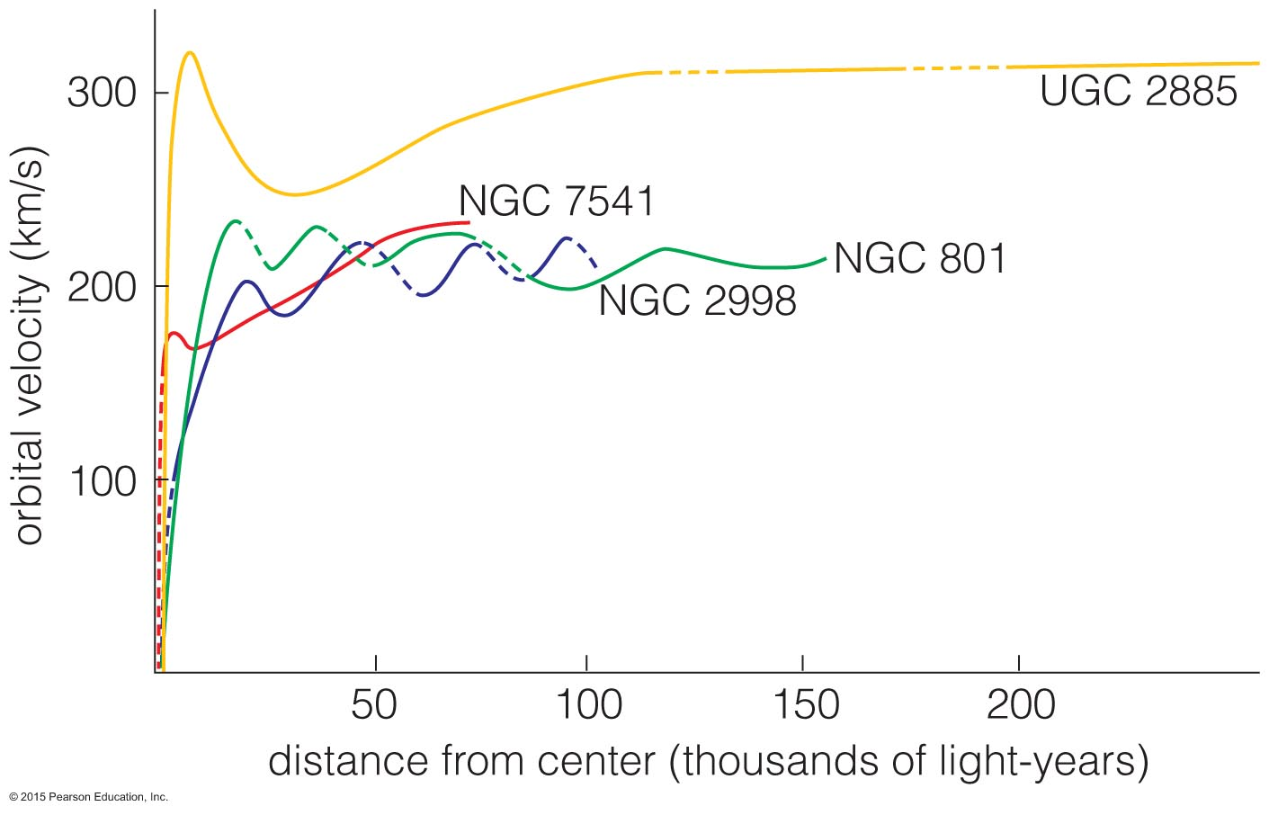
What is the evidence for dark matter in galaxies?

Slide 9
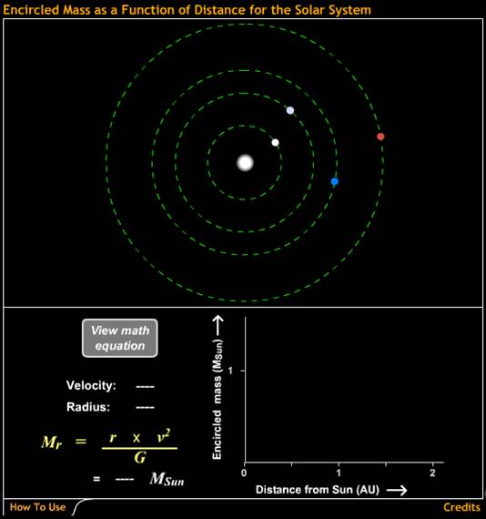
We measure the mass of the solar system using the orbits of planets.
Orbital period
Average distance
Or for circles:
Orbital velocity
Orbital radius
Encircled Mass as a Function of Distance for the Solar System

Slide 10
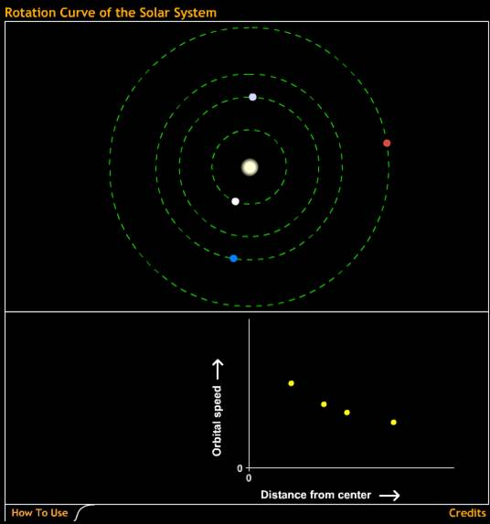
Rotation curve
A plot of orbital speed versus orbital radius
Solar system's rotation curve declines because Sun has almost all the mass.
Rotation Curve of the Solar System

Slide 11
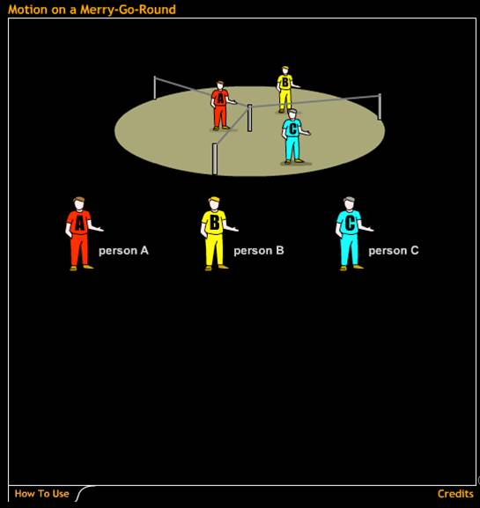
Who has the largest orbital speed?
A, B, or C?
Motion on a Merry-Go-Round

Slide 12
Who has the largest orbital speed?
A, B, or C?
Answer: C
Motion on a Merry-Go-Round

Slide 13
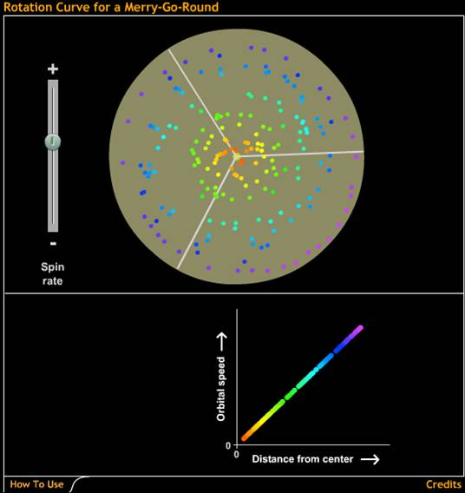
Rotation curve of merry-go-round rises with radius.
Rotation Curve for a Merry-Go-Round

Slide 14
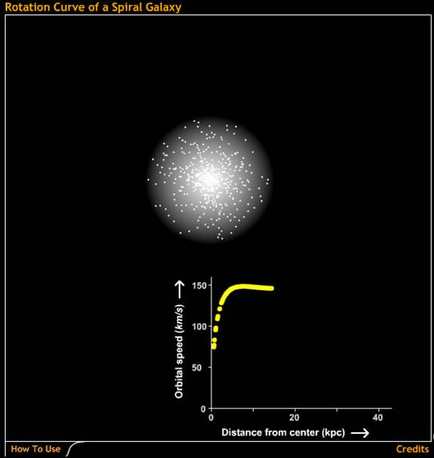
The rotation curve of the Milky Way stays flat with distance.
Mass must be more spread out than in the solar system.
Rotation Curve of a Spiral Galaxy

Slide 15
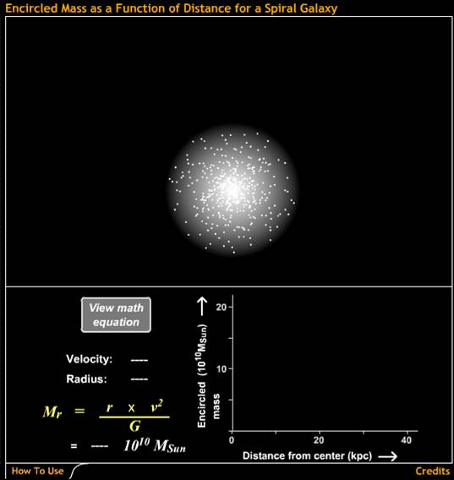
The mass in the Milky Way is spread out over a larger region than the stars.
Most of the Milky Way's mass seems to be dark matter!
Encircled Mass as a Function of Distance for a Spiral Galaxy

Slide 16
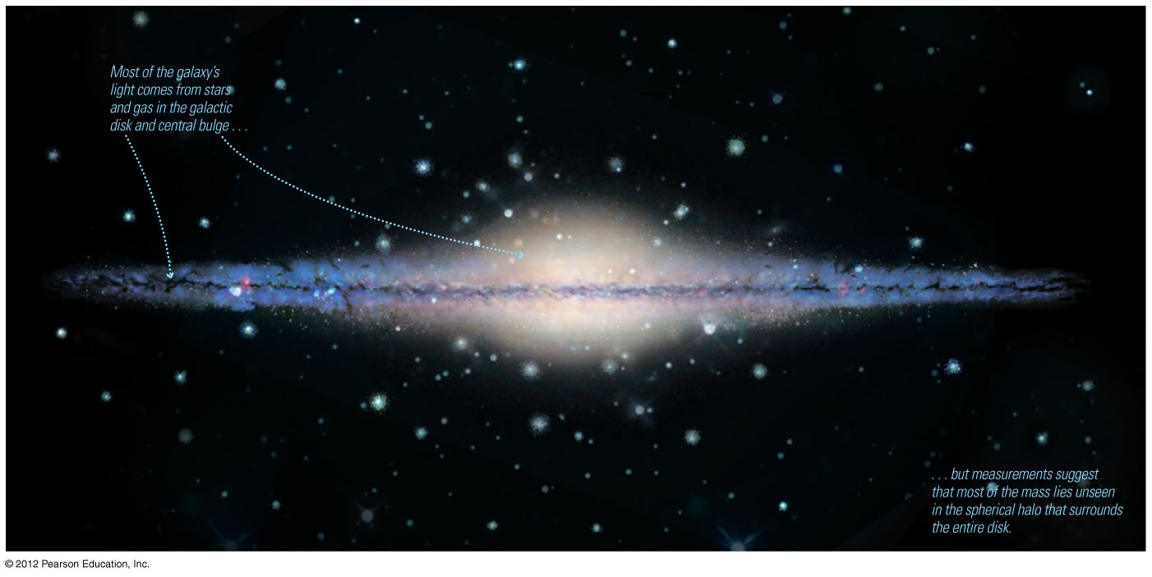
Mass within Sun's orbit: 1.0 ✕ 10¹¹M_{Sun}
Totalmass: ~10¹²M_{Sun}

Slide 17
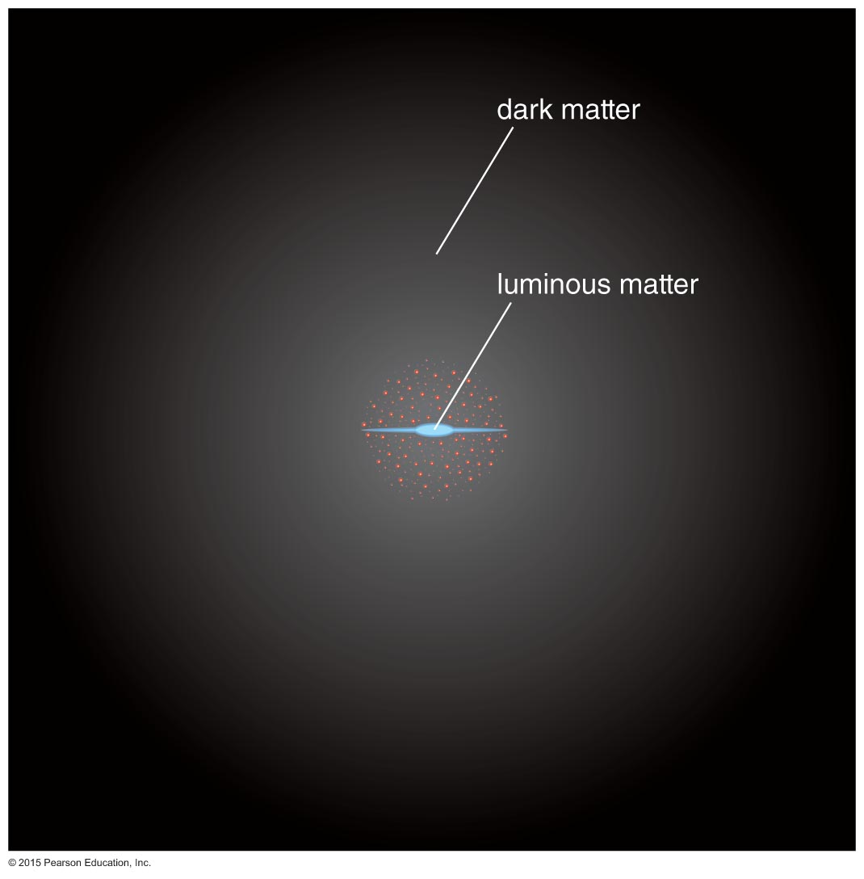
The visible portion of a galaxy lies deep in the heart of a large halo of dark matter.

Slide 18
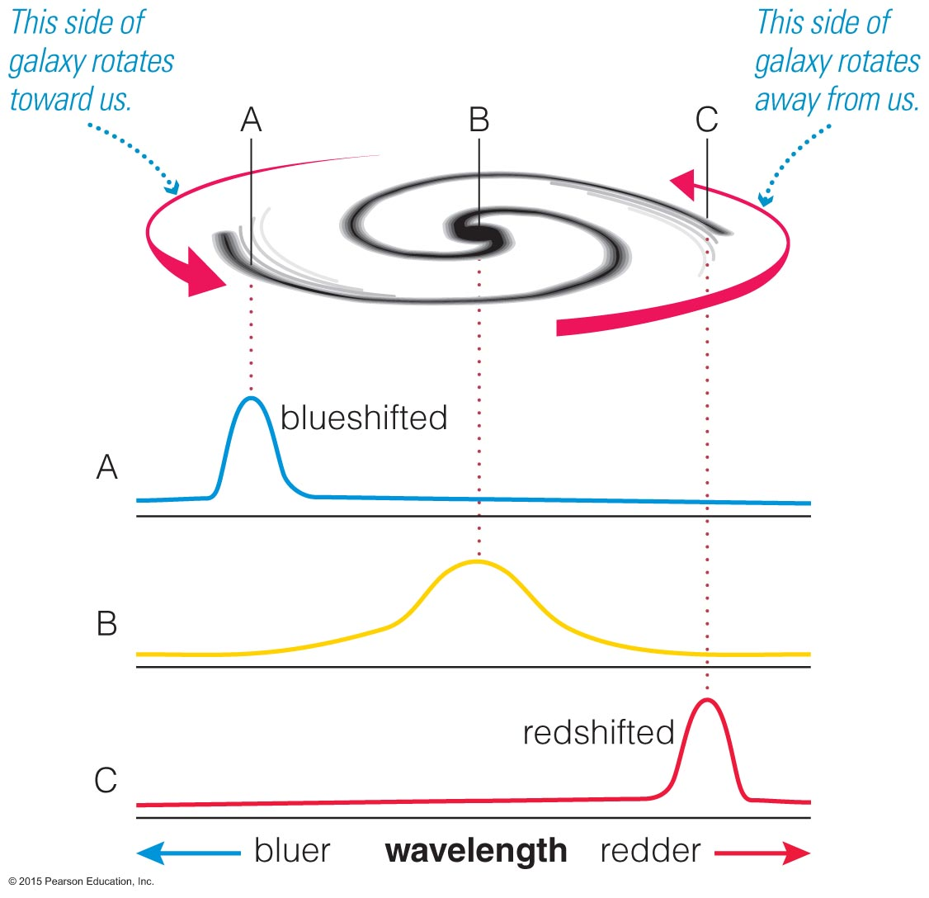
We can measure orbital velocities in other spiral galaxies using the Doppler shift of the 21-cm line of atomic H.

Slide 19
Spiral galaxies all tend to have orbital velocities that remain constant at large radii, indicating large amounts of dark matter.

Slide 20
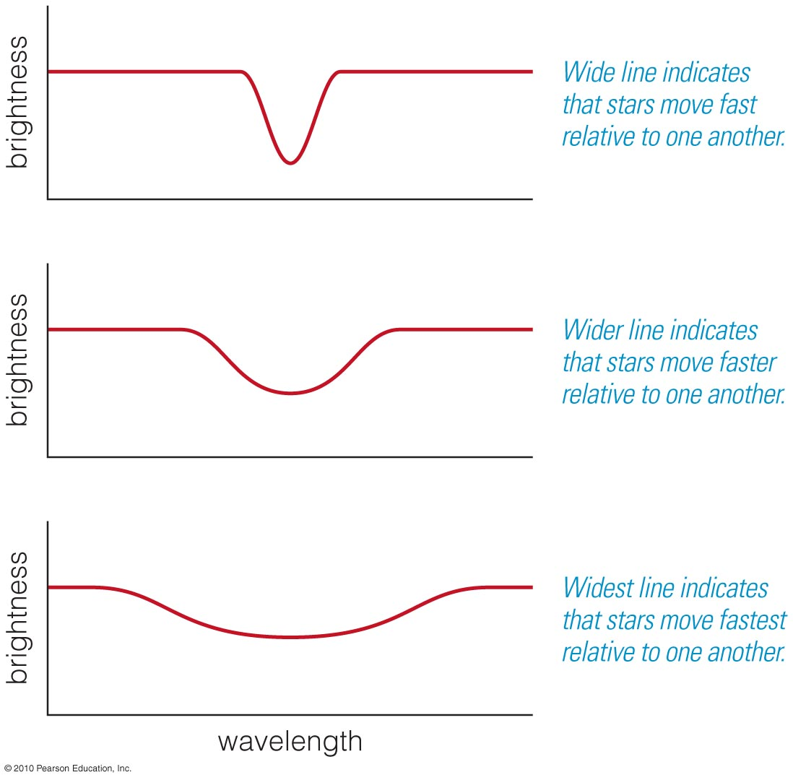
The broadening of spectral lines in elliptical galaxies tells us how fast the stars are orbiting.
These galaxies also have dark matter.

Slide 21
Thought Question
What would you conclude about a galaxy in which orbital velocities rise steadily with distance beyond the visible part of its disk?
Its mass is concentrated at the center.
It rotates like the solar system.
It is especially rich in dark matter.
It's just like the Milky Way.

Slide 22
Thought Question
What would you conclude about a galaxy in which orbital velocities rise steadily with distance beyond the visible part of its disk?
Its mass is concentrated at the center.
It rotates like the solar system.
It is especially rich in dark matter.
It's just like the Milky Way.

Slide 23
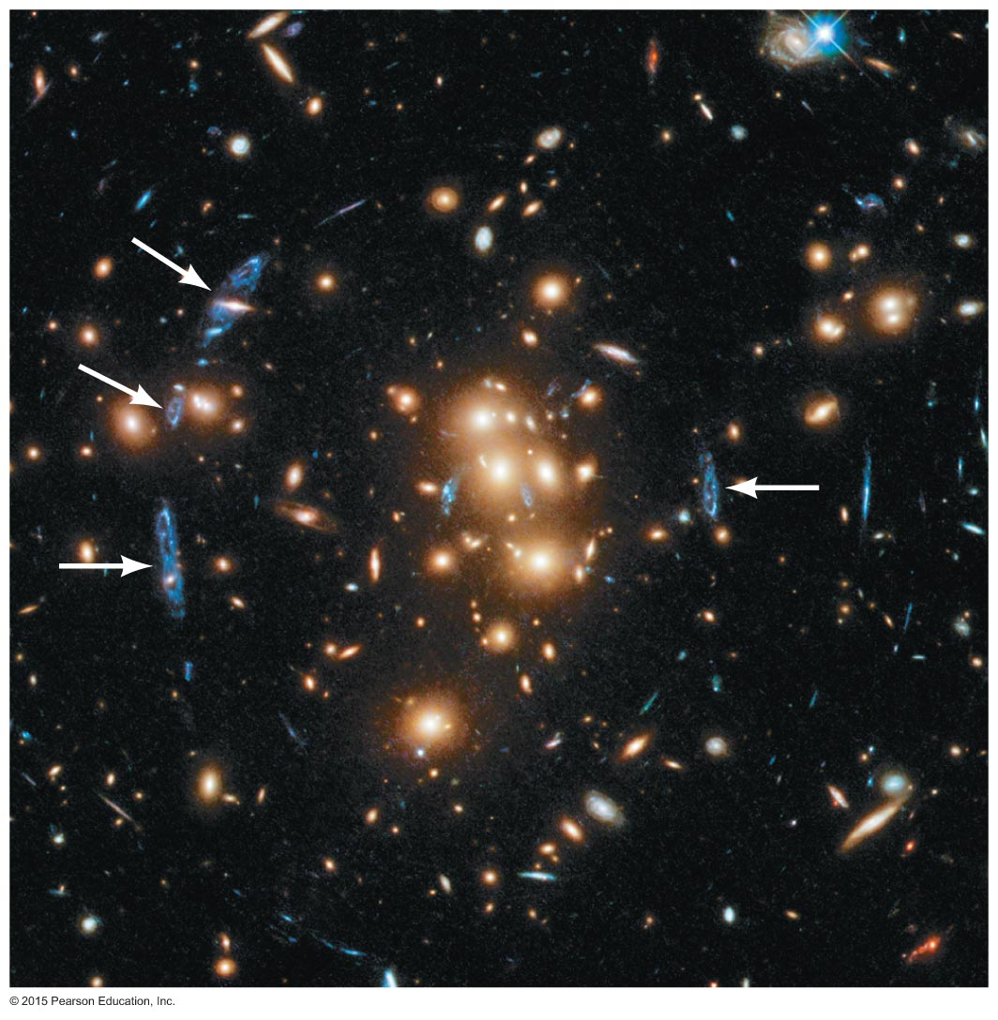
What is the evidence for dark matter in clusters of galaxies?

Slide 24
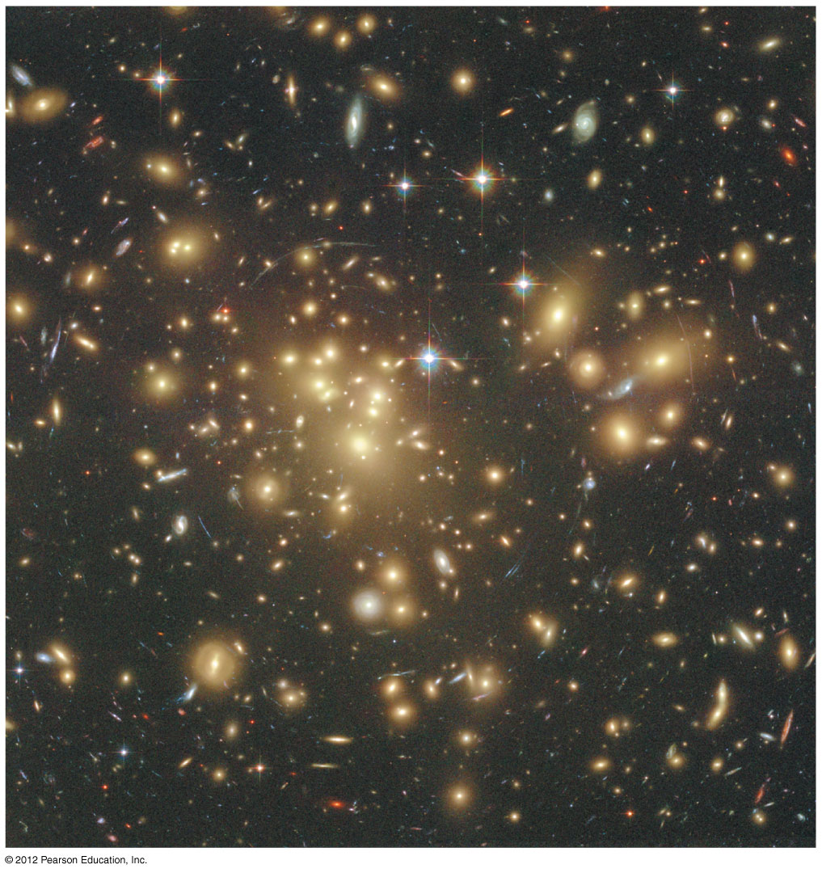
We can measure the velocities of galaxies in a cluster from their Doppler shifts.

Slide 25
The mass we find from galaxy motions in a cluster is about
50 times larger than the mass in stars!

Slide 26
Clusters contain large amounts of X-ray–emitting hot gas.
The temperature of hot gas (particle motions) tells us cluster mass:
85% dark matter
13% hot gas
2% stars

Slide 27
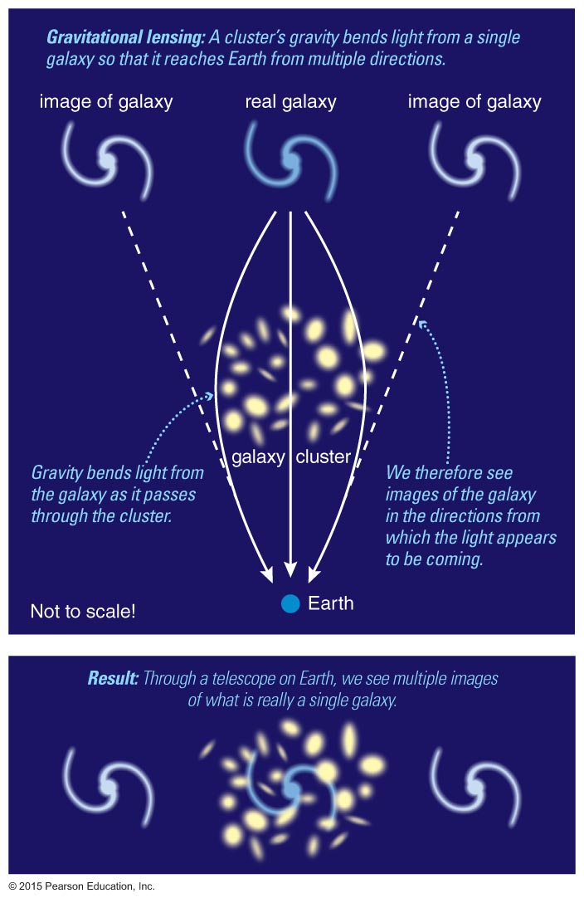
Gravitational lensing, the bending of light rays by gravity, can also tell us a cluster's mass.

Slide 28
A gravitational lens distorts our view of things behind it.
Gravitational Lensing Illustrated

Slide 29
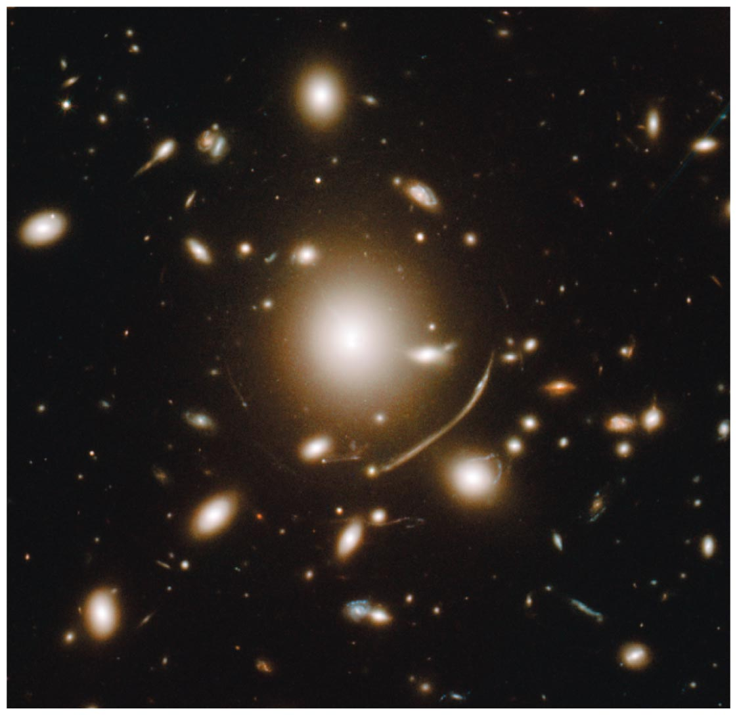
All three methods of measuring cluster mass indicate similar amounts of dark matter.

Slide 30
Thought Question
What kind of measurement does not tell us the mass of a cluster of galaxies?
Measuring velocity of a cluster galaxy
Measuring total mass of the cluster's stars
Measuring temperature of its hot gas
Measuring distorted images of background galaxies

Slide 31
Thought Question
What kind of measurement does not tell us the mass of a cluster of galaxies?
Measuring velocity of a cluster galaxy
Measuring total mass of the cluster's stars
Measuring temperature of its hot gas
Measuring distorted images of background galaxies

Slide 32
Does dark matter really exist?

Slide 33
Our Options
Dark matter really exists, and we are observing the effects of its gravitational attraction.
Something is wrong with our understanding of gravity, causing us to mistakenly infer the existence of dark matter.

Slide 34
Our Options
Dark matter really exists, and we are observing the effects of its gravitational attraction.
Something is wrong with our understanding of gravity, causing us to mistakenly infer the existence of dark matter.
Because gravity is so well tested, most astronomers prefer option #1.

Slide 35
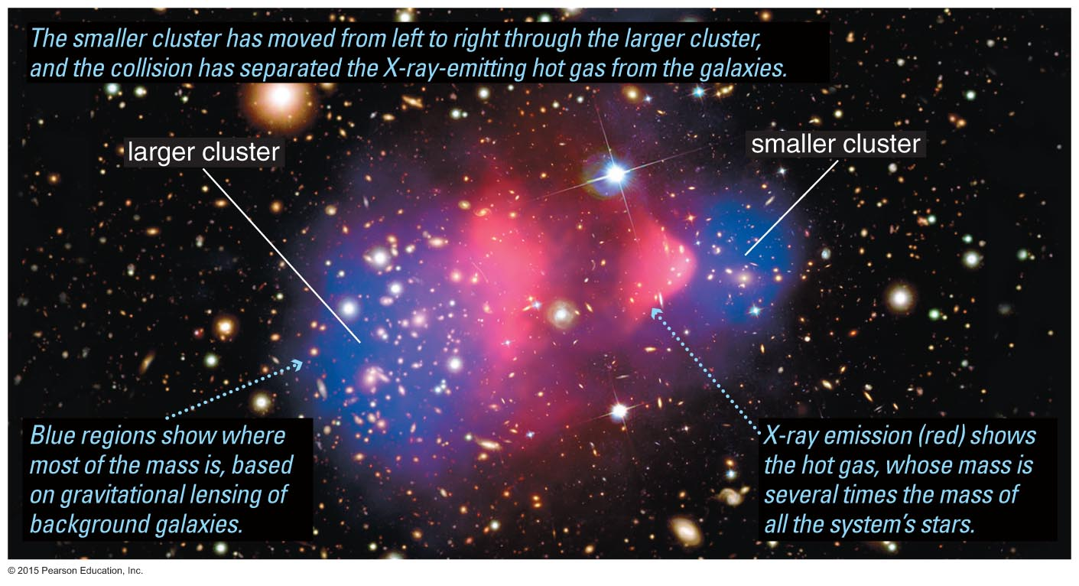
The Bullet Cluster, the collision of two smaller clusters, provides strong evidence for the existence of dark matter. Here the blue represents the bulk of the cluster mass, while the pink represents the gas (visible matter.)

Slide 36
What might dark matter be made of?

Slide 37
How dark is it?

Slide 38
How dark is it?
… not as bright as a star.

Slide 39
Two Basic Options
Ordinary Matter (MACHOs)
Massive Compact Halo Objects: dead or failed stars in halos of galaxies
Exotic Particles (WIMPs)
Weakly Interacting Massive Particles: mysterious neutrino-like particles

Slide 40
Two Basic Options
Ordinary Matter (MACHOs)
Massive Compact Halo Objects: dead or failed stars in halos of galaxies
Exotic Particles (WIMPs)
Weakly Interacting Massive Particles: mysterious neutrino-like particles
The Best Bet

Slide 41
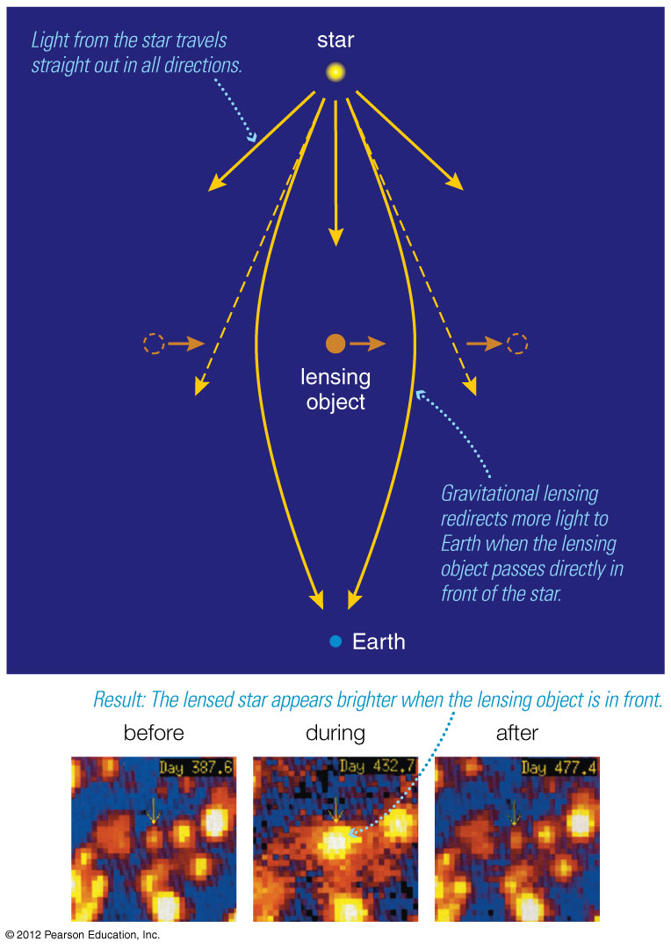
Compact starlike objects occasionally make other stars appear brighter through lensing…

Slide 42
Compact starlike objects occasionally make other stars appear brighter through lensing…
… but there are not enough lensing events to explain all the dark matter.

Slide 43
Why WIMPs?
There's not enough ordinary matter.
WIMPs could be left over from the Big Bang.
Models involving WIMPs explain how galaxy formation works.

Slide 44
What have we learned?
What is the evidence for dark matter in galaxies?
Orbital velocities within galaxies remain nearly constant at large radii, indicating that most of the matter lies outside the visible regions.
What is the evidence for dark matter in clusters of galaxies?
Masses measured from galaxy motions, temperature of hot gas, and gravitational lensing all indicate that the vast majority of matter in clusters is dark.

Slide 45
What have we learned?
Does dark matter really exist?
Either dark matter exists or our understanding of our gravity must be revised.
What might dark matter be made of?
There does not seem to be enough normal (baryonic) matter to account for all the dark matter, so most astronomers suspect that dark matter is made of (nonbaryonic) particles that have not yet been discovered.

Slide 46
18.3 Structure Formation
Our goals for learning:
What is the role of dark matter in galaxy formation?
What are the largest structures in the universe?

Slide 47
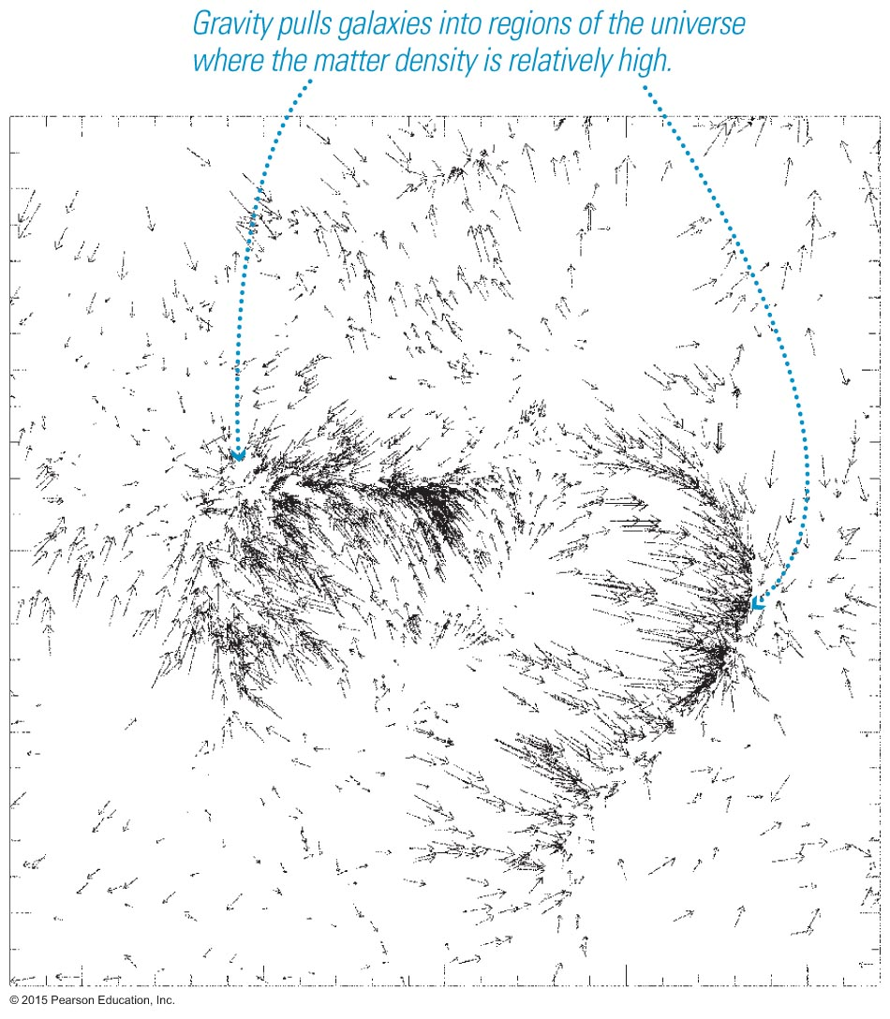
What is the role of dark matter in galaxy formation?

Slide 48
Gravity of dark matter is what caused protogalactic clouds to contract early in time.
⇒

Slide 49
WIMPs can't contract to the center because they don't radiate away their orbital energy.

Slide 50
Dark matter is still pulling things together.
After correcting for Hubble's law, we can see that galaxies are flowing toward the densest regions of space.

Slide 51
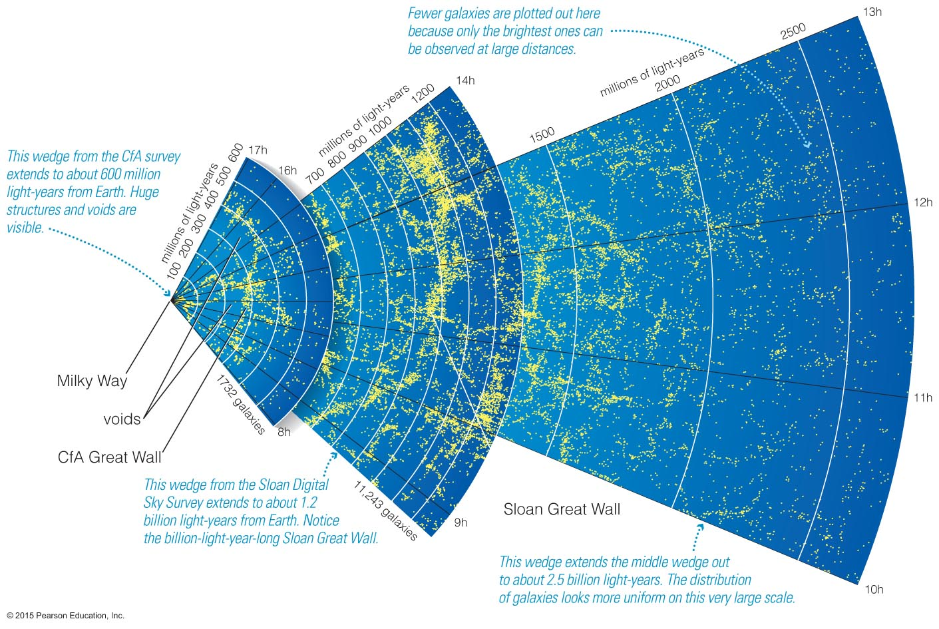
What are the largest structures in the universe?

Slide 52
Maps of galaxy positions reveal extremely large structures: superclusters and voids.

Slide 53
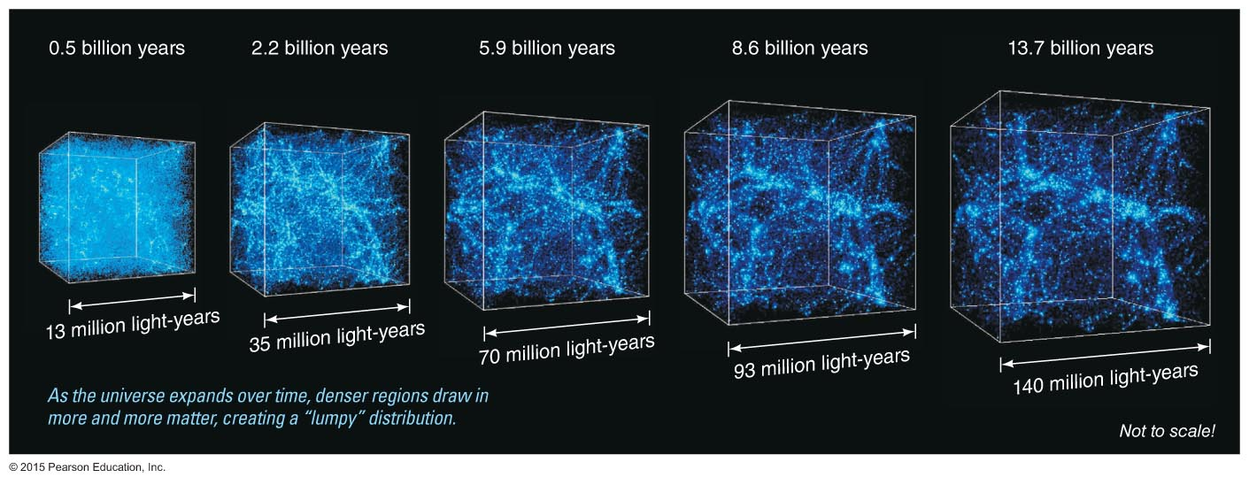
Time in billions of years
0.5
2.2
5.9
8.6
13.7
Models show that the gravity of dark matter pulls mass into denser regions—the universe grows lumpier with time.
13
35
70
93
140
Size of expanding box in millions of light-years

Slide 54
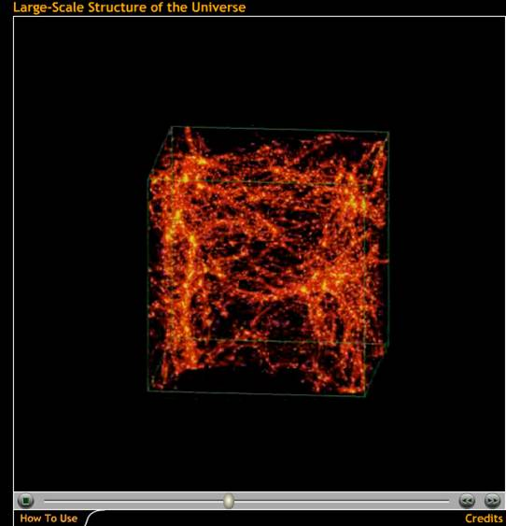
Models show that gravity of dark matter pulls mass into denser regions—the universe grows lumpier with time.
Large-Scale Structure of the Universe

Slide 55
Structures in galaxy maps look very similar to the ones found in models in which dark matter is WIMPs.

Slide 56
What have we learned?
What is the role of dark matter in galaxy formation?
The gravity of dark matter seems to be what draws gas together into protogalactic clouds, initiating the process of galaxy formation.
What are the largest structures in the universe?
Galaxies appear to be distributed in gigantic chains and sheets that surround great voids.

Slide 57
18.4 Dark Energy and the Fate of the Universe
Our goals for learning:
What is the evidence for an accelerating expansion?
Why is flat geometry evidence for dark energy?
What is the fate of the universe?

Slide 58
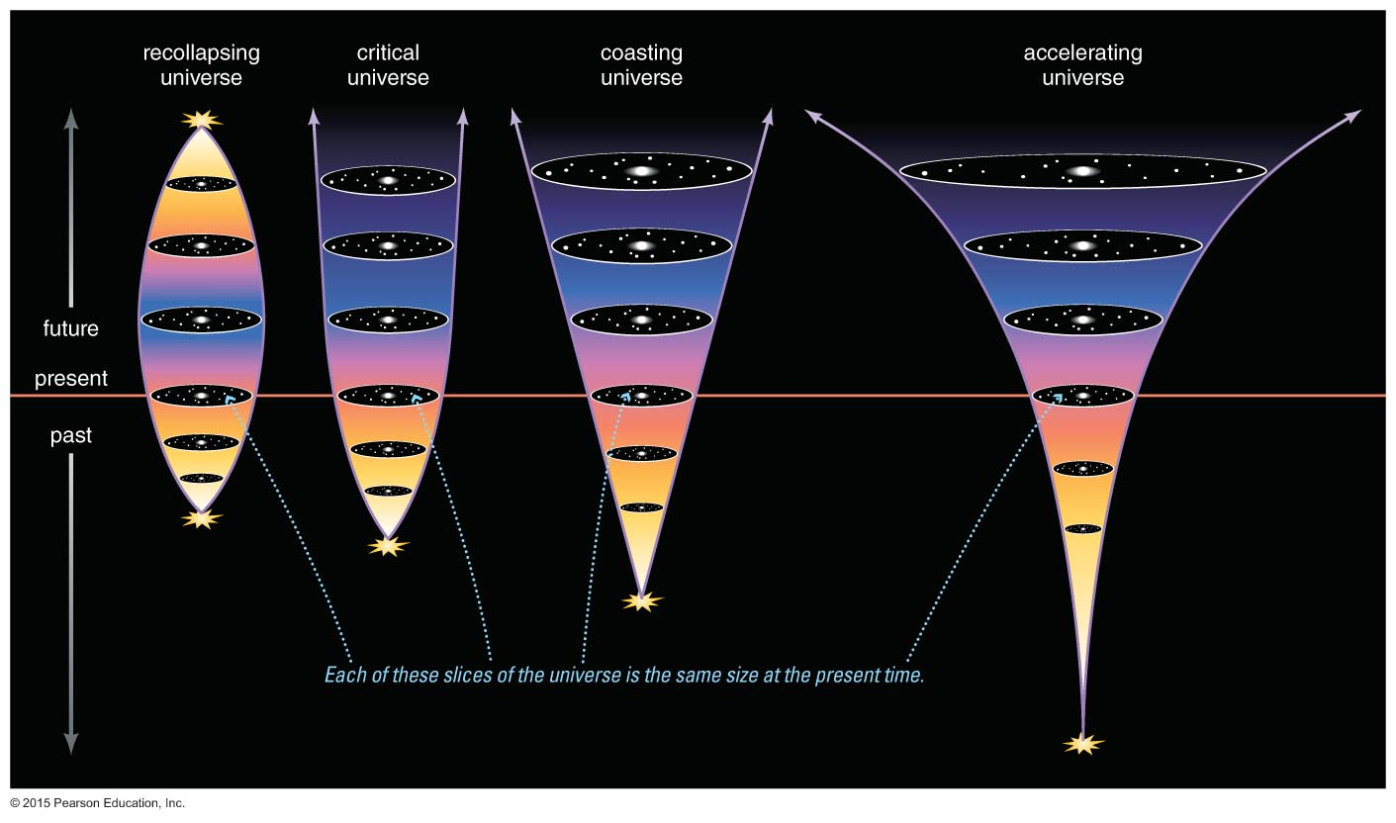
What is the evidence for an accelerating universe?

Slide 59
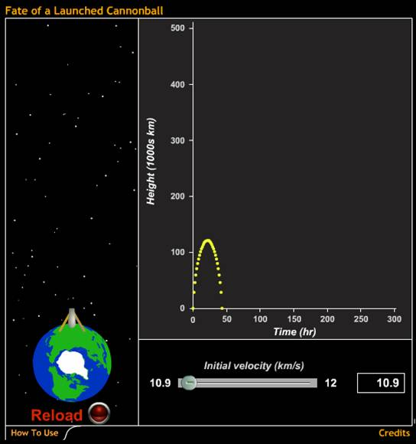
Does the universe have enough kinetic energy to escape its own gravitational pull?
Fate of a Launched Cannonball

Slide 60
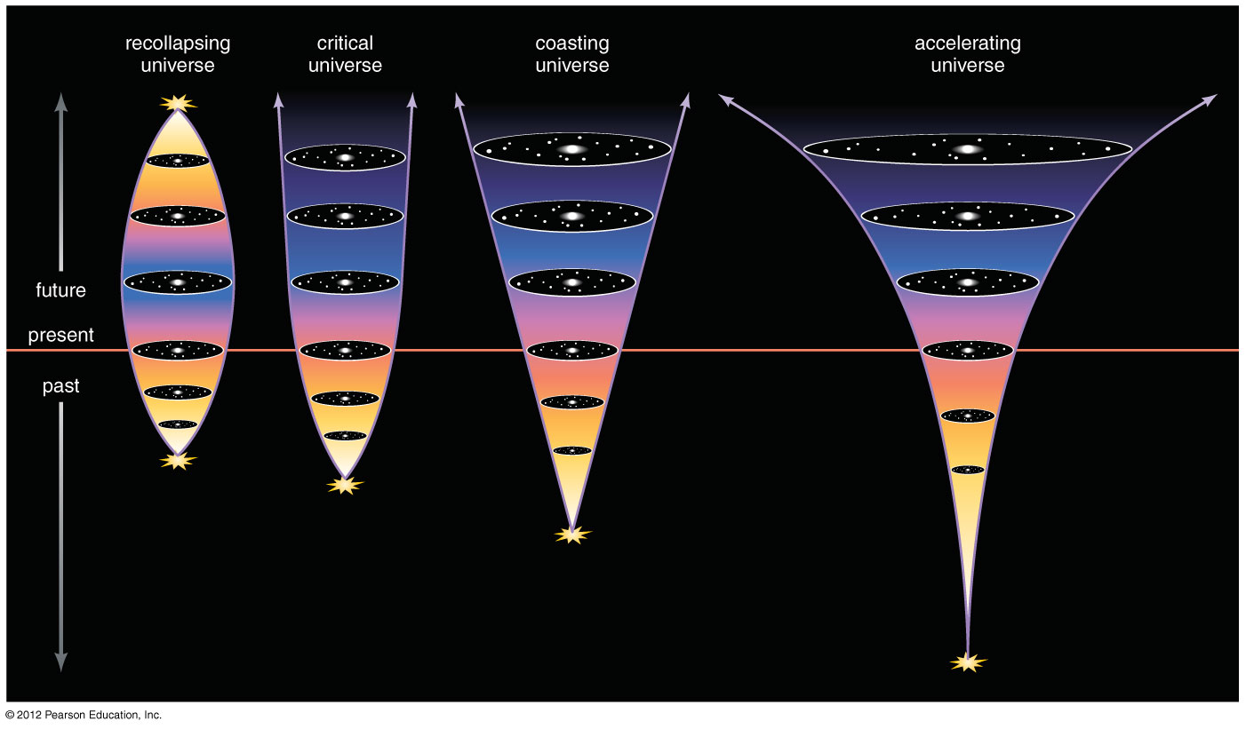
Fate of universe depends on the amount of dark matter.
Lots of dark
matter
Critical density of matter
Not enough dark matter

Slide 61
Amount of matter is ~25% of the critical density, suggesting fate is eternal expansion.
Not enough dark matter

Slide 62
But expansion appears to be speeding up!
Dark energy?
Not enough dark matter

Slide 63
Estimated age depends on both dark matter and dark energy.
old
older
oldest

Slide 64
Thought Question
Suppose that the universe has more dark matter than we think there is today. How would that change the age we estimate from the expansion rate?
Estimated age would be older
Estimated age would be the same
Estimated age would be younger

Slide 65
Thought Question
Suppose that the universe has more dark matter than we think there is today. How would that change the age we estimate from the expansion rate?
Estimated age would be older
Estimated age would be the same
Estimated age would be younger

Slide 66
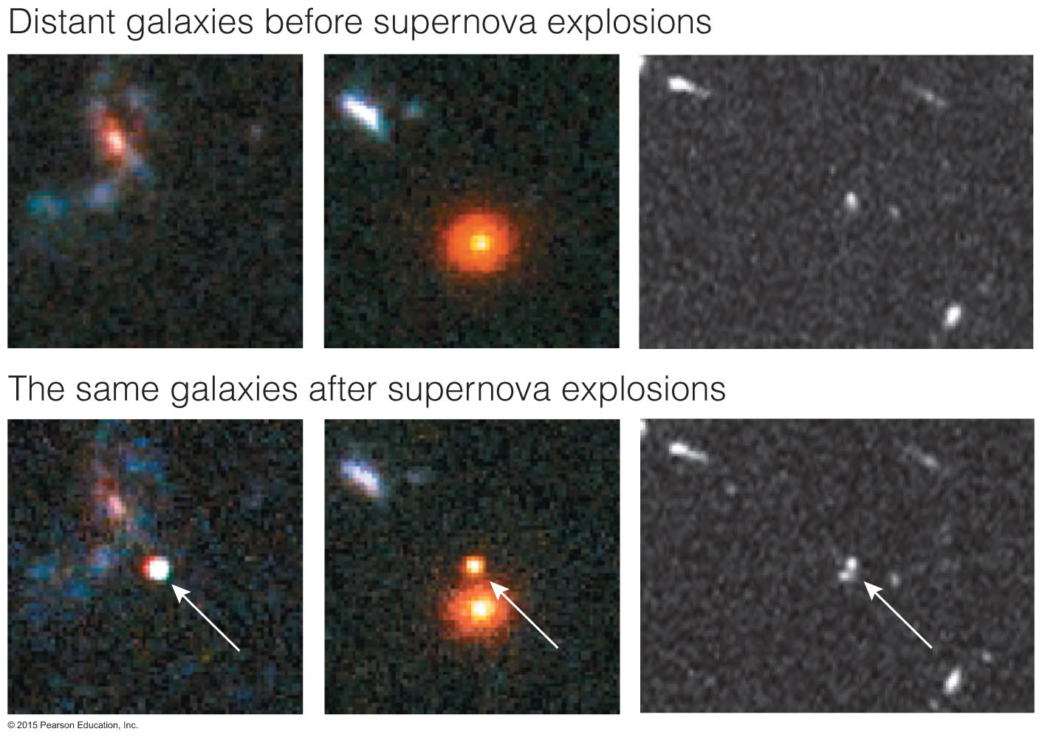
The brightness of distant white dwarf supernovae tells us how much the universe has expanded since they exploded.

Slide 67
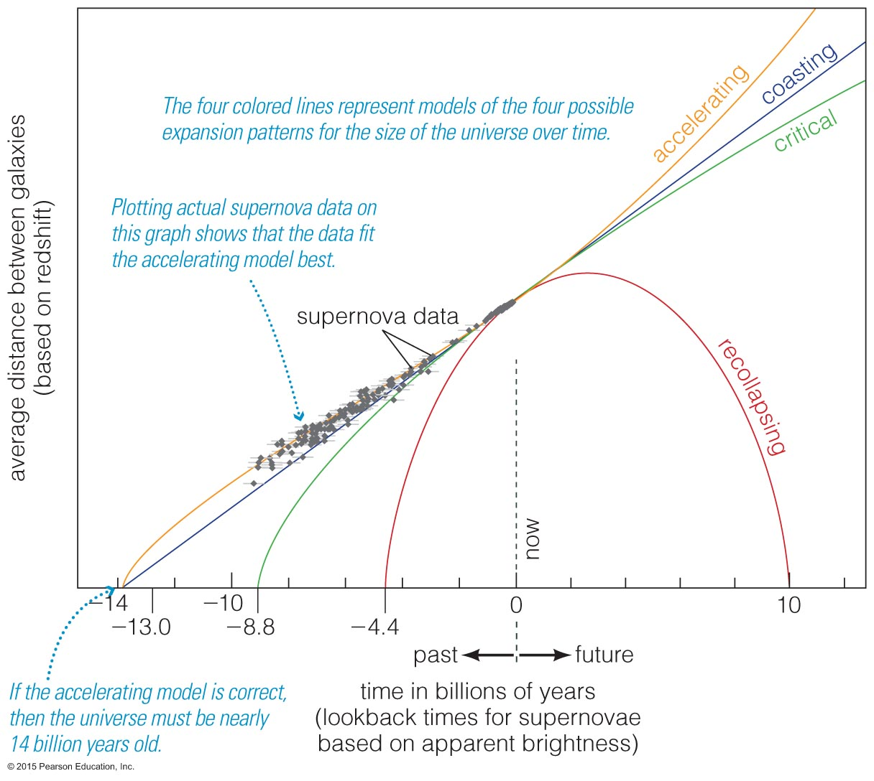
An accelerating universe is the best fit to supernova data.

Slide 68
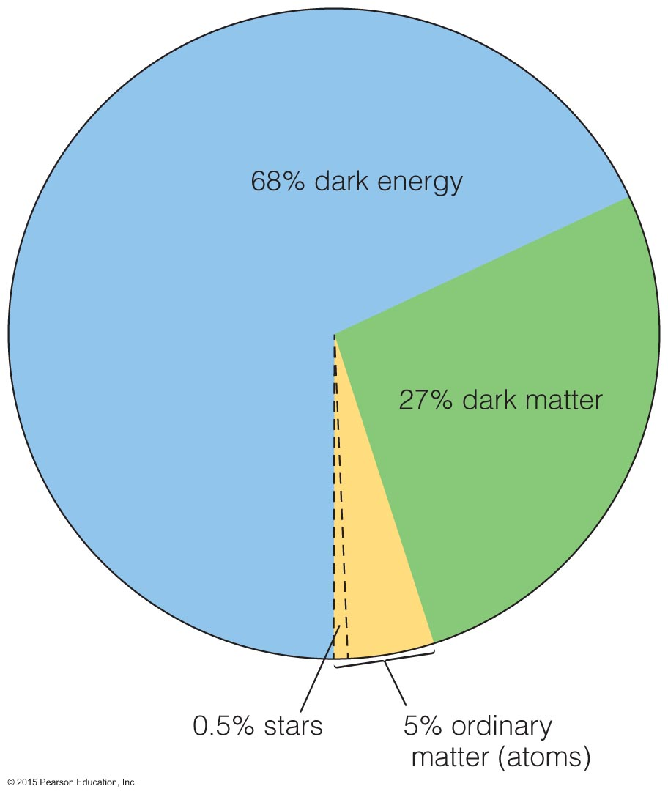
Why is flat geometry evidence for dark energy?

Slide 69
Observations tell us that the density of the universe is equal to the critical density, but we can only account for 30% of that with matter!

Slide 70
What is the fate of the universe?

Slide 71
We expect that the universe will continue expanding forever, as dark energy continues to accelerate the expansion!

Slide 72
What have we learned?
What is the evidence for an accelerating expansion?
An accelerating universe is the best explanation for the distances we measure when using white dwarf supernovae as standard candles.
Why is flat geometry evidence for dark energy?
If the overall geometry of the universe is flat, and matter makes up only 30% of the energy required to make it so, then we need dark energy to make up the remaining energy.

Slide 73
What have we learned?
What is the fate of the universe?
Seemingly, the universe will forever expand.

