Slide 1
Chapter 19: Life in the Universe

Slide 2
19.1 Life on Earth
Our goals for learning:
When did life arise on Earth?
How did life arise on Earth?
What are the necessities of life?

Slide 3
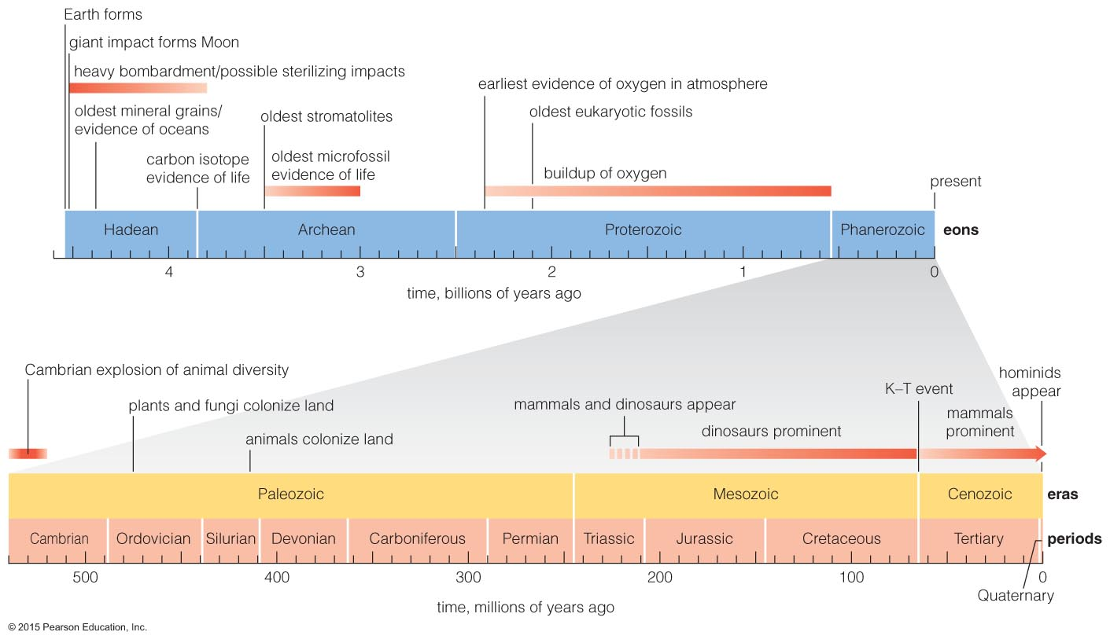
When did life arise on Earth?

Slide 4
Earliest Life Forms
Life probably arose on Earth more than 3.85 billion years ago, shortly after the end of heavy bombardment.
Evidence comes from fossils and carbon isotopes.
Notes:
Grand Canyon layers record 2 billion years of Earth's history.

Slide 5
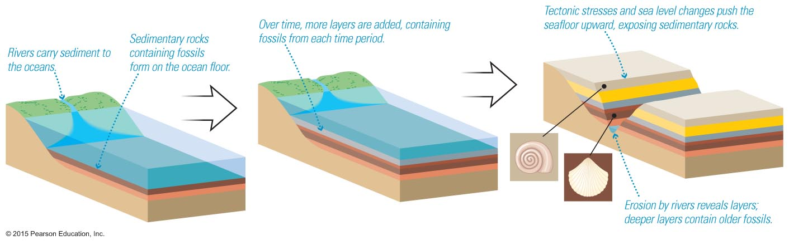
Fossils in Sedimentary Rock
Relative ages: deeper layers formed earlier
Absolute ages: radiometric dating
Notes:
Discuss formation of sedimentary layers so students can see how fossils are related through time.

Slide 6
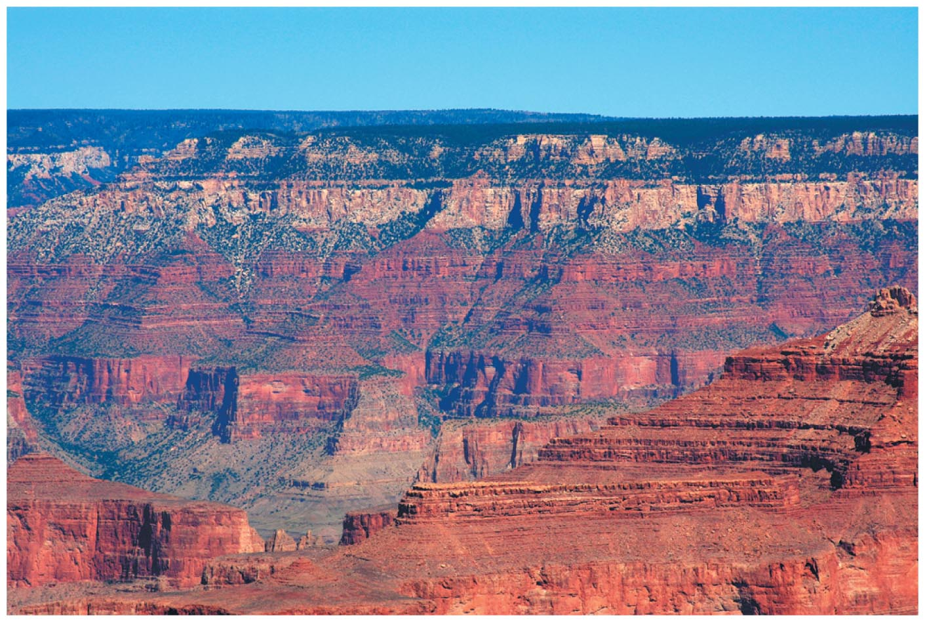
Fossils in Sedimentary Rock
Rock layers of the Grand Canyon record more than 500 million years of Earth's history.
Notes:
Discuss formation of sedimentary layers so students can see how fossils are related through time.

Slide 7
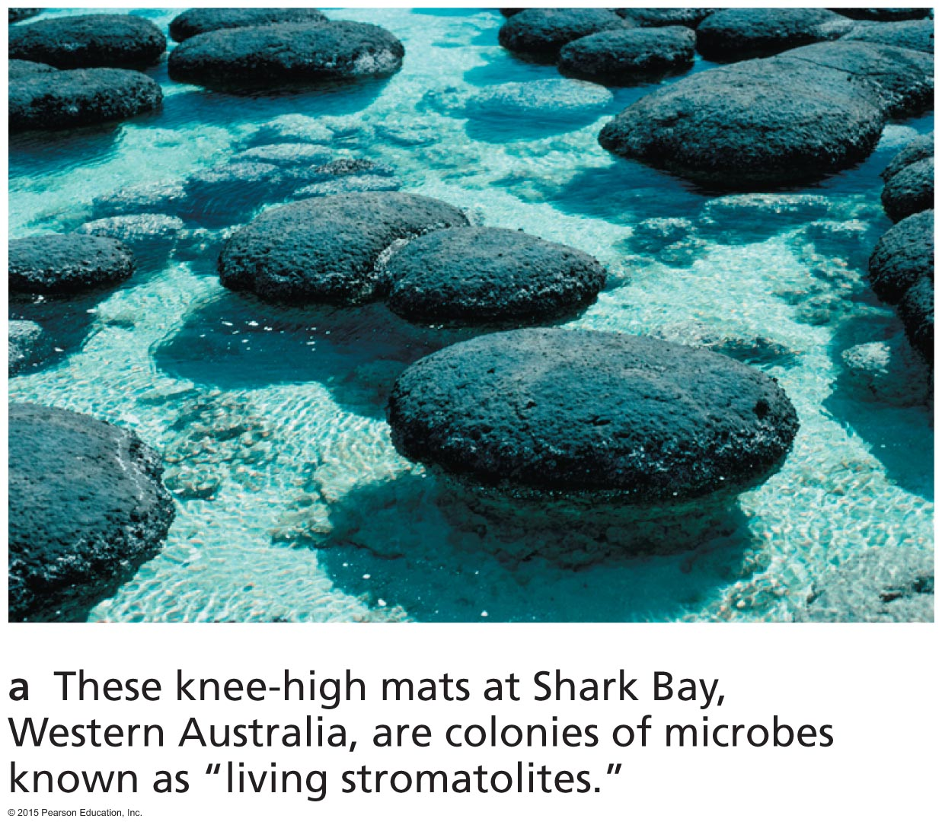
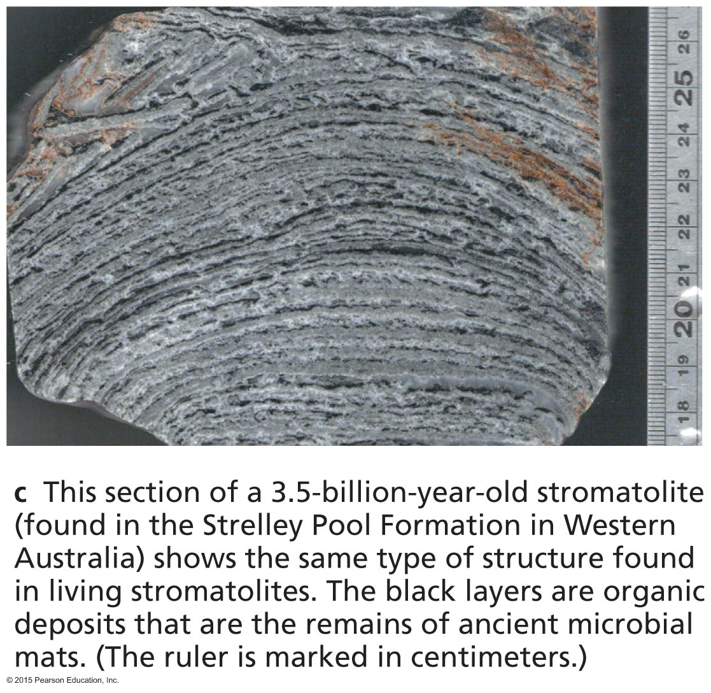
Earliest Fossils
The oldest fossils show that bacteria-like organisms were present over 3.5 billion years ago.
Carbon isotope evidence pushes the origin of life to more than 3.85 billion years ago.

Slide 8
The Geological Time Scale
Notes:
You may wish to spend some time discussing various events on the timeline. Also can relate back to cosmic calendar from Ch. 1, so students realize this is only the last third of the history of the universe that is shown here.

Slide 9
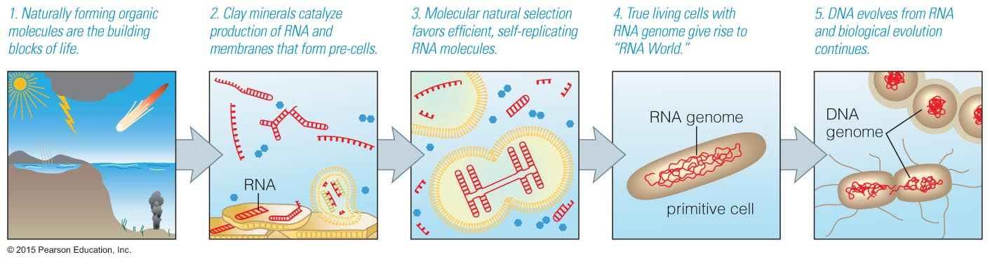
How did life arise on Earth?

Slide 10
Origin of Life on Earth
Life evolves through time.
All life on Earth shares a common ancestry.
We may never know exactly how the first organism arose, but laboratory experiments suggest plausible scenarios.
Notes:
DNA = Deoxyribonucleic acid. Most instructors won't insist their students learn this term.

Slide 11
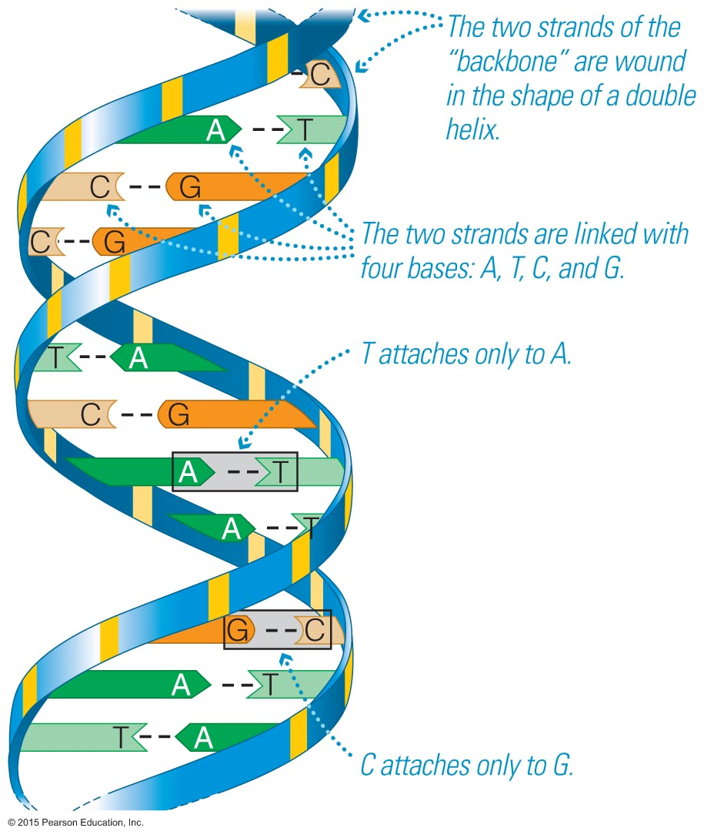
The Theory of Evolution
The fossil record shows that evolution has occurred through time.
Darwin's theory tells us HOW evolution occurs: through natural selection.
This theory was supported by the discovery of DNA: evolution proceeds through mutations.

Slide 12
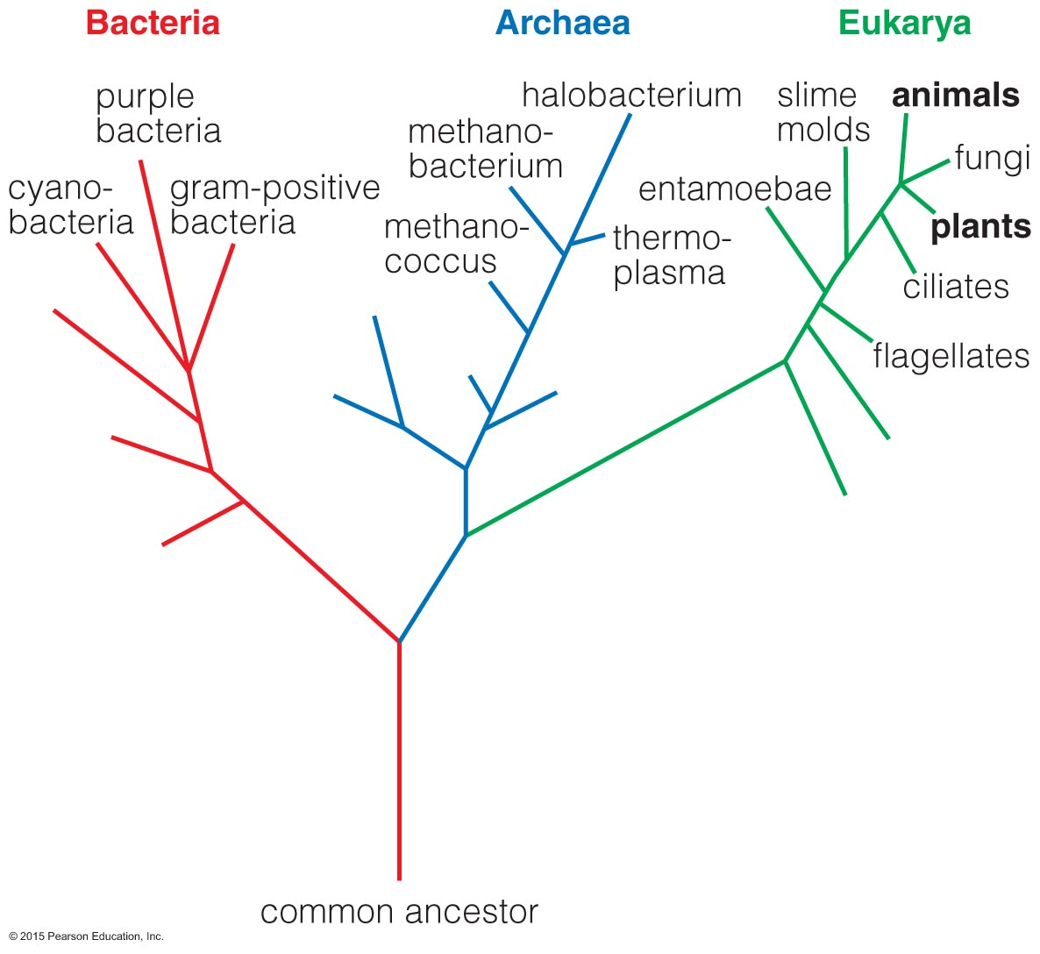
Tree of Life
Mapping genetic relationships has led biologists to discover this new "tree of life".
Plants and
animals are a
small part of
the tree.
Suggests
likely
characteristics
of common
ancestor.

Slide 13
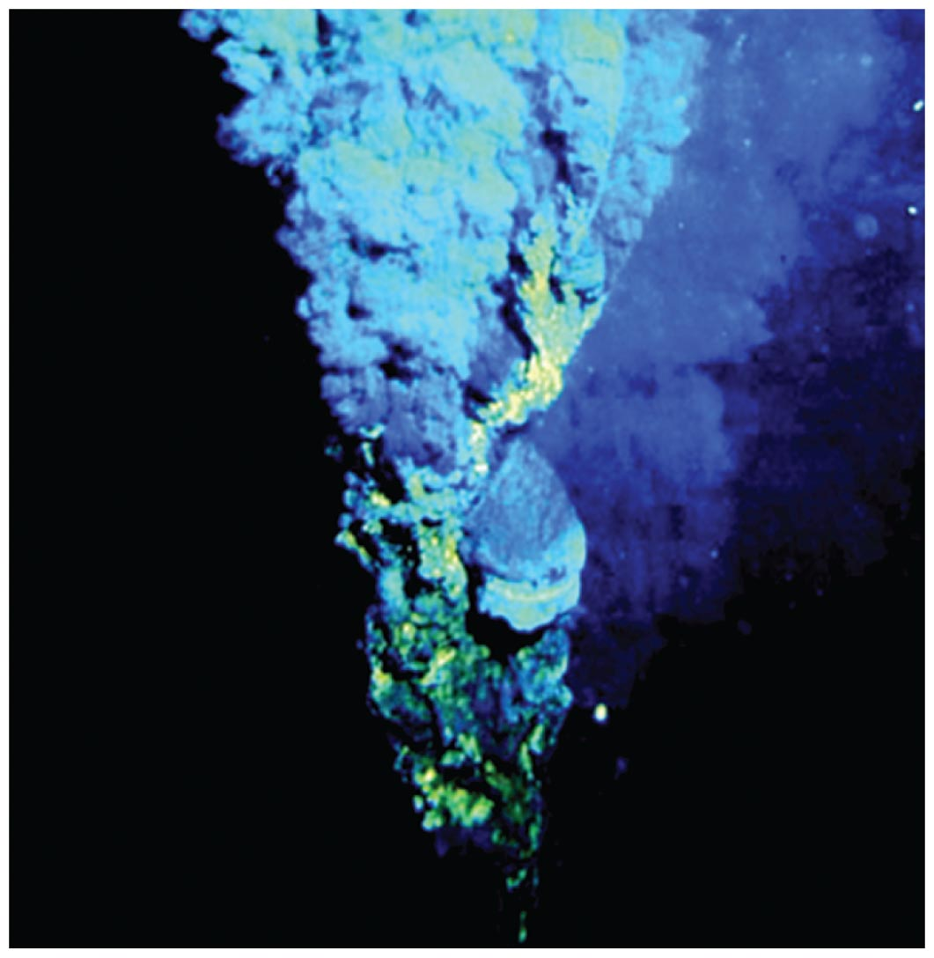
These genetic studies suggest that the earliest life on Earth may have resembled the bacteria today found near deep ocean volcanic vents (black smokers) and geothermal hot springs.

Slide 14
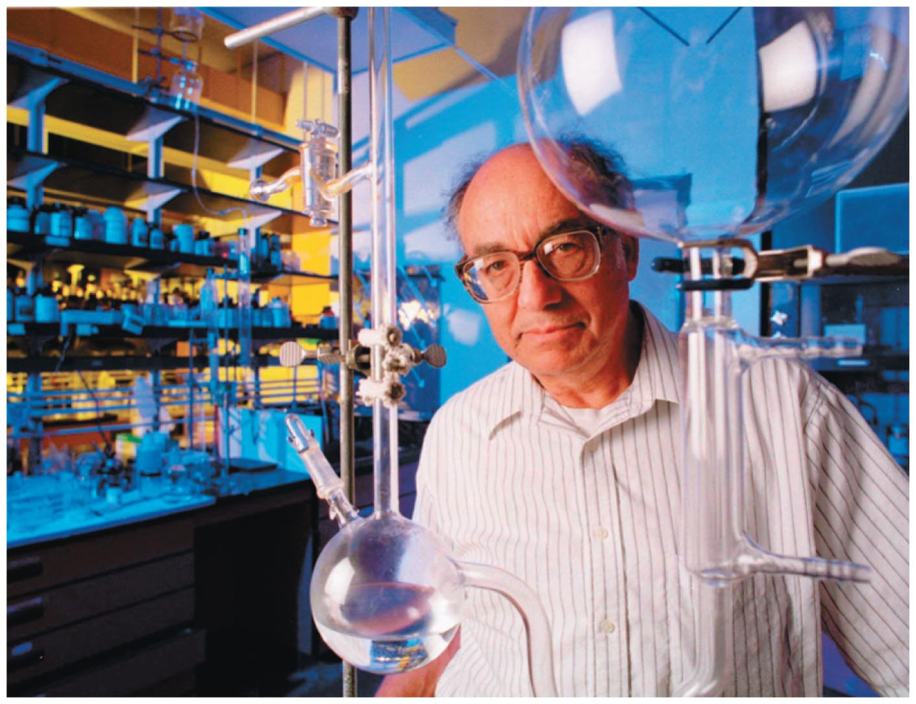
Laboratory Experiments
The Miller–Urey experiment (and more recent experiments) show that building blocks of life form easily and spontaneously under conditions of early Earth.

Slide 15
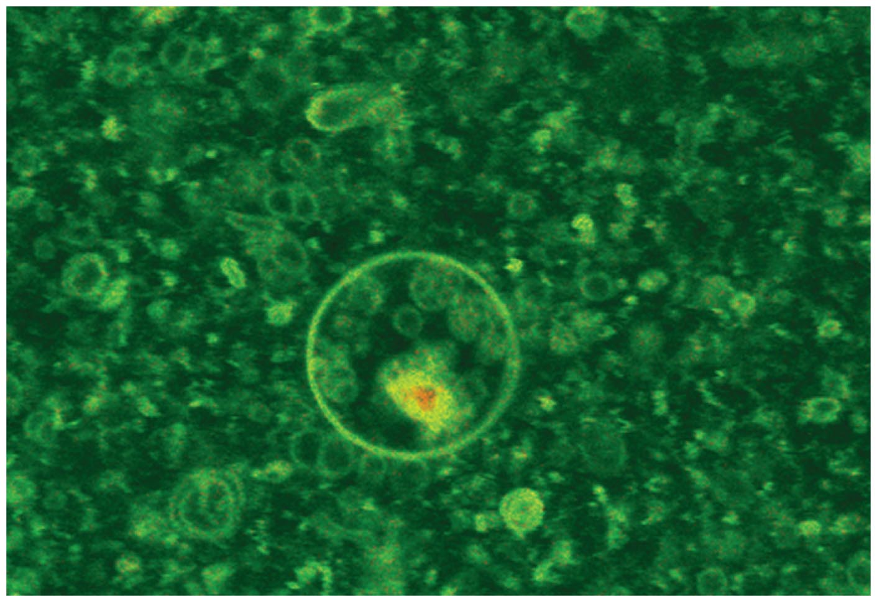
Microscopic, enclosed membranes or "pre-cells" have been created in the lab.

Slide 16
Chemicals to Life?

Slide 17
Could life have migrated to Earth?
Venus, Earth, and Mars have exchanged tons of rock (blasted into orbit by impacts).
Some microbes can survive years in space.
Notes:
A picture of the famous Murchison meteorite (many amino acids) can be found at http://www.nas.nasa.gov/Main/Features/2002/Spring/Images/meteorite.jpg.

Slide 18
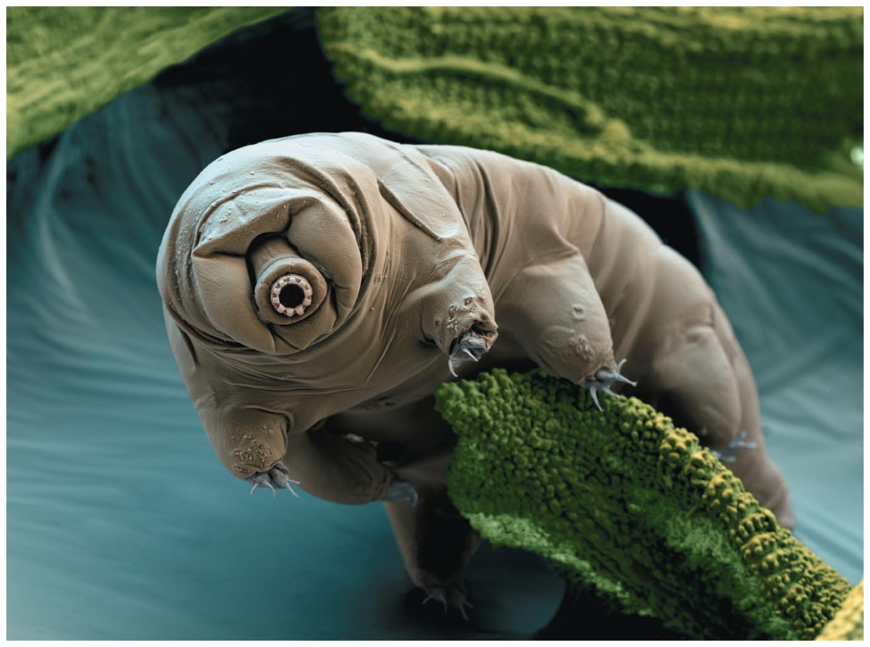
Could life have migrated to Earth?
There is even an animal, the tardigrade, which can survive some time in space.

Slide 19
Brief History of Life
4.4 billion years — early oceans form
3.5 billion years — cyanobacteria start releasing oxygen
2.0 billion years — oxygen begins building up in atmosphere
540–500 million years — Cambrian Explosion
225–65 million years — dinosaurs and small mammals (dinosaurs ruled)
Few million years — earliest hominids
Notes:
You may wish to repeat the slide with Figure 18.3 instead of showing this list…

Slide 20
Thought Question
You have a time machine with a dial that you can spin to send you randomly to any time in Earth's history. If you spin the dial, travel through time, and walk out, what is most likely to happen to you?
You'll be eaten by dinosaurs.
You'll suffocate because you'll be unable to breathe
the air.
You'll be consumed by toxic bacteria.
Nothing: you'll probably be just fine.
Notes:
This question should get students to realize that our atmosphere has only had sufficient oxygen to breathe for a small fraction of Earth's total history…

Slide 21
Thought Question
You have a time machine with a dial that you can spin to send you randomly to any time in Earth's history. If you spin the dial, travel through time, and walk out, what is most likely to happen to you?
You'll be eaten by dinosaurs.
You'll suffocate because you'll be unable to breathe the air.
You'll be consumed by toxic bacteria.
Nothing: you'll probably be just fine.
Notes:
This question should get students to realize that our atmosphere has only had sufficient oxygen to breathe for a small fraction of Earth's total history…

Slide 22
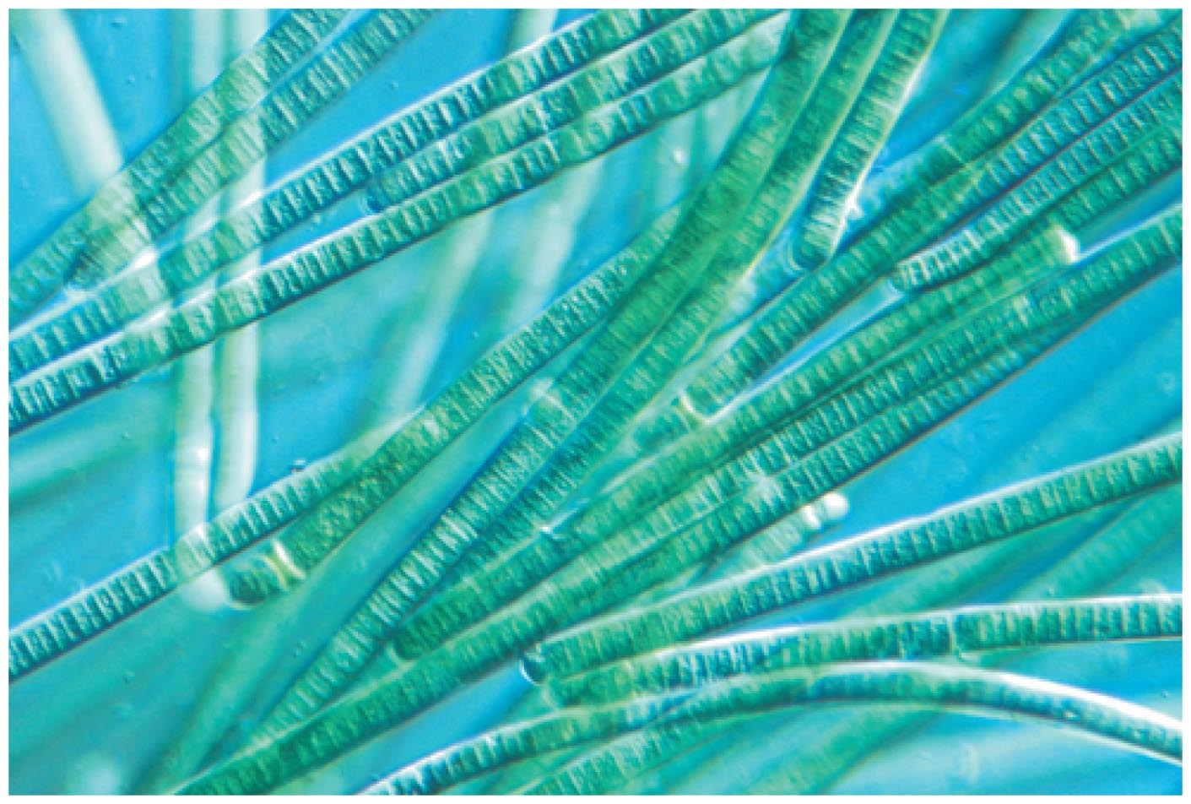
Origin of Oxygen
Cyanobacteria paved the way for more complicated life-forms by releasing oxygen into the atmosphere via photosynthesis.

Slide 23
What are the necessities of life?
Notes:
Applies to "life as we know it."

Slide 24
Necessities for Life
Nutrient source
Energy (sunlight, chemical reactions, internal heat)
Liquid water (or possibly some other liquid)
Hardest to find on other planets
Notes:
Applies to "life as we know it."

Slide 25
What have we learned?
When did life arise on Earth?
  Life arose at least 3.85 billion years ago, shortly after the end of heavy bombardment.
How did life arise on Earth?
  Life evolved from a common organism through natural selection, but we do not yet know the origin of the first organism.
What are the necessities of life?
  Nutrients, energy, and liquid water.

Slide 26
19.2 Life in the Solar System
Our goals for learning:
Could there be life on Mars?
Could there be life on Europa or other jovian moons?

Slide 27
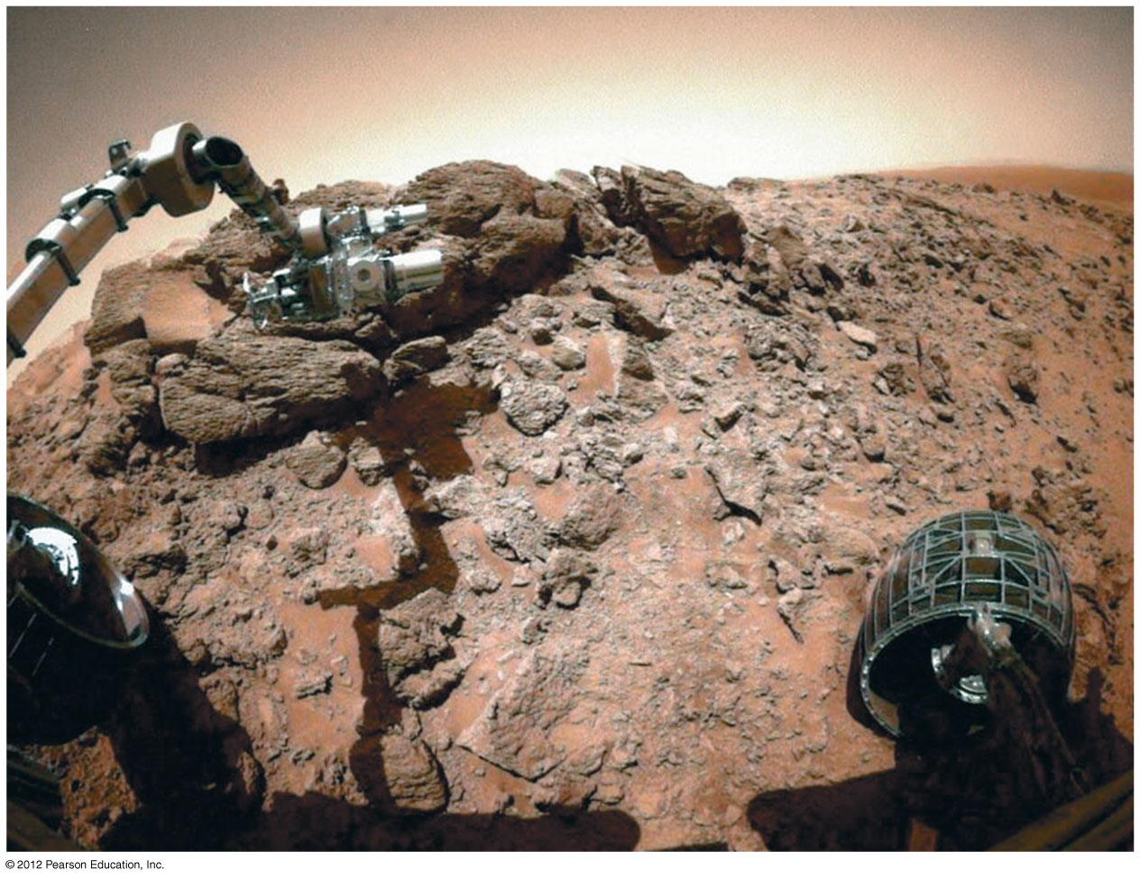
Could there be life on Mars?

Slide 28
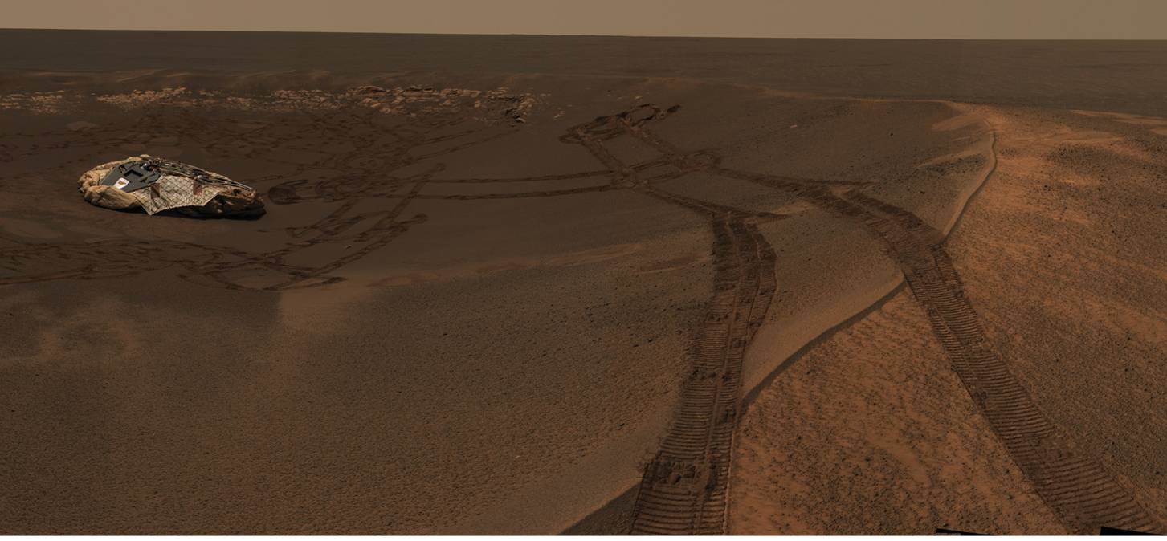
Searches for Life on Mars
Mars had liquid water in the distant past.
Mars still has subsurface ice—possibly subsurface water near sources of volcanic heat.
Notes:
This photo shows a panorama taken by Opportunity. Spend a couple minutes reviewing why Mars is a promising place for life: evidence of past water, evidence for subsurface ice today… You might wish to repeat some slides from Ch. 7 on Mars to show the evidence for past water from orbit.

Slide 29
In 2004, NASA's Spirit and Opportunity rovers sent home new mineral evidence of past liquid water on Mars.

Slide 30
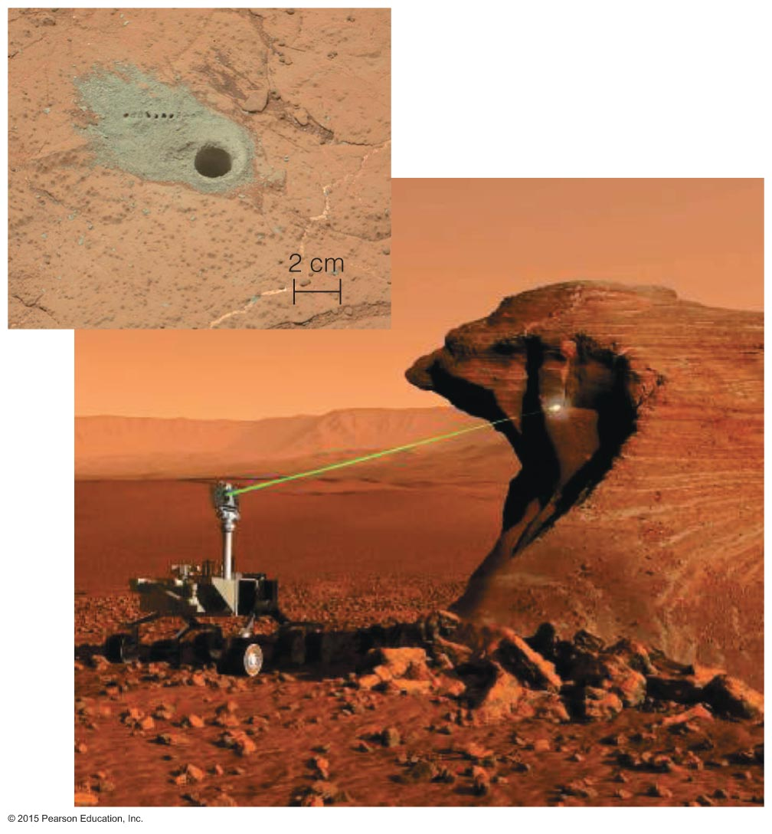
In 2012, NASA's Curiosity rover began its mission on the surface of the Red Planet.

Slide 31
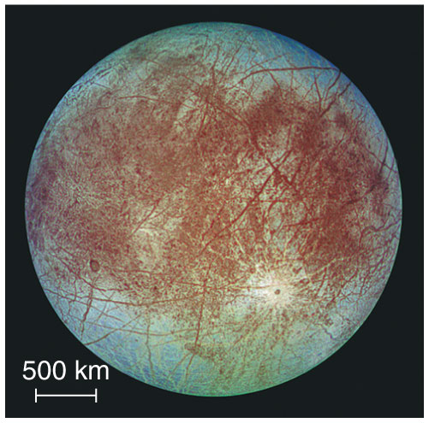
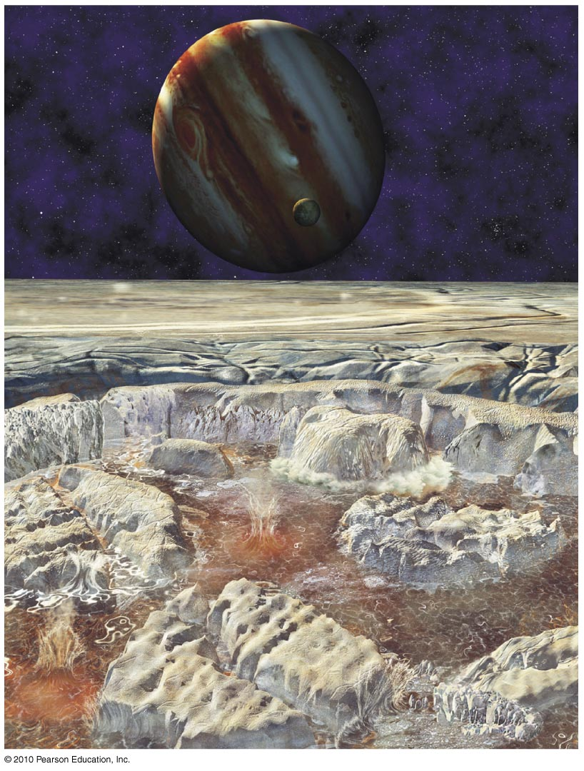
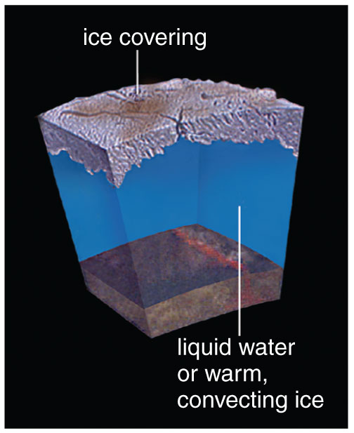
Could there be life on Europa or other jovian moons?
Notes:
Review evidence for liquid water ocean on Europa, in which case there might be undersea volcanoes. Artists conception of volcanic eruption temporarily disrupting surface ice.

Slide 32
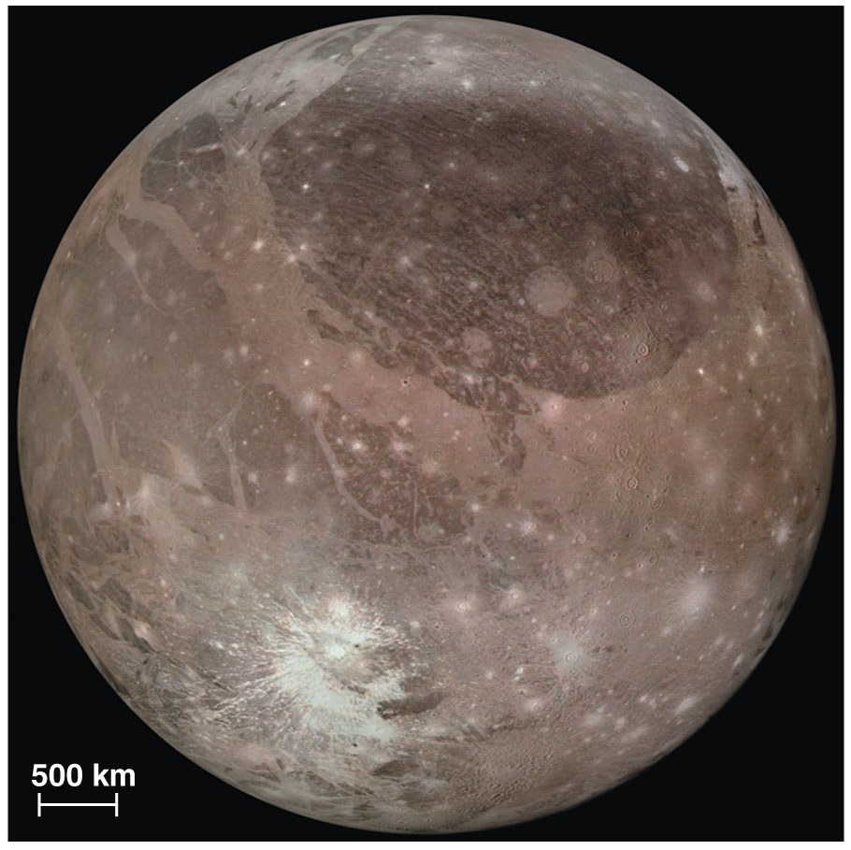
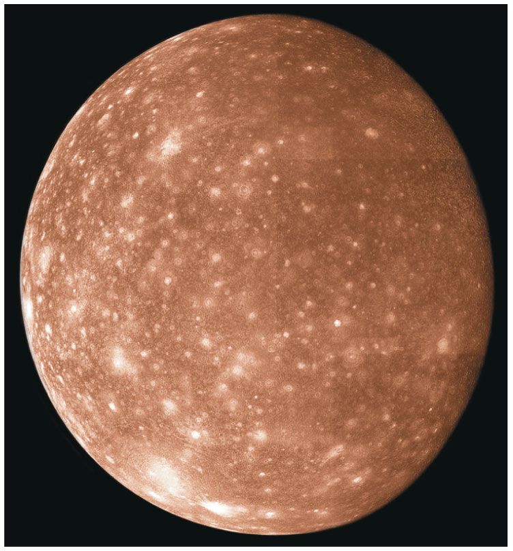
Ganymede, Callisto also show some evidence for subsurface oceans
Relatively little energy available for life, but still…
Intriguing prospect of THREE potential homes for life around Jupiter alone
Ganymede
Callisto

Slide 33
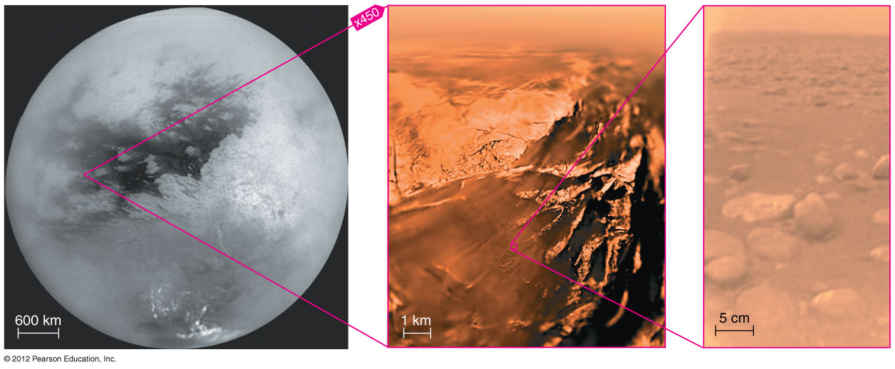
Titan
Surface too cold for liquid water (but deep underground?)
Liquid ethane/methane on surface

Slide 34
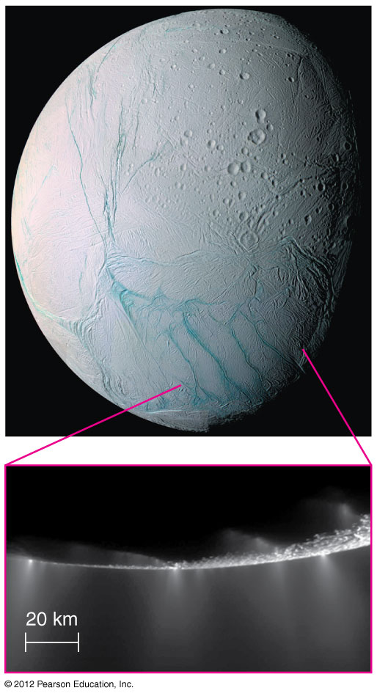
Enceladus
Ice fountains on Saturn's moon Enceladus suggest that it might have liquid water below the surface

Slide 35
What have we learned?
Could there be life on Mars?
  Evidence for liquid water in past suggests that life was once possible on Mars.
Could there be life on Europa or other jovian moons?
  Jovian moons are cold, but some show evidence for subsurface water and other liquids.

Slide 36
19.3 Life Around Other Stars
Our goals for learning:
What are the requirements for surface habitability?
Is life rare or common?

Slide 37
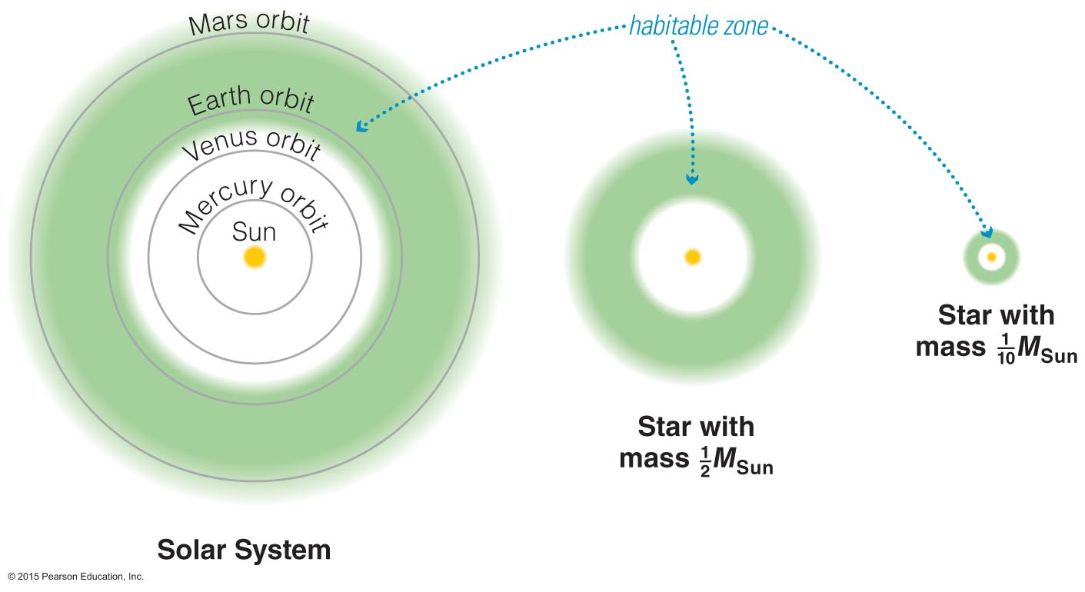
What are the requirements for surface habitability?
Notes:
Be sure students understand that "habitable" refers to a potential for life, not actually for life itself. And emphasize that while we may soon be able to search for worlds with habitable surfaces around other stars, we will NOT soon be able to look for worlds like Europa—even though these may well be more common.

Slide 38
Habitable Planets
Definition:
A habitable world contains the basic necessities for life as we know it, including liquid water.
It does not necessarily have life.
Notes:
Be sure students understand that "habitable" refers to a potential for life, not actually for life itself. And emphasize that while we may soon be able to search for worlds with habitable surfaces around other stars, we will NOT soon be able to look for worlds like Europa—even though these may well be more common.

Slide 39
Possible requirements for surface habitability
1. Proper distance from its star
2. Volcanism – to make and maintain an
atmosphere and oceans.
3. Plate tectonics – for climate regulation.
4. Planetary magnetic field to protect the
atmosphere.

Slide 40

The more massive the star, the larger the habitable zone—higher probability of a planet in this zone.
Notes:
Even if we focus only on G-type stars like our Sun, there are billions in the Milky Way Galaxy alone. And we can't rule out habitable worlds around smaller stars. (But much more massive stars have lifetimes too short for evolution.)

Slide 41
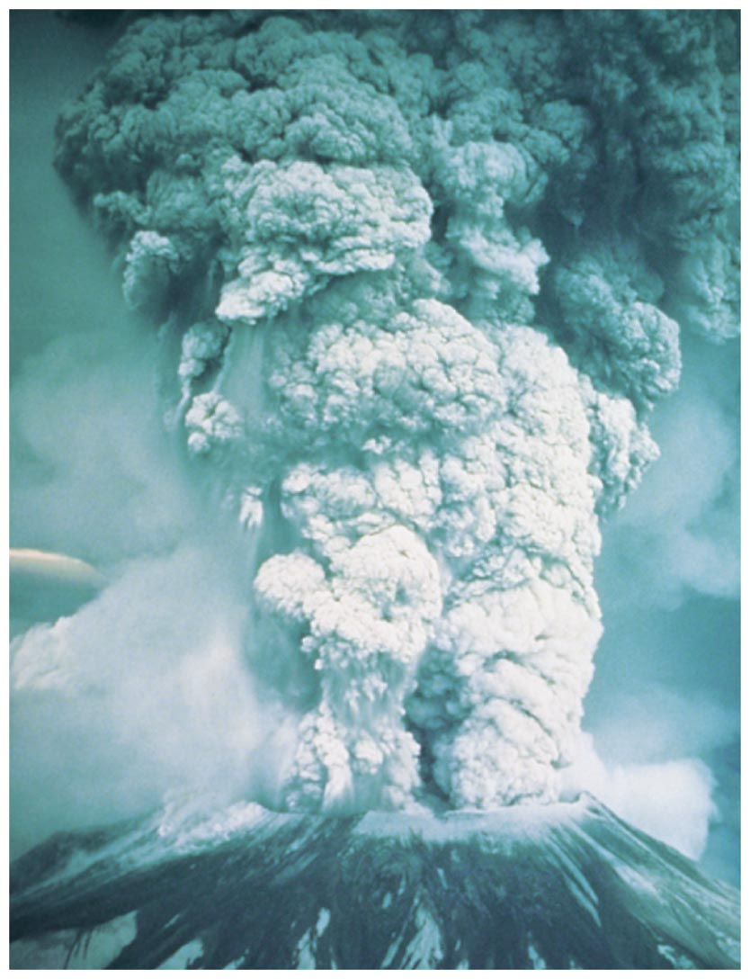
Bigger is better…
For terrestrial worlds to have a surface suitable for life they need to have volcanism, plate tectonics, and a global magnetic field.
This means they need to be roughly Earth-size or larger.

Slide 42
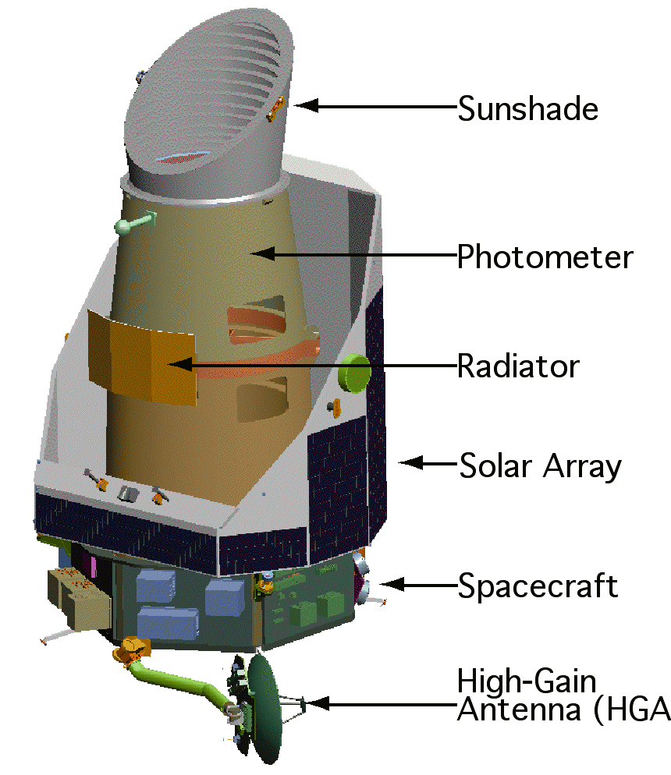
Kepler has monitored 100,000 stars for transit events for 4 years. It has found planets in the habitable zone!
Later: Planned orbiting interferometers will obtain spectra and crude images of Earth-size planets.
Notes:
Optional slide on future missions to search for planets. Also worth talking about SIM, possibly to be launched in 2009 as a precursor to TPF…

Slide 43
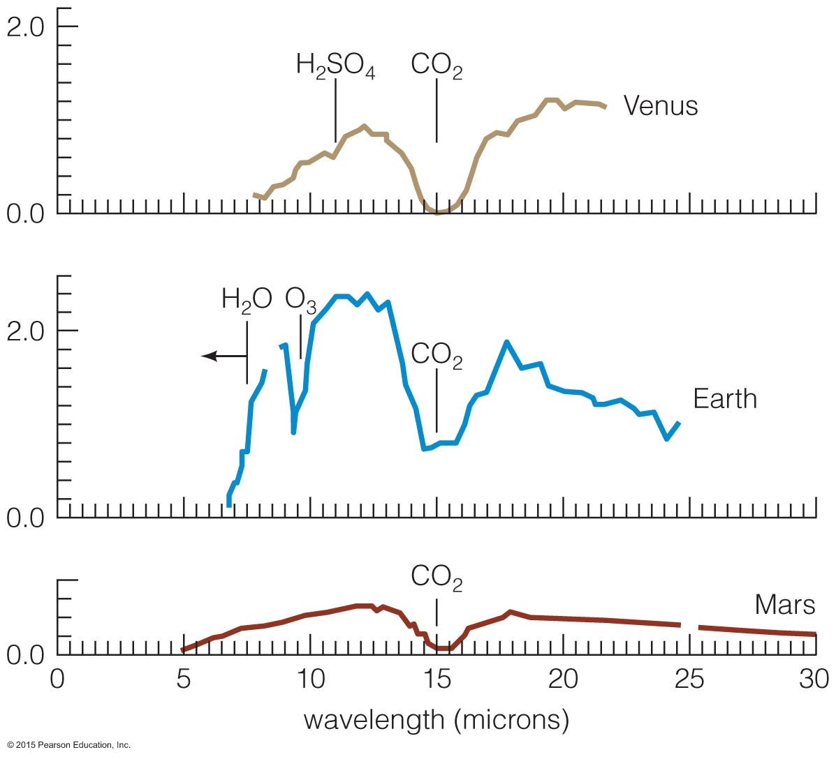
Spectral Signatures of Life
Venus
oxygen/ozone
Earth
Mars
Notes:
Can discuss how we might determine whether life exists on a distant world.

Slide 44
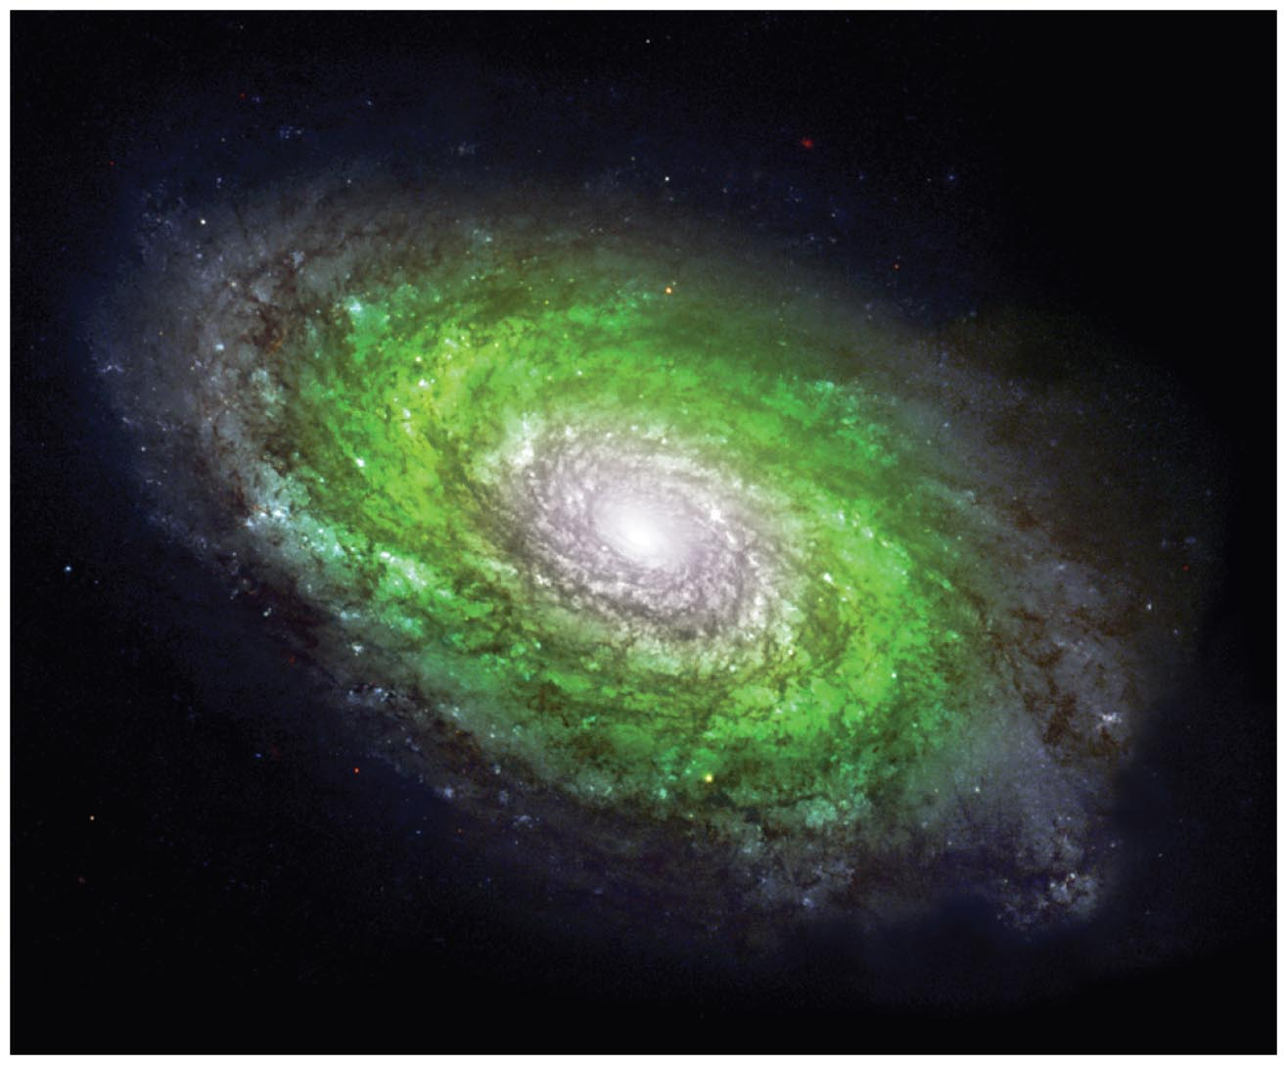
Is life rare or common?
Notes:
The text goes into a fair amount of detail on the rare Earth hypothesis, primarily because it has been in the news so much over the past few years. You may or may not want to go into the same level of detail in class.

Slide 45
Elements and Habitability
Some scientists argue that proportions of heavy elements need to be just right for the formation of habitable planets.
If so, then Earth-like planets are restricted to a galactic habitable zone.

Slide 46
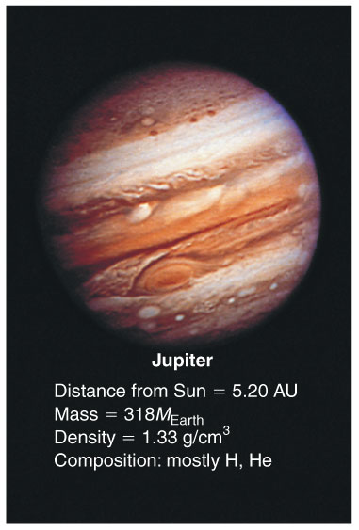
Impacts and Habitability
Some scientists argue that Jupiter-like planets are necessary to reduce the rate of impacts.
If so, then Earth-like planets are restricted to star systems with Jupiter-like planets.

Slide 47
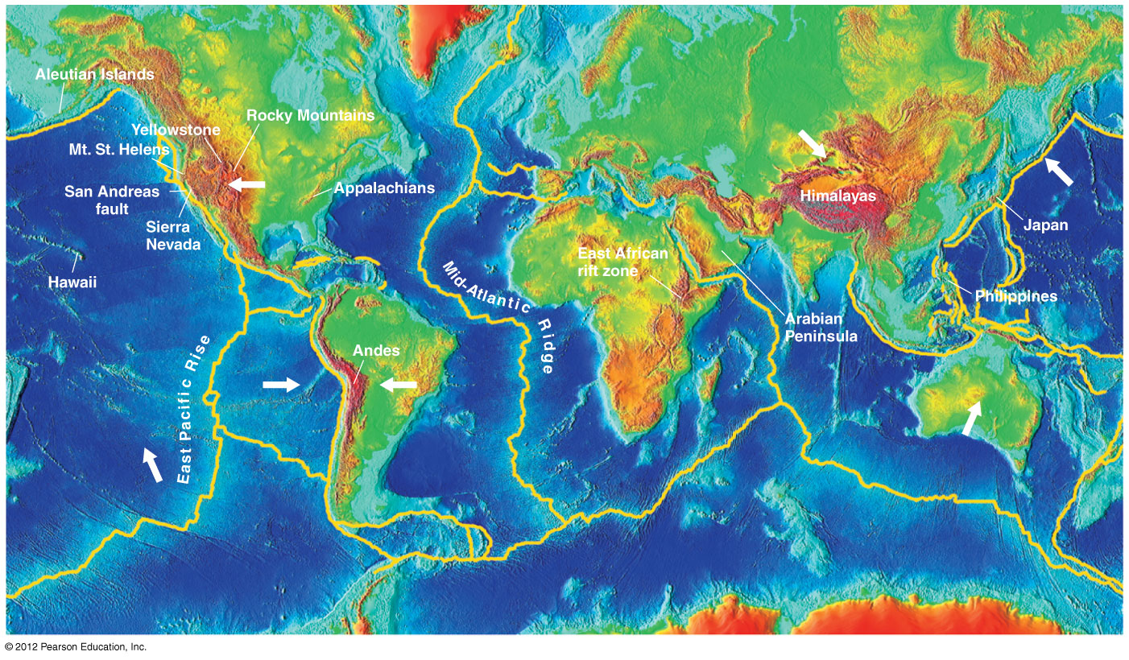
Climate and Habitability
Some scientists argue that plate tectonics and/or a large moon are necessary to keep the climate of an Earth-like planet stable enough for life.

Slide 48
The Bottom Line
We don't yet know how important or negligible these concerns are.

Slide 49
What have we learned?
What are the requirements for surface habitability?
  The right distance from its star, volcanism, plate tectonics, and a global magnetic field.
Is life rare or common?
  We don't yet know because we are still trying to understand all the factors that make Earth suitable for life.

Slide 50
19.4 The Search for Extraterrestrial Intelligence
Our goals for learning:
How many civilizations are out there?
How does SETI work?

Slide 51
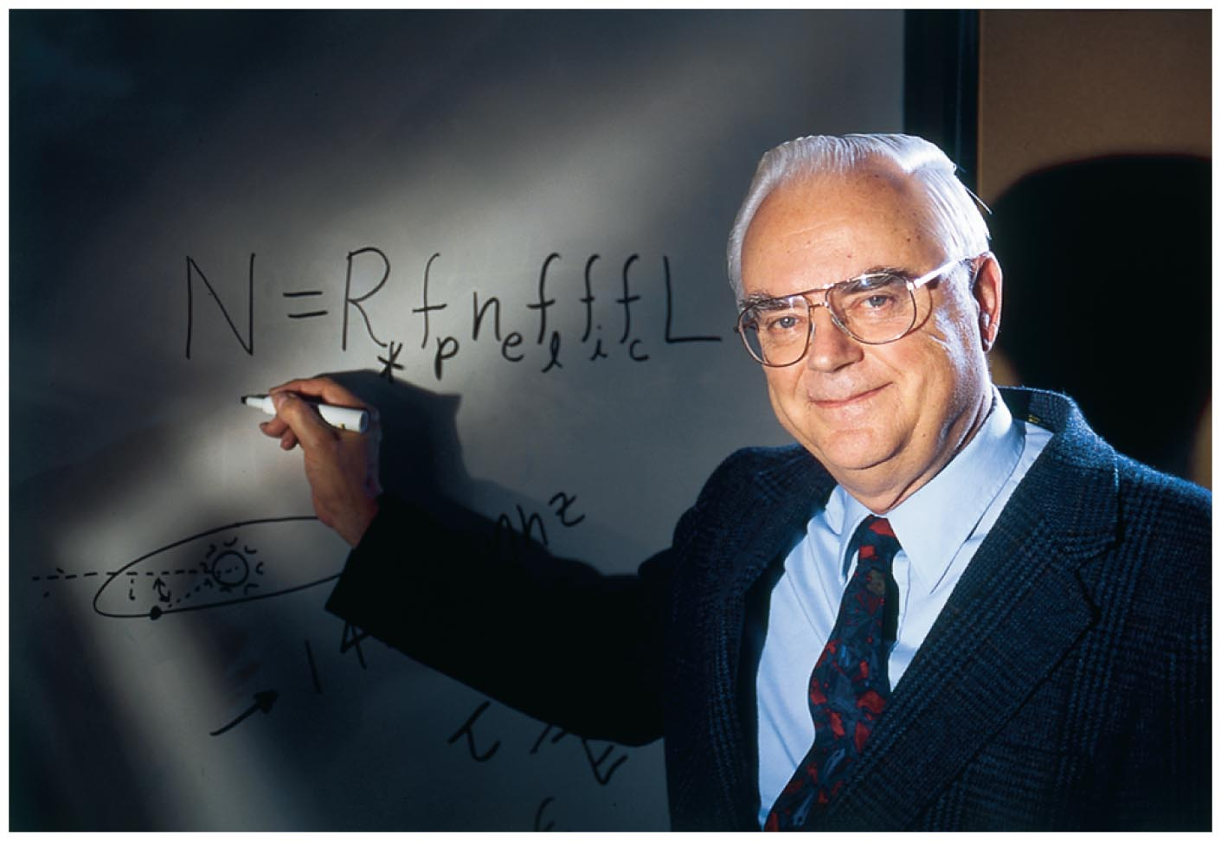
How many civilizations are out there?

Slide 52
The Drake Equation
Number of civilizations with whom we could potentially
communicate
= N_{HP} × f_{life} × f_{civ} × f_{now}
N_{HP} = total number of habitable planets in galaxy
f_{life} = fraction of habitable planets with life
f_{civ} = fraction of life-bearing planets with
civilization at some time
f_{now} = fraction of civilizations around now
Notes:
It's usually worth going through this equation slowly so that students can see how it leads to the number of civilizations that we could communicate with.

Slide 53
We do not know the following values for the Drake equation:
N_{HP} : probably billions
f_{life} : ??? Hard to say (near 0 or near 1)
f_{civ} : ??? It took 4 billion years on Earth
f_{now} : ??? Can civilizations survive long-term?

Slide 54
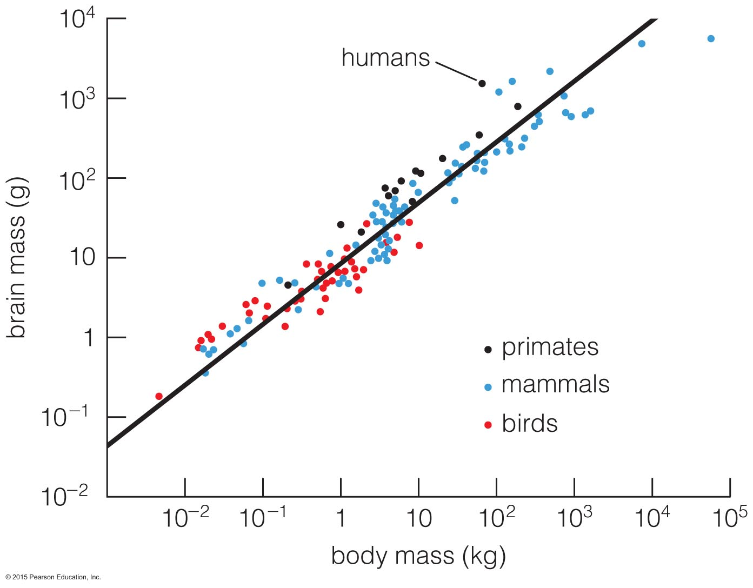
Are we "off-the-chart" smart?
Humans have comparatively large brains.
Does that mean our level of intelligence is improbably high?
Notes:
One interesting question on F_{civ} is whether it is likely or unlikely that a planet with life would ever get a species as smart as US. This is a fun slide to show, since it can be used to argue the question both ways. On the one hand, we have much larger brains in proportion to body mass than any other species that has ever lived on Earth. On the other hand, while we are a statistical outlier, statistically some outliers are to be expected…

Slide 55
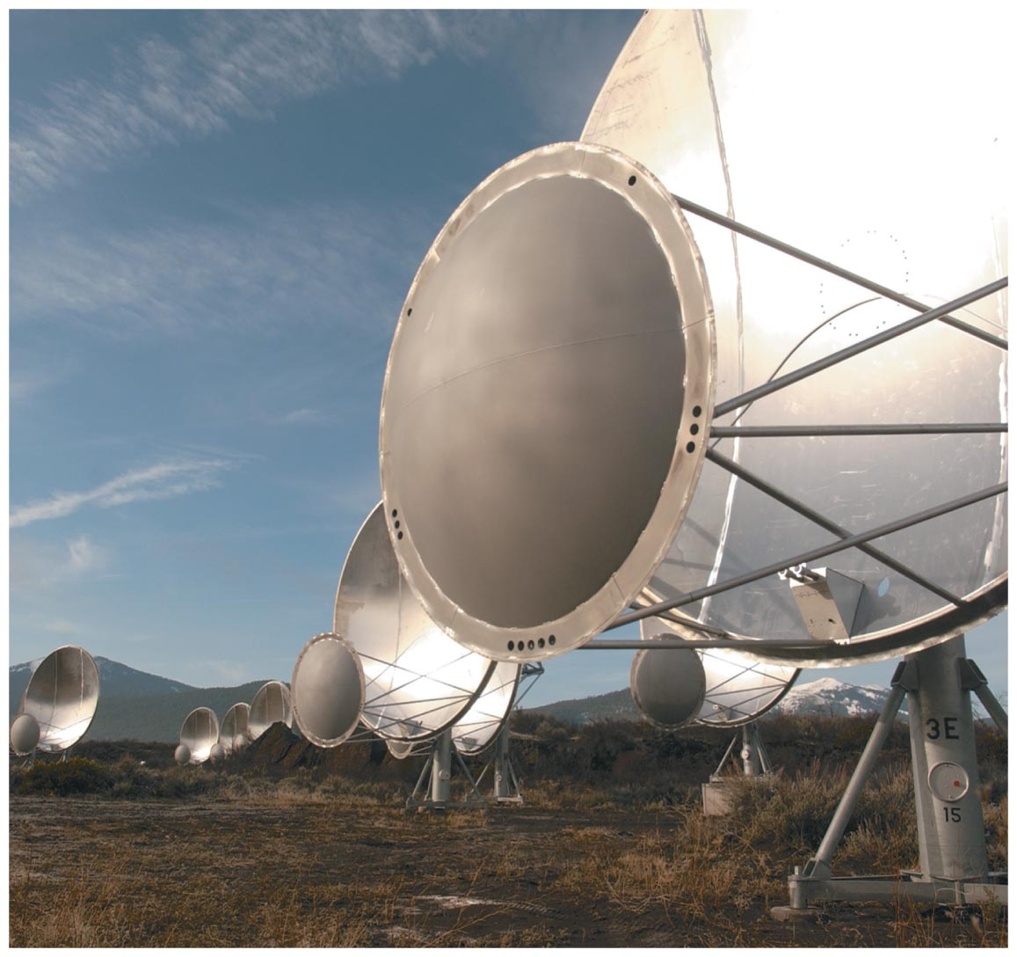
How does SETI work?

Slide 56
SETI experiments look for deliberate signals from E.T.
Notes:
Emphasize that current SETI efforts could not detect signals as weak as our own radio/TV broadcasts. For now, at least, we are looking for deliberately broadcast signals..

Slide 57
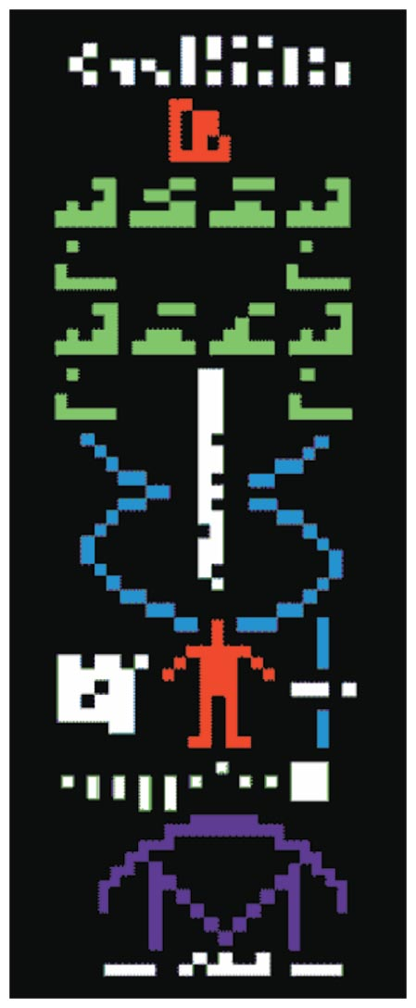
We've even sent a few signals ourselves…
Earth to globular cluster M13: Hoping we'll hear
back in about 42,000 years!
Notes:
Message sent from Arecibo in 1974… M13 distance approx. 21,000 light-years—but offers a lot of potential targets with its high density of stars.

Slide 58
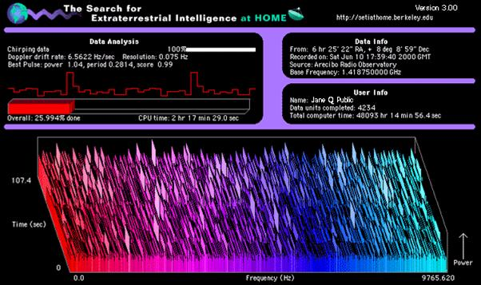
Your computer can help! SETI @ Home: a screensaver with a purpose
Notes:
Optional: There's a lot of data to sift though, and you can be a part of the effort… .

Slide 59
What have we learned?
How many civilizations are out there?
  We don't know, but the Drake equation gives us a framework for thinking about the question.
How does SETI work?
  Some telescopes are looking for deliberate communications from other worlds.

Slide 60
18.5 Interstellar Travel and Its Implications to Civilization
Our goals for learning:
How difficult is interstellar travel?
Where are the aliens?

Slide 61
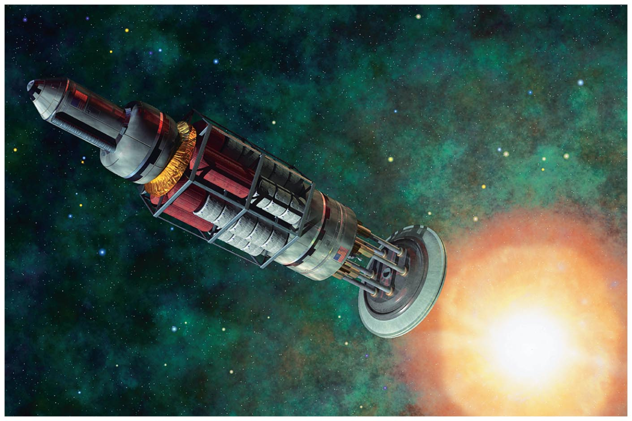
How difficult is interstellar travel?

Slide 62
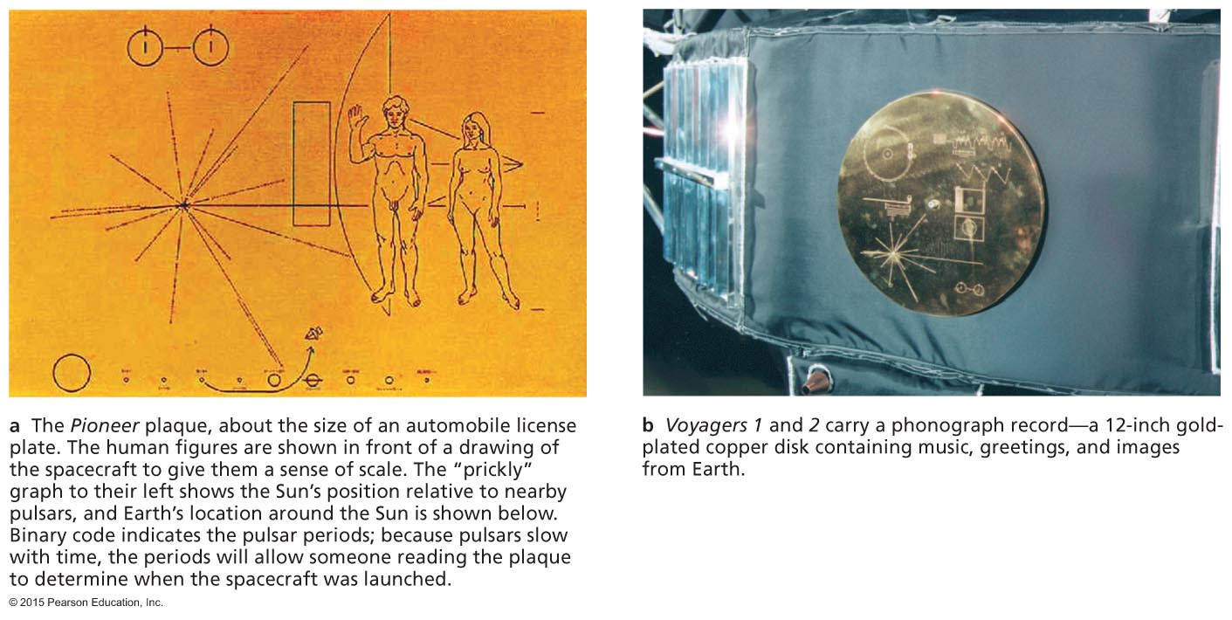
Current Spacecraft
Current spacecraft travel at <1/10,000c;
100,000 years to the nearest stars
Pioneer plaque
Voyager record
Notes:
Our first interstellar emissaries: the Pioneer and Voyager spacecraft.

Slide 63
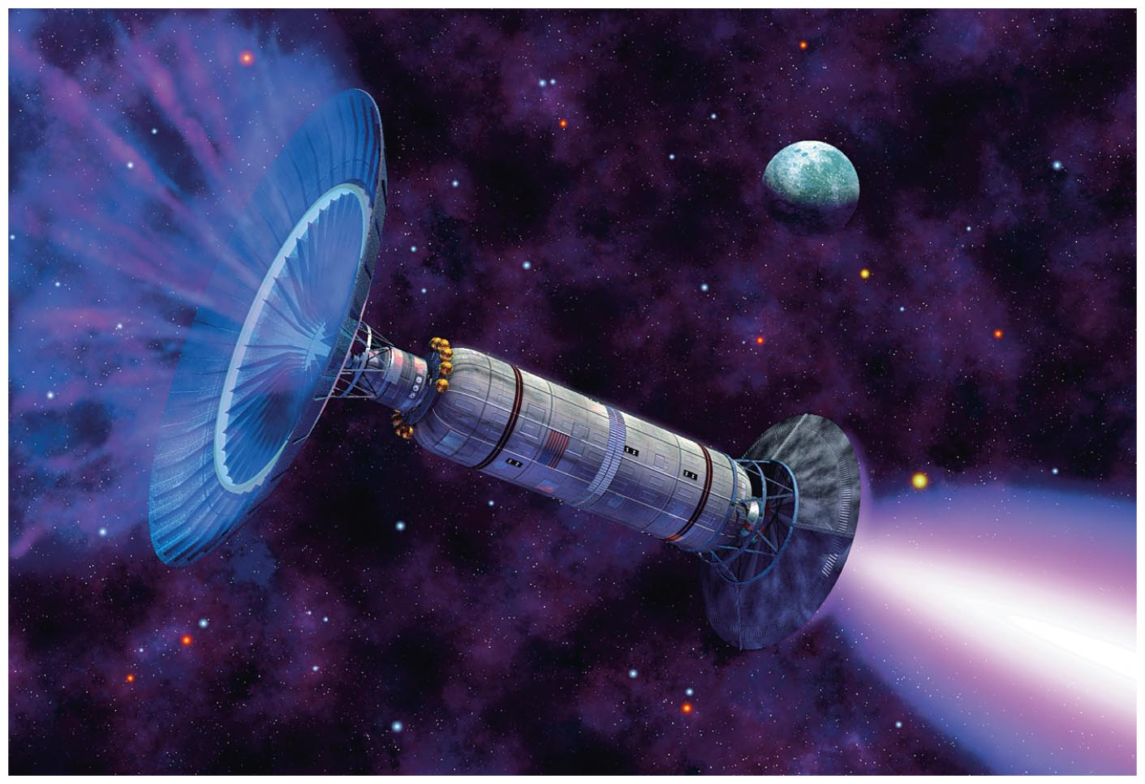
Difficulties of Interstellar Travel
Far more efficient engines are needed.
Energy requirements are enormous.
Ordinary interstellar particles become like cosmic rays.
There are social complications of time dilation.
Notes:
If you discuss the difficulty of interstellar travel in any detail, you might wish to discuss the implications to UFOs; see box on p. 523.

Slide 64
Where are the aliens?

Slide 65
Fermi's Paradox
Plausible arguments suggest that civilizations should be common. For example, even if only 1 in 1 million stars gets a civilization at some time ⇒ 100,000 civilizations!
So why haven't we detected them?
Notes:
This is one of our favorite topics, and if you have time it is worth using these slides as a capstone to your course…

Slide 66
Possible solutions to the paradox
  We are alone: life/civilizations much rarer than we might have guessed
    Our own planet/civilization looks all the more precious…

Slide 67
Possible solutions to the paradox
  Civilizations are common, but interstellar travel is not, perhaps because:
    interstellar travel is more difficult than we think.
    the desire to explore is rare.
    civilizations destroy themselves before achieving interstellar travel.
  These are all possibilities, but they are not very appealing.

Slide 68
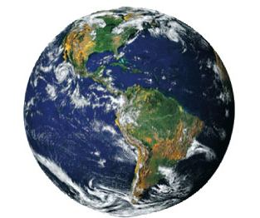
Possible solutions to the paradox
  There IS a galactic civilization…
  … and someday we'll meet them.
Notes:
A truly incredible possibility to ponder…

Slide 69
What have we learned?
How difficult is interstellar travel?
  Interstellar travel remains well beyond our current capabilities and poses enormous difficulties.
Where are the aliens?
  Plausible arguments suggest that if interstellar civilizations are common, then at least one of them should have colonized the rest of the galaxy.
  Are we alone? Has there been no colonization? Are the colonists hiding? We don't know—but we hope to find out someday.

