Slide 1
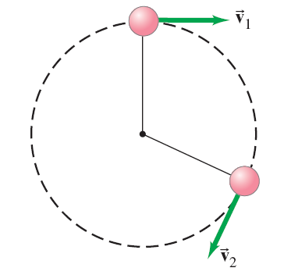
5-2 Uniform Circular Motion—Kinematics
Uniform circular motion: motion in a circle of constant radius at constant speed
Instantaneous velocity is always tangent to the circle.
Notes:
Figure 5-10. Caption: A small object moving in a circle, showing how the velocity changes. At each point, the instantaneous velocity is in a direction tangent to the circular path.

Slide 2
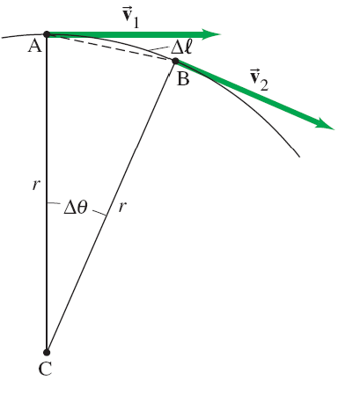
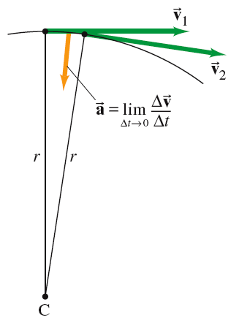
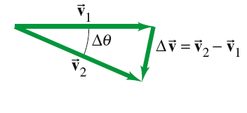
5-2 Uniform Circular Motion—Kinematics
Looking at the change in velocity in the limit that the time interval becomes infinitesimally small, we see that
.
Notes:
Figure 5-11. Caption: Determining the change in velocity, Δv, for a particle moving in a circle. The length Δl is the distance along the arc, from A to B.

Slide 3
5-2 Uniform Circular Motion—Kinematics
This acceleration is called the centripetal, or radial, acceleration, and it points toward the center of the circle.
Notes:
Figure 5-12. Caption: For uniform circular motion, a is always perpendicular to v.

Slide 4
5-2 Uniform Circular Motion—Kinematics
Example 5-8: Acceleration of a revolving ball.
A 150-g ball at the end of a string is revolving uniformly in a horizontal circle of radius 0.600 m. The ball makes 2.00 revolutions in a second. What is its centripetal acceleration?
a = v²/r; we can find v from the radius and frequency.
v = (2 x 2Ԯr)/t = 7.54 m/s,
so a = (7.54m/s)²/0.6 m
= 94.7 m/s².
Notes:
Figure 5-10. Caption: A small object moving in a circle, showing how the velocity changes. At each point, the instantaneous velocity is in a direction tangent to the circular path.
Answer: a = v²/r; we can find v from the radius and frequency. v = 7.54 m/s, so a = 94.7 m/s².

Slide 5
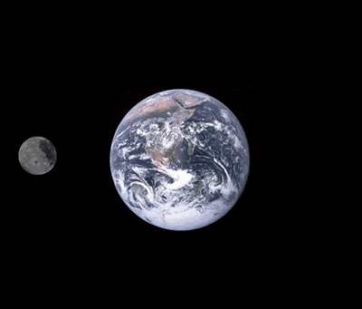
5-2 Uniform Circular Motion—Kinematics
Example 5-9: Moon’s centripetal acceleration.
The Moon’s nearly circular orbit about the Earth has a radius of about 384,000 km and a period T of 27.3 days. Determine the acceleration of the Moon toward the Earth.
Again, find v from r and the period; first convert r and T into meters and seconds, respectively. Then a = 2.72 x 10⁻³ m/s² = 2.78 x 10⁻⁴ g.
Notes:
Answer: Again, find v from r and the period; first convert r and T into meters and seconds, respectively. Then a = 2.72 x 10⁻³ m/s² = 2.78 x 10⁻⁴ g.

Slide 6
5-2 Uniform Circular Motion—Kinematics
A centrifuge works by spinning very fast. This means there must be a very large centripetal force. The object at A would go in a straight line but for this force; as it is, it winds up at B.
Notes:
Figure 5-13. Caption: Two positions of a rotating test tube in a centrifuge (top view). At A, the green dot represents a macromolecule or other particle being sedimented. It would tend to follow the dashed line, heading toward the bottom of the tube, but the fluid resists this motion by exerting a force on the particle as shown at point B.

Slide 7


Slide 8
5-2 Uniform Circular Motion—Kinematics
Example 5-10: Ultracentrifuge.
The rotor of an ultracentrifuge rotates at 50,000 rpm (revolutions per minute). A particle at the top of a test tube is 6.00 cm from the rotation axis. Calculate its centripetal acceleration, in “g’s.”
Find v and then a. Convert minutes to seconds (60 s/min x 1 min) and centimeters to meters (6.00 cm x 1 m/100 cm) .
v = (50000 x 2(3.14)(0.06 m))/60s
a = (50000 x 2(3.14)(0.06 m)/60s)²/0.06 m
Divide final answer by 9.8 m/s². a = 167,000 g’s
Notes:
Answer: Again, find v and then a. Convert minutes to seconds and centimeters to meters. Divide final answer by 9.8 m/s². a = 167,000 g’s.

Slide 9
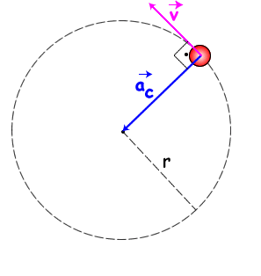
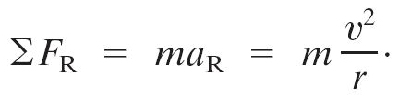
5-3 Dynamics of Uniform Circular Motion
For an object to be in uniform circular motion, there must be a net force acting on it.
We already know the acceleration, so can immediately write the force:
Notes:
Figure 5-14. Caption: A force is required to keep an object moving in a circle. If the speed is constant, the force is directed toward the circle’s center.

Slide 10
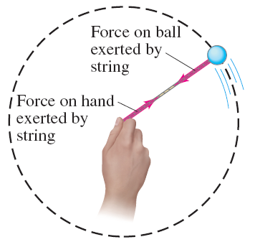
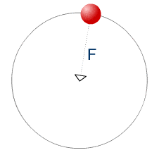
5-3 Dynamics of Uniform Circular Motion
We can see that the force must be inward by thinking about a ball on a string. Strings only pull; they never push.
Notes:
Figure 5-15. Caption: Swinging a ball on the end of a string.

Slide 11
5-3 Dynamics of Uniform Circular Motion
There is no centrifugal force pointing outward; what happens is that the natural tendency of the object to move in a straight line must be overcome.
If the centripetal force vanishes, the object flies off at a tangent to the circle.
Notes:
Figure 5-16. Caption: If centrifugal force existed, the revolving ball would fly outward as in (a) when released. In fact, it flies off tangentially as in (b). For example, in (c) sparks fly in straight lines tangentially from the edge of a rotating grinding wheel.

Slide 12
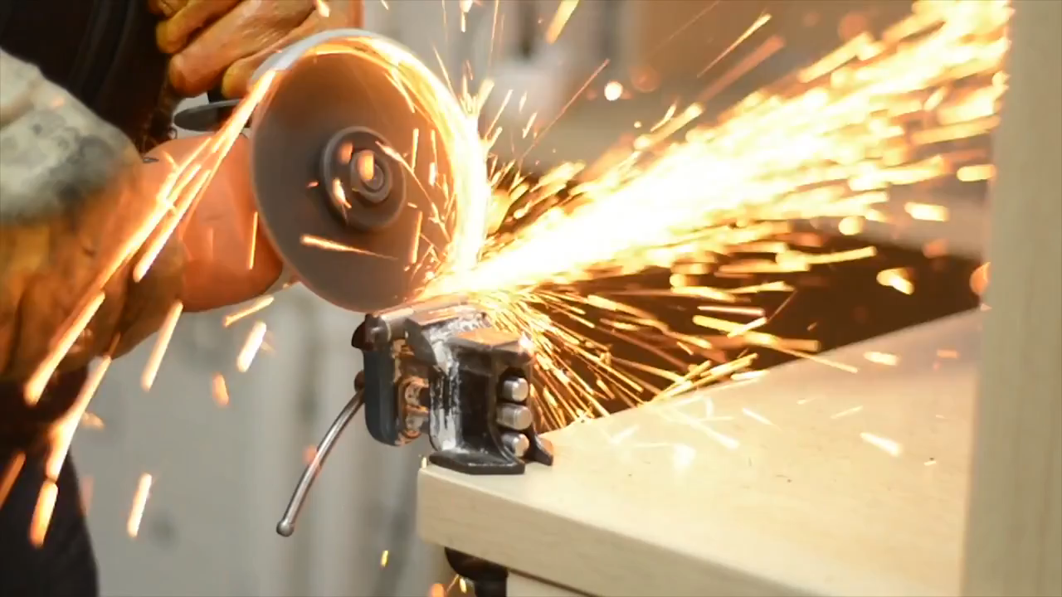

Slide 13
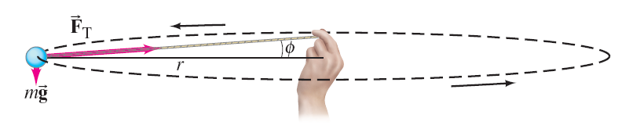
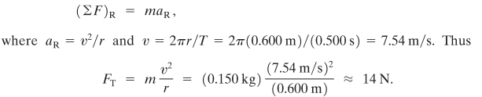
5-3 Dynamics of Uniform Circular Motion
Example 5-11: Force on revolving ball (horizontal).
Estimate the force a person must exert on a string attached to a 0.150-kg ball to make the ball revolve in a horizontal circle of radius 0.600 m. The ball makes 2.00 revolutions per second. Ignore the string’s mass.
Notes:
Figure 5-17.
Answer: Ignoring the weight of the ball, so F_{T} is essentially horizontal, we find F_{T} = 14 N.

Slide 14
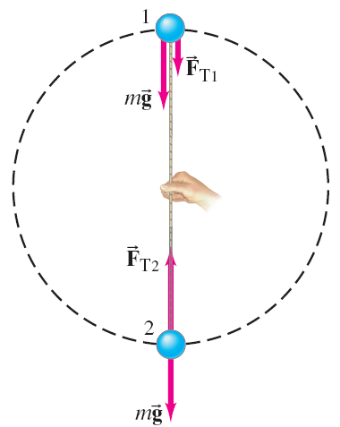


5-3 Dynamics of Uniform Circular Motion
Example 5-12: Revolving ball (vertical circle).
A 0.150-kg ball on the end of a 1.10-m-long cord (negligible mass) is swung in a vertical circle. (a) Determine the minimum speed the ball must have at the top of its arc so that the ball continues moving in a circle.
Notes:
Figure 5-18. Caption: Example 5–12. Freebody diagrams for positions 1 and 2.
Solution: See the freebody diagrams.
The minimum speed occurs when the tension is zero at the top; v = 3.283 m/s.
Substitute to find F_{T2} = 7.35 N.

Slide 15

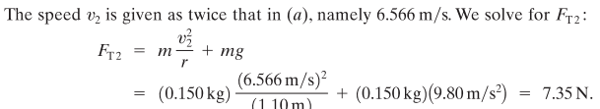
5-3 Dynamics of Uniform Circular Motion
Example 5-12: Revolving ball (vertical circle).
A 0.150-kg ball on the end of a 1.10-m-long cord (negligible mass) is swung in a vertical circle. Calculate the tension in the cord at the bottom of the arc, assuming the ball is moving at twice the speed of part (a).
Notes:
Figure 5-18. Caption: Example 5–12. Freebody diagrams for positions 1 and 2.
Solution: See the freebody diagrams.
The minimum speed occurs when the tension is zero at the top; v = 3.283 m/s.
Substitute to find F_{T2} = 7.35 N.

Slide 16
5-4 Highway Curves: Banked and Unbanked
When a car goes around a curve, there must be a net force toward the center of the circle of which the curve is an arc. If the road is flat, that force is supplied by friction.
Notes:
Figure 5-21. Caption: The road exerts an inward force on a car (friction against the tires) to make it move in a circle. The car exerts an inward force on the passenger.

Slide 17

5-4 Highway Curves: Banked and Unbanked
If the frictional force is insufficient, the car will tend to move more nearly in a straight line, as the skid marks show.
Notes:
Figure 5-22. Caption: Race car heading into a curve. From the tire marks we see that most cars experienced a sufficient friction force to give them the needed centripetal acceleration for rounding the curve safely. But, we also see tire tracks of cars on which there was not sufficient force—and which unfortunately followed more nearly straight-line paths.

Slide 18


Slide 19
5-4 Highway Curves: Banked and Unbanked
As long as the tires do not slip, the friction is static. If the tires do start to slip, the friction is kinetic, which is bad in two ways:
The kinetic frictional force is smaller than the static.
The static frictional force can point toward the center of the circle, but the kinetic frictional force opposes the direction of motion, making it very difficult to regain control of the car and continue around the curve.

Slide 20
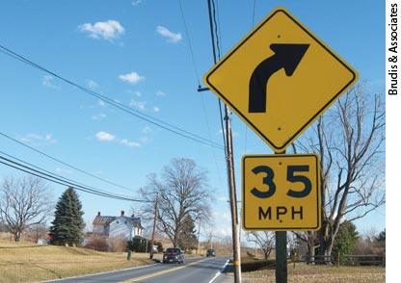

Slide 21
5-4 Highway Curves: Banked and Unbanked
Example 5-14: Skidding on a curve.
A 1000-kg car rounds a curve on a flat road of radius 50 m at a speed of 15 m/s (54 km/h). Will the car follow the curve, or will it skid? Assume: (a) the pavement is dry and the coefficient of static friction is μ_{s} = 0.60; (b) the pavement is icy and μ_{s} = 0.25.
The normal force equals the weight, and the centripetal force is provided by the frictional force (if sufficient). The required centripetal force is 4500 N.
The maximum frictional force is 5880 N, so the car follows the curve.
The maximum frictional force is 2450 N, so the car will skid.
Notes:
Figure 5-23. Caption: Example 5–14. Forces on a car rounding a curve on a flat road. (a) Front view, (b) top view.
Solution: The normal force equals the weight, and the centripetal force is provided by the frictional force (if sufficient). The required centripetal force is 4500 N.
The maximum frictional force is 5880 N, so the car follows the curve.
The maximum frictional force is 2450 N, so the car will skid.

Slide 22
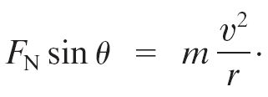
5-4 Highway Curves: Banked and Unbanked
Banking the curve can help keep cars from skidding. In fact, for every banked curve, there is one speed at which the entire centripetal force is supplied by the
horizontal component of the normal force, and no friction is required. This occurs when:
Notes:
Figure 5-24. Caption: Normal force on a car rounding a banked curve, resolved into its horizontal and vertical components. The centripetal acceleration is horizontal (not parallel to the sloping road). The friction force on the tires, not shown, could point up or down along the slope, depending on the car’s speed. The friction force will be zero for one particular speed.

