Slide 1

WORK

Slide 2
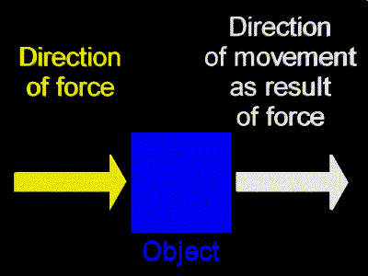
Work is only done by a force on an object if the force causes the object to move in the direction of the force.

Slide 3
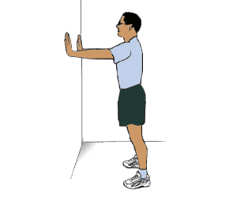
Objects that are at rest may have many forces acting on them, but NO work is done if the object does not move (zero displacement).

Slide 4

7-1 Work Done by a Constant Force
The work done by a constant force is defined as the distance moved multiplied by the component of the force in the direction of displacement:
Notes:
Figure 7-1. Caption: A person pulling a crate along the floor. The work done by the force F is W = Fd cos θ, where d is the displacement.

Slide 5
WORK = FORCE X DISTANCE
W = F d cos Θ
Joule (J) = Newton-meter
In this definition, only the force in the direction of motion counts.
motion
FORCE
Θ
We only consider this!

Slide 6
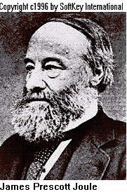
The SI unit of work
is the Joule,
named in honor of
James Prescott Joule.
One Joule, J,
is the work done when
1.0 N of force is applied
through a distance of 1.0 m.

Slide 7

7-1 Work Done by a Constant Force
In the SI system, the units of work are joules:
As long as this person does not lift or lower the bag of groceries, he is doing no work on it. The force he exerts has no component in the direction of motion.
Notes:
Figure 7-2. Caption: The person does no work on the bag of groceries since F_{P} is perpendicular to the displacement d.

Slide 8
Graphically, work is
the area under a
“Force vs. Displacement” graph.
WORK
displacement, m

Slide 9
Work Done with
Constant Force

Slide 10
A 5-kg block of wood is pushed across a frictionless surface by a horizontally applied force of 12 N. As a result, the block is displaced 6.0 m. How much work is done on the block?
W = F∆x
W = 12 N x 6.0 m
W = 72 J
m = 5 kg
F = 12 N
∆x = 6.0 m

Slide 11
The same block of wood is now pulled across a frictionless surface by a 30 N force applied at an angle of 30º to the horizontal. How much work is done if the wood is displaced 6.0 m?
W = F cosө ∆x
W = (30 N)(cos 30º)(6.0 m)
W = 156 J
F
ө = 30 º
F_{x}
m
∆x

Slide 12
A 10-kg wood block is placed at the top of a frictionless 30º inclined plane. How much work is done on the block as it slides down the 10-m incline?
m = 10 kg
ℓ = 10 m
ө = 30º

Slide 13
The force that does work on the block is the parallel component of the object’s weight.
Construct a free-body diagram:
Find Fp:
Fp = F_{W}•sin ө
Fp = (98 N)(sin 30º)
Fp = 49 N
Find W:
W = F∆x
W = (49 N)(10 m)
W = 490 J
F_{p}
ө
F┴
F_{W}

Slide 14
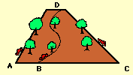
Which car does the greater amount of work?
Each vehicle does the same amount of work to get to the top of the hill, regardless of the path taken. Only force and vertical displacement are important in determining the amount of work done.

Slide 15

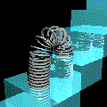
Work Done with
Variable Force
(Hooke's Law)

Slide 16
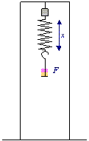
Hooke’s Law
F = kx k = spring constant
x = displacement from equilibrium position
A given force “F” will stretch a spring an amount “x”.
The ratio F/x is a constant value for a spring of a particular length, material, diameter, etc.

Slide 17
7-3 Work Done by a Varying Force
Work done by a spring force:
The force exerted by a spring is given by:
.
Notes:
Figure 7-10. Caption: (a) Spring in normal (unstretched) position. (b) Spring is stretched by a person exerting a force F_{P} to the right (positive direction). The spring pulls back with a force F_{S} where F_{S} = -kx. (c) Person compresses the spring (x < 0) and the spring pushes back with a force F_{S} = kx where F_{S} > 0 because x < 0.

Slide 18
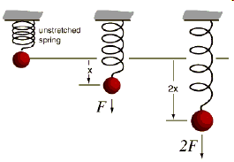
The work done in stretching a spring is variable over the distance x because the force required to stretch the spring an increasingly greater distance from equilibrium increases as x increases.
Therefore, the simple equation W = F∆x DOES NOT WORK for springs and other elastic materials.

Slide 19
7-3 Work Done by a Varying Force
Plot of F vs. x. Work done is equal to the shaded area.
Notes:
Figure 7-11. Caption: Work done to stretch a spring a distance x equals the triangular area under the curve F = kx. The area of a triangle is ½ x base x altitude, so W = ½(x)(kx) = ½ kx².

Slide 20
7-3 Work Done by a Varying Force
Example 7-5: Work done on a spring.
(a) A person pulls on a spring, stretching it 3.0 cm, which requires a maximum force of 75 N. How much work does the person do? (b) If, instead, the person compresses the spring 3.0 cm, how much work does the person do?
Calculate for the spring constant (k):
k = F/x = 75 N/0.03 m = 2500
W = ½ kx² = ½ 2500 (0.03m) ² = 1.1 J
Notes:
Solution: First calculate the spring constant: k = 2.5 x 10³ N/m. Then W = 1.1 J, whether stretching or compressing.

Slide 21


7-4 Kinetic Energy and the Work-Energy Principle
If we write the acceleration in terms of the velocity and the distance, we find that the work done here is
We define the kinetic energy as:
Notes:
Figure 7-14. Caption: A constant net force F_{net} accelerates a car from speed v₁ to speed v₂ over a displacement d. The net work done is W_{net} = F_{net}d.

Slide 22

7-4 Kinetic Energy and the Work-Energy Principle
This means that the work done is equal to the change in the kinetic energy:
If the net work is positive, the kinetic energy increases.
If the net work is negative, the kinetic energy decreases.

Slide 23

Work
can be done
by or against
the
Earth’s gravitational field.

Slide 24

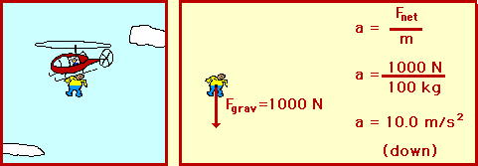
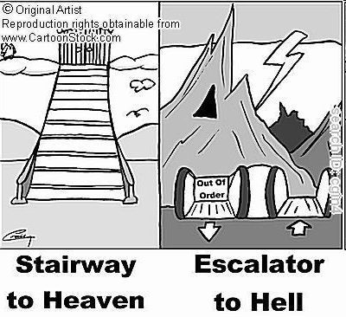
Work is done by gravity when an object:
- slides down an incline
- is in free-falls
- undergoes any downward vertical displacement, including moving down at an angle

Slide 25

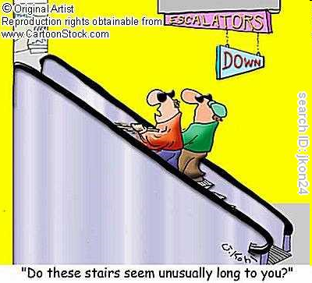
Work is done against gravity when an object:
moves up an incline
is lifted
- undergoes any upward vertical displacement, including moving up at an angle

Slide 26
7-4 Kinetic Energy and the Work-Energy Principle
Because work and kinetic energy can be equated, they must have the same units: kinetic energy is measured in joules. Energy can be considered as the ability to do work:
Notes:
Figure 7-15. Caption: A moving hammer strikes a nail and comes to rest. The hammer exerts a force F on the nail; the nail exerts a force -F on the hammer (Newton’s third law). The work done on the nail by the hammer is positive (W_{n} = Fd >0). The work done on the hammer by the nail is negative (W_{h} = -Fd).

Slide 27
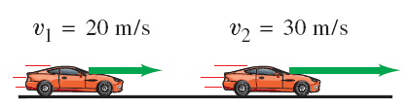
7-4 Kinetic Energy and the Work-Energy Principle
Example 7-8: Work on a car, to increase its kinetic energy.
How much net work is required to accelerate a 1000-kg car from 20 m/s to 30 m/s?
W = ΔKE = ½ (mv)²
= ½ (1000 kg) ((30 m/s)² -(20 m/s)²)
= 250 000 J
Notes:
Figure 7-16.
The net work is the increase in kinetic energy, 2.5 x 10⁵ J.

Slide 28
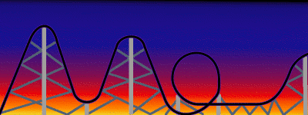
Conservation of Energy

Slide 29
8-1 Conservative and Nonconservative Forces
If friction is present, the work done depends not only on the starting and ending points, but also on the path taken. Friction is called a nonconservative force.
A crate is pushed at constant speed across a rough floor from position 1 to position 2 via two paths, one straight and one curved. The pushing force F_{P} is always in the direction of motion. (The friction force opposes the motion.) Hence for a constant magnitude pushing force, the work it does is W = F_{P}d, so if d is greater (as for the curved path), then W is greater. The work done does not depend only on points 1 and 2; it also depends on the path taken.
Notes:
Figure 8-3. Caption: A crate is pushed at constant speed across a rough floor from position 1 to position 2 via two paths, one straight and one curved. The pushing force F_{P} is always in the direction of motion. (The friction force opposes the motion.) Hence for a constant magnitude pushing force, the work it does is W = F_{P}d, so if d is greater (as for the curved path), then W is greater. The work done does not depend only on points 1 and 2; it also depends on the path taken.

Slide 30
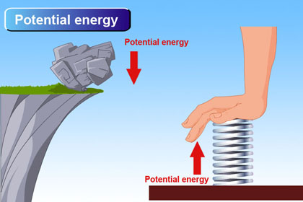
8-2 Potential Energy
An object can have potential energy by virtue of its surroundings.
Familiar examples of potential energy:
A wound-up spring
A stretched elastic band
An object at some
height above the
ground

Slide 31
8-2 Potential Energy
In raising a mass m to a height h, the work done by the external force is
.
We therefore define the gravitational potential energy at a height y above some reference point:
.
Notes:
Figure 8-4. Caption: A person exerts an upward force F_{ext} = mg to lift a brick from y₁ to y₂ .

Slide 32
8-2 Potential Energy
Example 8-1: Potential energy changes for a roller coaster.
A 1000-kg roller-coaster car moves from point 1 to point 2 and then to point 3. (a) What is the gravitational potential energy at points 2 and 3 relative to point 1? That is, take y = 0 at point 1. (b) What is the change in potential energy when the car goes from point 2 to point 3?
U = mgh
At point 2, U = (1000 kg) (9.8 m/s² ) (10 m) = 9.8 x 10⁴ J;
At point 3,
U = (1000 kg) (9.8 m/s² ) (-15 m)
= -1.5 x 10⁵ J.
b. U = (1000 kg) (9.8 m/s² ) (-25 m)
= -2.5 x 10⁵ J.
Notes:
Figure 8-5.
Answer: a. At point 2, U = 9.8 x 10⁴ J; at point 3, U = -1.5 x 10⁵ J.
b. U = -2.5 x 10⁵ J.
c. At point 1, U = 1.5 x 10⁵ J. At point 2, U = 2.5 x 10⁵ J. At point 3, U = 0 (by definition); the change in going from point 2 to point 3 is -2.5 x 10⁵ J.

Slide 33
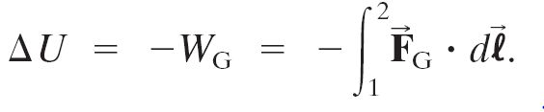
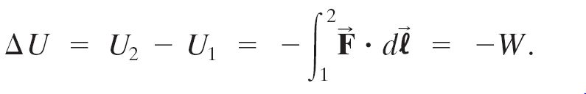
8-2 Potential Energy
General definition of gravitational potential energy:
For any conservative force:

Slide 34

8-3 Mechanical Energy and Its Conservation
If there are no nonconservative forces, the sum of the changes in the kinetic energy and in the potential energy is zero—the kinetic and potential energy changes are equal but opposite in sign.
This allows us to define the total mechanical energy:
And its conservation:
.

Slide 35
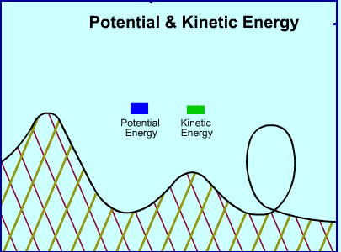
8-3 Mechanical Energy and Its Conservation
The principle of conservation of mechanical energy:
If only conservative forces are doing work, the total mechanical energy of a system neither increases nor decreases in any process. It stays constant—it is conserved.

Slide 36
Problem Solving Using Conservation of Mechanical Energy
Conceptual Example 8-5: Speeds on two water slides.
Two water slides at a pool are shaped differently, but start at the same height h. Two riders, Paul and Kathleen, start from rest at the same time on different slides. (a) Which rider, Paul or Kathleen, is traveling faster at the bottom? (b) Which rider makes it to the bottom first? Ignore friction and assume both slides have the same path length.
a. The speeds are the same, due to conservation of energy.
b. At every point, Kathleen has less PE than Paul, and therefore more KE. This means her speed is faster (until the end) and she reaches the bottom first.
Notes:
Figure 8-9.
Answer: a. The speeds are the same, due to conservation of energy.
b. At every point, Kathleen has less potential energy than Paul, and therefore more kinetic energy. This means her speed is faster (until the end) and she reaches the bottom first.

Slide 37
8-4 Problem Solving Using Conservation of Mechanical Energy
Example 8-6: Pole vault.
Estimate the kinetic energy and the speed required for a 70-kg pole vaulter to just pass over a bar 5.0 m high. Assume the vaulter’s center of mass is initially 0.90 m off the ground and reaches its maximum height at the level of the bar itself.
ΔKE = ΔPE
½ mv² = mgh
v² = 2gh _______________
v = √2gh = √2 (9.8 m/s²) (4.5m)
= 9.4 m/s
Notes:
Figure 8-10. Caption: Transformation of energy during a pole vault.
Solution: Assume the vaulter’s body is at rest at 9.0 m, and equate that total energy to the total energy when the running vaulter starts placing the pole. This gives a speed of about 9 m/s.

Slide 38

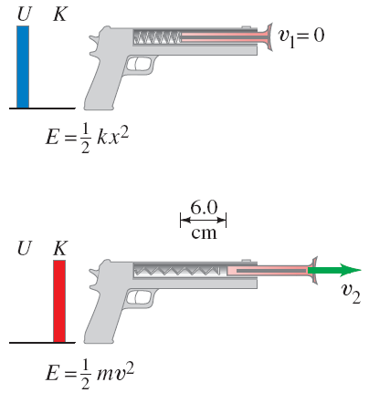
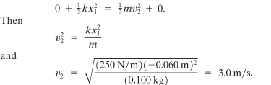
8-4 Problem Solving Using Conservation of Mechanical Energy
For an elastic force, conservation of energy tells us:
Example 8-7: Toy dart gun.
A dart of mass 0.100 kg is pressed against the spring of a toy dart gun. The spring (with spring stiffness constant k = 250 N/m and ignorable mass) is compressed 6.0 cm and released. If the dart detaches from the spring when the spring reaches its natural length (x = 0), what speed does the dart acquire?
Notes:
Figure 8-12. Caption: Example 8-7. (a) A dart is pushed against a spring, compressing it 6.0 cm. The dart is then released, and in (b) it leaves the spring at velocity v₂.
Solution: Use conservation of energy, with the initial energy as elastic potential energy; v = 3.0 m/s.

Slide 39
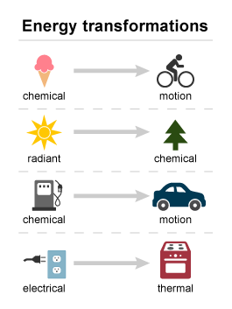
8-5 The Law of Conservation of Energy
The law of conservation of energy is one of the most important principles in physics.
The total energy is neither increased nor decreased in any process. Energy can be transformed from one form to another, and transferred from one object to another, but the total amount remains constant.

Slide 40
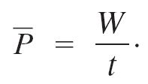
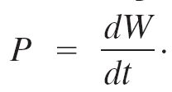

8-8 Power
Power is the rate at which work is done. Average power:
Instantaneous power:
In the SI system, the units of power are watts:

Slide 41

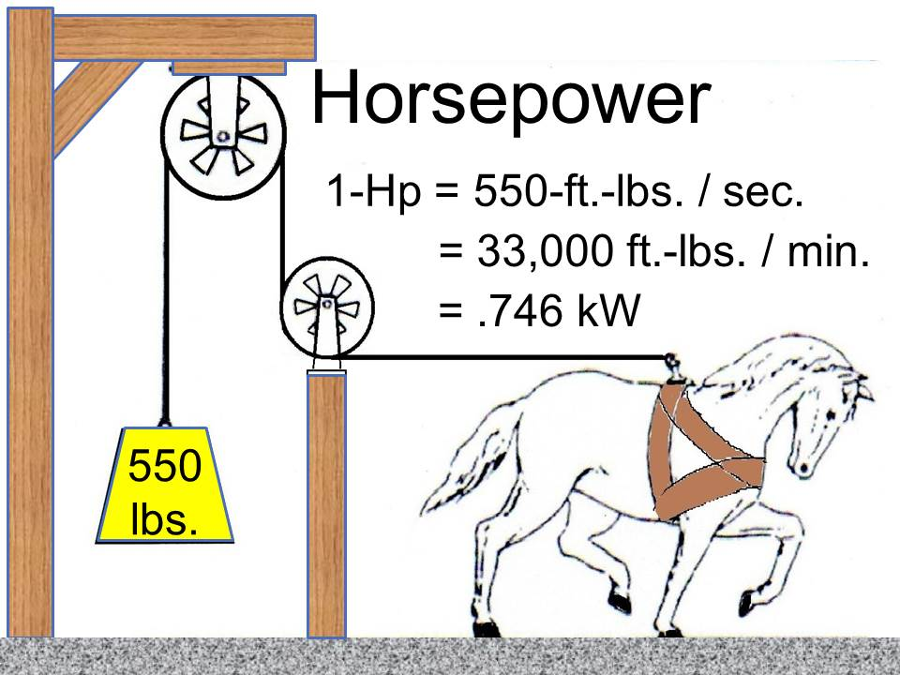
8-8 Power
Power can also be described as the rate at which energy is transformed:

Slide 42
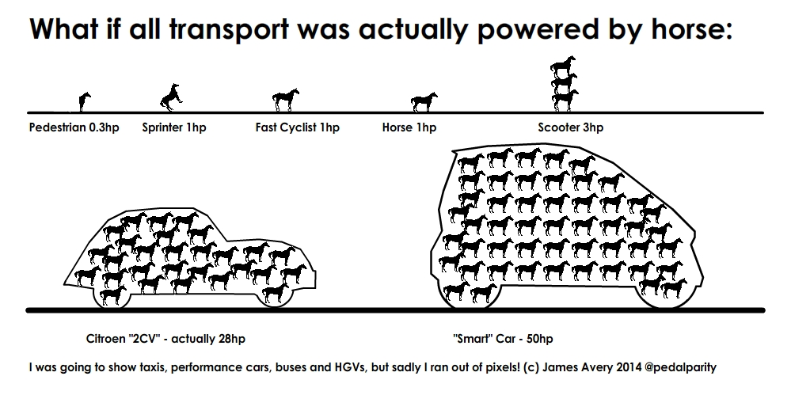

Slide 43
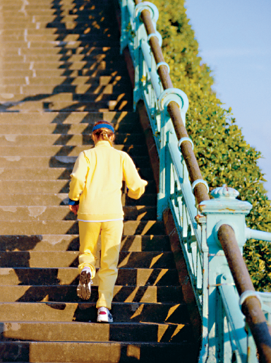
8-8 Power
Example 8-14: Stair-climbing power.
A 60-kg jogger runs up a long flight of stairs in 4.0 s. The vertical height of the stairs is 4.5 m. (a) How much energy did this require? (b) Estimate the jogger’s power output in watts.
PE = mgh = (60kg)(9.8m/s²)(4.6m) = 2600 J
(b) P = W/t = 2600 J/ 4.0s = 660 W
Notes:
Figure 8-21.
Solution: a. The work is the change in potential energy, and the power is the work divided by time: P = 660 W = 0.88 hp.
b. The energy is 2600 J.

