Slide 1
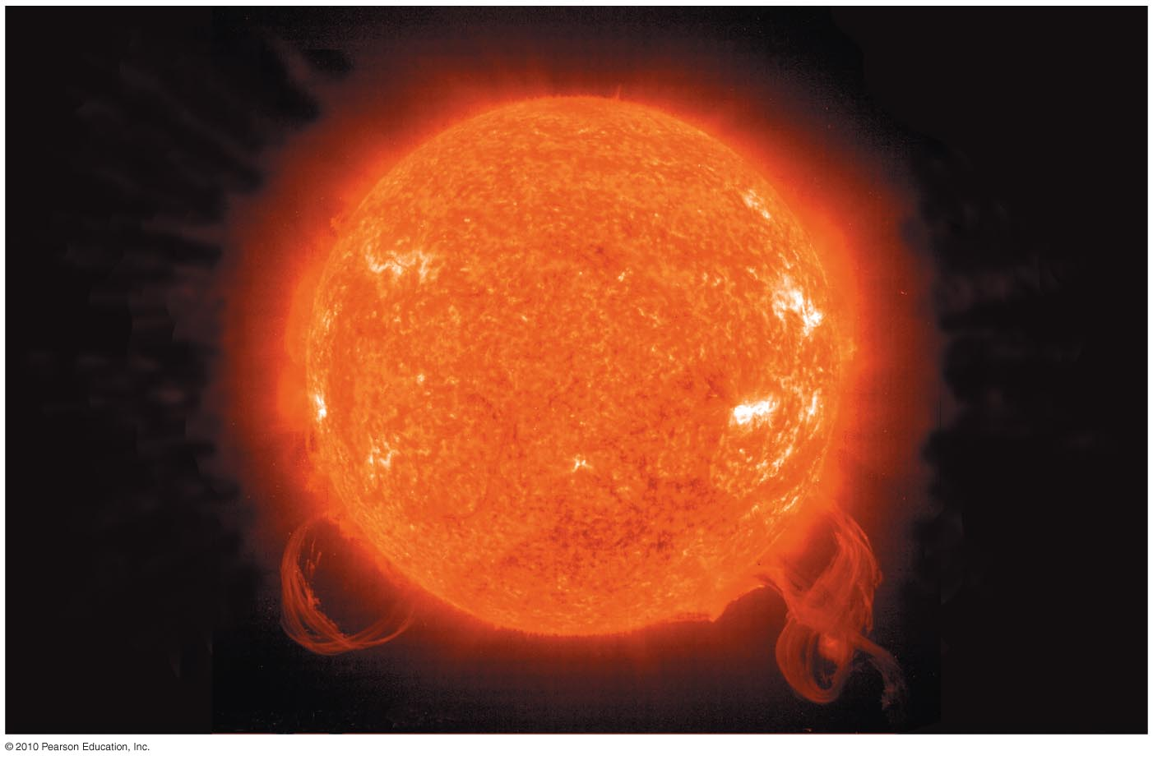
Why was the Sun’s energy source a major mystery?

Slide 2
Is it on FIRE?
Most of the ancient people assume that the sun is a huge ball of fire. These assumptions were due to their lack of knowledge concerning the distance and the size of the sun.

Slide 3
Is it on FIRE?
Chemical energy content
~ 10,000 years
Luminosity

Slide 4
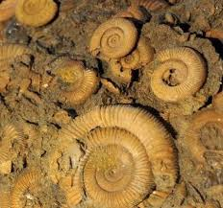
Gravitational potential energy
~ 25 million years
Luminosity
Fossils of single cell microbes dug up in Australia dated 3.5 billion years ago.

Slide 5
Why does the Sun shine?

Slide 6
It can be powered by NUCLEAR ENERGY! (E = mc²)
Nuclear potential energy (core)
~ 10 billion years
Luminosity

Slide 7
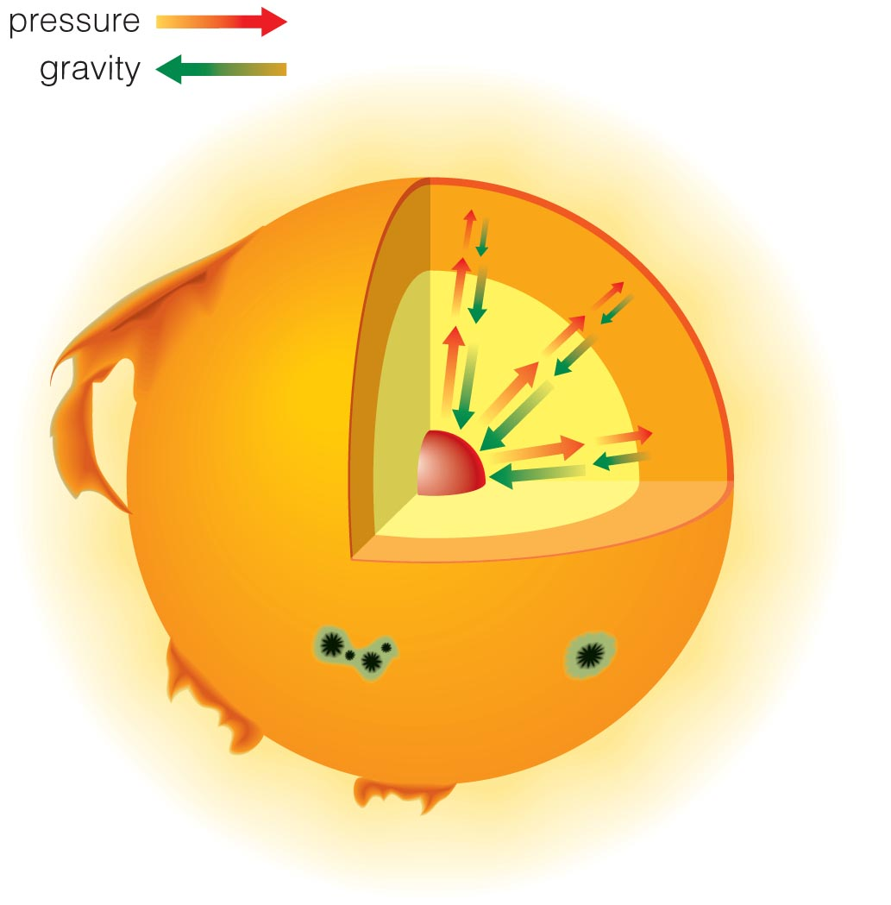
Gravitational equilibrium:
Energy supplied by fusion maintains the pressure that balances the inward crush of gravity.

Slide 8
Gravitational contraction:
Provided the energy that heated the core as Sun was forming
Contraction stopped when fusion began.

Slide 9
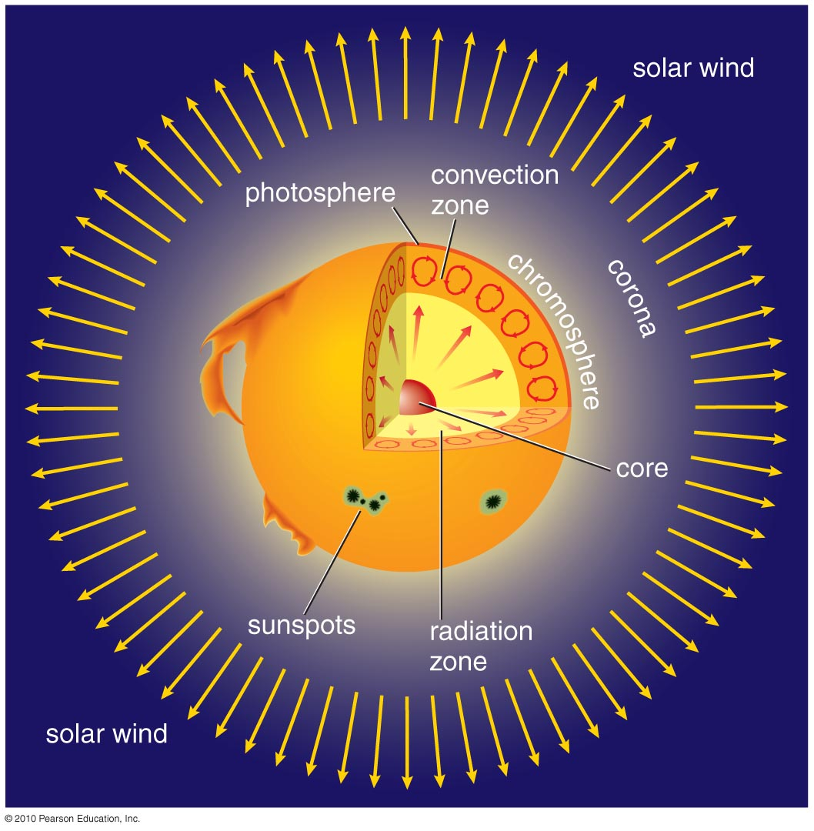
What is the Sun’s structure?
Insert TCP 6e Figure 14.3

Slide 10
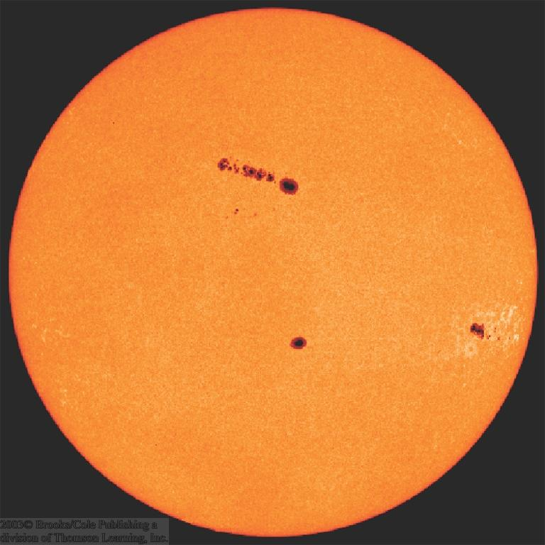
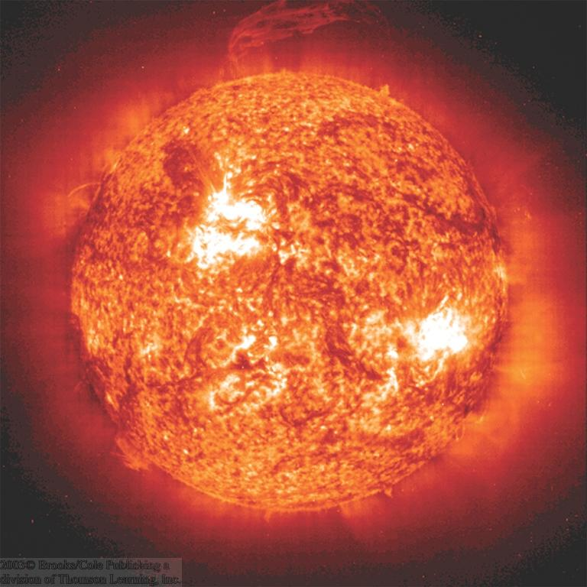
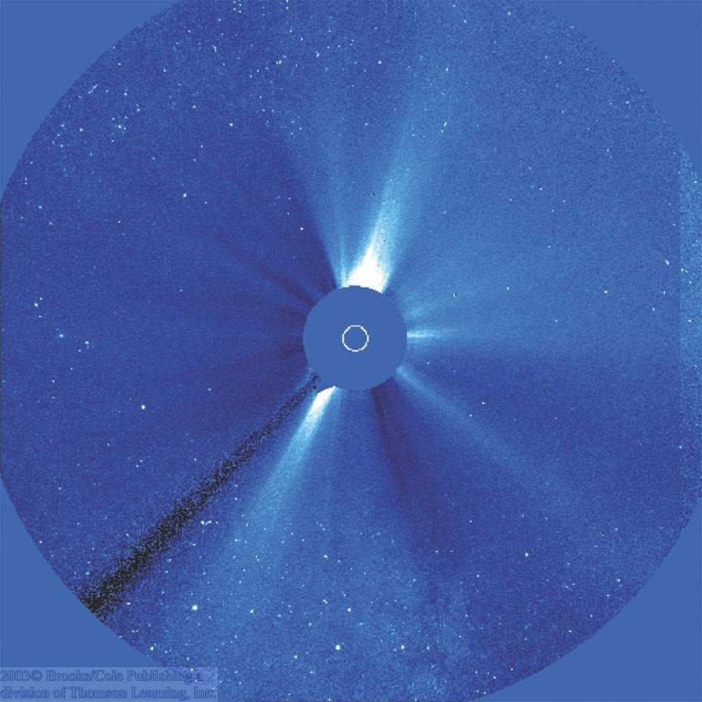
The Layers of the Solar Atmosphere
Visible
Sun Spot Regions
Ultraviolet
Photosphere
Corona
Chromosphere
Coronal activity, seen in visible light

Slide 11
Solar wind:
A flow of charged particles from the surface of the Sun with velocity ranging from 300-800 km/s
Sun is constantly losing mass: 10⁷ tons/year (≈ 10⁻¹⁴ of its mass per year)

Slide 12
Corona:
Outermost layer of solar atmosphere
~1 million K

Slide 13
Chromosphere:
Middle layer of solar atmosphere
~ 10⁴–10⁵ K

Slide 14
The Chromosphere
Region of sun’s atmosphere just above the photosphere.
Visible, UV, and X-ray lines from highly ionized gases
Temperature increases gradually from ≈ 4500 ºK to ≈ 10,000 ºK, then jumps to ≈ 1 million ºK
Filaments
Transition region
Chromospheric structures visible in Hα emission (filtergram)

Slide 15
Photosphere:
Visible surface of Sun
~ 6000 K

Slide 17
The Photosphere
Apparent surface layer of the sun
Depth ≈ 500 km
Temperature ≈ 5800 ºK
Highly opaque (H⁻ ions)
Absorbs and re-emits radiation produced in the solar interior
The solar corona

Slide 18
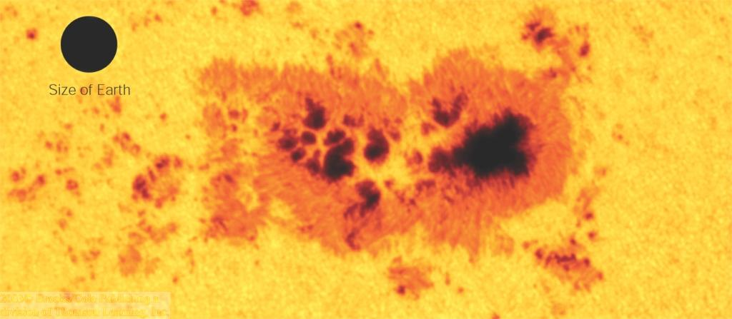
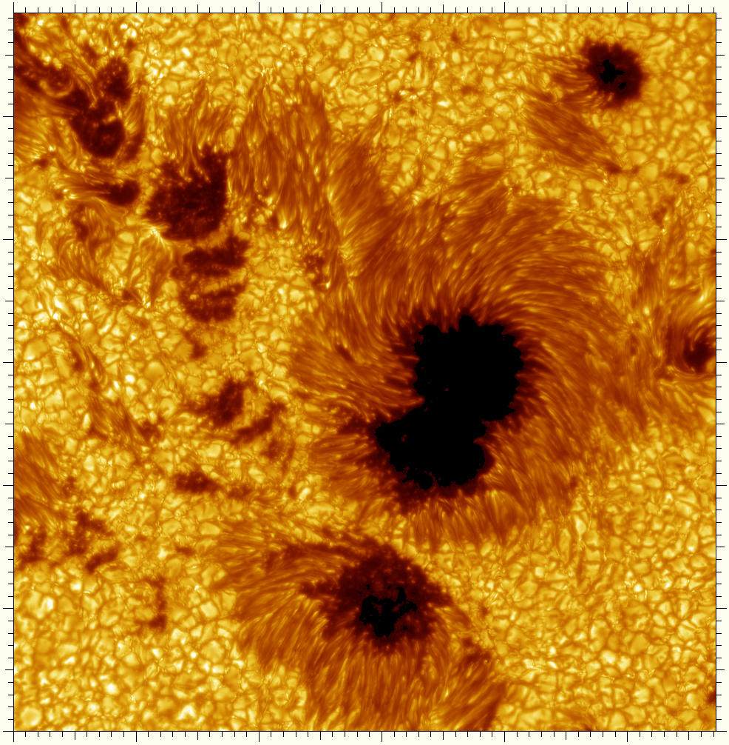
Sun Spots
Cooler regions of the photosphere (T ≈ 4240 K).
Only appear dark against the bright sun. Would still be brighter than the full moon when placed on the night sky!

Slide 19
Sun Spots (2)
Active Regions
Visible
Ultraviolet

Slide 20
Magnetic Fields in Sun Spots
Magnetic fields on the photosphere can be measured through the Zeeman effect
 Sun Spots are related to magnetic activity on the photosphere

Slide 21
Sun Spots (3)
Magnetic field in sun spots is about 1000 times stronger than average.
Magnetic North Poles
Magnetic South Poles
In sun spots, magnetic field lines emerge out of the photosphere.

Slide 22
Convection Zone:
Energy transported upward by rising hot gas

Slide 23
Radiation Zone:
Energy transported upward by photons

Slide 24
Core:
Energy generated by nuclear fusion
~ 15 million K

Slide 25
14.2 The Cosmic Crucible
Our goals for learning:
How does nuclear fusion occur in the Sun?
How does the energy from fusion get out of the Sun?
How do we know what is happening inside the Sun?

Slide 26
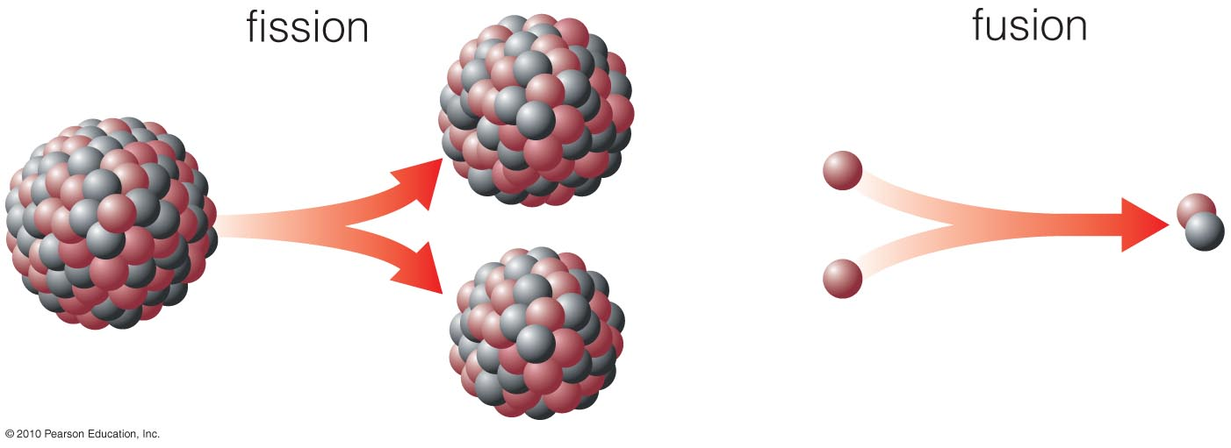
Fission
Big nucleus splits into smaller pieces.
(Example: nuclear power plants)
Fusion
Small nuclei stick together to make a bigger one.
(Example: the Sun, stars)

Slide 27
High temperatures enable nuclear fusion to happen in the core.

Slide 28
The Sun releases energy by fusing four hydrogen nuclei into one helium nucleus.

Slide 29
Thought Question
What would happen inside the Sun if a slight rise in core temperature led to a rapid rise in fusion energy?
A. The core would expand and heat up slightly.
B. The core would expand and cool.
C. The Sun would blow up like a hydrogen bomb.

Slide 30
Thought Question
What would happen inside the Sun if a slight rise in core temperature led to a rapid rise in fusion energy?
A. The core would expand and heat up slightly.
B. The core would expand and cool
C. The Sun would blow up like a hydrogen bomb.
The solar thermostat keeps burning rate steady.

Slide 31
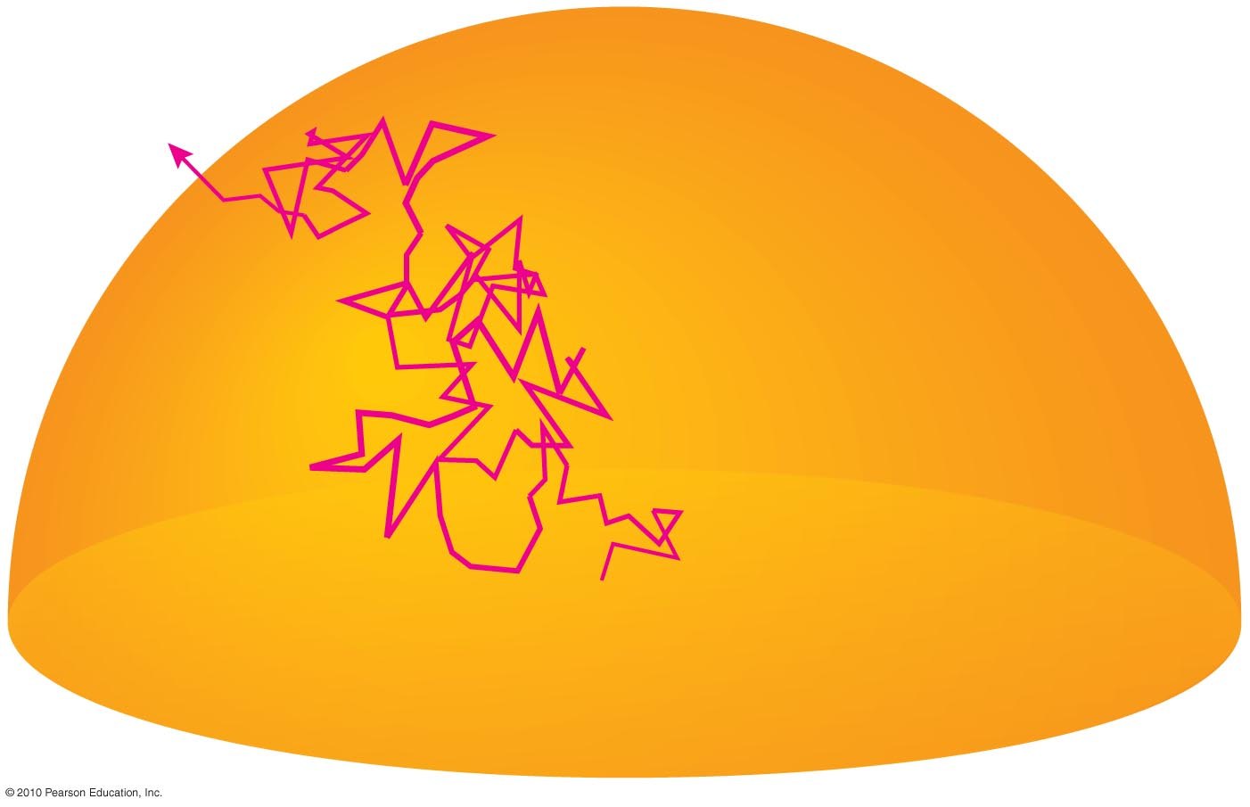
Energy gradually leaks out of radiation zone in form of randomly bouncing photons.

Slide 32
Energy Transport in the Photosphere
Energy generated in the sun’s center must be transported outward.
In the photosphere, this happens through
Convection:
Cool gas sinking down
Bubbles of hot gas rising up
≈ 1000 km
Bubbles last for ≈ 10 – 20 min.

Slide 33
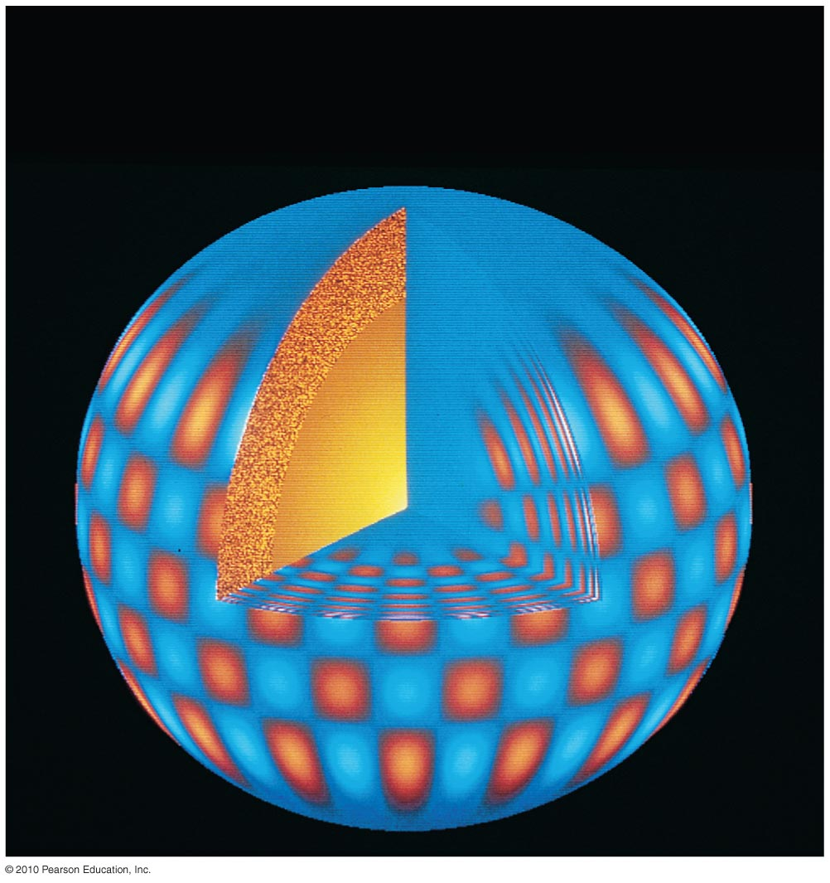
Patterns of vibration on the surface tell us about what the Sun is like inside.
Notes:
Download a movie to illustrate solar oscillations from:
http://science.nasa.gov/ssl/pad/solar/p_modes.htm

Slide 34
Neutrinos created during fusion fly directly through the Sun.
Observations of these solar neutrinos can tell us what’s happening in core.
Notes:
John Updike poem - permissions needed ?

Slide 35
14.3 The Sun–Earth Connection
Our goals for learning:
What causes solar activity?
How does solar activity affect humans?
How does solar activity vary with time?

Slide 36
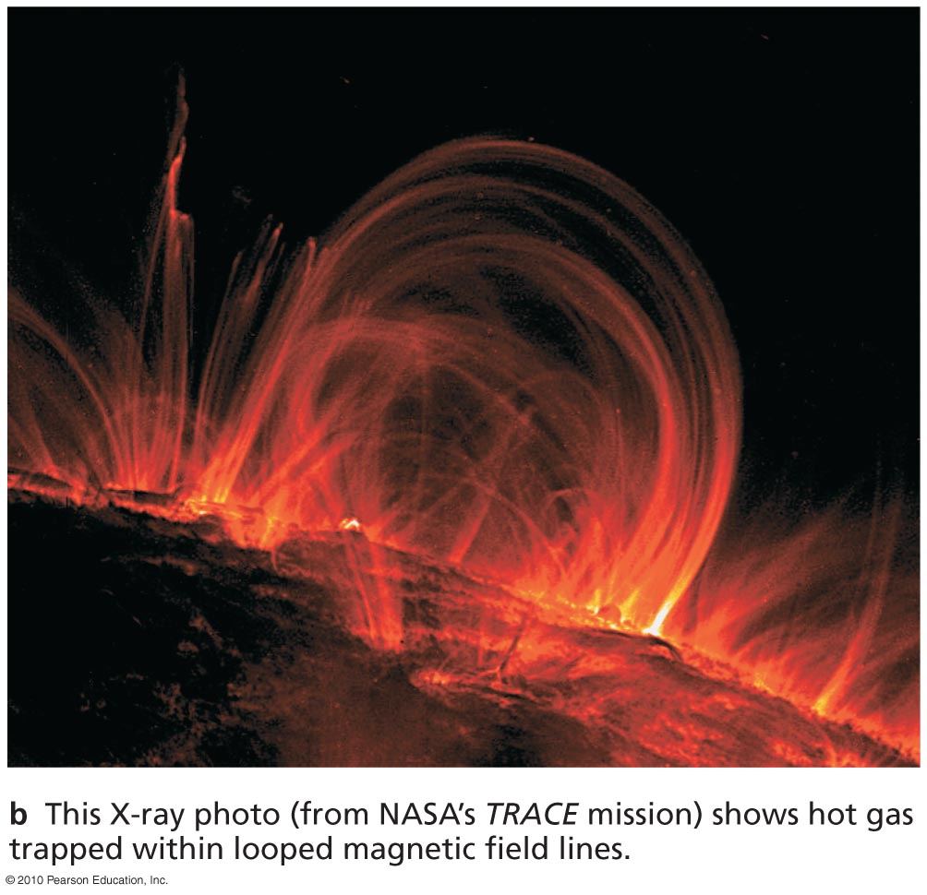
What causes solar activity?

Slide 37
Solar activity is like “weather”.
Sunspots
Solar flares
Solar prominences
All these phenomena are related to magnetic fields.

Slide 38
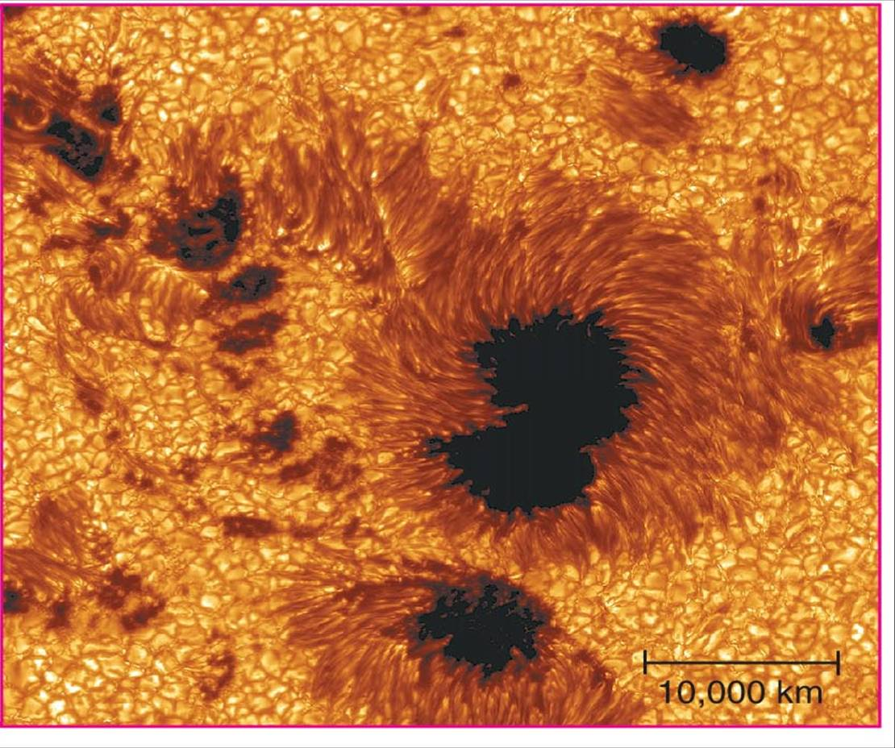
Sunspots
Are cooler than other parts of the Sun’s surface (4000 K)
Are regions with strong magnetic fields

Slide 39
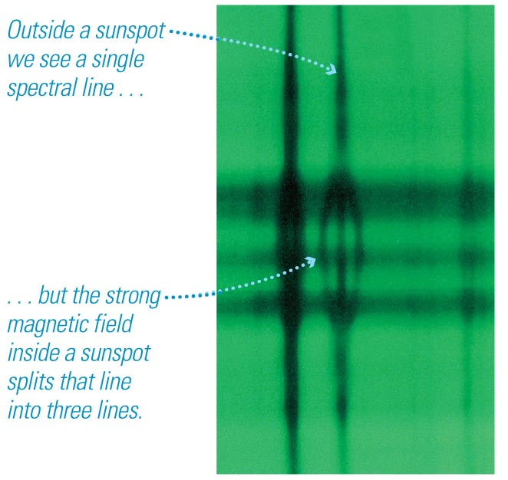
Zeeman Effect
We can measure magnetic fields in sunspots by observing the splitting of spectral lines.

Slide 40
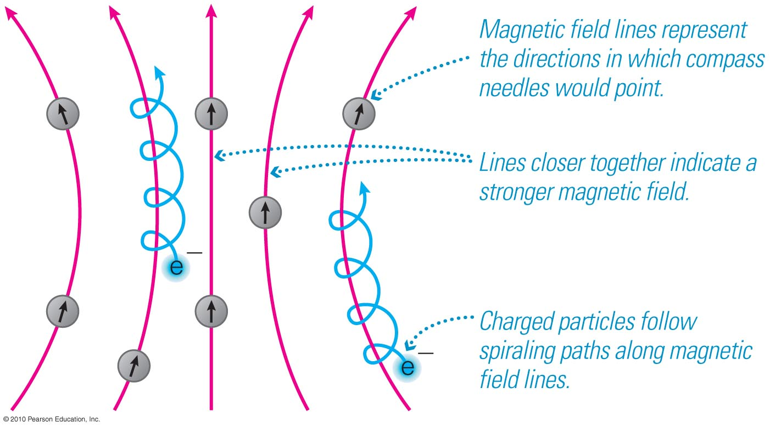
Charged particles spiral along magnetic field lines.

Slide 41
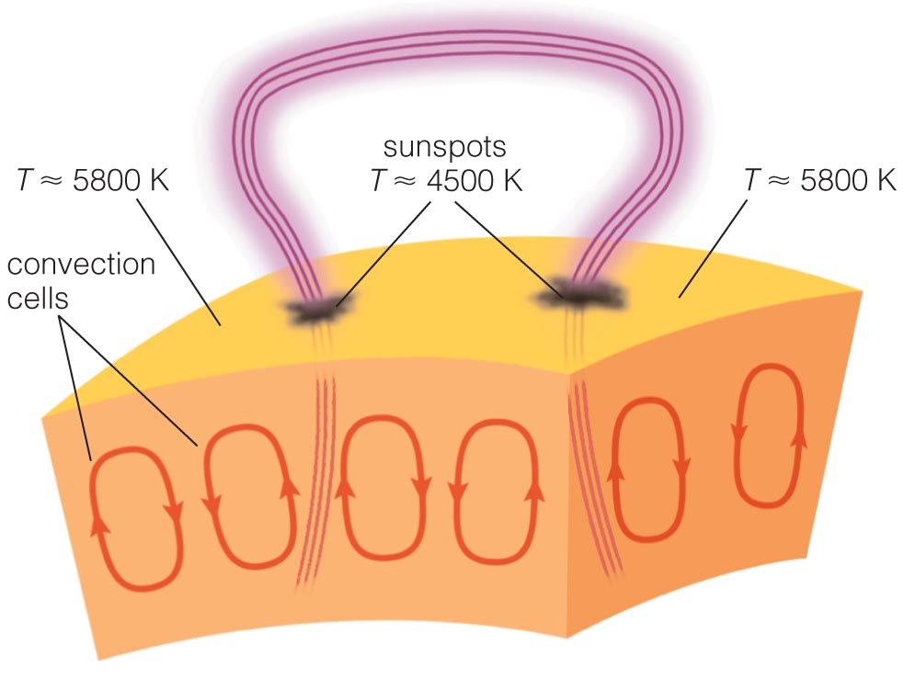
Loops of bright gas often connect sunspot pairs.

Slide 42
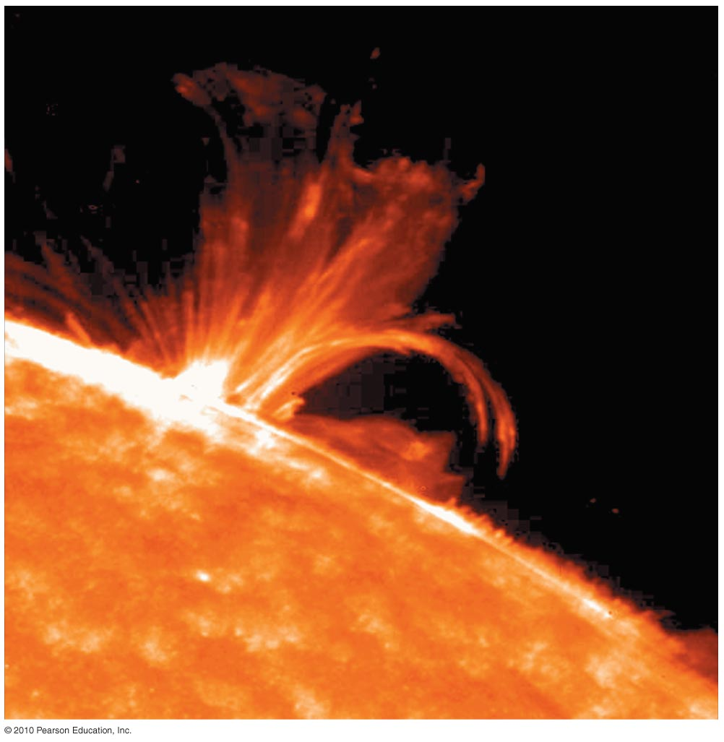
Magnetic activity causes solar flares that send bursts of X rays and charged particles into space.

Slide 43
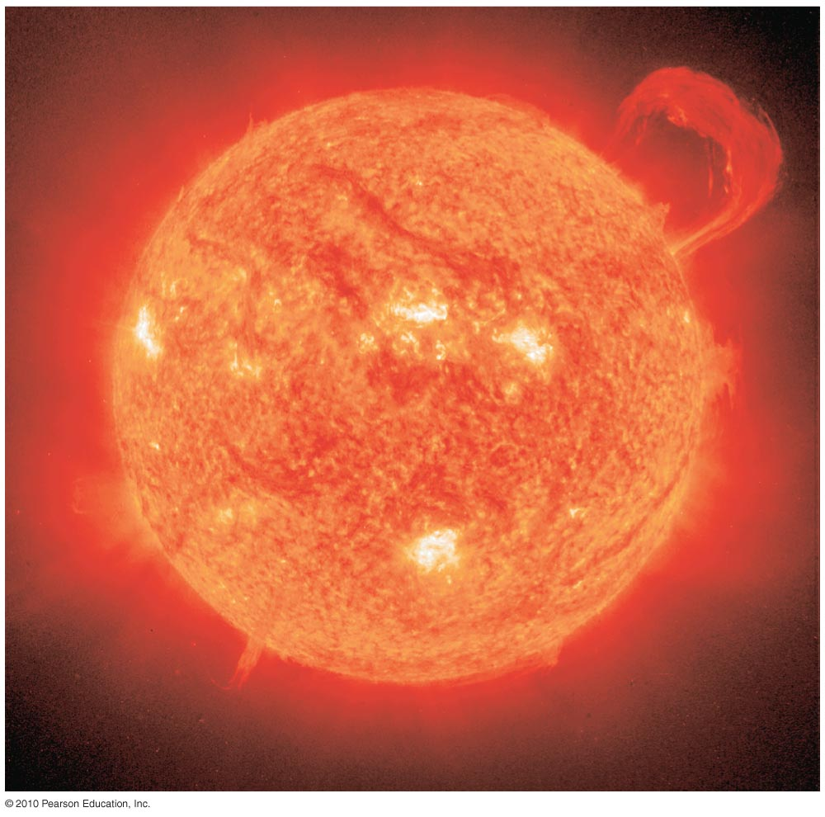
Magnetic activity also causes solar prominences that erupt high above the Sun’s surface.

Slide 44
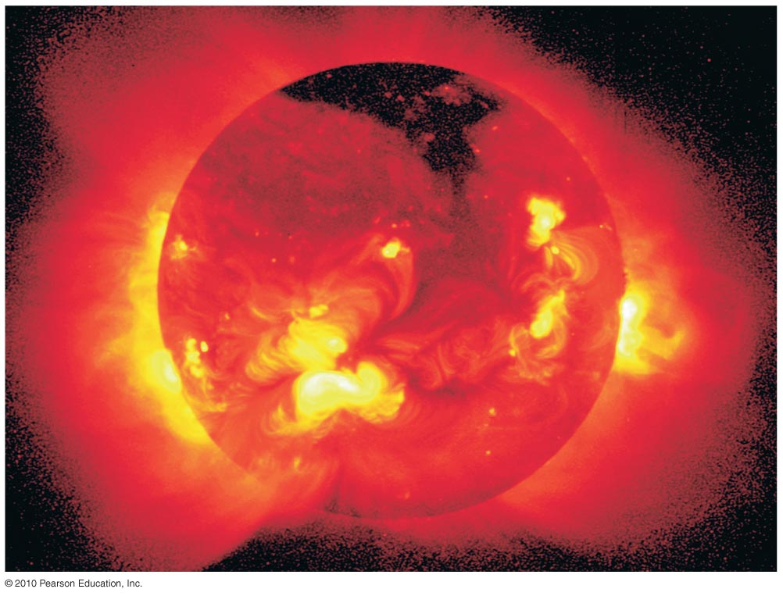
The corona appears bright in X-ray photos in places where magnetic fields trap hot gas.
Notes:
Wave_fade.mpg photosphere:chromosphere:corona, optical:UV:X-ray
http://www.lmsal.com/YPOP/FilmFestival/index.html

Slide 45
How does solar activity vary with time?

Slide 46
Insert TCP 6e Figure 14.21a unannotated
The number of sunspots rises and falls in an 11-year cycle.
Insert TCP 6e Figure 14.21b unannotated

